Slide 1
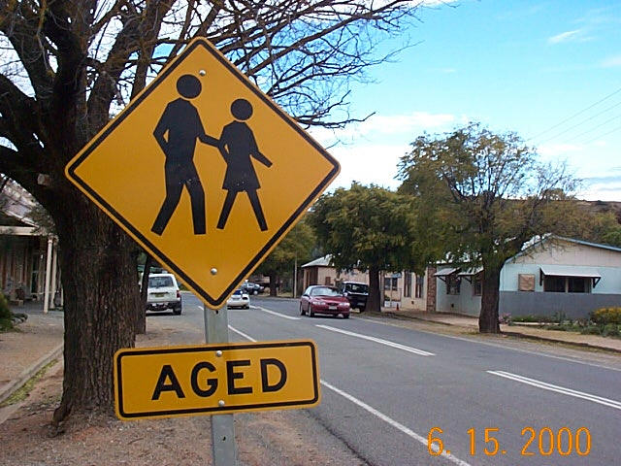
Problems of ageing / The true value of age

Slide 2
What is ageing?
It is a part of human life cyrcle.
It is a process of becoming older.
It is an important part of all human societies.
The effects of ageing on a human face

Slide 3
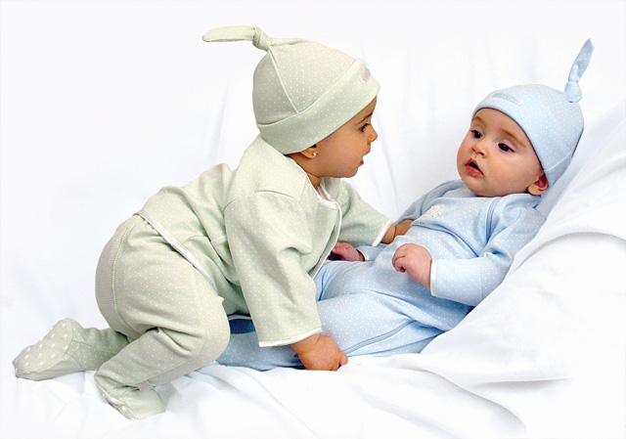
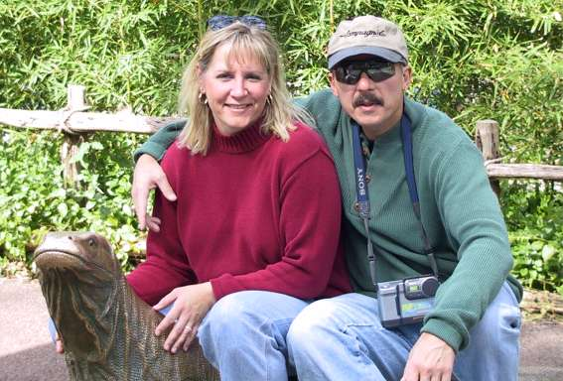
Dividing the lifespan
A human life is often arbitrarily divided into various ages.
Biological changes are slow moving and vary from person to person → arbitrary dates are usually set to mark periods of human life.

Slide 4
Cultural variations
In some cultures are older people more respected than in other (they have an important status and said to be more wiser than younger people).
In our culture people
try to hide their age.
But among the young,
there is often a desire to
seem older to gain
more responsibility and
respect.

Slide 5
Population ageing
A highly generalised process.
It is most advanced in the most highly developed countries.
Japan ist one of the fastest ageing countries in the world.

Slide 6
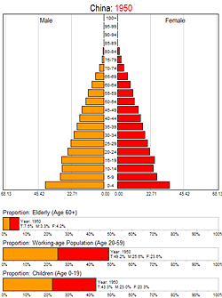
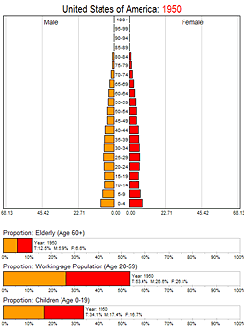

Slide 7
The sources of population ageing
A significant increase in life expectancy.
Life expectancy rose rapidly in the twentieth century due to:
improvements in public health,
nutrition,
medicine.

Slide 8
A significant fall in fertility.
It is the result of constraints on families’ choices:
late access to employment,
job instability,
expensive housing,
lack of incentives (family
benefits, parental leave,
child care, equal pay).

Slide 9
The ageing baby-boomer generation
Baby boomer is a person born during a baby boom,
especially after the Second World War.
Baby boomers represent
the vast majority of the
work force.
In 2011 the first "boomers“
will turn 65.

Slide 10
Ageing of the European population
Europe is the first region in the world to experience demographic ageing.
In 2030 roughly two active people (15-65) will have to take care of one inactive person (65+).

Slide 11
The number of older workers (aged 55 to 64) will increase by 24 million between 2005 and 2030.
The EU's total working age population (15-64 years) will fall by 20.8 million (- 6.8 per cent) between 2005 and 2030.
The number of people aged over 80 will rise from 18.8 million today to 34.7 million in 2030.

Slide 12
Rate of demographic dependence
It is the ratio of population aged 0-14 years and older than 65 years to the population aged 15-64 years.
It will rise from 49 per cent in 2005 to 66 per cent in 2030.
The annual rate of potential growth
of Europe's GDP is projected to fall
from today's 2-2.25 % to 1.5 % in
2015 and 1.25 % in 2040.

Slide 13
Problems of population ageing
Smaller generations of children will increasingly have to take responsibility for larger numbers of people in the older generations.
At the same time, young people have difficulty finding employment and are particularly at risk of poverty.

Slide 14
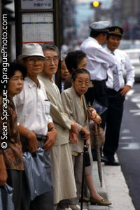
Senior citizens are healthier and want to play an active part in social and economic life.
There will be a significant increase in the number of very old people (aged 80+) – the "fourth generation" or "fourth age”.
Older people are more likely to be saving money and less likely to be spending it on consumer goods.

Slide 15
Earlier pay-as-you-go pension systems are now almost completely unsustainable due to population ageing.
The cost of health systems will increase dramatically as populations age.
Expenses for education will tend to fall with an ageing population.

Slide 16
It will affect:
consumption patterns,
business,
family life,
public policy and voting behaviour,
the infrastructure of our cities,
public transport,
design of houses and flat and shopping possibilities.

Slide 17
The true value of age
Many of us fear growing older.
This thought is the result of our society's glorifying benefits of our youthful years and minimizing and degrading the elderly and the value of the ageing process.

Slide 18
Ageing through our later years can be a remarkable time for increasing self-understanding.
We have more time to reflect on the nature of life and death.
We have a special opportunity to open to our inner process and bring greater clarity, meaning and peace into our lives.
We also have a lot of time
for our hobbies.

Slide 19
On the other hand loss is everywhere.
Our friends are dying or moving.
Our family is often too busy to spend time with us.
Our health is deteriorating.

Slide 20
Diseases that afflict the elderly
Alzheimer's Disease
Arthritis
Chronic Pain
Congestive Heart Failure
COPD (Chronic obstructive pulmonary disease )
Diabetes
Depression
Osteoporosis
Parkinson's Disease
Stroke

Slide 21
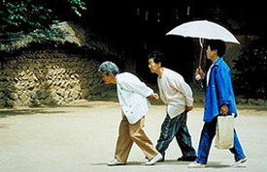
Arthritis
Diabetes
Depression
COPD
Osteoporosis

Slide 22
The oldest person in the world
Madame Jeanne Clamet form France.
She was born on February 21, 1875 and died August 4, 1997 at the age of 122.
She took up fencing at 85, still rode a bicycle at 100, and released a rap CD at 121.
By the end she was blind, nearly deaf and in a wheelchair, but still mentally alert.

Slide 23
Top tips to avoid ageing
Look after your health.
Avoid fast foods, and fatty or salty food.
Eat plenty of raw fruit and vegetables, especially the brightly coloured ones.
Take regular workouts for mind and body.
Avoid smoking and chemical pollution.
Cover up in the sun.
Think positively. Try to view old age as something you have yet to reach, no matter how old you are.

Slide 24
New vocabulary
reflect (V) - to show or be a sign
convention (N) - the way in which sth is done that most people in a society expect and consider to be polite or the right way to do it
median (Adj.) - having a value in the middle of a series of values
nutrition (N) - the process by which living things receive the food necessary for them to grow and be healthy
fertility (N) - the state of being fertile
constraint (N) - a thing that limits or restricts sth
unsustainable (Adj.) - that cannot be continued at the same level, rate, etc.
labour (N) - the people who work or are available for work in a country or a company

Slide 25
proportion (N) - a part or share of a whole
baby boom (N) - a period when many more babies are born than usual
sustainable (Adj.) - that can continue or be continued for a long time
consumption (N) - the act of using energy, food or materials; the amount used
glorify (V) - to make sth seem better or more important than it really is
degrade (V) - to make sth become worse, especially in quality
clarity (N) - the ability to think about or understand sth clearly
deteriorate (V) - to become worse
rigid (Adj.) - not willing to change their ideas or behaviour.
extent (N) - the physical size of an area

