Slide 1
QUEEN ELIZABETH ii

Slide 2
She is the queen of the Unitet Kingdom.
The elder daughter of King George VI and Queen Elizabeth, she
was born on April 21, 1926 in London.
Five weeks after her birth she was christened in the chapel of
Buckingham Palace and was given the names Elizabeth
Alexandra Mary.
In 1930, Princess Elizabeth gained a sister, with the birth of
Princess Margaret Rose. The family of four was very close.

Slide 3
Princess Elizabeth's quiet family life came to an end in 1936, when her
grandfather, King George V, died. His eldest son came to the throne as King
Edward VIII, but, before the end of the year, King Edward had decided to
give up the throne in order to marry the woman he loved, Mrs Wallis
Simpson.
Upon his resignation, Princess Elizabeth's father acceded to the throne as
King George VI.
Princess Elizabeth was now first in line to the throne, and a figure of even
more intense public interest.
It was not expected that her father would become King, or that she would
become Queen.

Slide 4
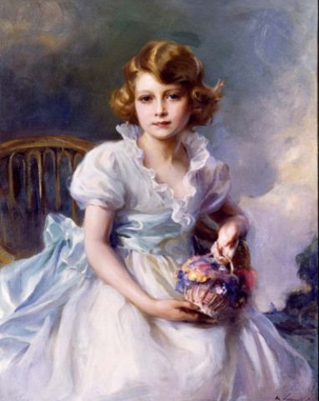
Along with her younger sister, Margaret, she
was educated at Home and with her becoming
Queen in 1936 she started to study
constitutional History and law.

Slide 5
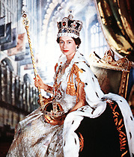
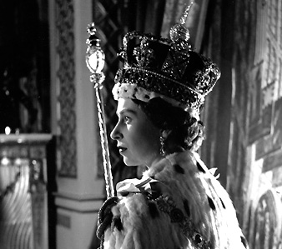
During an Official tour of Kenya in 1952 Princess
Elizabeth was informed of the death of her
father, and that she was now Queen Elizabeth II.
She immediately returned to England to take up
her duties and to lead the nation in mourning
the death of King George VI.
Her coronation was
in June , 1953.
She became Queen at the age of 25, and has ruled through more than five
decades of enormous social change and development.

Slide 6
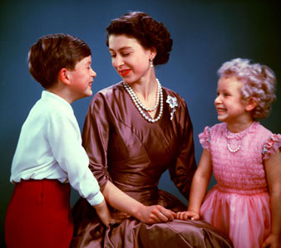
The Queen is married to Prince Philip, Duke of Edinburgh, and has four children and eight grandchildren.
The Queen in 1954 with Prince Charles and Princess Anne.

Slide 7
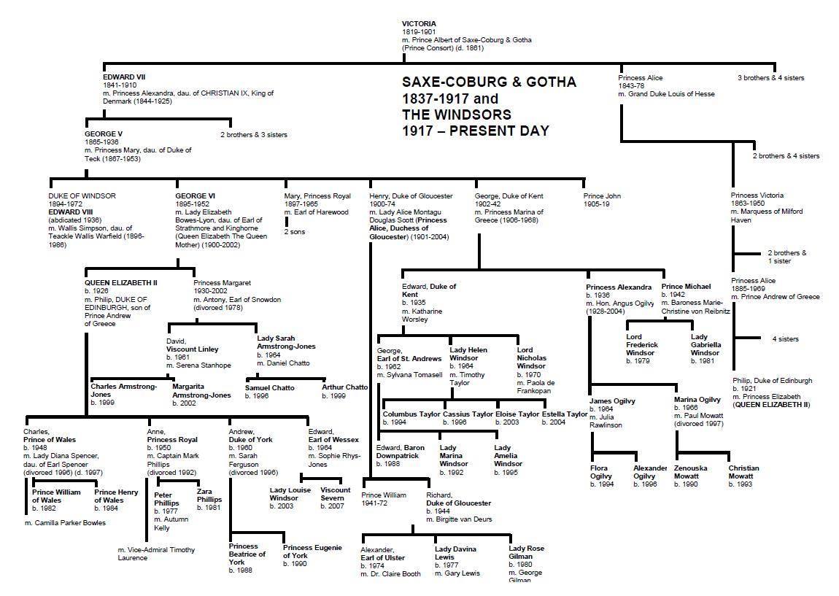

Slide 8
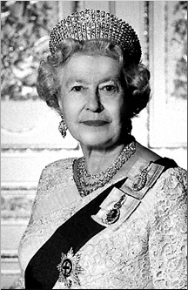
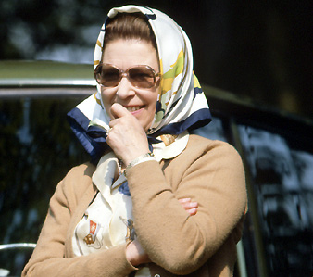
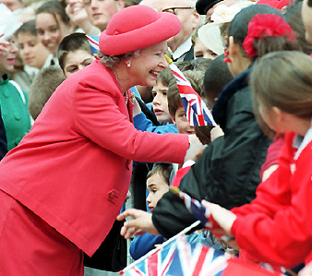
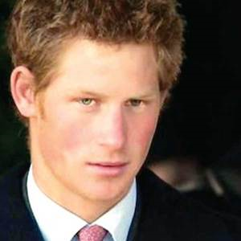
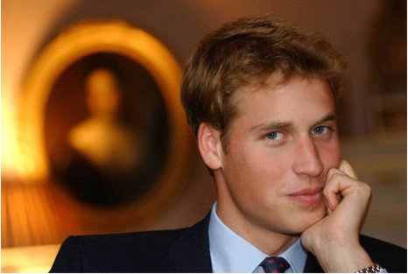
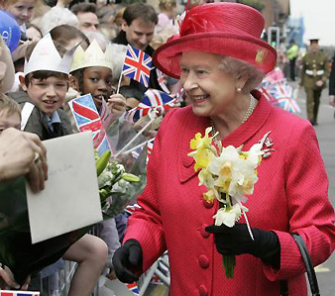
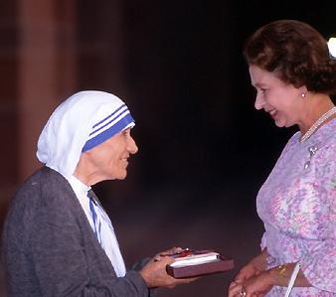
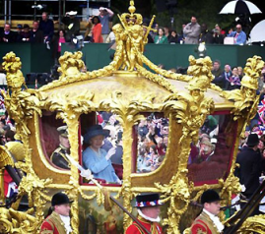
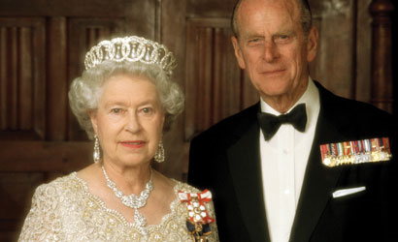
Pictures
Her Majesty Queen Elizabeth II Queen of the United Kingdom

Slide 9
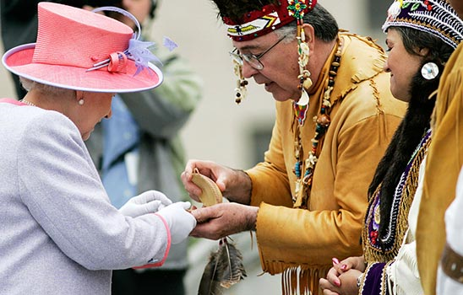
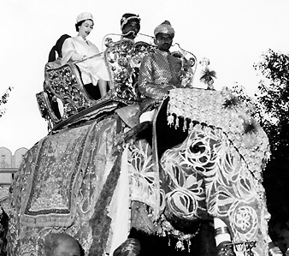
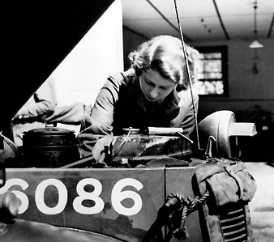
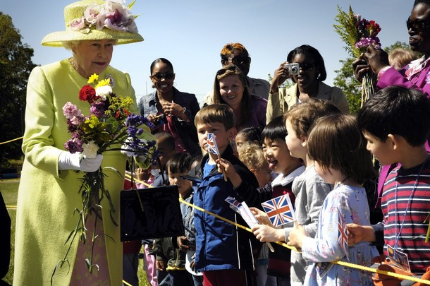
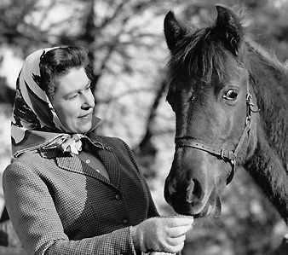
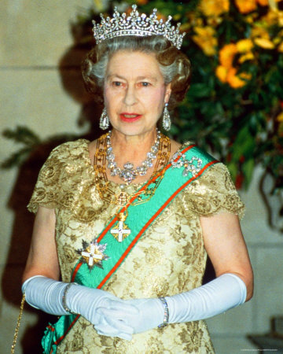
In her life she has done alot of good for
Commonwealth
We will remember her forever as a great leader
as she was and is.

Slide 10
Sources:
http://www.royal.gov.uk/
http://www.royal.gov.uk/files/pdf/Windsor%20family%20tree.pdf
http://www.lucidcafe.com/library/96apr/elizabeth2.html
http://images.google.si/images

