Slide 1
Religious migrations

Slide 2
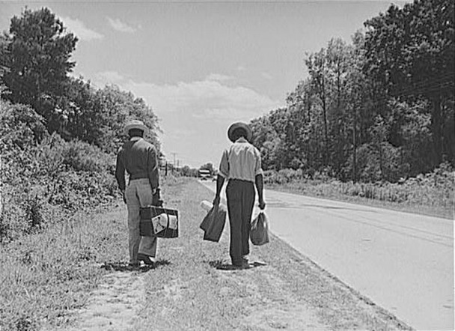
MIGRATION AND RELIGION
Migration almost always affects religion. This is so because when people migrate to a new place they alter routines of daily life, and new experience inevitably acts upon even the most tenaciously held religious tradition. Conversely, religion often inspires migration.

Slide 3
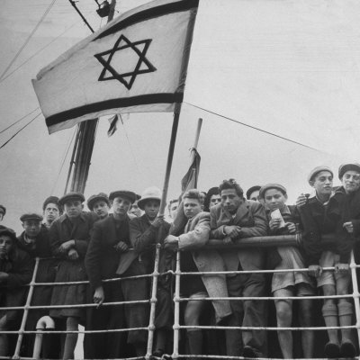
Religious Motives
Organized religious groups may decide to move to a place where their pursuit of holiness will face fewer obstacles. Some successful colonies of this kind played important historic roles by defining patterns of conduct for larger, less religiously incandescent communities that succeeded them.

Slide 4
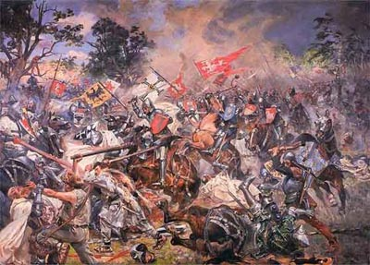
Armed migrations
Among Christians and Muslims, though rarely for other religions, armed migration also played an important part in spreading and defending the faith. Crusade and jihād, between them, defined the frontier between Dār al-Islām and Christendom for more than a millennium, from the first Muslim conquests of the seventh century until the secularized statecraft of the eighteenth pushed religious antipathy to the margins of military enterprise. The Muslim conquest of India (eleventh to seventeenth century) was likewise sustained by a flow of fighting men who came to Hindustan in order to combat infidelity, and, perchance, to acquire fame and wealth in the process.

Slide 5
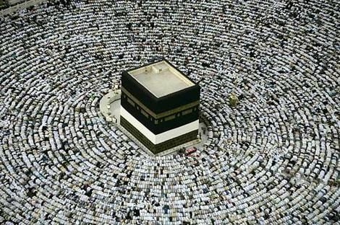
Pilgrimage
Personal and private pursuit of holiness has also inspired innumerable pilgrims to visit shrines that are usually located where their religion originated or had its earliest efflorescence.

