Slide 1
Renewable energy
Year: 2015/16

Slide 2
Kazalo
Renewable energy
History
Wind power
Hydro power
Solar energy
Video
Words

Slide 3
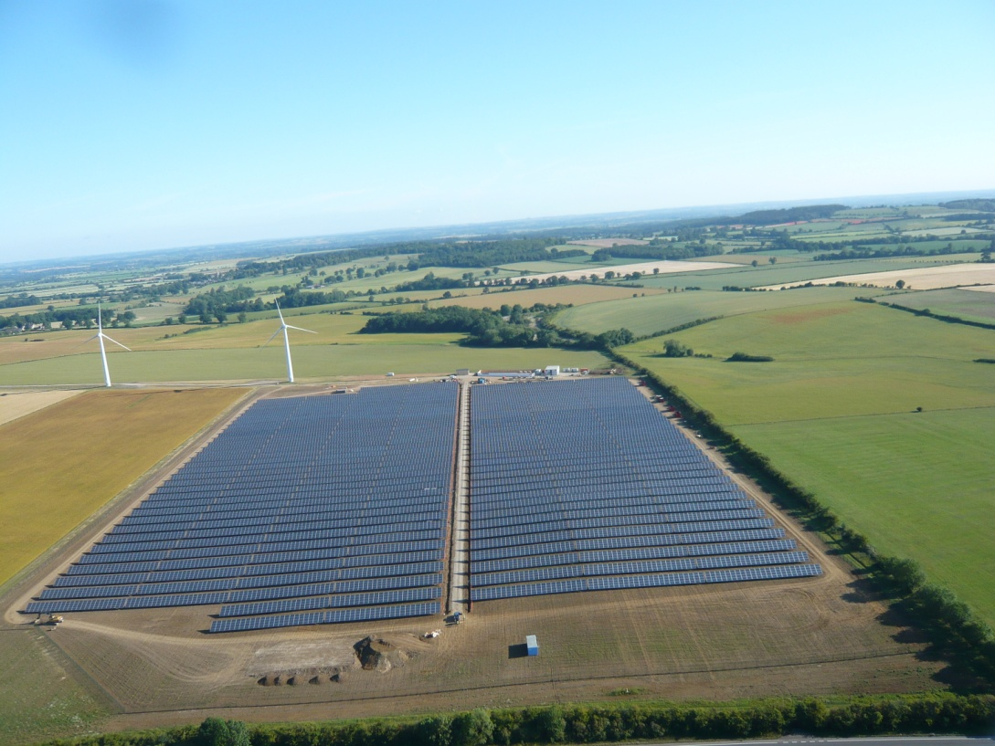
Renewable energy
Is generally defined as energy
Using renewable energy

Slide 4
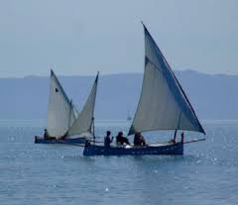
History
Oldest usage of renewable energy is wind

Slide 5
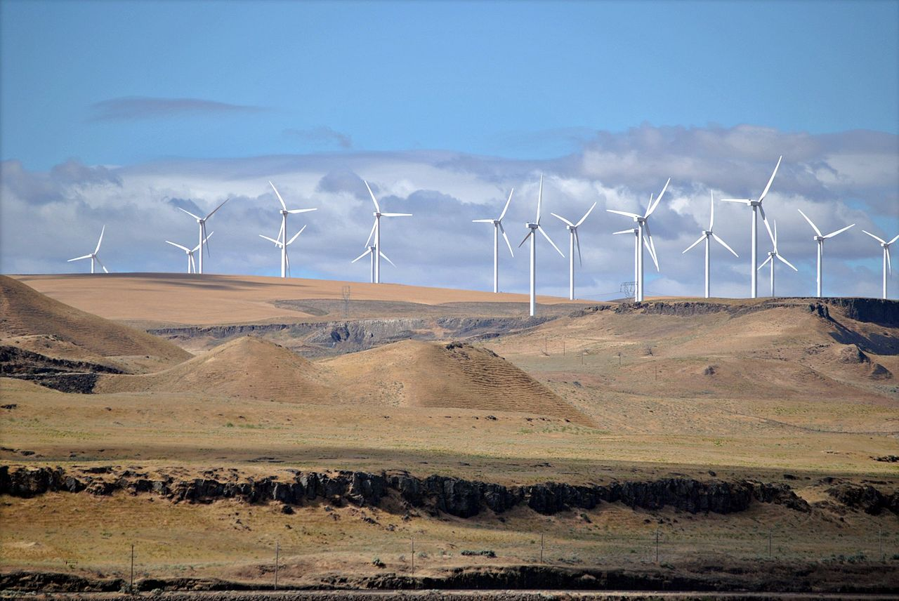
Wind power
Airflows can be used to run wind turbines
600 kW to 5 MW of rated power
With rated output of 1.5–3 MW

Slide 6
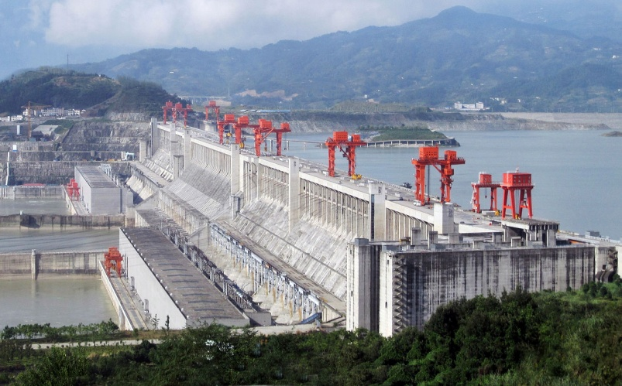
Hydropower
Energy in water can be harnessed and used
water is about 800 times denser than air
The largest of which is the Three Gorges Dam in China
smaller example is the Akosombo Dam in Ghana.

Slide 7
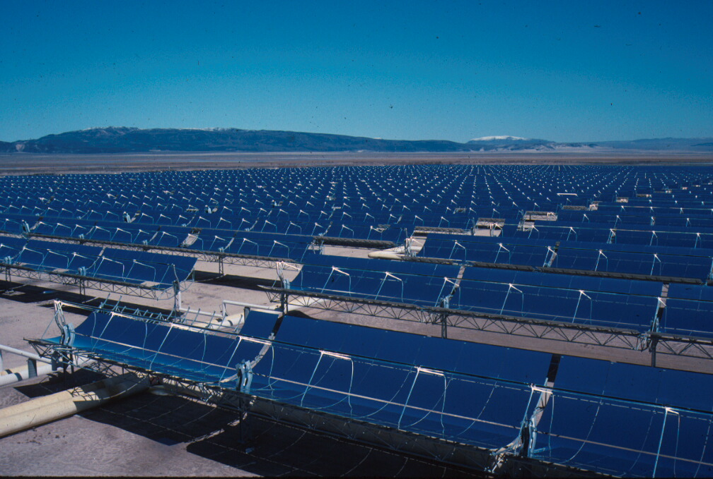
Solar energy
Solar energy,light and heat from the sun
A photovoltaic system

Slide 8
How do different types of Renewable Energy work?
https://www.youtube.com/watch?v=mIj8EuEJ8FY

Slide 9
Words
Resources- sredstvo
Harnessed- izkoristiti
Rated power- nazivna moč
considerable amounts of energy- precejšne količine energije

