Slide 1
CRISTIANO RONALDO
PLAYER OF THE TEAM MANCHESTER UNITED

Slide 2
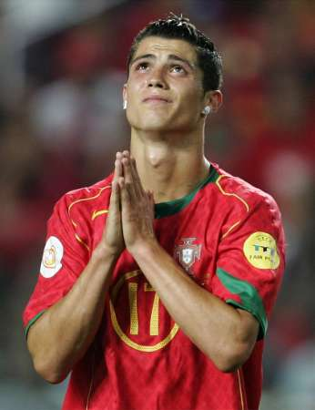
PERSONAL INFORMATIONS
Full name: Cristiano Ronaldo dos Santos Aveiro
Date of birth:February 5, 1985
Place of birth: Funchal, Madeira, Portugal
Height: 1.84 m (6ft 1in)
Nickname: Ronnie, CR, Rocket Ronaldo, CR7, C. Ronaldo
Position: Right/Left Winger & Forward

Slide 3
BIOGRAPHY
Cristiano Ronaldo was born in Funchal, Madeira, Portugal
Mother:Maria Dolores dos Santos Aveiro
Father:José Dinis Aveiro.
He grew up with a brother, Hugo, and two sisters, Elma and Katia.
His second name ("Ronaldo") is relatively rare in Portugal. His parents named him after former US president Ronald Reagan because he was his father's favourite actor, and not for political reasons.

