Slide 1
Here Is A Slideshow About Cristiano Ronaldo
Enjoy!

Slide 2
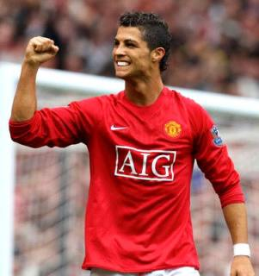
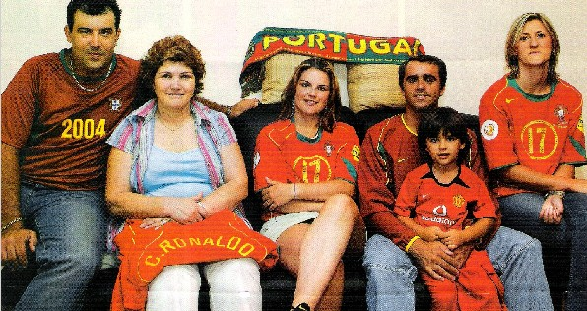
Cristiano Ronaldo
Name: Cristiano Ronaldo dos santos aveiro( Cristiano Ronaldo)
Family: Father, Mother, Brother( Hugo) Sisters (Elma and Liliana)
Place of birth: Funchal, Madeira, Portugal
Date of birth:1985 February 5

Slide 3
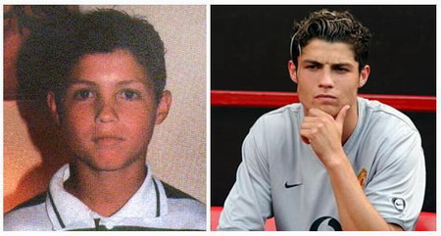
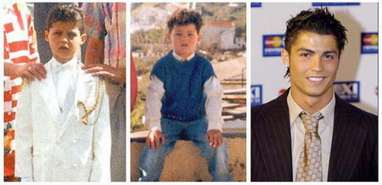
Young Ronaldo
Ronaldo’s parents named him after the 40th president of America, Ronald Reagan
He started to play soccer at the age of 3
He played for an amateur team at the age of 8
When he was 10, he was already getting famous in Portugal

Slide 4
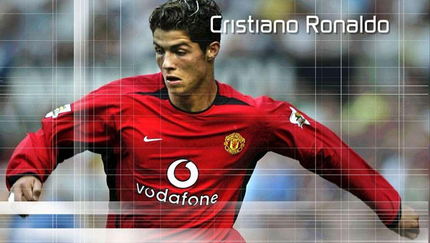
Early Career
Ronaldo started his professional career at Sporting Lisbon
He was featured for Portugal in the UEFA Under 17 Championships
He was first spotted by the former Liverpool F.C. manager Gérard Houllier at the age of 16
Liverpool later rejected him because he was too young
However he came to the attention of Sir Alex Ferguson in the summer of 2003, when Sporting Lisbon beat Manchester United 3–1

Slide 5
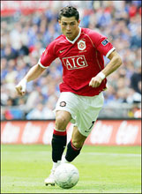
1st Year at ManU
He played his first game in a 4-0 win against Bolton and scored his first goal for the club against Portsmouth in November 2003
In his first season at the club he won the FA Cup as United thrashed Millwall 4-0 in the final at the Millennium Stadium

Slide 6
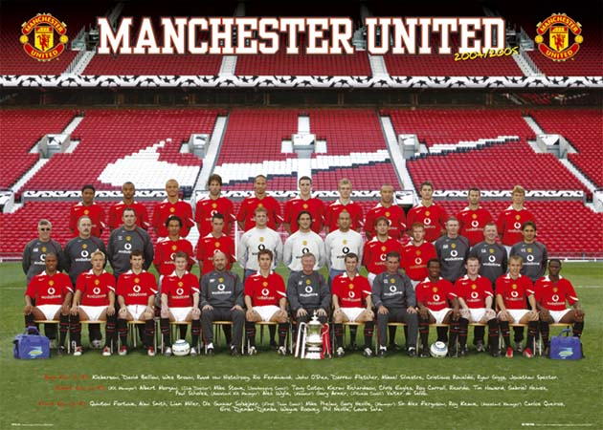
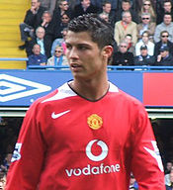
Ronaldo and Manchester United
Cristiano was signed for a fee of £12.24 million for Manchester United in 2003 (at the age of 17)
He was given the famous number 7 jersey to wear
He scored 9 goals in the first year playing for ManU

Slide 7
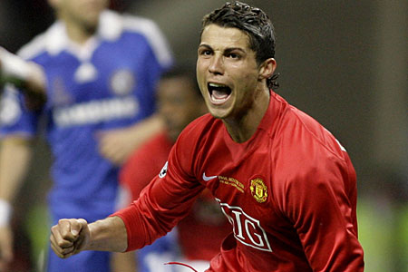
2004/2005 and 2005/2006: Manchester United
In October 2005, he scored the 1000th Premier League goal for ManU
Ronaldo scored in the Carling Cup Final against Wigan - his 10th goal of that season
He received the FIFPro Special Young Player of the Year 2005 award, which was voted by the fans
He was ranked on the No. 20 position in the FIFA Player of the Year 2005
The Portuguese player signed a new contract with ManU that will keep him at the club until 2010
Yeah!

Slide 8
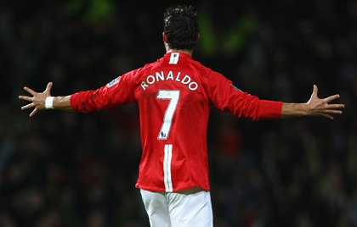
2006/2007: Manchester United
By December 2006, Cristiano Ronaldo became one of Manchester United’s most important players
He scored his 50th goal for this team in the game against Manchester City, a goal that decided ManU to get the Premier League title for the first time in 4 years
In April 2007, Ronaldo signed a new five-year, £120,000-a-week contract with ManU
He became the highest-paid player in the football club’s history

Slide 9
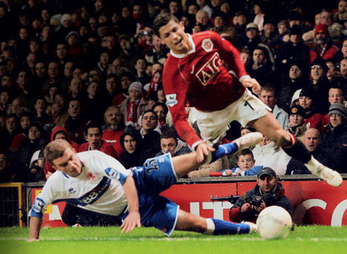
2007/2008: Manchester United
OUCH!
On 12 January 2008, Cristiano Ronaldo scored his first hat trick (3 goals in one game) for ManU , during a game against Newcastle United bringing ManU to the top of the English Premier League table
On 19 March 2008, Ronaldo erased George Best’s 40-year-old ManU record for the most goals scored by midfielder in one season (32 goals in the 1967/1968 season)
Ronaldo scored 42 goals that season
Newspapers reported that Real Madrid has offered to pay a world-record £100 million for Ronaldo
“GOOD = PAIN”

Slide 10
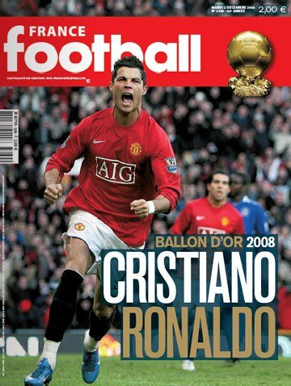
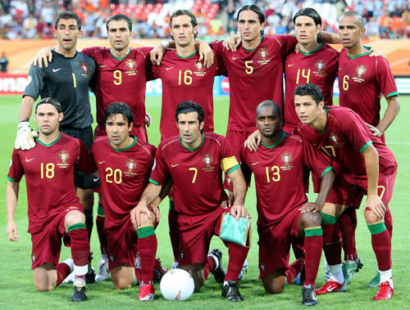
Euro 2008
Cristiano Ronaldo kicks off Euro 2008 in winning style as Portugal overcome Turkey
Ronaldo scored a goal for Portugal to a second successive victory at Euro 2008 against Czech Republic (3-1 Portugal)
Unfortunately, Portugal lost to Germany (3-1) during the quarter final
Ronaldo scored only one goal during Euro 2008

Slide 11
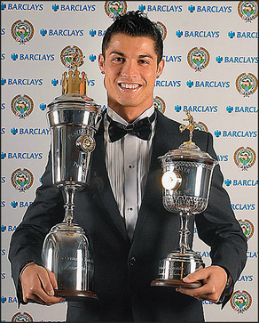
European Player of the Year
In May 2008, Cristiano Ronaldo was voted footballer of the year by English Football Writers’ Association
Ronaldo won the European footballer of the year in Dec 2008
Ronaldo won the award after an excllent club season at ManU. (ManU won both the Premier League and the Champions League)
He scored 42 goals in all competitions for the club
Ronaldo is the fourth Manchester United player to win the award, but the first since George Best won the award in 1968
Thank you Everyone!

