Slide 1
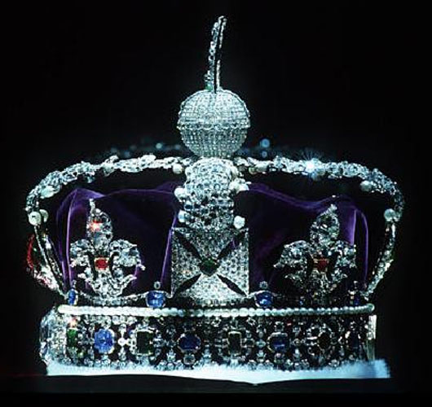
Royal Ceremonies
November 2009
Gimnazija Koper
Vir: http://en.wikipedia.org/wiki/File:Imperial_State_Crown2.JPG

Slide 2
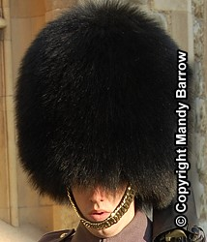
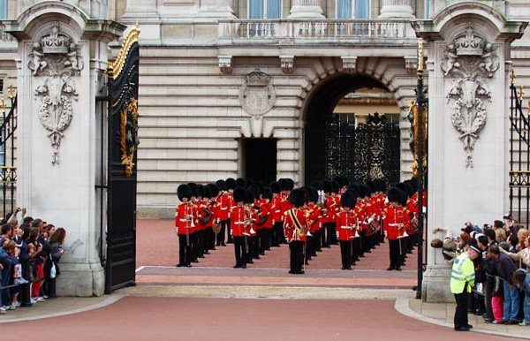
Changing of the guard
outside Buckingham Palace
uniforms
since 1660
Vir: http://teachers.greenville.k12.sc.us/sites/ekrezdor/Everything%20Royal/Changing%20of%20the%20Guard%20at%20Buckingham%20Palace.jpg
Vir: http://www.woodlands-junior.kent.sch.uk/customs/questions/royal/footguard.htm

Slide 3
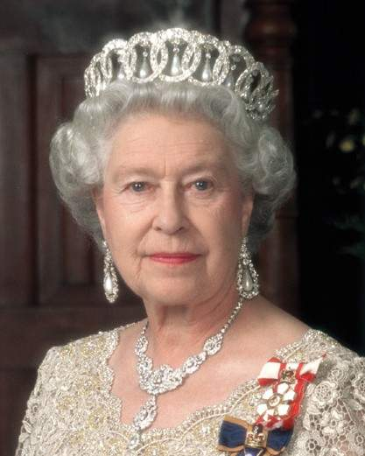
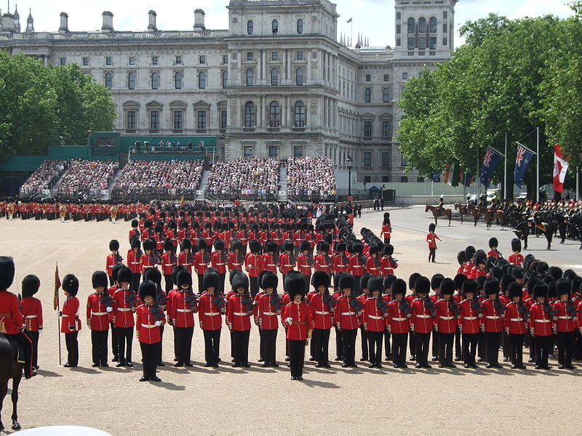
Trooping of the colour
carrying of the flag
military parade
birthday of Queen Elizabeth II
Vir: http://en.wikipedia.org/wiki/File:Trooping_the_Colour_form_march_past.JPG
Vir: http://nickbaines.wordpress.com/2009/07/15/

Slide 4
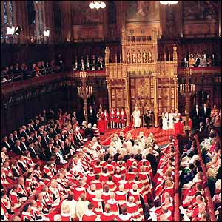
THE STATE OPENING OF PARLIAMENT
new session of Parliament
in November or after a General Election
stage coach
messenger (Black Rod)
"Queen's Speech"
Vir: http://news.bbc.co.uk/2/shared/spl/hi/pop_ups/03/uk_politics_state_opening_of_parliament/html/7.stm

Slide 5
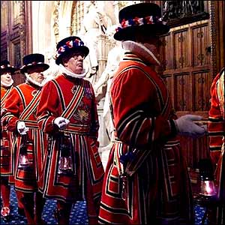
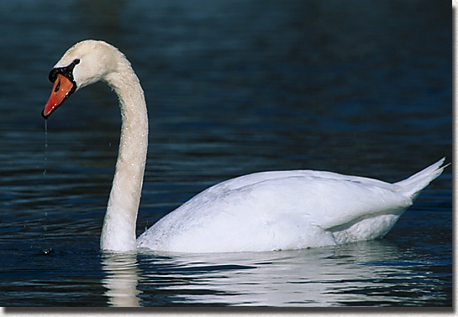
SEARCHING THE HOUSES OF PARLIAMENT
before every State Opening of Parliament
cellars are searched
Swan upping
swan census
health of swans
Vir: http://www.birdsofoklahoma.net/MuteSwan.htm
Vir: http://news.bbc.co.uk/2/shared/spl/hi/pop_ups/03/uk_politics_state_opening_of_parliament/html/2.stm

Slide 6
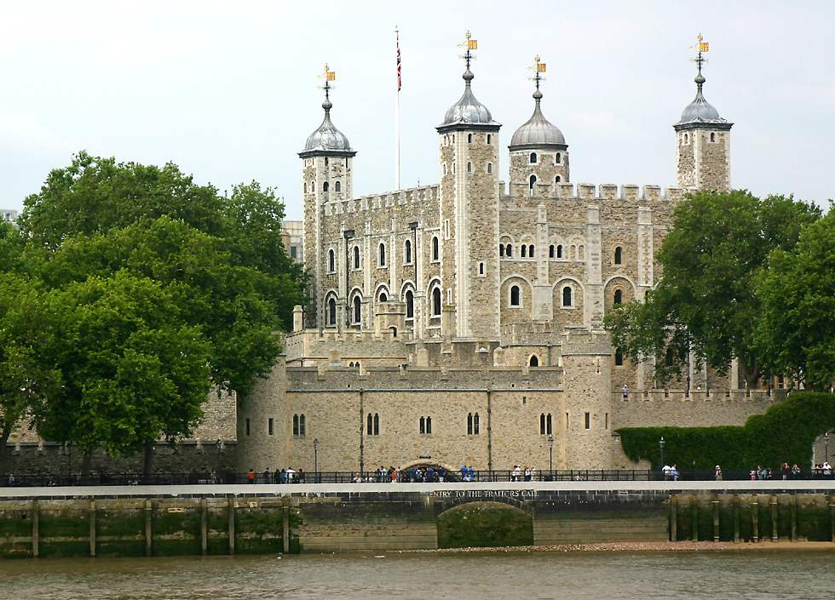
Ceremony of the keys
Tower of London
9.53 pm every night
gate locking
Vir: http://www.richard-seaman.com/Travel/UK/London/Highlights/index.html

