Slide 1
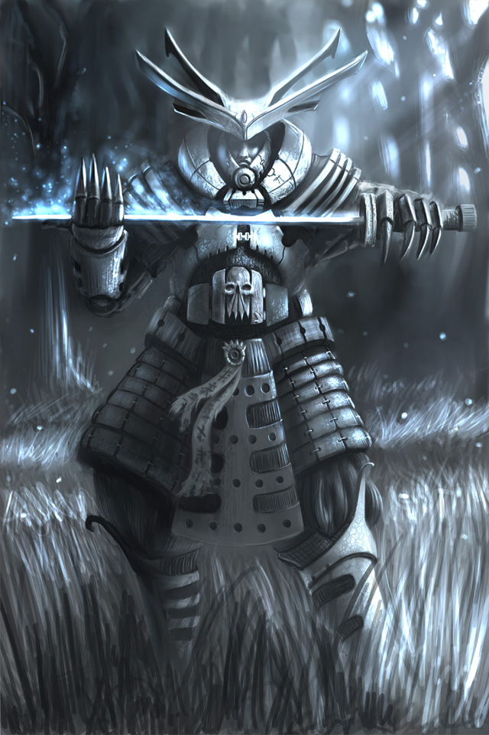
SAMURAI
Samurai is a servant, the servant of a lord.

Slide 2
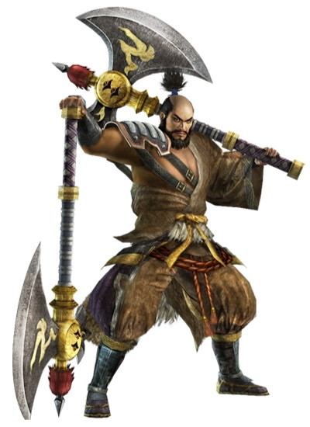
The word samurai is derived from the archaic Japanese verb samorau, changed to saburau, meaning "to serve".

Slide 3
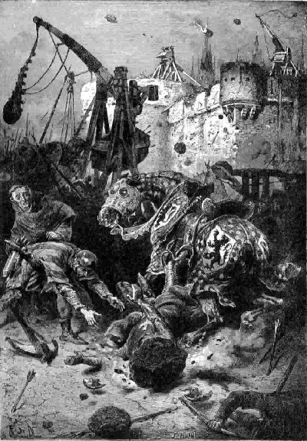
History
With an understanding of how the population was distributed, Emperor Mommu introduced the law where 3–4 adult males were drafted into the national military. These soldiers were required to supply their own weapons and in return were exempted from duties.

Slide 4
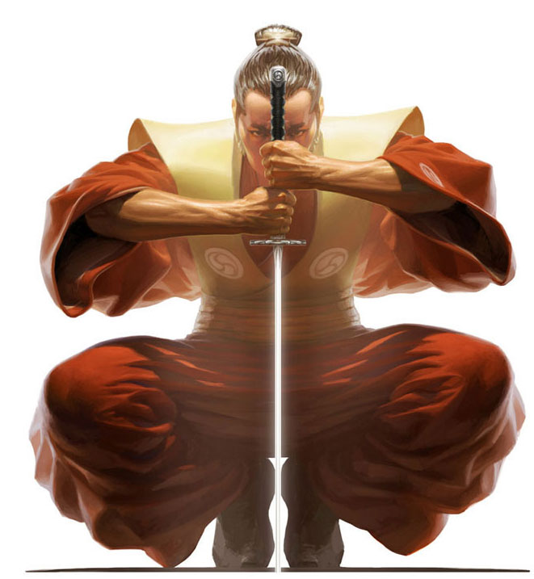
Education
A samurai was expected to read and write, as well as to know some mathematics. Samurai were expected, though not required, to have interests in other arts such as dancing, literature, potry…

Slide 5
Marriage
A samurai could have a mistress but her background was strictly checked by higher ranked samurai. In many cases, this was treated like a marriage. Kidnapping a mistress would have been shameful, if not a crime. If a samurai's wife gave birth to a son he could be a samurai.
The marriage of samurai was done by having a marriage arranged by someone with the same or higher rank, than those being married. Most samurai married women from a samurai family.

Slide 6
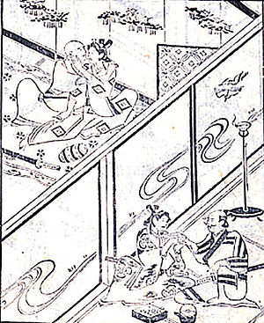
A samurai could divorce his wife. A reason for divorce would be if she could not produce a son, but then adoption could be arranged as an alternative to divorce. A samurai could divorce for personal reasons, even if he simply did not like his wife, but this was generally avoided as it would embarrass the samurai who had arranged the marriage. A woman could also arrange a divorce. Some rich merchants had their daughters marry samurai to erase a samurai's debt and advance their positions.

Slide 7
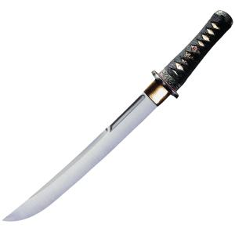
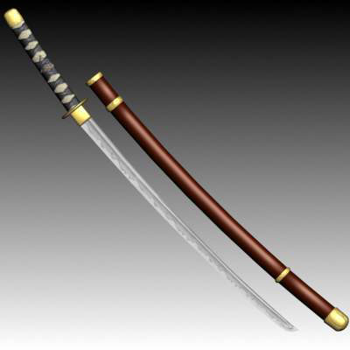
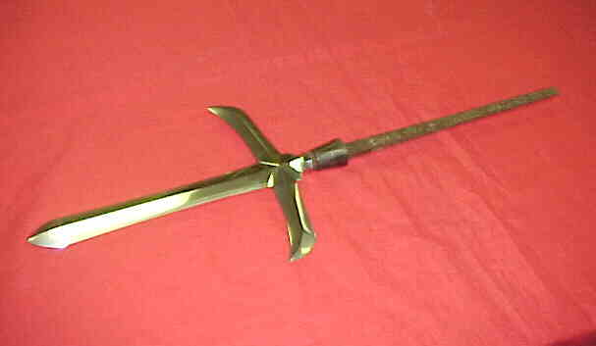
Weapons
Yari : spear
Katana : is the samurai's soul and sometimes a samurai is pictured as entirely dependent on the katana for fighting. They believe that the katana was so precious that they often gave them names and considered them as part of the living
tantō : small dagger
jōbō
trebuchets

Slide 8
21 new words
Spear-sulica, kopje
Arranged-domeniti se
Rank-ugled, položaj, čin
Mistress-ljubica
Adoption-posvojitev
Alternative-izbira med dvema možnostima
Generally-običajno
Merchants-trgovec
Erase-zbrisati
Debt-dolg
Drafted-rekrutirati (rekrut-vojak v začetku služenja)
Servant-služabnik
Derive-izhajati
Archaic-starodaven
Distribute-razpošiljati
National-naroden
Required-zahtevati
Supply-preskrbeti
Exempted-oproščen
Dutis-dolžnosti
Advance-napredovati

