Slide 1
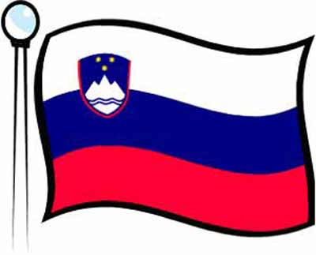
My country
Slovenia

Slide 2
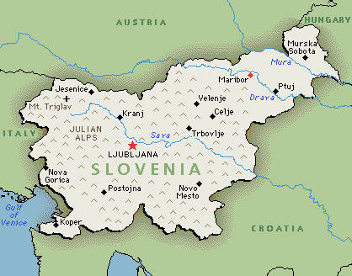
It lies between four countries:

Slide 3
France Prešeren (1800-1848)
He wrote the anthem of
Slovenia – Zdravljica.
We can find his portrait
on 2€ coin.

Slide 4
The anthem of Slovenia is Zdravljica

Slide 5
The capital of Slovenia is Ljubljana

Slide 6
City core – Tromostovje (by Jože Plečnik)
Tromostovje are three
bridges that are situated
in the middle of
Ljubljana, and passes
the river Ljubljanica
which flows through
this city.

Slide 7
Maribor
Maribor is the second
largest city of Slovenia.
It lies on the river
Drava.
Lent is the oldest part of
Maribor.
Picture: The old part of Maribor Lent with Drava

Slide 8
Ptuj
Ptuj is the oldest town
of Slovenia. It is
situated in Podravje.
Important for history of
Ptuj is Ptuj castle.
Picture: Ptuj

Slide 9
Sava – longest river in Slovenia
The longest river in
Slovenia is Sava. The
Sava Bohinjka is a
beautiful alpine river
which pours out in the
Lake Bohinj. Lake
Bohinj is the largest
natural lake of
Slovenia.
Picture: River Sava

Slide 10
Karst
We are very proud on Karst, becouse of
caves, underground rivers and lakes. The
two of most visited caves are Postojna
cave and Škocijanske caves. Trougt the
Postojna cave you can take the ride with
small trains. There you can see an animal –
a human fish who live just in this cave.

Slide 11
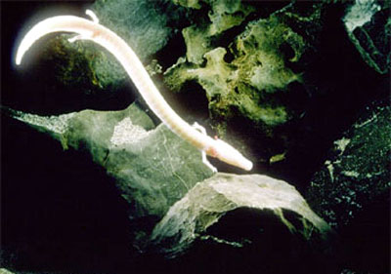
Picture: Human fish

Slide 12
About sixty percent of
the country’s surface is
covered by
woods.

Slide 13
Triglav and Aljažev stolp
The higest mountain in
Slovenia is Triglav
(2864m).
On the top of Triglav is
Aljažev stolp.

Slide 14
Lake Bled
Lake have
an island on
the middle
and there is
a very old
church on it.

Slide 15
We also have 46km
long coast line and
there are two big tourist
cities:
Koper (there is biggest Slo. port)
Portorož (is the one of country’s largest tourist area)

Slide 16
Thank you for your attention!

