Slide 1
SLOVENIA

Slide 2
Republic of Slovenia is a cuntry in southern CENTRAL EUROPE
The capital of Slovenia is LJUBLJANA.
Slovenia has more than 2.000.000 people.
PRESIDENT: Danilo TÜRK
PRIME MINISTER : Janez Janša
European union : 1. may 2004
AIRPORT : BRNIK (Aerodrome J. Pučnika)

Slide 3
Neighbour counties:
ITALY to the west
CROATIA to the south and east
HUNGARY to the northeast
AUSTRIA to the north

Slide 4
Slovenia's highest mountain is TRIGLAV (2864 m)

Slide 6
Natural regions

Slide 7
Landscape types in Slovenia
ALPINE landscape (in the northwest)
PANONNIAN landscape (in the northeast)
DINARIC landscape (in the southeast)
MEDITERRANEAN landscape (in the southwest)

Slide 8
Regionalisations of Slovenia
ALPS (visokogorske Alpe)
PREALPINE HILLS (predalpsko hribovje)
LJUBLJANA BASIN (Ljubljanska kotlina)
Submediterranean (LITTORAL) (submediteranska - primorska)
DINARIC KARST (dinarski kras)
SUBPANNONIAN (subpanonska)

Slide 9
SIGHTS
Ljubljana (work of native born architect JOŽE PLEČNIK)
JULIAN ALPS (Lake Bled, Soča valley, nation's highest peak, mount Triglav,..)
POSTOJNA CAVE
ŠKOCJAN CAVES
ADRIATIC SEA (46 m)
Second-largest city, MARIBOR

Slide 10
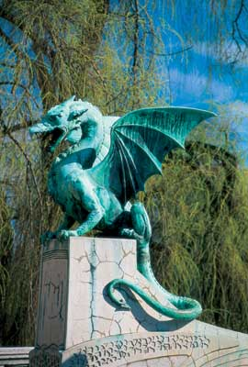

Slide 11
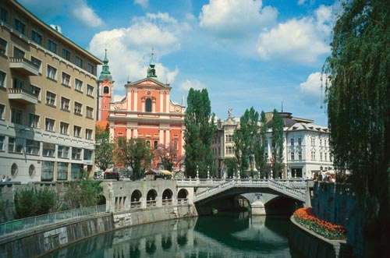
LJUBLJANICA RIVER

Slide 12
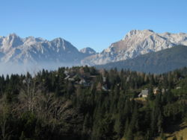
Tourism in Slovenia
KAMNIK ALPS

Slide 13
PIRAN popular tourist destination

Slide 14
SKIING
Ski centers
KRANJSKA GORA
MARIBOR POHORJE
MOUNT KANIN
KRVAVEC
ROGLA
CERKNO
PLANICA ( ski jumper )

Slide 15
LAKES
BLED ( swimming areas , hotels with pools , walking paths , tennis and golf courses , casino, rowing regattas , sports airport in Lesce )
BOHINJ
ZBILJSKO LAKE

Slide 16
Music of Slovenia
Slovenian folk music means a form of POLKA
Slovenian folk music consists of many different styles

