Slide 1
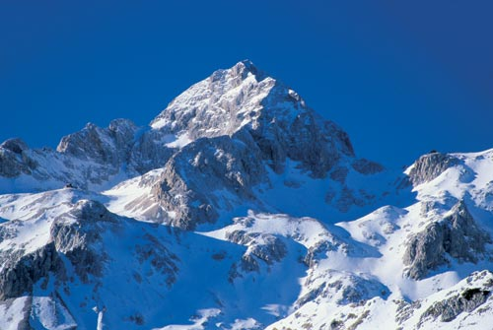
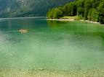
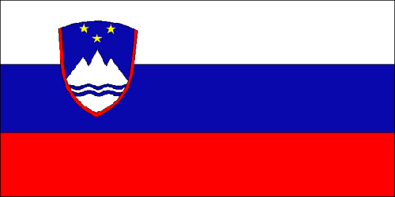
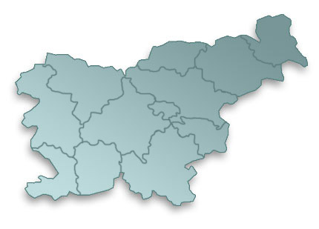
SLOVENIA

Slide 2
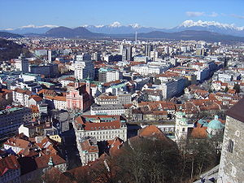
BASIC INFORMATION
Slovenia (officially the Republic of Slovenia) is a democratic republic.
The capital of the Republic of Slovenia is Ljubljana
Republic of Slovenia has about 2 miljoni population.
It´s major cities are: Krsko, Maribor, Celje, Velenje ...
Head of State is Danilo Turk. The Prime Minister is Borut Pahor.
The highest mountain of Slovenia Triglav.

Slide 3
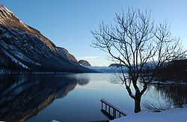
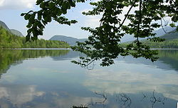
LAKE BOHINJ
Lake Bohinj is the largest natural lake in Slovenia.
Lake Bohinj is a 4101 meter long and 1200 meters wide.
Maximum depth is 45 meters
The surface of the lake is 318 hectares.

Slide 4
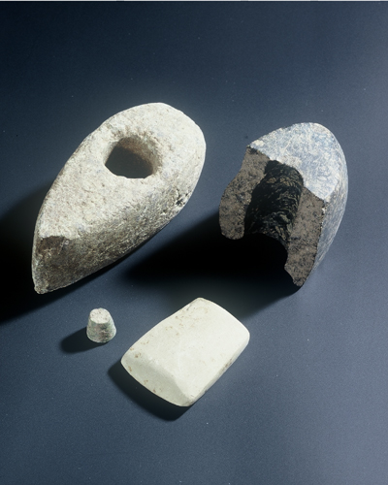
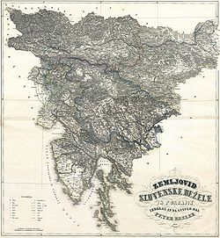
HISTORY OF SLOVENIA
History of Slovenia is history of all inhabitants in the territory of present-day Republic of Slovenia.
The oldest evidence of human existence on the Slovenian territory are two stone tools from the caves in the Lozi in Orehku, about 250,000 years old.

Slide 5
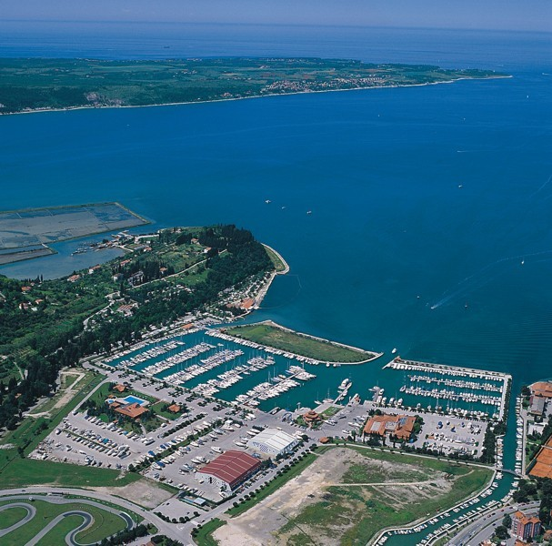
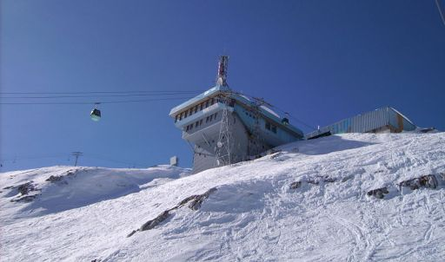
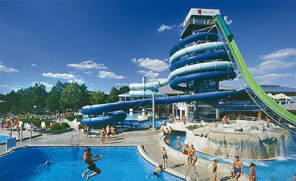
ECONOMY
Slovenia is an economically highly developed country.
The tourism are important seaside resorts (Piran, Portorož, Izola, Koper, Ankaran...), ski resorts (Maribor, Kranjska Gora, Vogel, Kanin, Rogla ...) and spa (Radenci, Spa Čatež, Spa Dubrna, Lendava, Maribor, Ptuj, Šmarješke Toplice ...).

