Slide 1
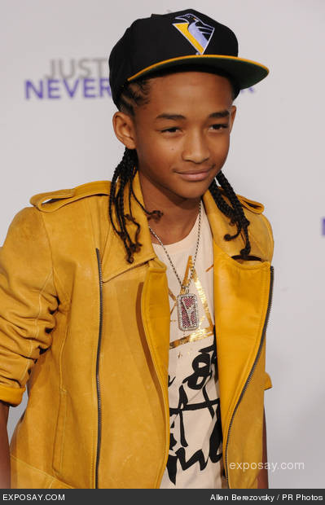
Jaden Smith
Subject: English
Year: 2011/2012

Slide 2
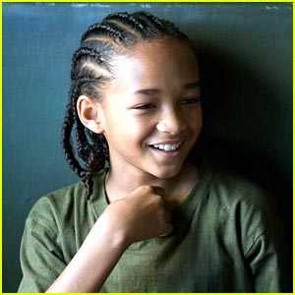
Jaden Smith
Jaden Christopher Syre Smith
8th July , 1998
California
13 years old
an actor, artist, songwriter, dancer

Slide 3
Jaden's favorite things
Favorite color:red
Favorite musician:Nicki Minaj
Color of eyes :brown
Color of hair:brown

Slide 4
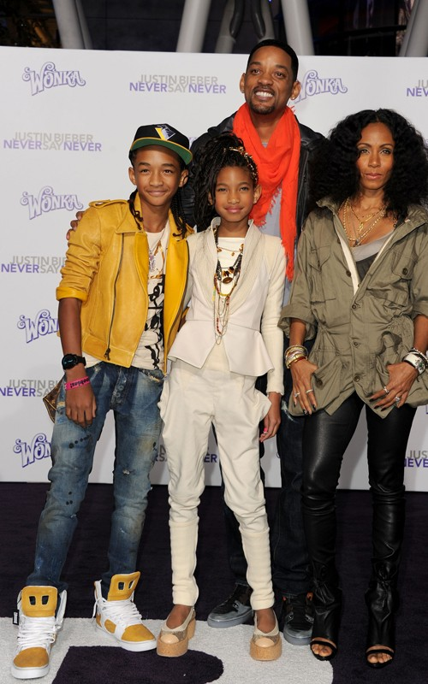
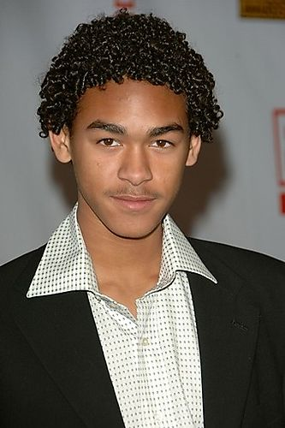
Jaden smith
son of Will Smith and Jada Smith
brother of singer Willow Smith
Older half-brother Trey Smith

Slide 5
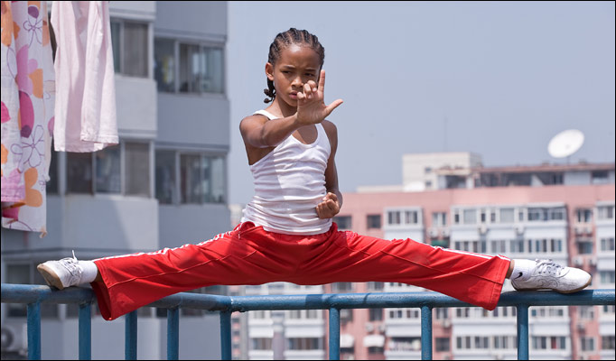
Jaden Smith
Artist in
Alicia Keys- "Superwoman“
Justin Bieber,Jaden Smith- "Never Say Never“
Willow Smith"Whip My Hair“
Karate kid
others

Slide 6
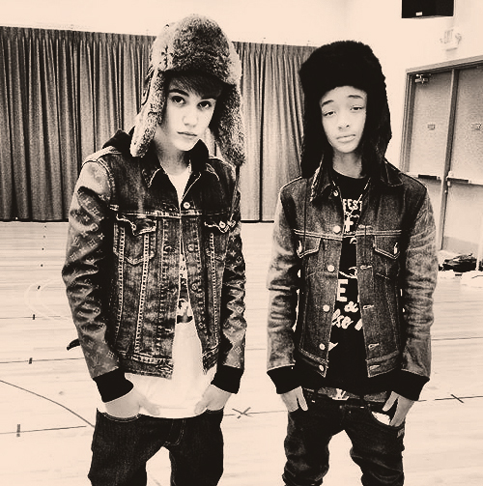
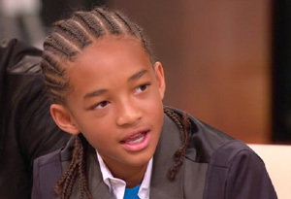
Jaden Smith
13 years old and already a millionaire
Good friend of Justin Bieber
Great style
Very successful

Slide 7
1) when is Jaden Smith's Birthday
A.May 16,1998
B.October 28,1997
C.July 8,1998
D.August 7,1999
C.July 8,1998

Slide 8
2) What is Jaden Smith's middle name?
A.Joseph
B.Christopher-Syre
C.Franklin
D.Will
B.Christopher-Syre

Slide 9
3) What is Jaden's sister name?
A.Danielle
B.Taylor
C.Willow
D.Cindy
C.Willow

Slide 10
4) What is Jaden's favorite color?
A.blue
B.red
C.yellow
D.white
B.red

Slide 11
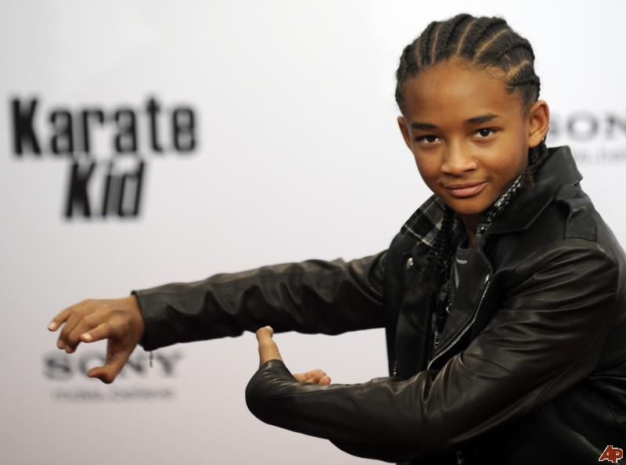
Sources
Wikipedia,the free encyclopedia
THANK YOU FOR
YOUR ATTENTION

Slide 12
http://www.youtube.com/watch?v=_Z5-P9v3F8w

