Slide 1
Sports

Slide 2
Contents
1. What is sport?
2. Team and individual sports
3. Problems in sport
1. What is sport?
2. Team and individual sports
3. Problems in sport

Slide 3
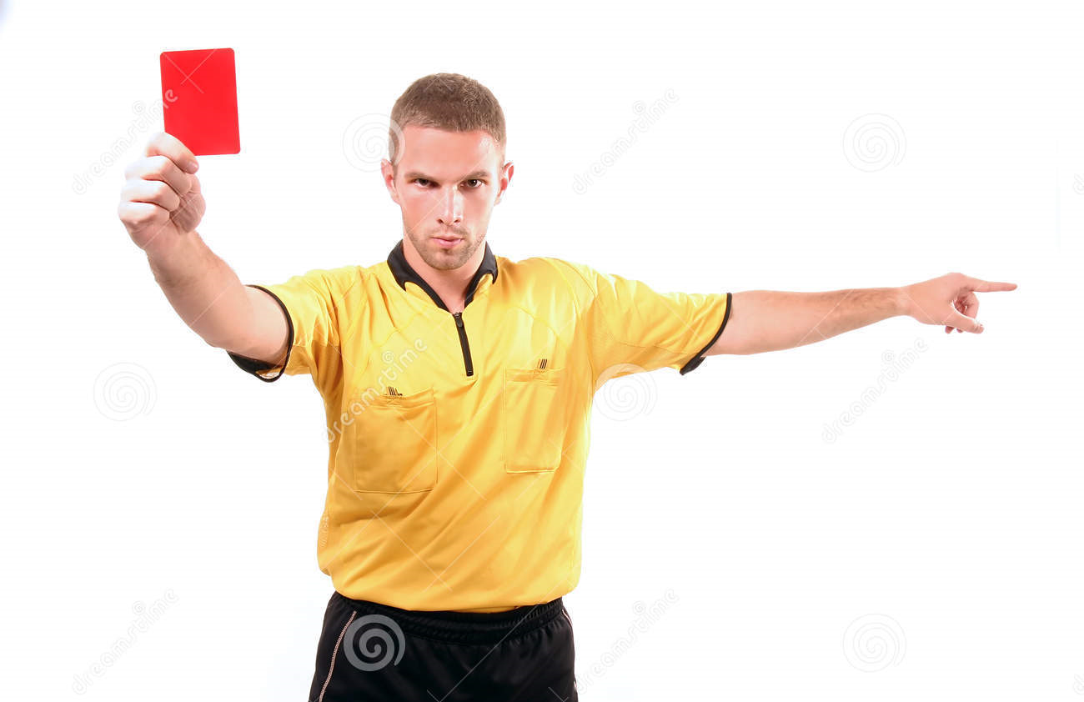
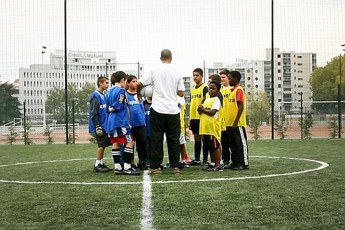
What is sport?
Photo 1: A judge
All forms of physical activity or games,
Sport consist of:
a lot of rules, which providing fair play,
consisted adjudication, e.g. „Who is winner?“ etc.
Sport is divided into:
recreation,
amateur sport and
professional sport.
Photo 2: An amateur group

Slide 4
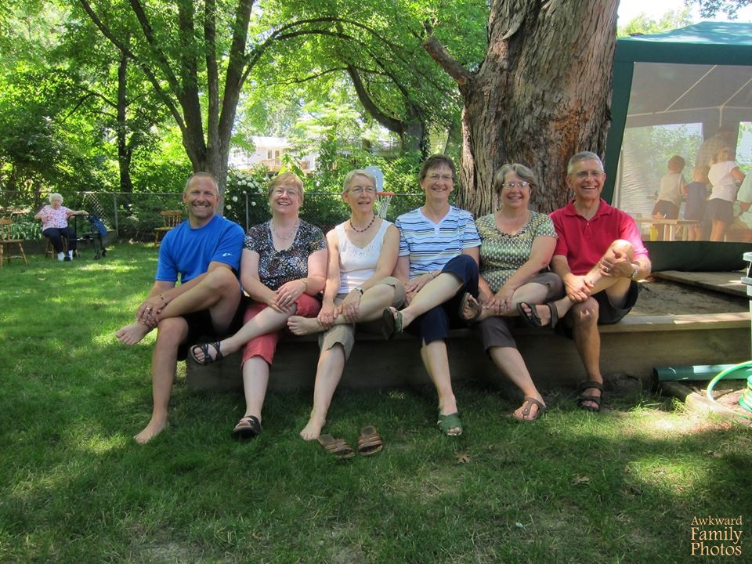
What is sport?
Recreation
Means actively spending of time,
is healthy,
it can be dance, or other sport activities.
Amateur sport
no payment for achievements.
Professional sport
the most complex,
requires a whole person,
is not necessary healthy.
Photo 3: A recreation group

Slide 5
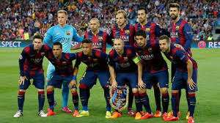
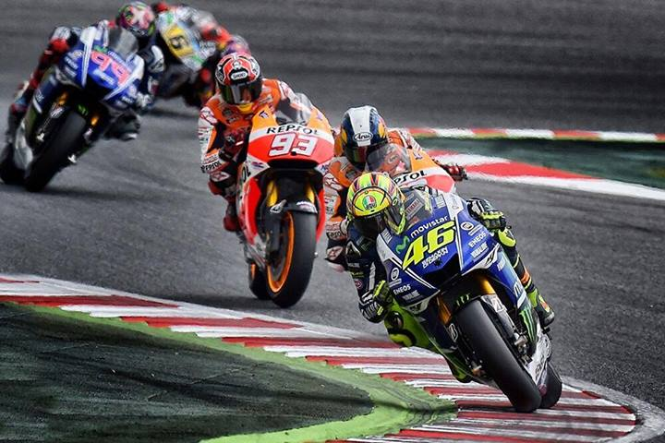
2. Team and individual sports
Photo 4: Football team
Two or more people
Organized individuals
Are divided in two types:
Team as a one, work together
Have same goal (football, hockey, basketball…)
Same teams
Play against each other (Moto GP, cycling…)
Team sports:
Compeatig against each other
Same teams (Moto GP, cycling…)
Photo 5: Motor race

Slide 6
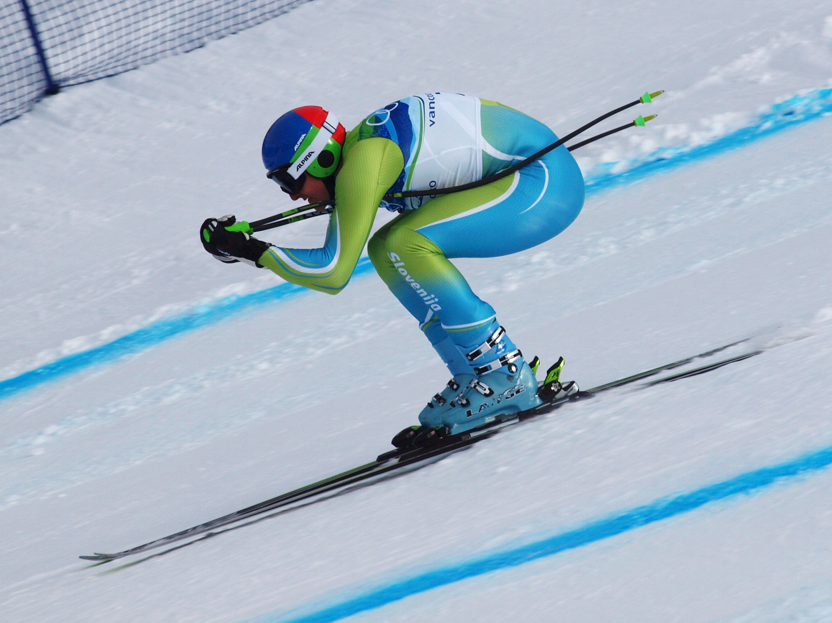
2. Team and individual sports
Only one athlete
All depends on yourself
More pressure
Can‘t hide behind teammates
Higher level of discipline
Photo 6: Skiing

Slide 7
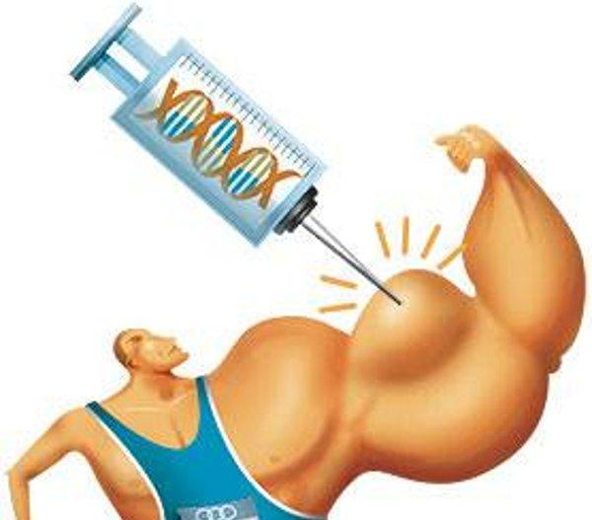
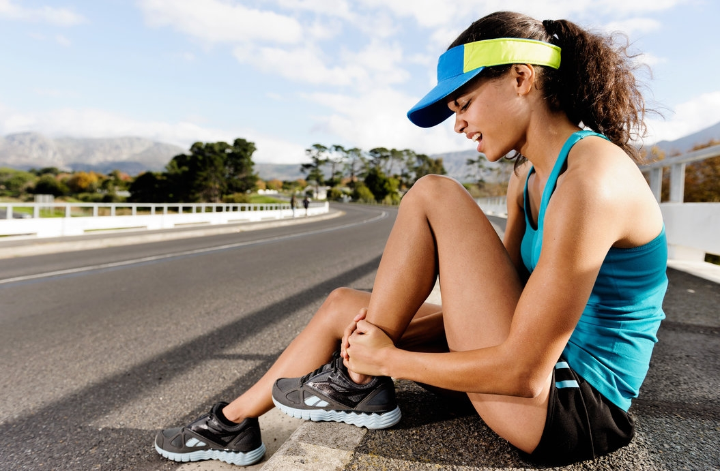
3. Problems in sport
Injury
lasting effects on health (destroyed joints, muscles, ...)
doping
Cheating
Photo 8: Painful ancle
Photo 7: Doping

Slide 8
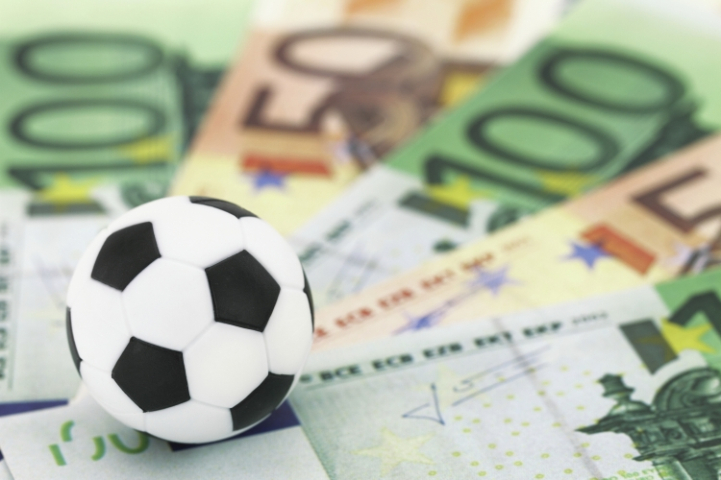
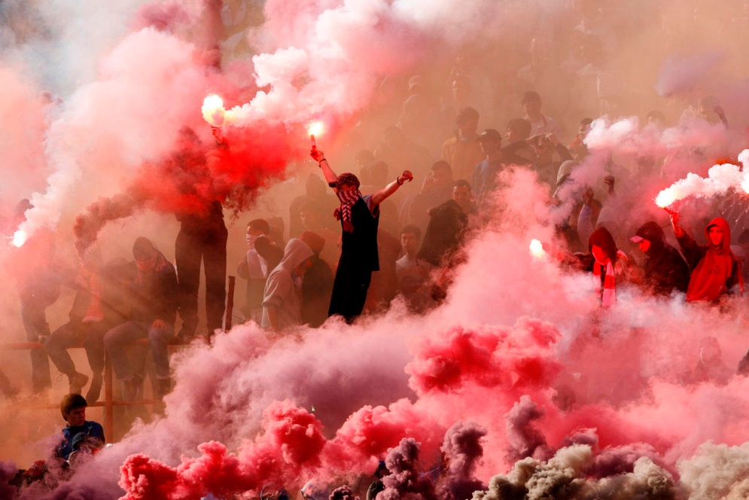
3. Problems in sport
Photo 9: Coruption in sport
modified results (sport bets...)
Bribery
money
Fans
Photo 10: Violence after football match

Slide 9
Summary
Today we talked about:
definition of sport,
types of sports (professional, amateur, recreation),
division of sports to team and individual,
problems in sport (e.g. coruption, doping etc.)

Slide 10
Conclusion
sport in general,
traps in sport,
we can completed:
recreation is healthy,
professional sports are not healthy,
we hope, that in sport in the future will be
more fair play and less coruption.

Slide 11
Question time
?

Slide 12
Sources
https://en.wikipedia.org/wiki/Sport
https://sl.wikipedia.org/wiki/Rekreacija
http://www.viva.si/V-gibanju/5461/Razvoj-športa-od-praskupnosti-do-danes?index=2
http://www.storitev.com/clanki/sport-kaj-je-to/
https://en.wikipedia.org/wiki/Amateur_sports
https://www.bing.com/images/search?q=football+judge&view=detailv2&id=75D54F374A597F7BA70A6C70619C35A8C860F76F&selectedindex=4&ccid=538TePR8&simid=608006085403934817&thid=OIP.Me77f1378f47c65dfc1ca87c3d9ed1423o0&mode=overlay&first=1
https://www.bing.com/images/search?q=amateur+sport&view=detailv2&&id=A966375CA4176F2D1F506912FF692BAD0B8FA6EE&selectedIndex=3&ccid=JX583hYt&simid=607992264196950183&thid=OIP.M257e7cde162df1df7d24a7147ef7fd79o0&ajaxhist=0
https://www.bing.com/images/search?q=recreation+grandma&view=detailv2&&id=769DDC562943A4E1BA0C69E11582B2A193ED8960&selectedIndex=0&ccid=gNwU9Edo&simid=608035054959659789&thid=OIP.M80dc14f447681f18c3df0b6f77559fa0o0&ajaxhist=0

