Slide 1
JASON STATHAM

Slide 2
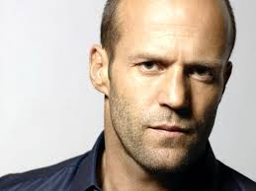
Introduction
My faovurite male actor Jason Statham.

Slide 3
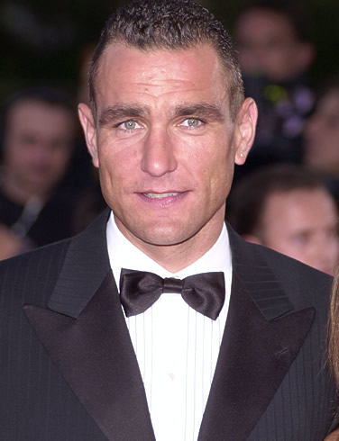
Early life
Born on 12 September 1967 in Derbshire, UK
Son of Eilen and Barry Statham
His idol Vinnie Jones
Sport model of French Connectoin
Vinnie Jones

Slide 4
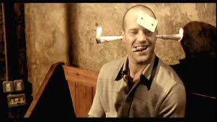
Career
Supporting role in Lock, Stock and two Smoking Barrels.
In role of poor seller Bacon

Slide 5
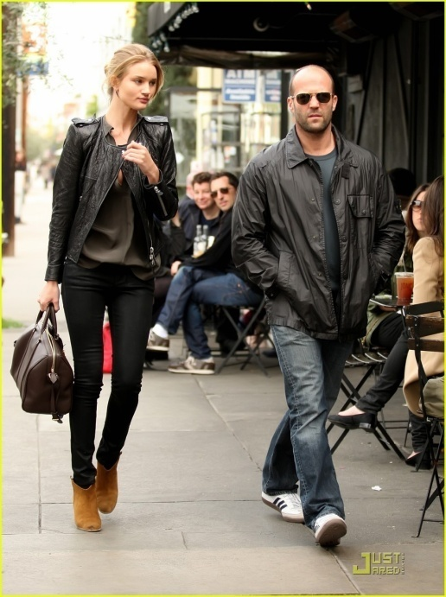
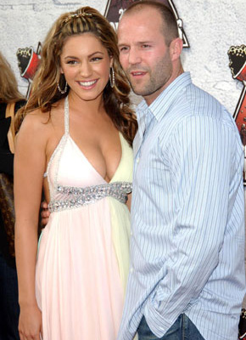
Personal life
Kelly Brook: 1997-2004
Rosie Huntington-Whiteley: 2010-present
Kelly Brook Rosie

Slide 6
Movies
Transporter, 2, 3

Slide 7
Death race

Slide 8
The Expendables, 2

Slide 9
Other films
The Mechanic
Crank
Crank: High Voltage
Blitz
Safe

Slide 10
THE END

