Slide 1
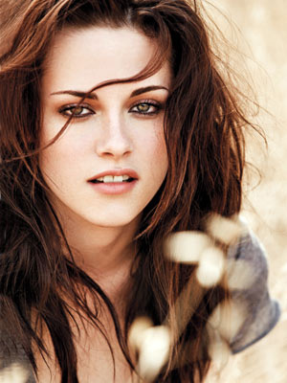
KRISTEN STEWART

Slide 2
Kristen Jaymes Stewart was born in Los Angeles , California April 9, 1990
Her father, John Stewart, is a stage manager and television producer who has worked for Fox.
Her mother, Jules Mann-Stewart, is a script supervisor originally from Maroochydore,Quensland, Australia.
She has an older brother, Cameron and an adopted brother, Taylor.

Slide 3
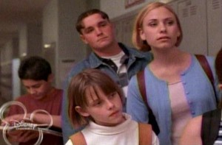
Her whole family all worked behind the camera and Kristen thought she would become a writer/director, but never considered being an actor. Stewart's acting career began at the age of eight, after an agent saw her perform in her elementary school's Christmas play.After a year of auditioning, her first role was a small nonspeaking part in the film The thirteen year

Slide 4
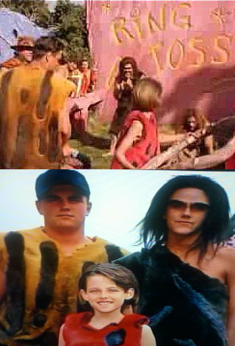
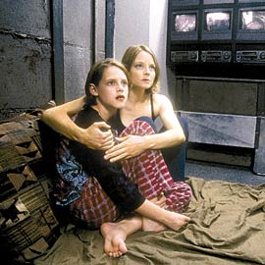
Then, she had another part in the film The Flintstones in Viva Rock Vegas. Kristen also played a tomboy in the film Panic Room, She was nominated for a Young Artist Award for her performance.

Slide 5
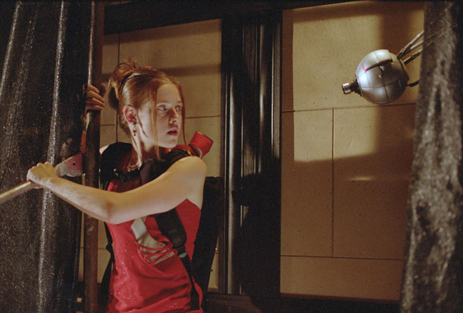
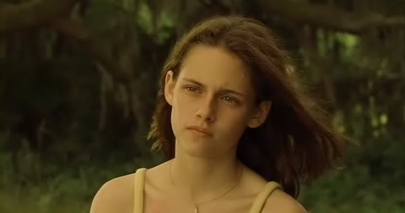
Her first starring role followed, in the children's action-comedy Catch That Kid. She also played the role of Lila in the thriller Undertow

Slide 6
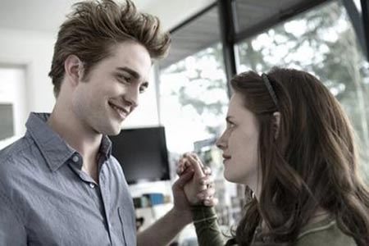
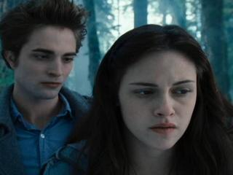
On November 2007, Summit Entertainment announced that Kristen would play Isabella Swan in the film Twilight, based on Stephenie Meyer's bestselling vampire romance novel. She stars alongside Robert Pattinson, who plays Edward Cullen, her character's vampire boyfriend. Her performance garnered mixed reviews with some critcs calling her "the ideal casting choice“. While others criticized her acting for being "wooden" and lacking variety in her facial expressions which they described as "blank".

Slide 7
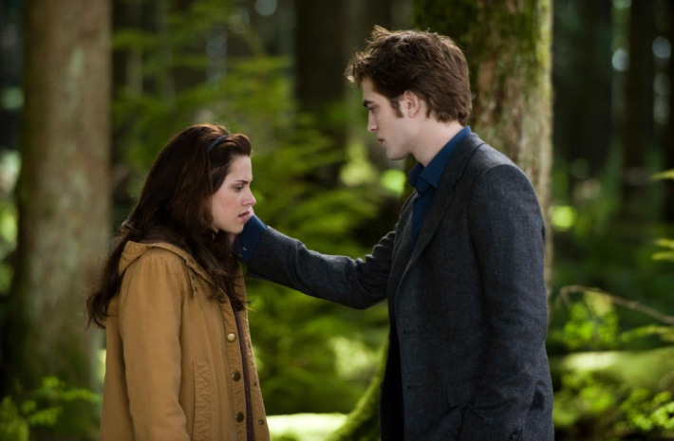
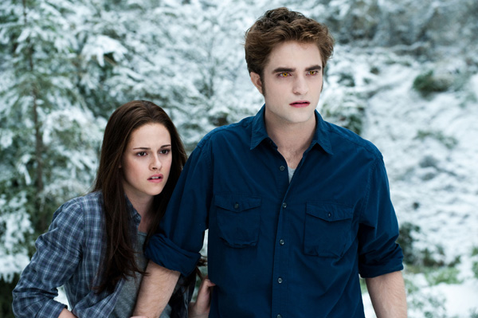
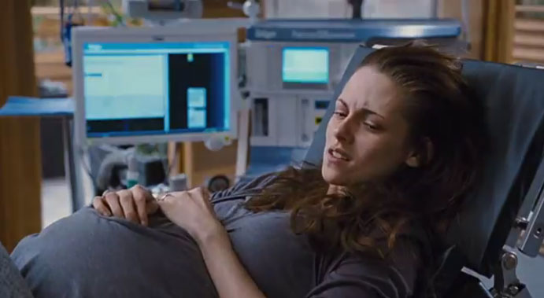
Kristen reappeared as Bella in the sequel, The Twilight Saga: New Moon,Eclipse, Breakin Dawn

Slide 8
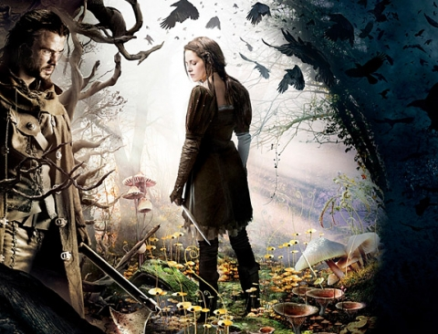
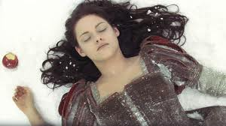
Stewart will be playing Snow White in the film Snow White and the Huntsman

Slide 9
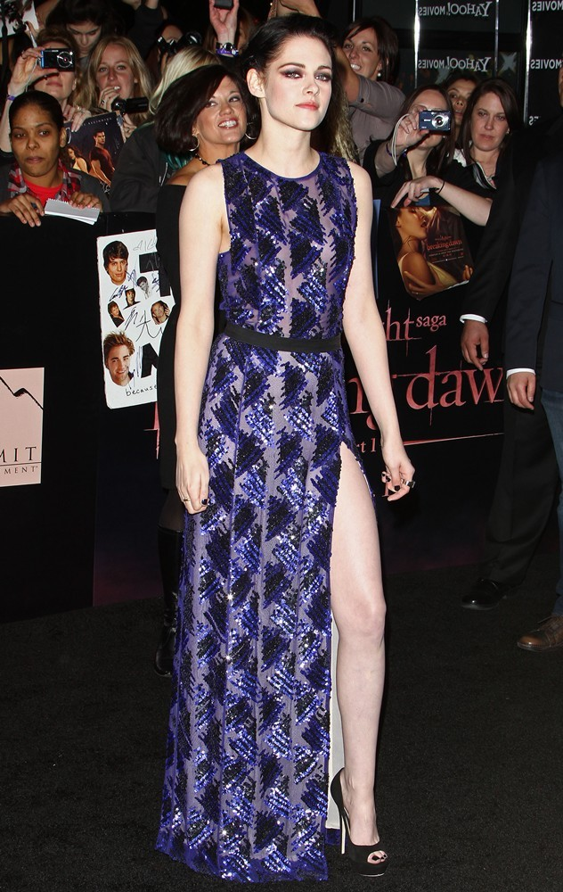
On December 2011, Kristen was named number one on Forbes magazine's list of Hollywood's Best Actors for the Buck.

Slide 10
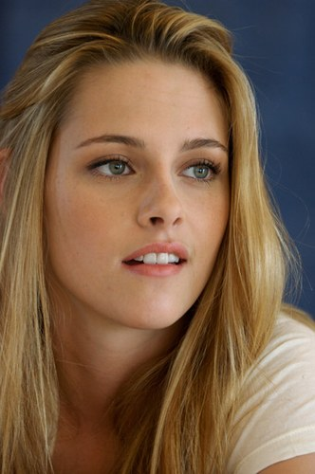
THE END

