Slide 1
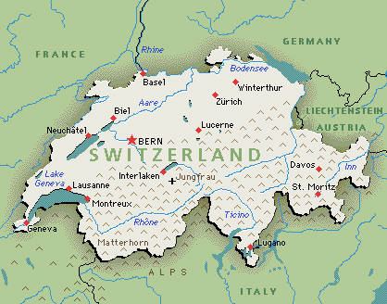
Srednja šola Ravne
Referat pri Angleščini
SWITZERLAND

Slide 2
1. Switzerland data
Switzerland, also known as Swiss, is a country of 7.5 million people in Western Europe with an area of 41,285 km².
Area
- | Total | 41,285 km² (136th) 15,940 sq mi
- | Water (%) | 4.2
Population
- | 2006 estimate | 7,508,700
- | 2000 census | 7,288,010
- | Density | 182/km² 100/sq mi

Slide 3
1.1. Switzerland’s flag
and coat of arms
Coat of arms
Flag

Slide 4
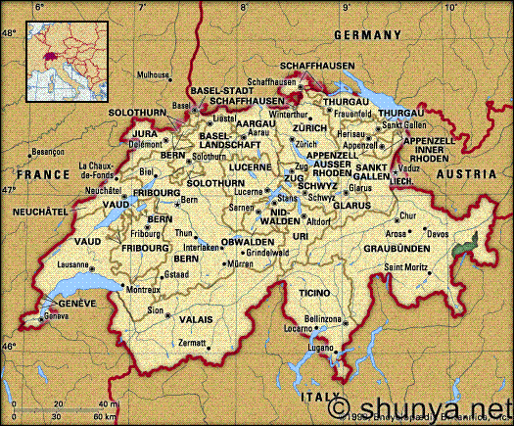
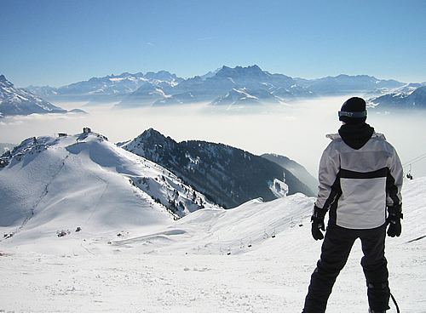
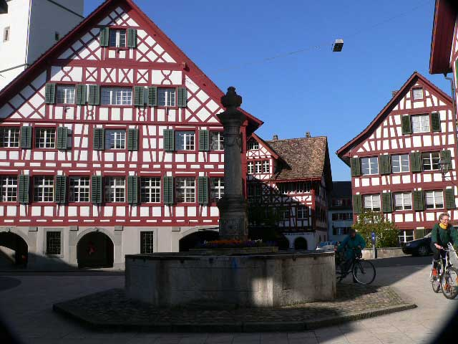
2. Switzerland angle
federal republic
Switzerland is a federal republic, consisting of 26 states, called cantons.
Bern is the seat of the federal government and de facto capital, while the country's economic centers are its two global cities, Geneva and especially Zürich.
Switzerland is bordered by Germany, France, Italy, Austria and Liechtenstein.
Switzerland is multilingual and has four national languages: German, French, Italian and Romanish.

Slide 5
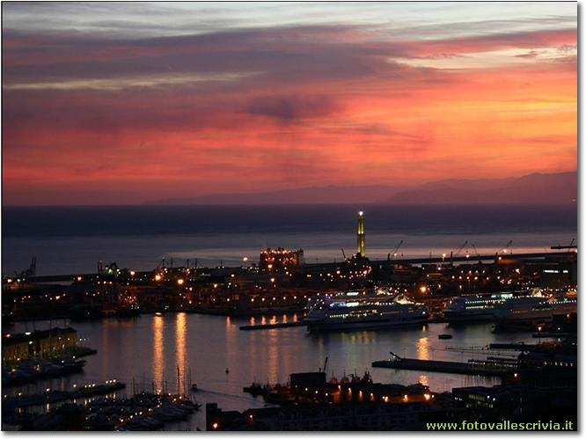
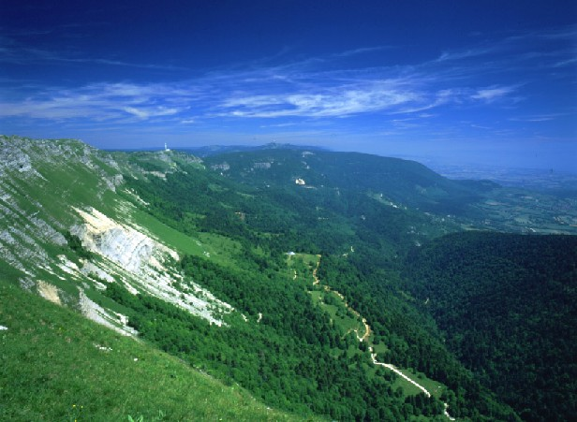
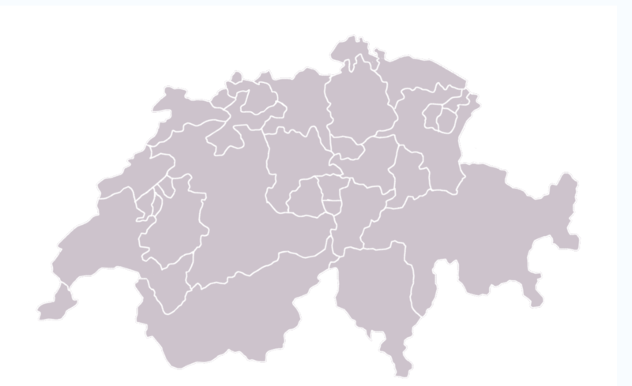
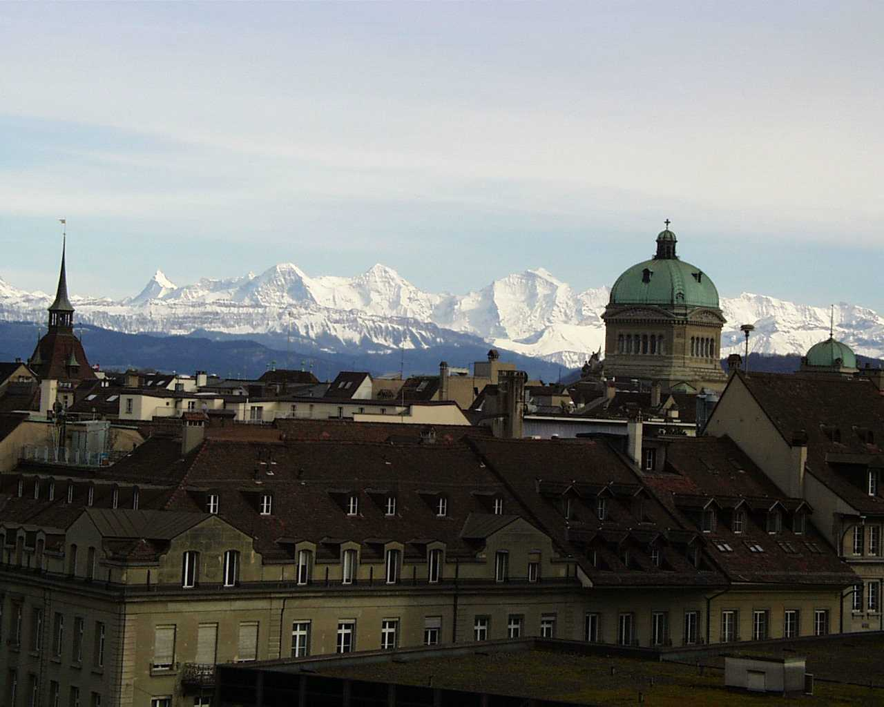
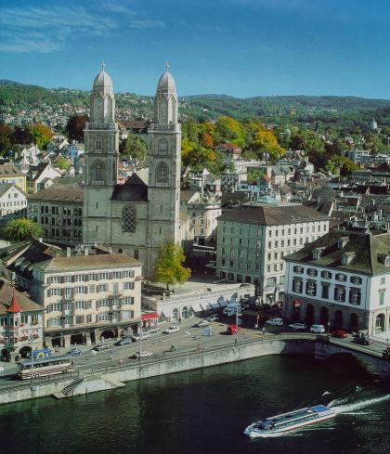
3. Switzerland and cantons
The Swiss confederation consists of 26 cantons:
Aargau
Appenzell Innerrhoden
Appenzell Ausserrhoden
Basel-Stadt
Basel-Landschaft
Bern
Fribourg
Geneva
Glarus
Graubünden
Jura
Lucerne
Neuchâtel

Slide 6
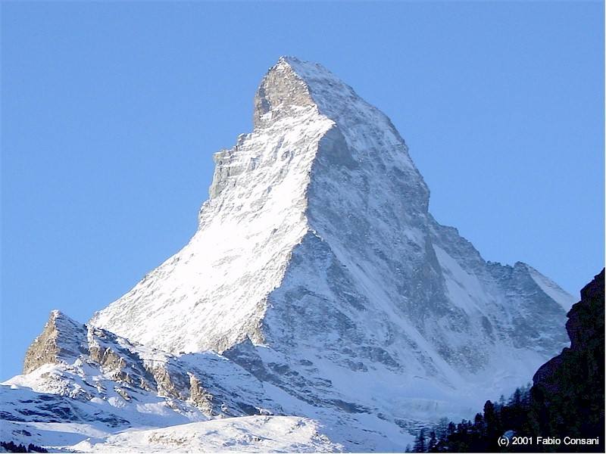
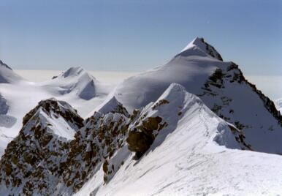
4. Mountainous Switzerland
The southern half of the country has more mountains and is far more sparsely populated than this average, while the northern half has a somewhat greater density, is more hospitable hilly terrain, partly forested and partly cleared, as well as several large lakes.

Slide 7
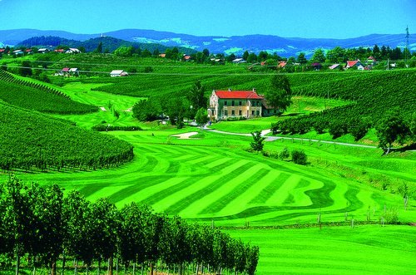
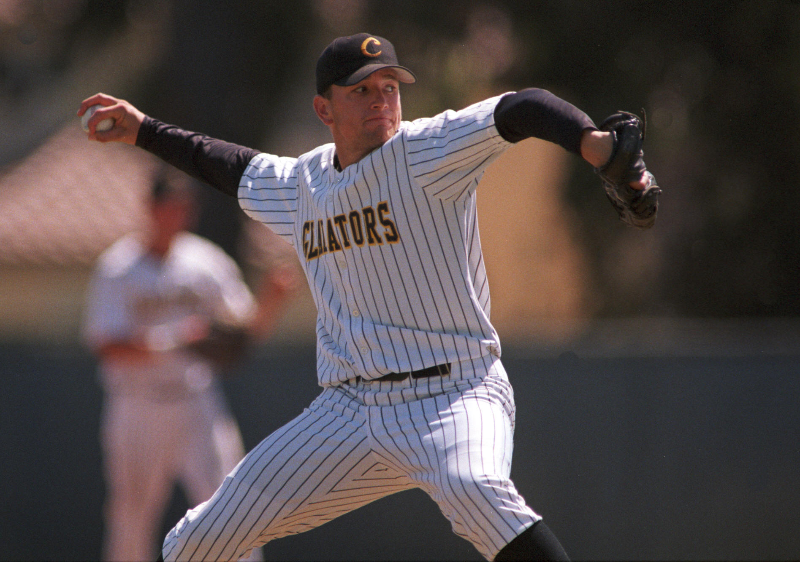
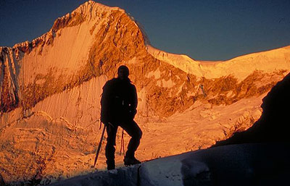
5. Switzerland and sports
Like many European nations the Swiss are big fans of football and the national team or 'Nati' is widely supported. Swiss wrestling or "Schwingen" is an old tradition from the rural central cantons and considered the national sport. Hornussen is another indigenous Swiss sport, which is like a cross between baseball and golf.

Slide 8
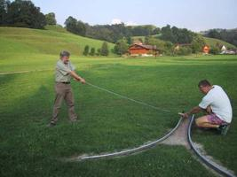
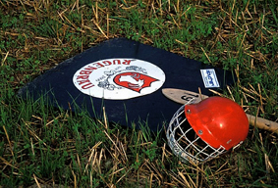
5.1. What´s hornussen
Hornussen is an indigenous Swiss sport and is like a cross between baseball and golf. The sport gets its name from the puck which is hit which is known as a "Hornuss’' or "Nouss" or ‘’hornet’’ in English on account of the noise it makes as it whizzes through the air at up to 300 km per hour.

Slide 9
