Slide 1
TECHNOLOGY is LIBERATING US,
PRO et CONTRA

Slide 2
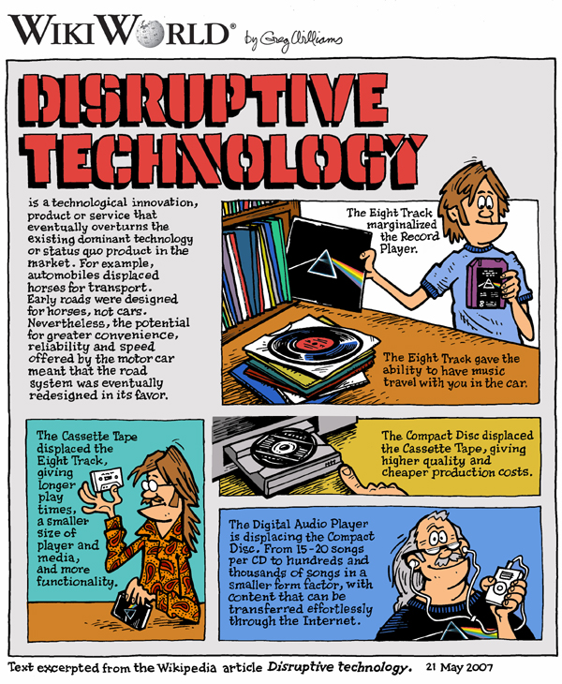
What is technology?
The process by which people modify nature to meet their needs and wants
Technology is a product of engineering and science

Slide 3
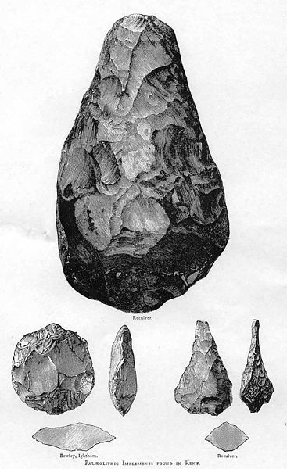
HISTORY OF TECHNOLOGY
The history of the invention of tools and techniques
These certainly changed lifestyle
STONE & METAL TOOLS
→ artifacts, including bracelets, axe heads, chisels (dleto), and polishing tools
→ perform a variety of tasks; chopping wood; cracking open nuts; skinning an animal

Slide 4
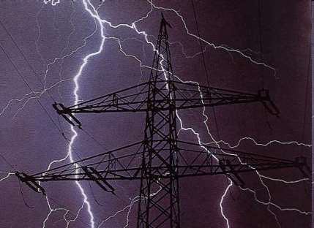
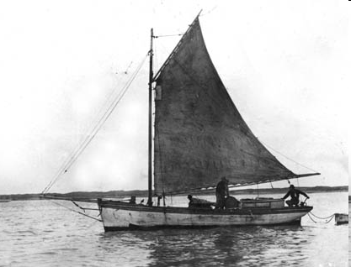
CLOTHING
→ the fur and other materials
ENERGY
FIRE
WIND POWER
→ ELECTRICITY

Slide 5
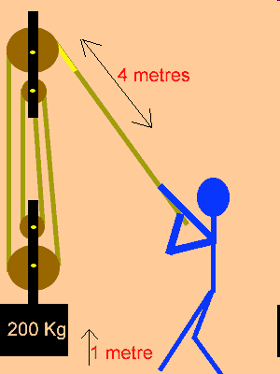
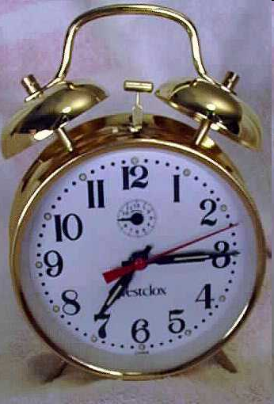
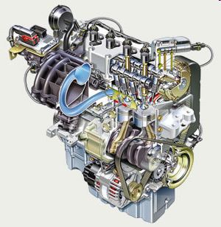
SIMPLE MACHINES AND COMPLEX MACHINES
→ the lever, the screw, the pulley
the clock, the engine, the electric generator and the electric motor, the computer, the radio,…
As tools increase in complexity, so does the type of knowledge needed to support them

Slide 6
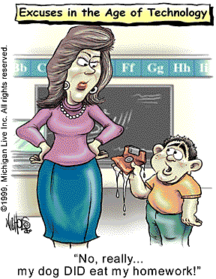
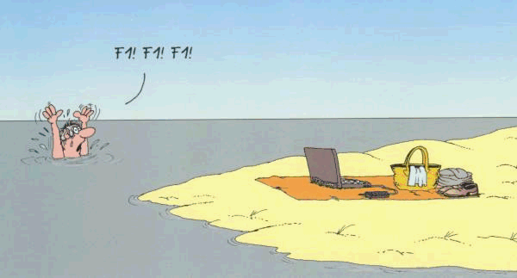
1. INFORMATION TECHNOLOGY
Information technology (IT); is the study, design, development,management of computer-based information systems
The information technology is quite large, it covers many fields.

Slide 7
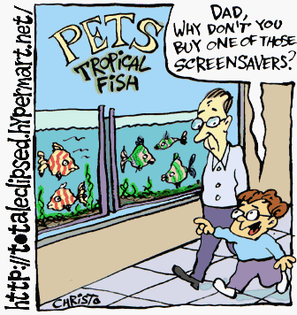
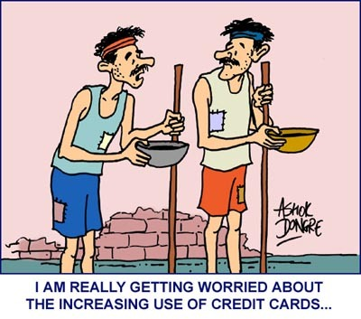
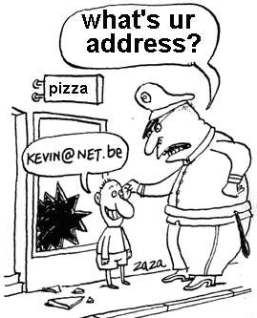

Slide 8
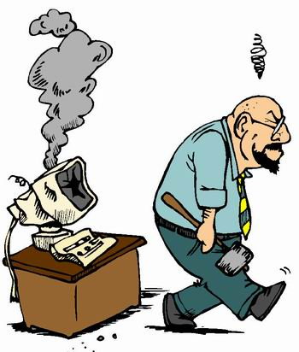
PRO
mobile phones
internet
television
CONTRA
mobile phones
computers and internet
television

Slide 9
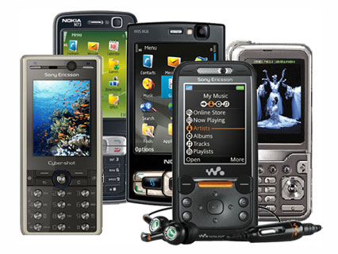
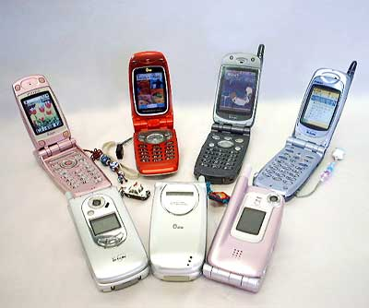
1. MOBILE PHONES -pro
communication
functions (SMS, internet, camera,…)

Slide 10
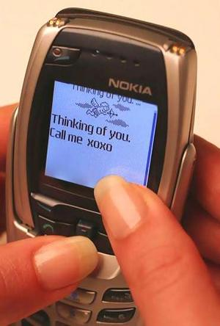
1. MOBILE PHONES -pro
SMS → most used function
mobile phone penetration rate
Luxembourg 158%
Hong Kong 139.8%
Western European 110%
2006 → 80% of the world's population has access to mobile phone

Slide 11
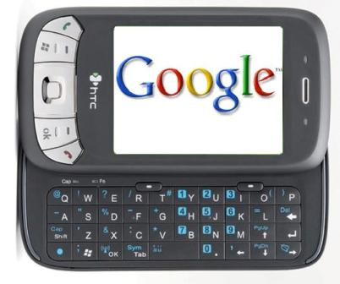
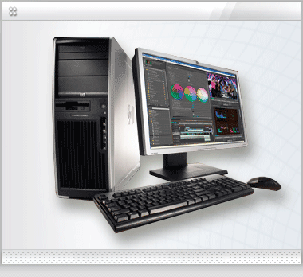
2. INTERNET -pro
information resources
services (e-mail, chat, …)
accessible everywhere
social interaction

Slide 12
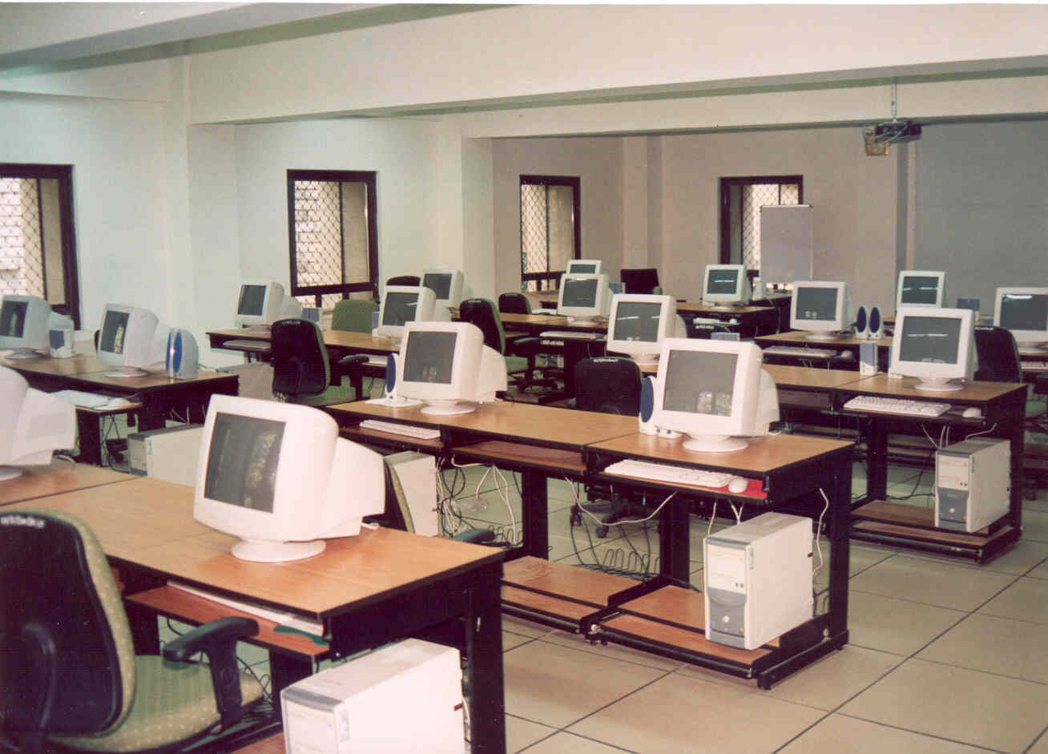
2. INTERNET - pro
June 2008 → one billion PCs
June 2008 → 1.463 billion people use the Internet
SLOVENIA, 2006 → 880.000 users of internet

Slide 13
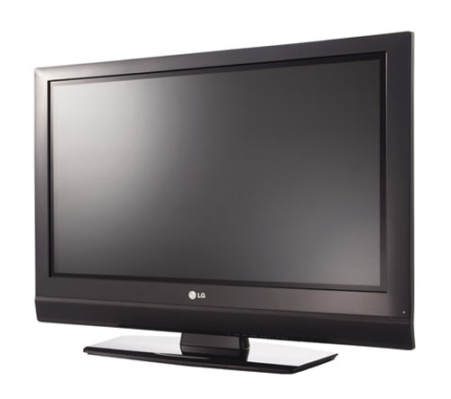
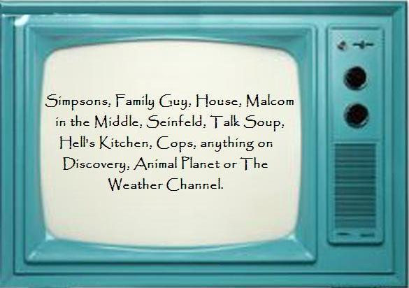
3. TELEVISION
source of entertainment and news
households with one television → 99%
SLOVENIA → 98% of households

Slide 14
MOBILE PHONES - contra
Radiation,
lack of personal contact & privacy,
addiction.

Slide 15
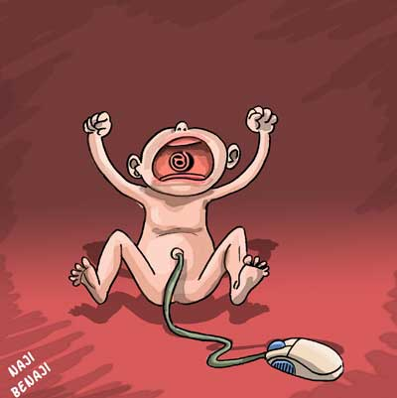
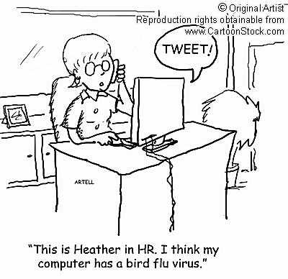
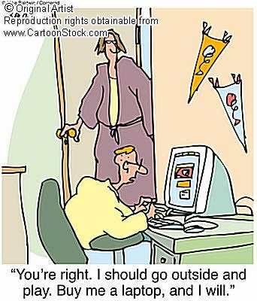
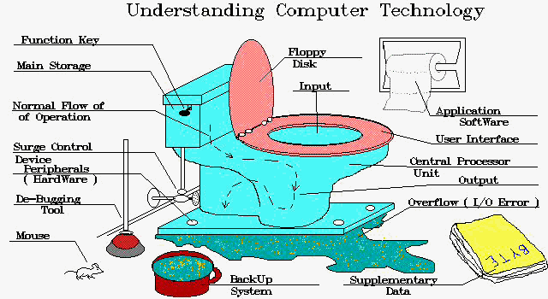
COMPUTERS & INTERNET
Inappropriate content,
no privacy,
playing computer games.

Slide 16
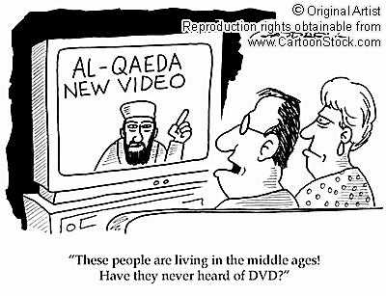
TELEVISION - contra
Addiction,
loss of sense of time.

Slide 17
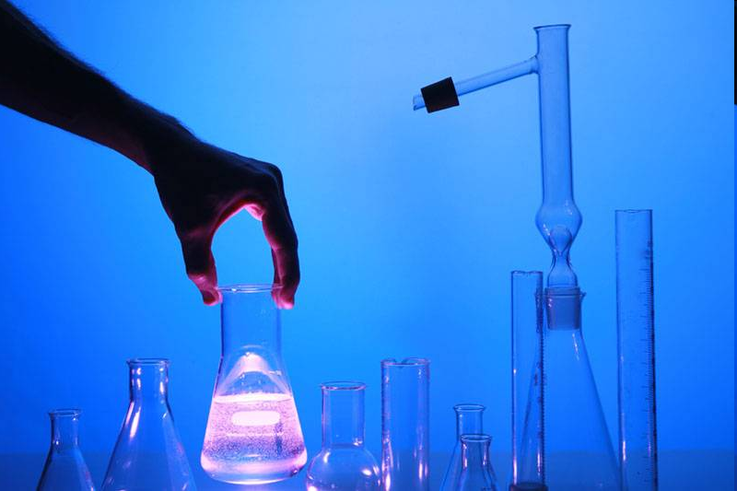
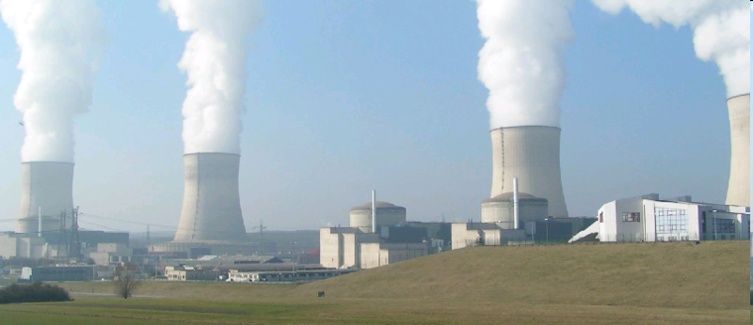
2. ENGINEERING
Technical, scientific knowledge+natural laws, physical resources = engineering

Slide 18
PRO:
BIOTECHNOLOGY
CHEMICAL TECHNOLOGY
NUCLEAR TECHNOLOGY
CONTRA:
WEAPON OF MASS DESTRUCTION
NUCLEAR WEAPONS
NUCLEAR ACCIDENTS

Slide 19
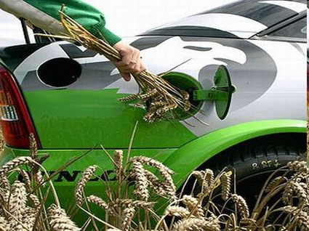
1. BIOTECHNOLOGY - pro
Cultivation of plants,
improves the taste, texture and appearance of the fruit,
bio fuel,
in drug discovery and approval process (INSULINE),
gene therapy ~ treating.

Slide 20
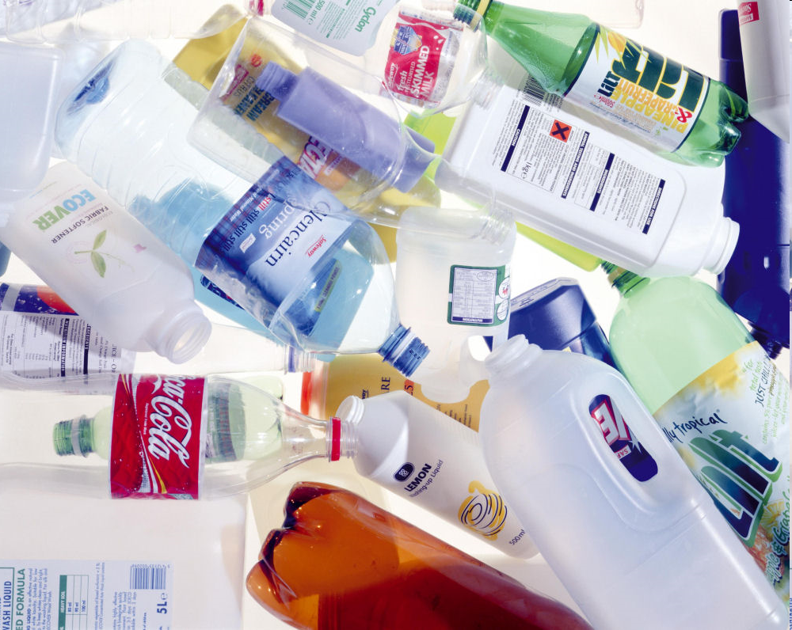
2. CHEMICAL INDUSTRY - pro
Products: RUBBER, PVC, PLASTIC, PAPER, PRIMARY METALS …,
the largest industrial sectors,
3.2 million jobs.

Slide 21
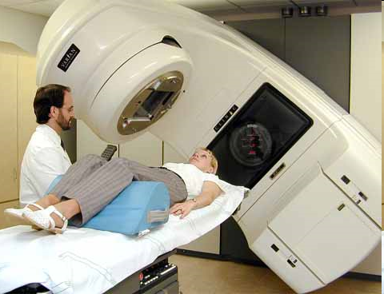
3. NUCLEAR INDUSTRY - pro
Nuclear power ~ heat, electricity …,
radiation therapy.

Slide 22
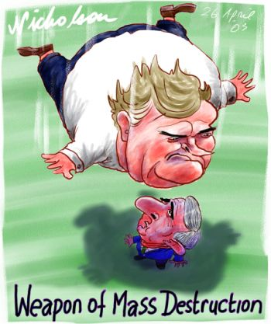
1. WEAPON OF MASS DESTRUCTION - contra
Biological, chemical and nuclear,
kill a lot of people, cause damage to buildings.

Slide 23
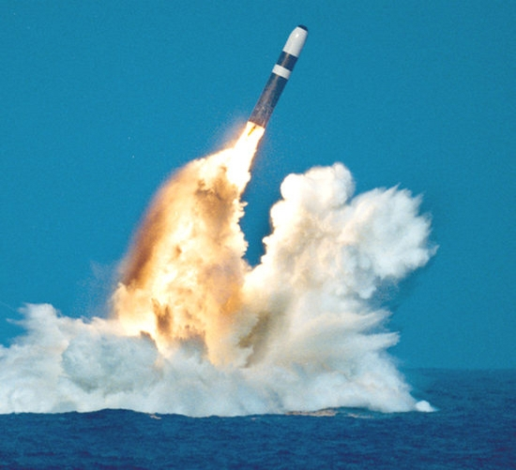
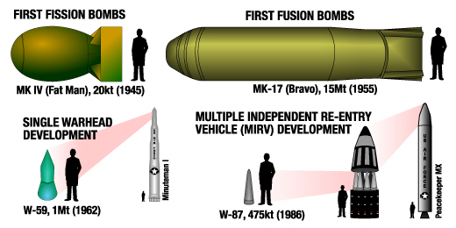
2. NUCLEAR WEAPONS - contra
Destructive bombs,
Nuclear deterrent.

Slide 24
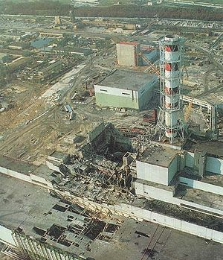
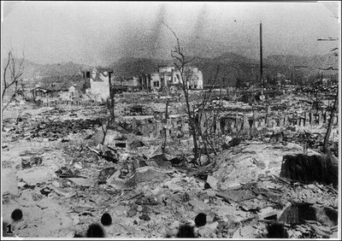
3. NUCLEAR ACCIDENTS - contra
Under accidental circumstances, an explosion can take place inadvertently,
Chernobyl:
nuclear reactor accident,
the worst nuclear power
plant disaster,
release of radioactivity.

Slide 25
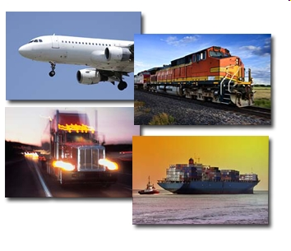
3. TRANSPORTATION
The movement of people and goods from one location to another
The field can be divided into
infrastructure,
vehicles,
operations.

Slide 26
PRO
CARS.
CONTRA
POLLUTION,
CHANGING ENVIRONMENT,
IMPACT ON PEOPLE.

Slide 27
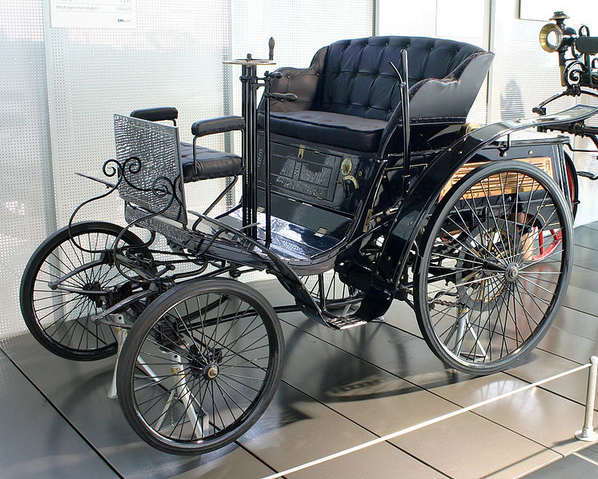
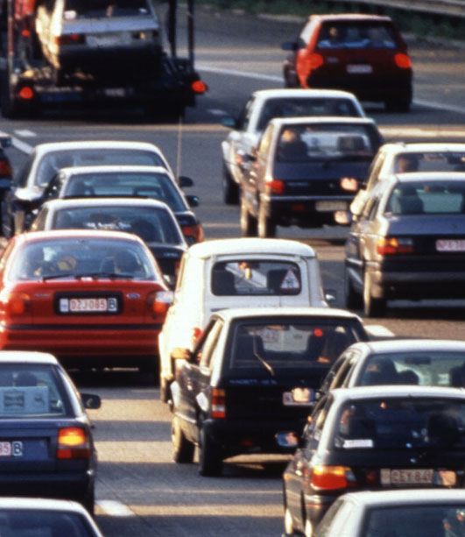
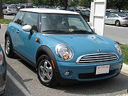
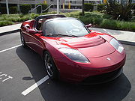
CARS -pro
availability of use
transporting passengers
easier access to remote places
independence, freedom, and increased status for owner
2002→ 590 million cars

Slide 28
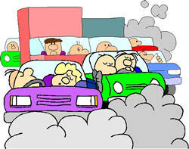
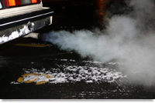
1. POLLUTION - contra
Air pollution.
global warming - emission of carbon dioxide,
traffic jams.

Slide 29
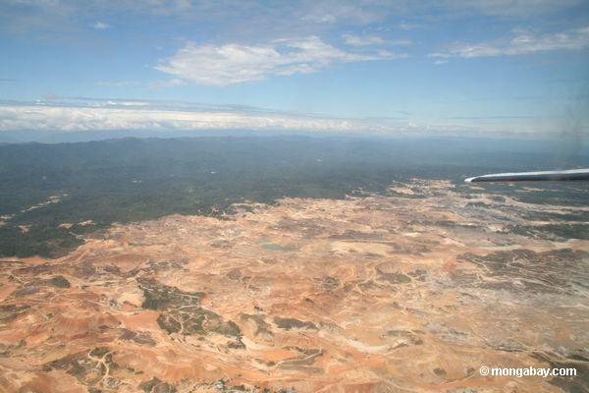
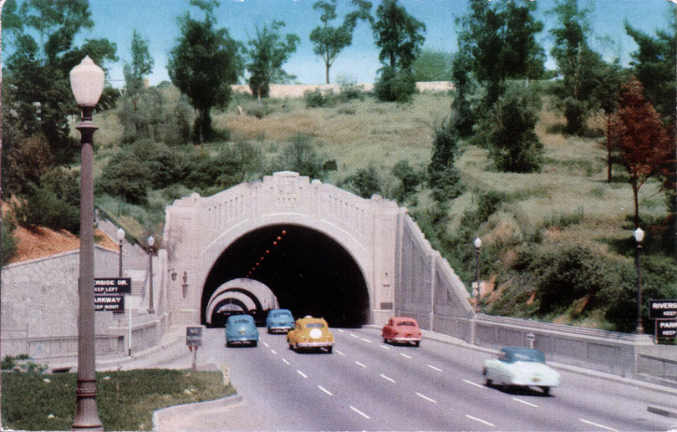
2. CHANGING ENVIRONMENT - contra
Infrastructure – intervening with nature
cut down forests,
tunnels,
destroyed agriculral lands,
changed ecosystem.

Slide 30
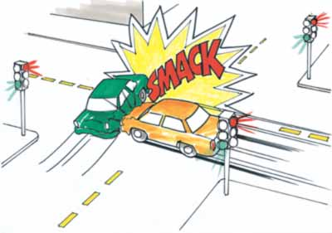
3. IMPACT ON PEOPLE - contra
Breathing unhealthy air,
car collisions:
1.2 million people die and
40 million people are injured each year

Slide 31
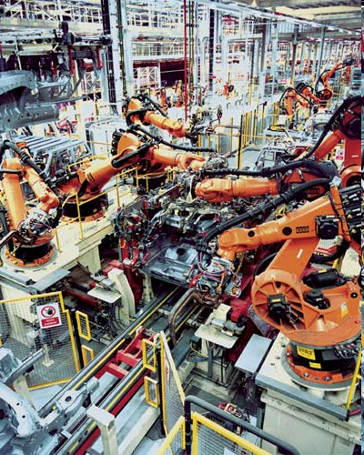
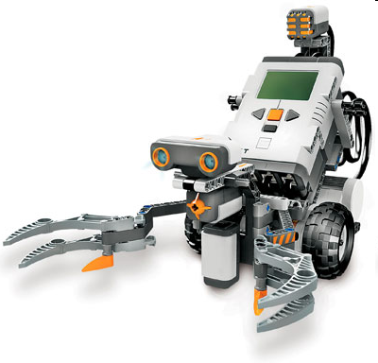
4. ROBOTICS
Robotics is the science and technology of robots
Robots are machines that can perform some human tasks or imitate some of the things that a person can do

Slide 32
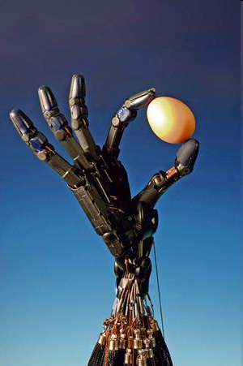
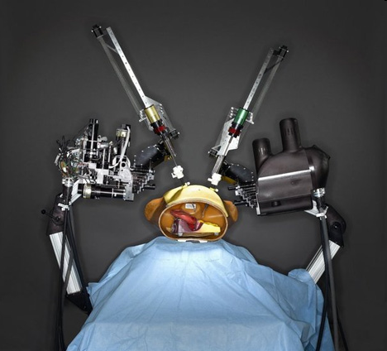
PRO:
Car industry,
Packaging,
MEDICINE → surgery.

Slide 33
CONTRA:
Replace human labor,
abusing.

