Slide 1
Teenage health

Slide 2
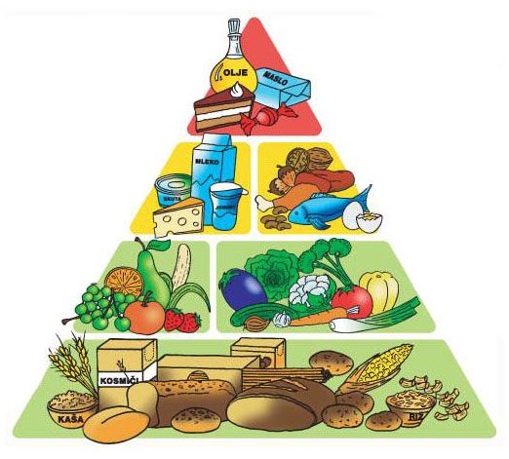
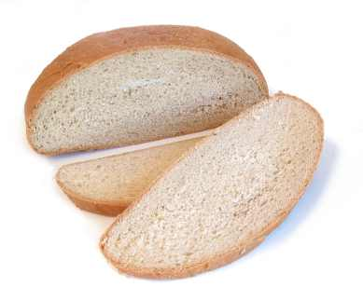
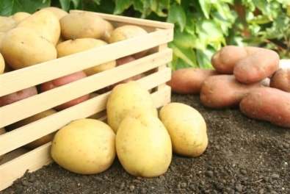
Food:
Our body needs a lot of different kinds of food, so we must eat quality and varied food.
For healthy life are very important carbohydrates,
becouse they give us a lot of energy. We can find
carbohydrates in potatoes, rice, pasta, bread and in
other things. But carbohydrates that are sweet
(cakes, muffinns...,) can olso tired our body so we
should be careful.

Slide 3
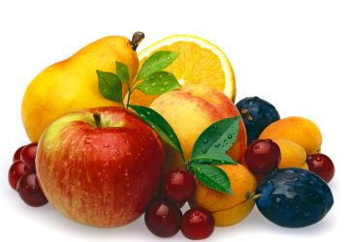
Food:
Specifically teenagers shouldn’t eat so much
junk food and sweets, but they should eat many
fruit and vegetables becouse they are full of
vitamins and minerals.
Vitamins and minerals are very important
when you are a teeenager becouse your body is
growing, but in other case junk food is very bad
for you becouse doesn’t contain vitamins and
minerals.

Slide 4
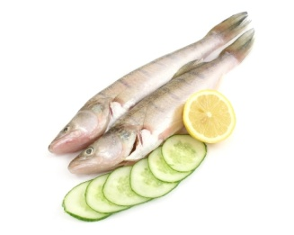
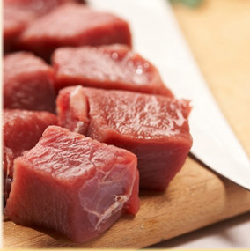
Food:
Teenagers should eat olso red meat (for muscles),
fishes, eggs and cheese. This things give us a
lot of protein, but they olso contain some
vitamins. But we shouldn’t eat too much protein
becouse they can hurt your kidney and this can
be very dangerouse.

Slide 5
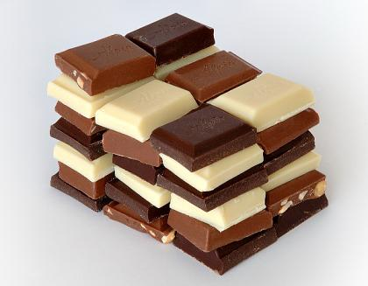
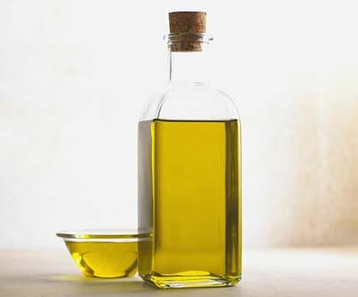
Food:
For healthy life we need olso some fat.
Fat is very important becouse give us a lot
of energy, olso more than carbohydrates and
protect our nervous.

Slide 6
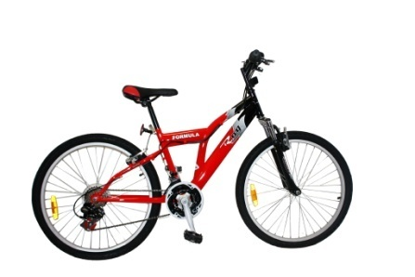
Exercise:
Almost all teenagers spend all their time in front of computer or TV. They should take more exercise (they should cycling in the city or they should walk to the school), becouse people that take exercise are fitter and don’t get flu so often.

Slide 7
Smoking:
Most of teenagers begin smoke at fifteen or sixteen. Smoking is very dangerouse becouse can hurt your lungs. People who smoke in many cases get cancer on the lungs and they live about five years less that people who don't smoke. Smoking is olso very dangerouse for people who don't smoke becouse they must breathe the smoke around them.

Slide 8
Thank you for
attention!

