Slide 1
TEENAGE PROBLEMS

Slide 2
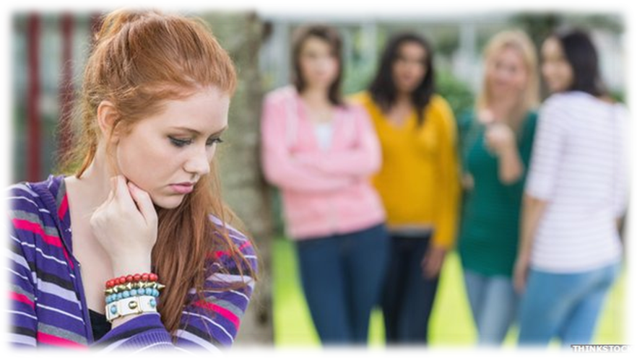
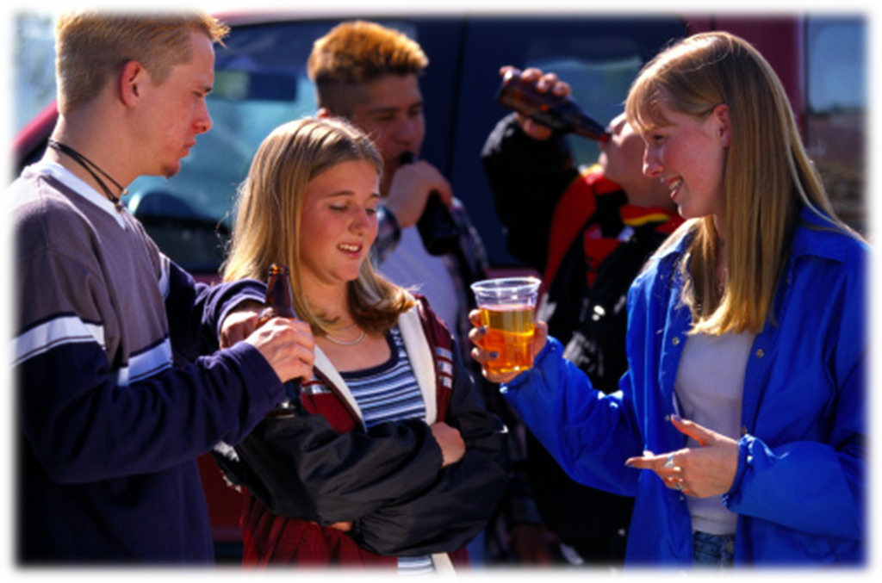
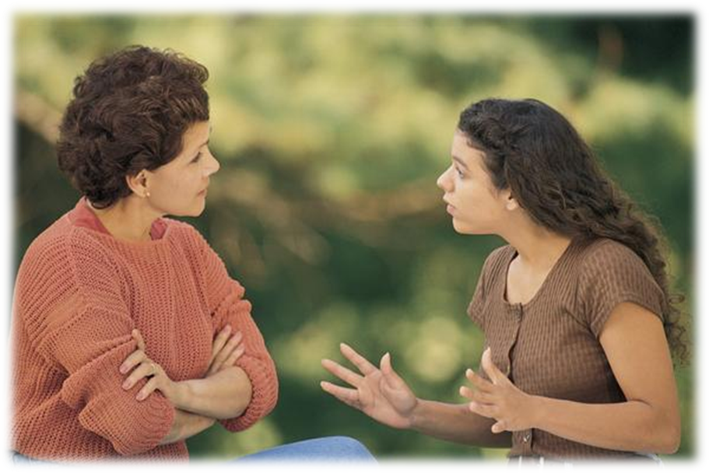
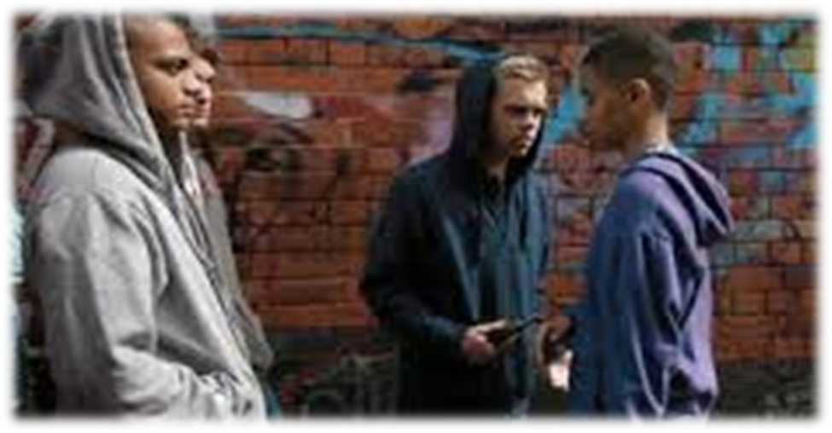
WHY?
peer pressure
bullying at school, at home…
intimidation
parents, teachers put pressure on teens
teens get into bad company
discrimination

Slide 3
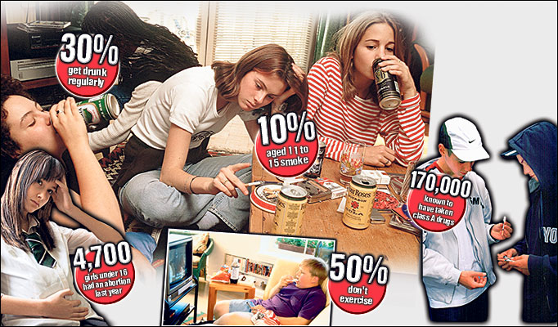
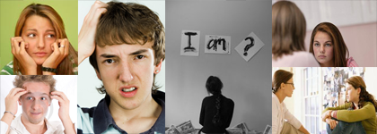
PROBLEMS
addiction (with computer, TV…)
compulsive eating disorder
bullying
drugs and alcohol
depression
teen pregnancy

Slide 4
ADDICTION WITH COMPUTERS, TV…
with computers, TV, phones
don‘t have any friends
nobody talk with they about they problem
addictied people forget how flowchart life outside (they know just how to plan on TV, in computer games…)

Slide 5
COMPLUSIVE EATING DISORDER
anorexia (people don‘t eat enough)
bulimia (people eat enough, but later they throw up food)
unconfident
rant
people think they are fat
by girls (32% anorexia, 29,5% bulimia)
by boys (25,5% anorexia, 15% bulimia)

Slide 6
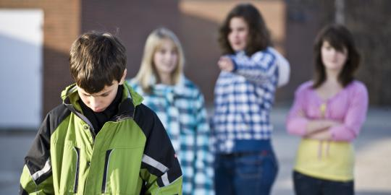
BULLYING
physical (wounds on the victim‘s body)
mental or cybre (victims suffers constant insult)
pain in mental (cybre) bullying is stronger
victims sometimes commit suicide
violent person go in prison

Slide 7
DRUGS & ALCOHOL
they think drugs and alcohol are rescue
they start to steal tings
they start to prostitute themselves
often they become addicted
causes are family issues, experimentation, pressure at school, at home…

Slide 8
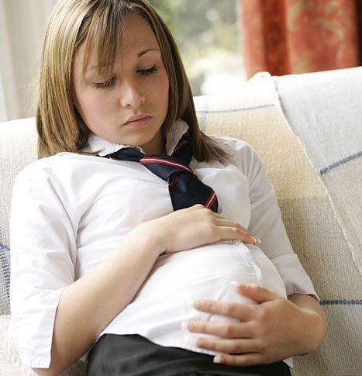
TEEN PREGNANCY
the cause is sex without contraception, rape
in 50% girls have an abortion
dads often escape
girls aren‘t table to look after the baby
some girls commit suicide

Slide 9
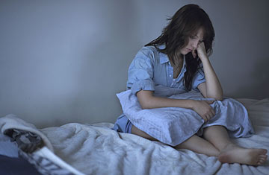
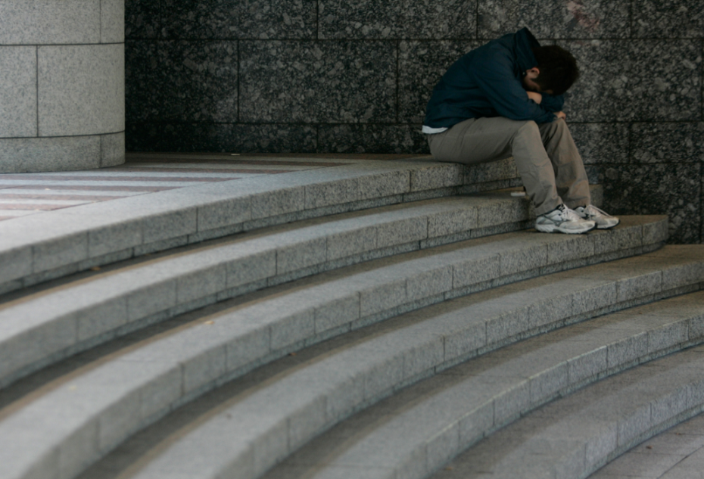
DEPRESSION
people are sad
causes: drugs, alcohol, parents, other problems is their private lives
sometimes they don‘t know why they life
sometimes they sleep to much

Slide 10
CONSEQUENCES TEENS PROBLEMS
escape
self harming
death of diseaeses (anorexia, bulimia)
mental illnesses

Slide 11
HELP
some remedy
talks with right people- friends, psychiatrists…

Slide 12
DICTIONARY
intimidation- ustrahovanje
addiction- odvisnost
bullying- nasilje
flowchart- poteka
unconfident- nesamozavest
rant- zmerjanje
wounds- poškoduje
consequences- posledice
abortion- splav
victim- žrtev
suffer- trpeti
violent- nasilen
cause- vzrok
rape- posilstvo
escape- oditi, zbežati
able- dorasle
illnesses- bolezen

Slide 13
BOOKS AND MOVIES ABOUT TEEN PROBLEMS
BOOKS
FILMS
Beautiful (Amy Reed)
Wir Kinder Vom Bahnhof ZOO (Christiane F)
Scars (Cheyrl Rainfield)
Good Evil (James Heneghan)
Slut (Beth Goobie)
Miriam Es Anorexica (Marliese Arold)
Chocolate For Breakfast (Pamela Moore)
Kozarček preveč (Stella Kos)
Thirteen (2003)
Kids (1995)
Min Lilla Syster (2015)
The Virgin Suicides (2000)
Juno (2007)
Wir Kinder Vom Bahnhof ZOO (1981)
Speak (2004)

Slide 14
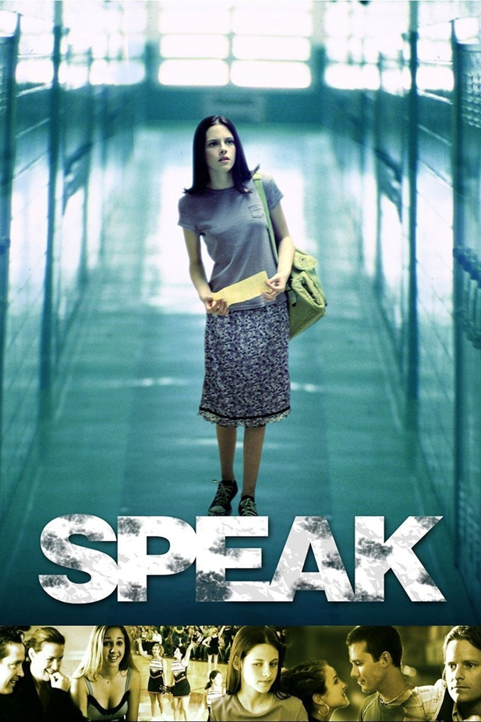
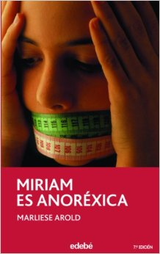

Slide 15
VIDEOS
https://www.youtube.com/watch?v=QuN0Z65sp5c
https://www.youtube.com/watch?v=ySpPkHZ66aI
https://www.youtube.com/watch?v=dad4-gQfhMs
https://www.youtube.com/watch?v=Qe3HbVegpjM

Slide 16
PHOTOS
http://pixgood.com/girl-being-bullied.html
http://www.secureteen.com/peer-pressure/keep-your-teen-away-from-the-wrong-company/
http://www.shutterstock.com/video/clip-3849824-stock-footage-gang-intimidation-gang-members-pressure-a-younger-boy-to-take-a-gun.html
http://everydaylife.globalpost.com/longterm-effects-strict-parenting-6180.html
http://nkmt.sze.hu/hirek-esemenyek
http://www.techaddiction.ca/symptoms-of-computer-game-addiction-cog.html
http://quizcavern.com/quizzes/are-you-a-facebook-addict
http://www.wisegeek.org/what-is-physical-bullying.htm#didyouknowout
http://medicmagic.net/victims-of-bullying-are-prone-to-experience-mental-disorder.html
http://www.psychologicalharassment.com/
http://ingles.colegioromareda.com/?p=46
http://www.telegraph.co.uk/news/health/news/4141649/Teenagers-turn-to-alcohol-and-drugs-to-cope-with-school-stress.html
https://janedungo.wordpress.com/2015/02/15/how-much-alcohol-do-teens-use/
http://beginningandend.com/teens-smoke-drugs-alcohol-report/
http://esol.britishcouncil.org/content/learners/uk-life/be-safe-uk/drugs-alcohol-and-cigarettes
http://content.time.com/time/health/article/0,8599,1902500,00.html
http://www.natureworldnews.com/articles/6070/20140218/stress-hormone-cortisol-act-biomarker-depression-researchers.htm
https://www.pinterest.com/paradigmmalibu/teen-depression-treatment/
http://www.keepcalm-o-matic.co.uk/p/keep-calm-and-avoid-drugs-and-alcohol/
http://www.1079thebreeze.com/index.php/the-big-breakfast/news-of-the-weird/14094-doctor-despicable
http://www.cbsnews.com/news/us-teen-pregnancy-rates-at-an-all-time-low-across-all-ethnicities/
https://www.pinterest.com/pin/397090892117108615/
http://www.refuge.org.uk/get-help-now/help-for-teenage-girls/
http://www.totalchoirresources.com/how-to-build-a-choir-community/

Slide 17
PHOTOS
http://www.smar-team-org.si/KNJIGE%20NA%20SPLETU/INDEKSIKNJIGE/indexKOZARCEKPREVEC.html
http://www.amazon.com/Miriam-Es-Anorexica-Is-Anorexic/dp/8423676749
http://www.goodreads.com/book/show/16248270-chocolates-for-breakfast
http://www.goodreads.com/book/show/293724.The_Lottery
http://www.peircescott.com/jamesheneghan/hitsquad.htm
http://www.goodreads.com/book/show/7531478-scars
http://www.beltz.de/produkt_produktdetails/2755-wir_kinder_vom_bahnhof_zoo.html
http://www.goodreads.com/book/show/6323474-beautiful
http://putlocker3.com/movies/speak-2004/
http://www.tower.com/juno-ellen-page-dvd/wapi/113109582
http://www.rogerebert.com/reviews/thirteen-2003

Slide 18
SEOURCES
http://www.slideshare.net/marinosa/teen-problems-28374108
http://www.slideshare.net/pamaee/teenage-social-problems?related=1
http://www.slideshare.net/ByronPoliano/anorexia-nervosa-48027430
http://sl.pons.com/prevod?q=prostitucija&l=ensl&in=&lf=en

