Slide 1
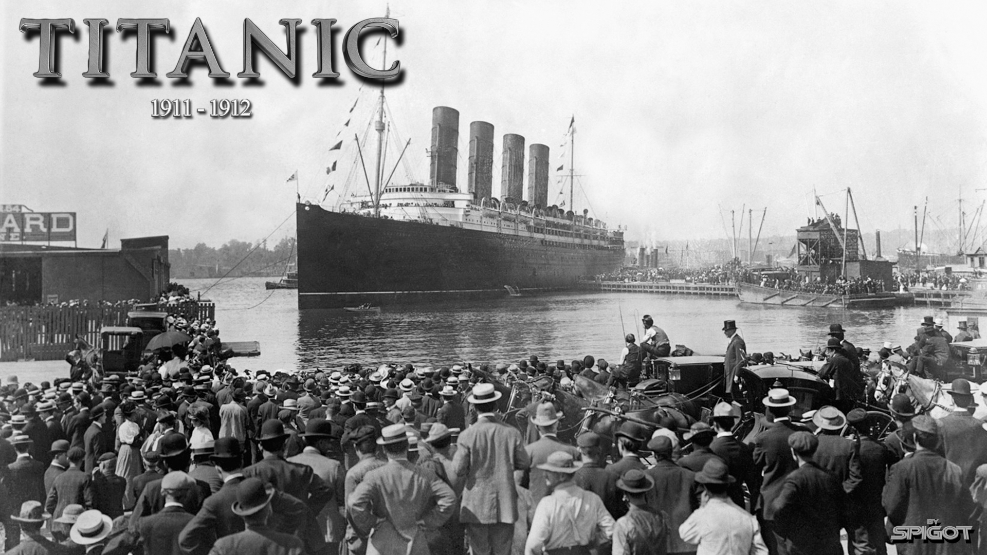

Slide 2
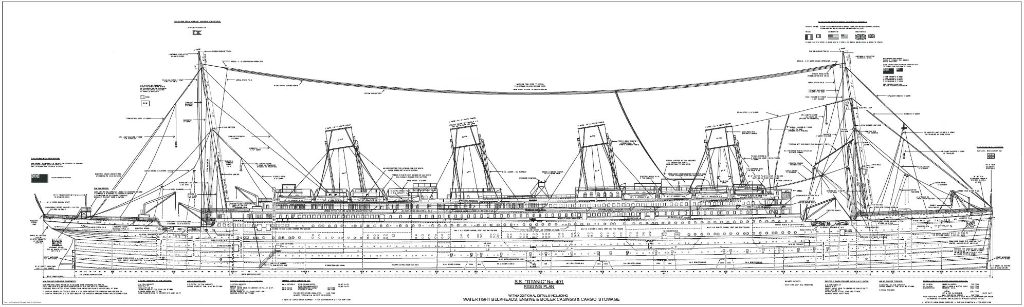
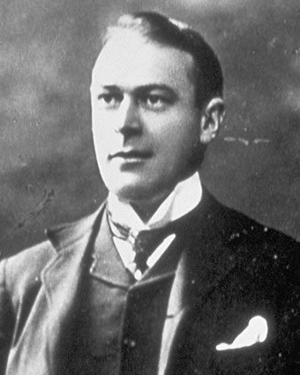
TECHNICAL INFORMATION
Thomas Andrews-plan (he say:,,TITANIC IS unsinkable ship’’)
Length 269M
WIdtH 28M
HEIGHT 53M
WEIGHT 52 000t
4 chimneys
29 pans
16 LIFEBOATS

Slide 3
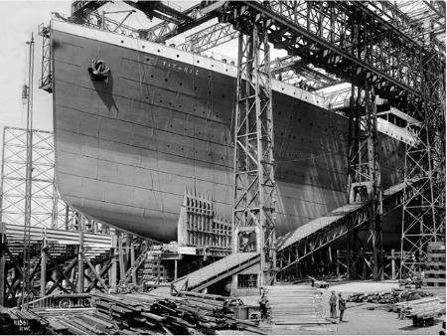
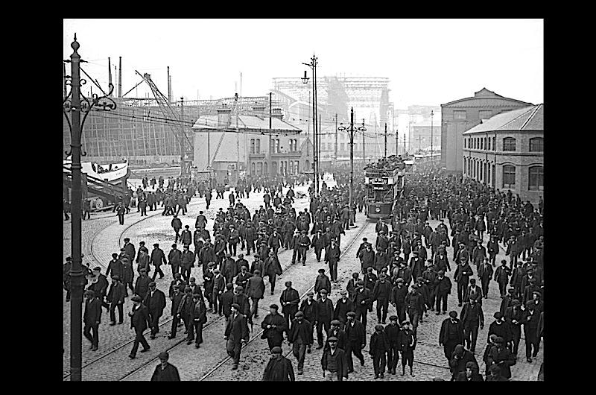
BUILDING
31st March 1909- 31st May 1911
Queen's Island-today Titanic Quarter (Great Britain)
100 000 workes
test drive 2nd April 1912

Slide 4

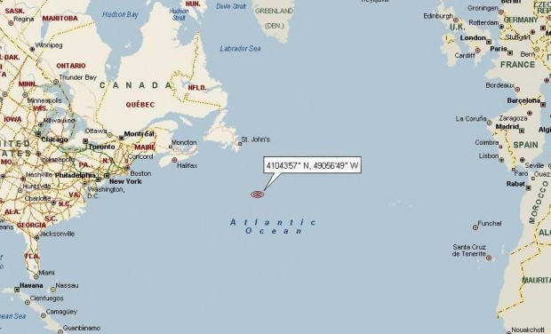
WHEN and where
departure: 12th April 1912 Belfast (gbr)
dive: 15th April 1912 Atlantic ocean

Slide 5
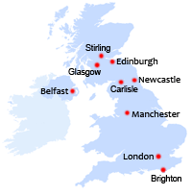
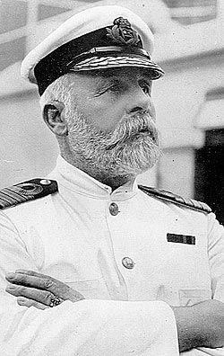
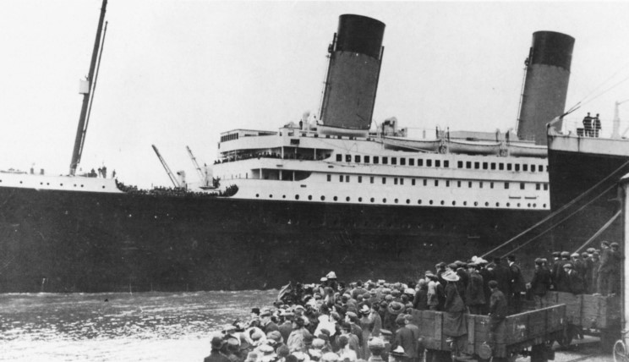
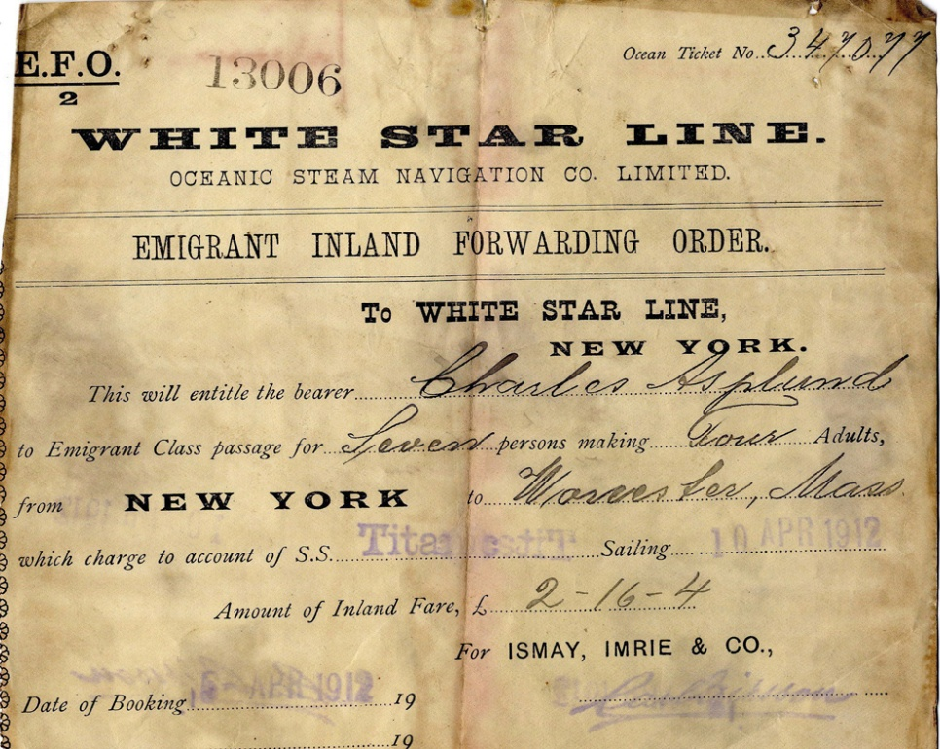
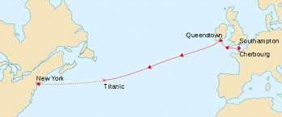
DEPARTURE
12TH APRIL 1912 Belfast (GBR)
At 1:30 pm
Capitan Edward J. Smith
885 people Crew
1 517 other passengers
1st, 2nd and 3rd class
Path: belfast- queenstone- southampton- cherbourg (aim new york)

Slide 6
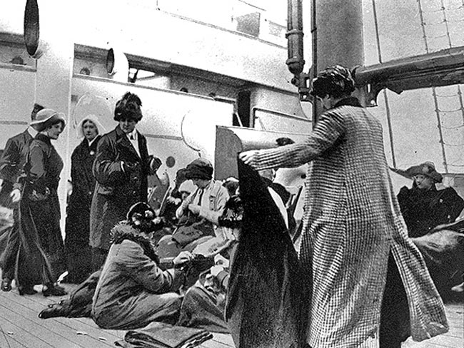
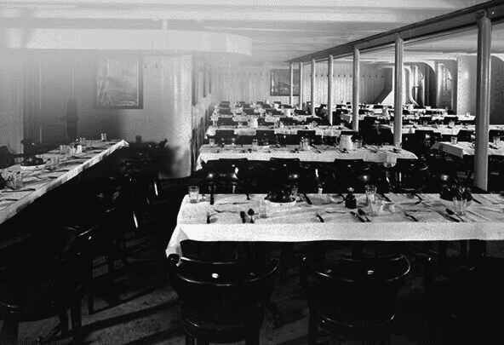
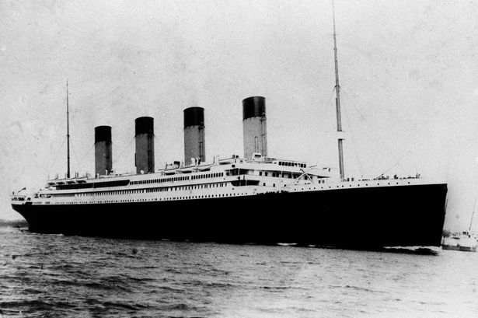
TRAVEL
3 DAYS (12TH, 13RD AND 14TH APRIL)
ATLANTIC OCEAN
PASENGERS- BREKFAS, LUNCH, DINNER (SOME TEA), Their PERSONAL interests

Slide 7
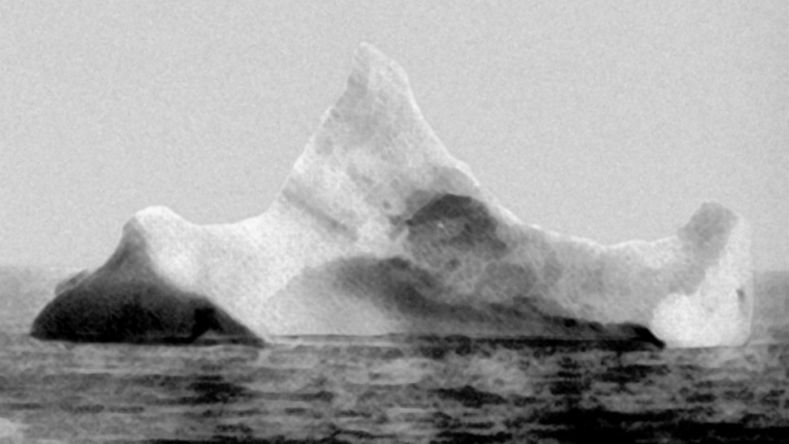
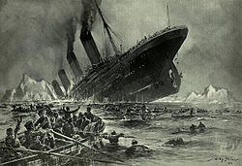
dive
Collision in ice rock in 14th april at 11:40 pm
Wather 6 flooded furnace
Survive 300 peopel
Daid 1 500 people
At 2:22 titanic forever disappear into the depths in atlantic ocean

Slide 8
Video and photos
https://www.youtube.com/watch?v=xD9-z6Nw2FM

Slide 9
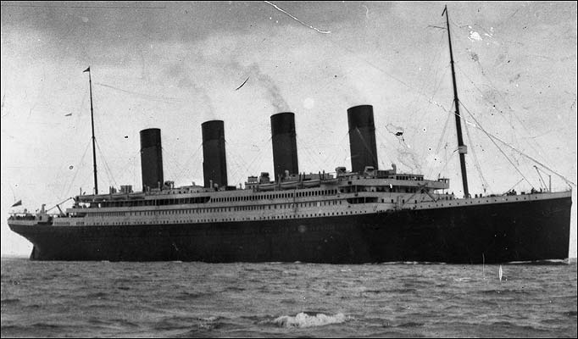

Slide 10
RESOURCES
WEB:
WIKIPEDIA
DIJASKI.NET
GOOGLE PHOTOS
YOUTUBE

