Slide 1
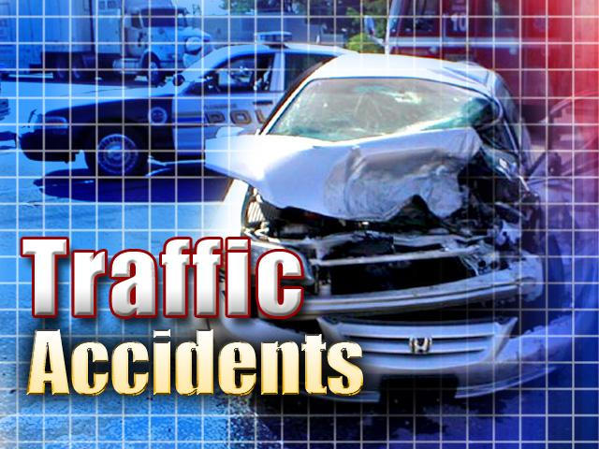
Srednja zdravstvena šola Ljubljana

Slide 2
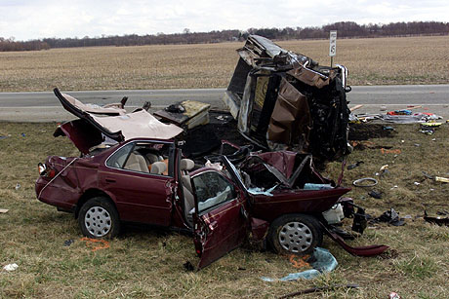
What is a traffic accident?

Slide 3
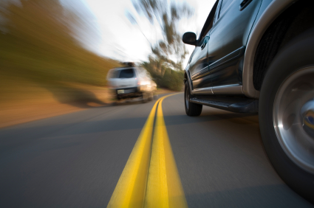
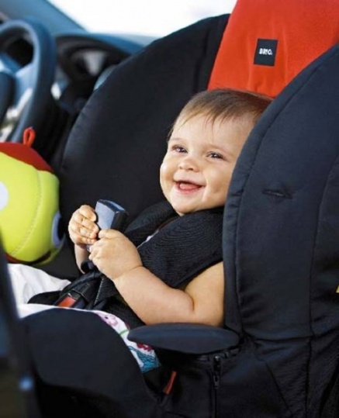
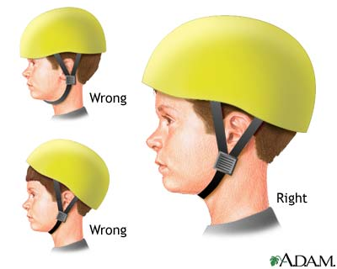
Facts about traffic accidents
Fact 1
Fact 2
Fact 3 Speeding
Fact 4 Blood alcohol
Fact 5 Helmets
Fact 6 Seat-belts.
Fact 7 Child restraints
Fact 8 Pedestrians and cyclists

Slide 4
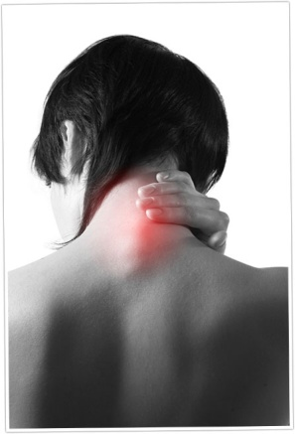
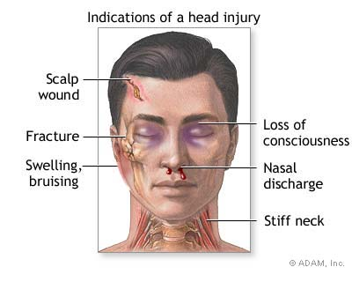
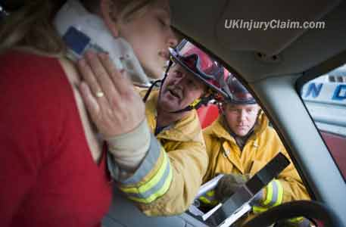
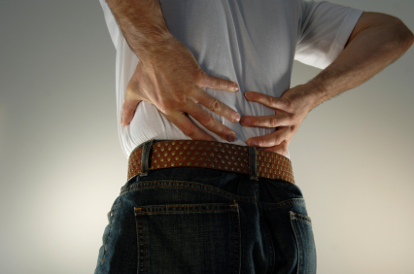
Most common injuries
Face and Head Injuries
Brain Injuries
Neck Injuries
Shoulder and Arm Injuries
Back Injuries
Leg, Knee and Foot Injuries
Psychological Injuries
Death

Slide 5
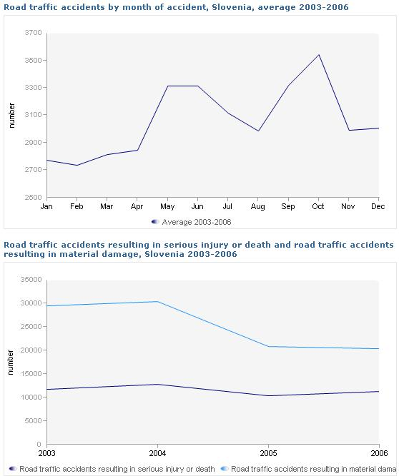
In Slovenia
300 car accident fatalities per year, which translates into about 23 per 100,000 people- very high and one of the highest in Europe.

Slide 6
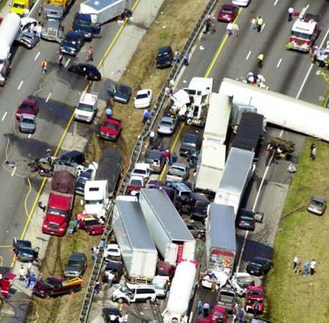
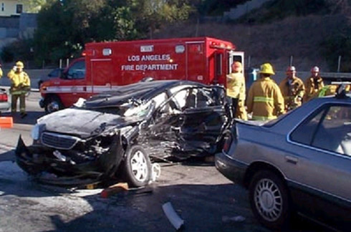
Factors for causing a car accident
1. Equipment Failure
2. Roadway Design
3. Poor Roadway Maintenance
4. Driver Behavior

Slide 7
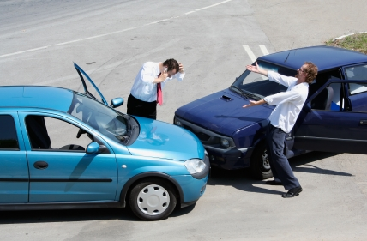
What must a driver involved in a traffic accident do
A driver involved in a traffic accident should stop if:
- anyone, other than themselves, is injured; or
- another vehicle, or someone else’s property, is damaged; or
- an animal in another vehicle or running across the road is injured; or
- a bollard, street lamp or other item of street furniture is damaged.

Slide 8
http://www.youtube.com/watch?v=Y7lCM9ElUqQ

