Slide 1
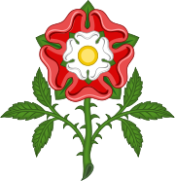
THE TUDORS
-enter name here-

Slide 2
-THE TUDORS WERE ENGLISH RULERS WHO REIGNED ENGLAND FROM 1458 TO 1603
-They were very powerful and are known to have had lots of people executed

Slide 3
There were five Tudor kings and queens:
-Henry VII
-Henry VIII
-EDWARD VI
-Lady Jane Grey
-Mary I
-Elizabeth I

Slide 4
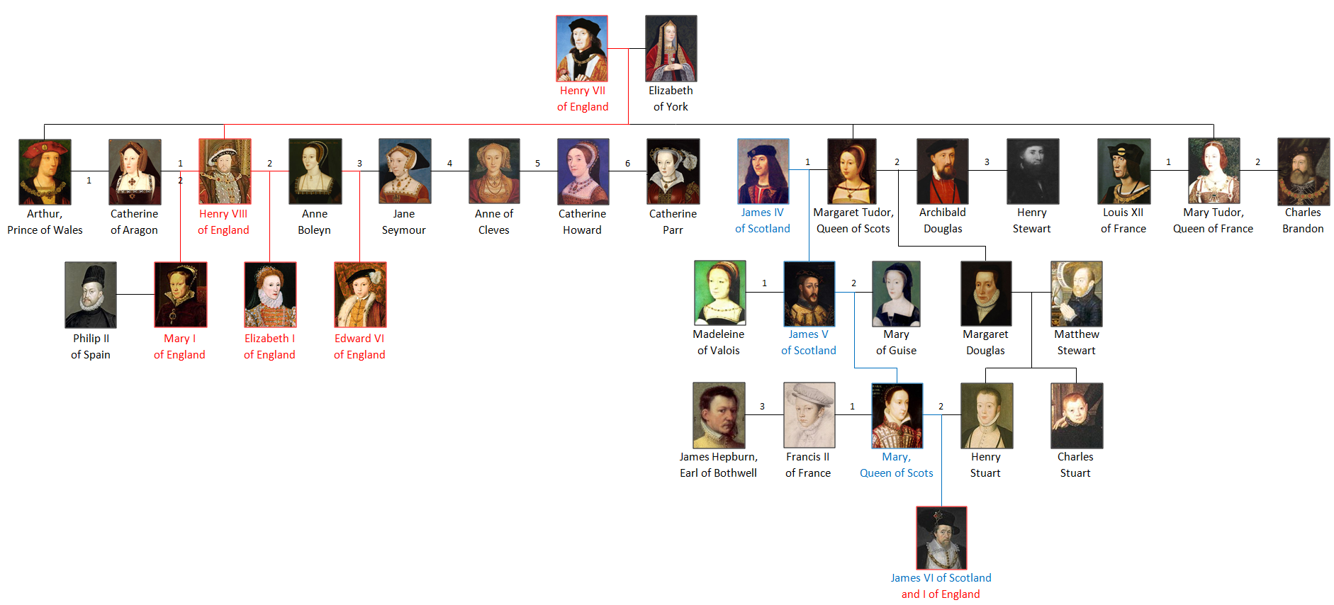
The Tudor Family Tree

Slide 5
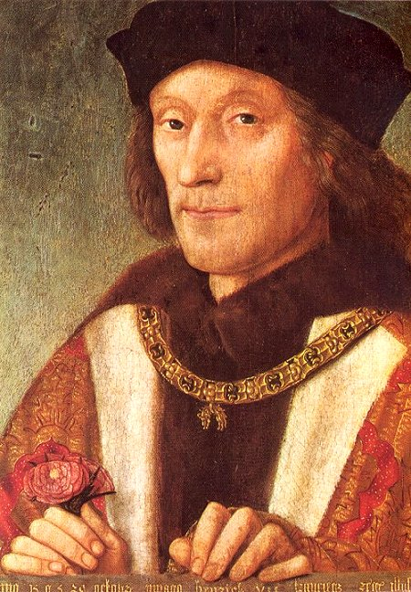
Henry VII
-Henry VII was the first Tudor king
-He was born on 28. January 1457 and died on 21. April 1509

Slide 6
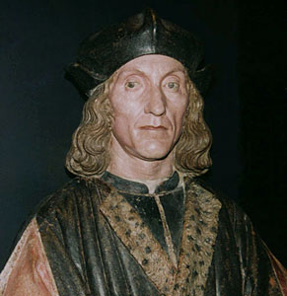
-HE BECAME KING BY DEFEATING RICHARD III AT THE BATTLE OF BOSWORTH IN 1485, ending the wars of the roses
-He married elizabeth york-the daughter of his enemy edward iv

Slide 7
-He then went on to forge international relationships
through the marriages
of his children

Slide 8
The Wars of the Roses
-The wars of the roses were a series of battles, fought between the houses of Lancastre and York
-THEY are called the wars of the roses because the Yorkists were represented by a white rose and the Lancastrians
by a red rose
+
=

Slide 9
THE BATTLE OF BOSWORTH
-THE BATTLE OF BOSWORTH WAS A BATTLE WHICH HAPPENED BY THE NEIGHBOURING TOWN OF MARKET BOSWORTH
-IT WAS FOUGHT BETWEEN THE ARMIES OF HENRY VII AND RICHARD III, WHO WERE ACTUALLY DISTANT RELATIVES

Slide 10
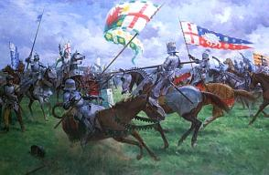
-RICHARD’S ARMY WAS FAR GREATER IN NUMBERS BUT IT WAS NONETHELESS DEFEATED
-WITH THIS QUITE SPECTACULAR VICTORY HENRY WON HIMSELF THE RIGHT TO THE THRONE

Slide 11
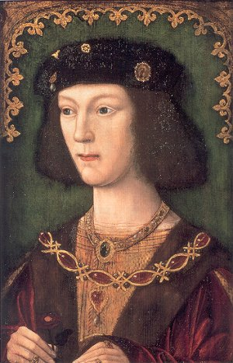
Henry VIII
-He was born on 28. June 1491 and died on 28. January 1547
-He was the second son of Henry VII and became heir when his older brother arthur died

Slide 12
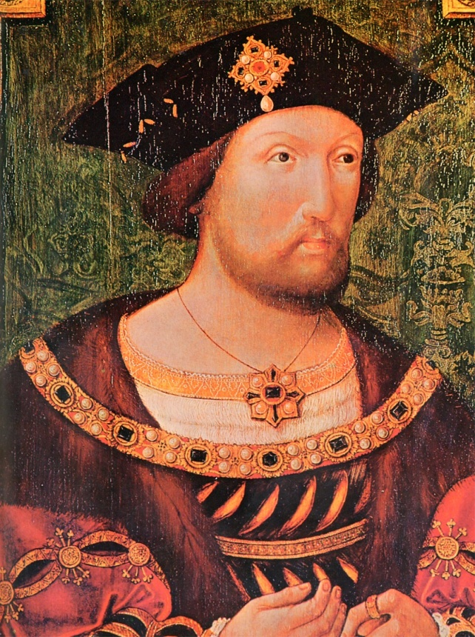
-Spain and England wanted to keep their alliance even after Arthur’s death so Henry married Catherine of Aragon-Arthur’s widow
-After 20 years she still didn’t bear him a son, ONLY A DAUGHTER MARY, so he wanted to get a divorce

Slide 13
-UNLUCKILY FOR HIM DIVORCES WERE PROHIBITED BY THE CATHOLIC CHURCH AT THE TIME
-HE TOLD CARDINAL WOLSEY TO ASK THE POPE FOR SPECIAL PERMISSION, BUT HE WAS REFUSED
-SO HE USED THAT AS A REASON TO CREATE THE CHURCH OF ENGLAND, WITH HIMSELF AS THE SUPREME HEAD

Slide 14
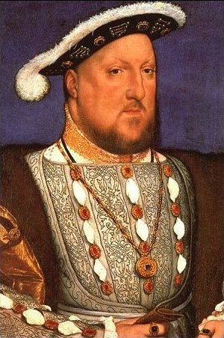
-HIS FIRST ACT, OF COURSE, WAS TO DIVORCE CATHERINE OF ARAGON
-AFTER DIVORCING CATHERINE OF ARAGON HENRY QUICKLY MARRIED ANNE BOLEYN WHO GAVE BIRTH TO HIS SECOND DAUGHTER ELIZABETH I

Slide 15
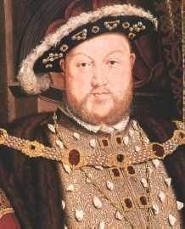
-LATER HE HAD ANNE BEHEADED AT THE TOWER OF LONDON FOR ADULTERY AND INCEST
-HIS THIRD WIFE JANE SEYMOUR FINALLY BORE HIM A SON-EDWARD VI, BUT HE DIED A FEW years LATER

Slide 16
-HE WENT ON TO MARRY ANNE OF CLEVES BUT IT ONLY LASTED 6 MOnTHS AND HE GOT OUT BY SAYING THAT HE WAS IMPOTENT ON THE WEDDING NIGHT (MARRIAGE HAD TO BE SEALED THROUGH SEXUAL RELATIONS)
-HE THEN MARRIED CATHERINE HOWARD, A 17 YEAR OLD, WHO WAS SOON BEHEADED FOR ADULTERY
-SO HENRY MARRIED FOR THE SIXTH AND FINAL TIME TO CATHERINE PARR

Slide 17
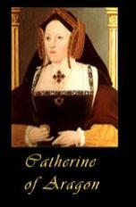
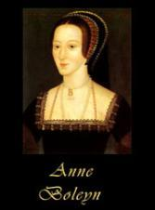
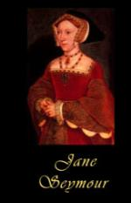
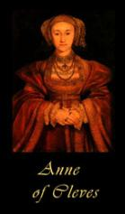
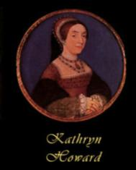
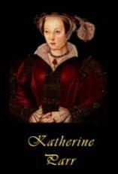

Slide 18
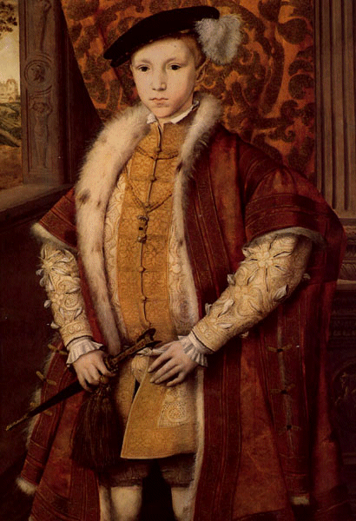
EDWARD VI
-HE WAS BORN ON 12TH OCTOBER 1537 AND DIED ON 6TH JULY 1553
-EDWARD WAS THE SON OF HENRY VIII AND JANE SEYMOUR

Slide 19
-HE WAS A PROTESTANT WHO BECAME KING AT THE AGE OF 9
-HE WAS ILL ALMOST ALL OF HIS LIFE AND HE DIED AT THE AGE OF 16
-DURING HIS REIGN, ENGLAND WAS MOSTLY UNDER THE RULE OF EDWARD’S COUNCIL, WHICH INCLUDED THOMAS SEYMOUR

Slide 20
-Elizabeth fell in love with seymour and he wanted to marry either her or Mary
-but both of them could marry him only with the agreement of the entire council, so he married Henry’s widow Catherine Parr instead
-When Catherine Parr died, she left all to Thomas Seymour in her will

Slide 21
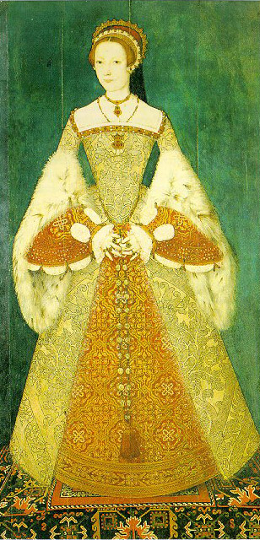
Lady Jane Gray
-Lady Jane Gray was chosen to be the queen because she was protestant, although she had no right to the throne
-after just nine days of ruling she had to leave the throne and was later beheaded

Slide 22
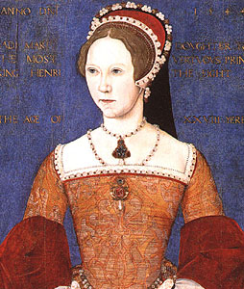
Mary I
-Mary I was born on 18th February 1516 and died on 17th November 1558
-She was the daughter of Henry VIII and Catherine of Aragon

Slide 23
-as queen she attempted to restore catholicism
-she married Philip of Spain
-she is known as the Bloody Mary because of all the protestants she had executed for not returning to catholic church

Slide 24
-Philip later on left her in pursuit of other kingdoms
-he managed to take England to war with France, and the English lost the fort of Calais
-Mary’s regime had failed and when she died peacefully, Elizabeth suceeded to the throne

Slide 25
Elizabeth I
-she was the daughter of Henry VIII and Anne Boleyn
-she became queen after Mary’s death without an heir

Slide 26
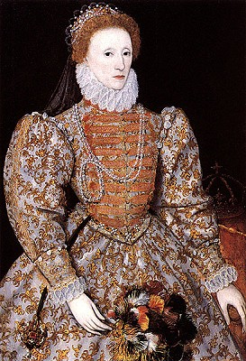
-Elizabeth reinstalled the church of England
-She was determined to increase England’s power and strongly supported explorers like
Drake and Raleigh
in their efforts to
increase England’s
wealth

Slide 27
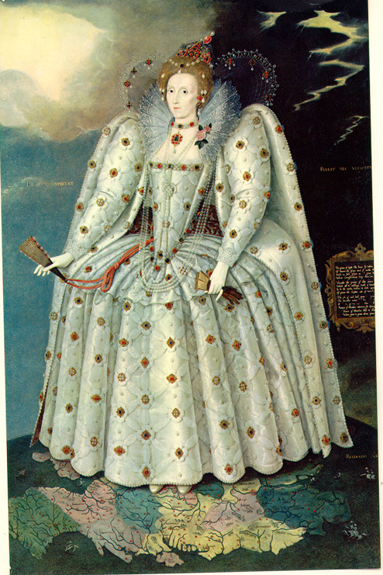
-she suceeded and England becAME THE MOST POWERFULL COUNTRY IN THE WORLD
-SHE ALSO SWORE NEVER TO MARRY AND IS SINCE KNOWN AS THE VIRGIN QUEEN
-SHE NEVER HAD ANY CHILDREN AND SO THE TUDOR AGE ENDED WITH HER

Slide 28
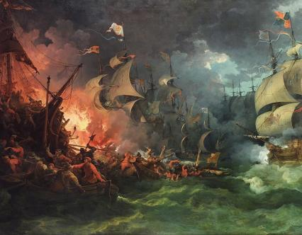
DEFEATING THE SPANISH ARMADA
-PHILIP II, KING OF SPAIN WANTED ENGLAND TO BE A CATHOLIC COUNTRY, SO HE DECIDED TO INVADE
-HE SENT 131 SHIPS TO ATTACK ENGLAND’S SHORES

Slide 29
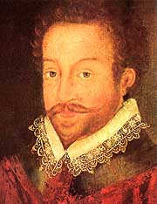
-ELIZABETH MADE SIR FRANCIS DRAKE THE HEAD OF THE ENGLISH NAVY AND TOLD HIM, DESPITE HAVING HALF THE spanish STRENGTH, TO KEEP THE FORCES AT BAY
-HE, BEING A GREAT TACTICIAN, DEFEATED THE SPANIOLS

Slide 30
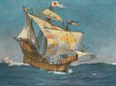
THE TUDOR TIMELINE
1485-HENRY VII WINS THE BATTLE OF BOSWORTH AND BECOMES KING OF ENGLAND
1492-1498-THE AGE OF DISCOVERY BEGINS

Slide 31
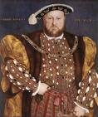
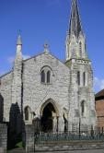
1509-HENRY VII DIES, HENRY VIII BECOMES KING
1534-HENRY CREATES THE CHURCH OF ENGLAND

Slide 32
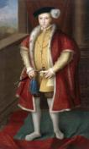
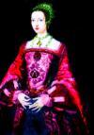
1547-EDWARD VI BECOMES KING, BUT SUDDENLY DIES AT THE AGE OF 16
1553-LADY JANE GRAY WAS QUEEN FOR 9 DAYS-THE SHORTEST REIGN EVER

Slide 33
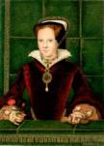
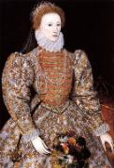
1553-MARY I BECOMES QUEEN AND IS QUICKLY KNOWN AS THE BLOODY MARY
1558-ELIZABETH I BECOMES QUEEN; DURING HER REIGN ENGLAND BECOMES MORE POWERFUL

Slide 34
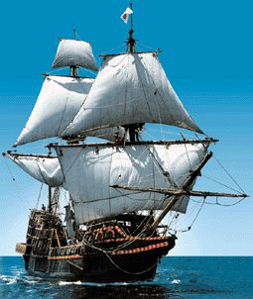
1570-1577-SIR FRANCIS DRAKE DISCOVERS THE WEST INDIES AND SAILS RIGHT AROUND THE GLOBE
1588-THE SPANISH ARMADA IS DEFEATEN BY DRAKE

Slide 35
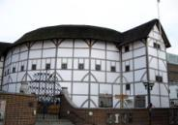
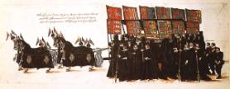
1591-WILLIAM SHAKESPEAR’S FIRST PLAY WAS PERFORMED
The
end
1603-ELIZABETH I, THE LAST OF THE TUDORS DIES; KING JAMES OF SCOTLAND TAKES OVER ENGLAND

Slide 36
TRUE or FALSE?!
1.Henry VIII was the first Tudor monarch.
2. Henry VII defeated Richard III at the battle of
Bosworth Field.
3. Henry VIII had 8 wives.
4. Henry VIII founded the Church of England.

Slide 37
5. Edward VI was Henry VIII's only surviving son.
6. Lady Jane Grey was queen for 21 days.
7. Mary I married Philip II of Spain.
8. Elizabeth I became queen in 1558.
9. Elizabeth I had several husbands.

Slide 38
THAT
WOULD
BE
ALL

Slide 39
THANK YOU FOR LISTENING and I HOPE YOU ENJOYED MY PRESENTATION
NOW PLEASE feel free to ask some questions!

Slide 40
http://en.wikipedia.org/wiki/Tudor_dynasty
http://www.spartacus.schoolnet.co.uk/Tudors.htm
http://www.primaryresources.co.uk/history/history3.htm
http://www.chiddingstone.kent.sch.uk/homework/Tudors.html
http://tudorhistory.org/
http://www.historyonthenet.com/Tudors/tudorsmain.htm
-VARIOUS ESSAYS, PRESENTATIONS
RESOURCES

