Slide 1
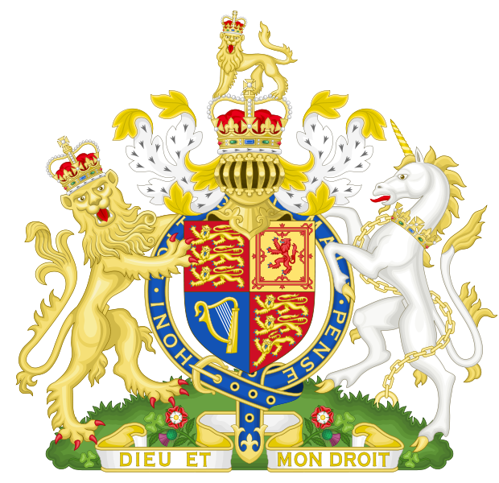
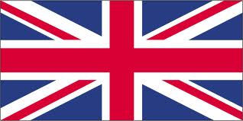
United Kingdom of Great Britain

Slide 2
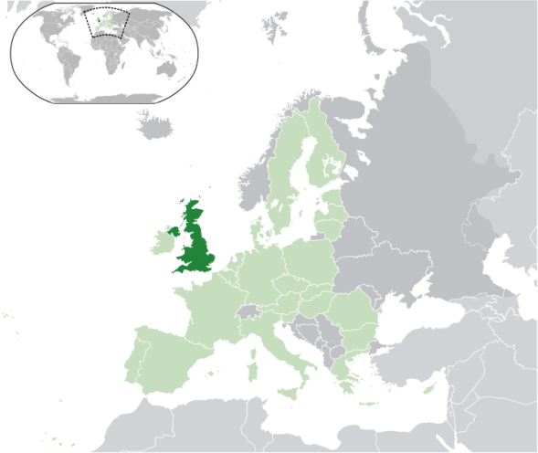
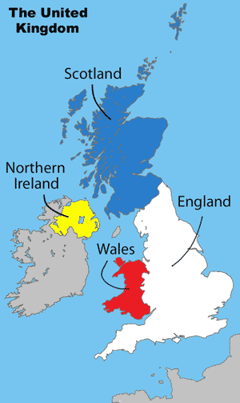
The United Kingdom
The UK is a state in northwest Europe.
It is made up of four countries: England, Northern Ireland, Scotland and Wales.

Slide 3
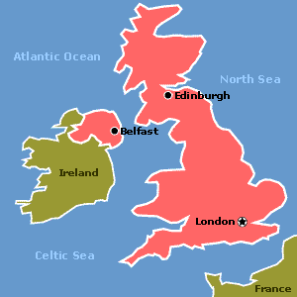
Languages
Most people in the UK speak English, but there are 5 native languages other than English: Welsh, Gaelic, Scots, Irish and Cornish

Slide 4
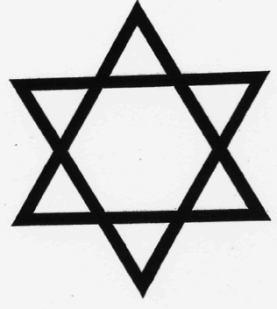
Religions
About 61 million people live in the UK.
Its multi-religion country. The most popular religions are Christianity, Muslim and Jewish.

Slide 5
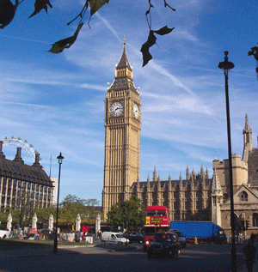
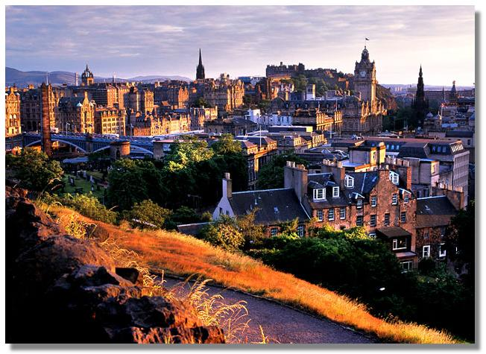
Cities
The capital city is London with 8 million inhabitants.
Other big cities are: Edinburgh, Cardiff, Belfast and Manchester.

Slide 6
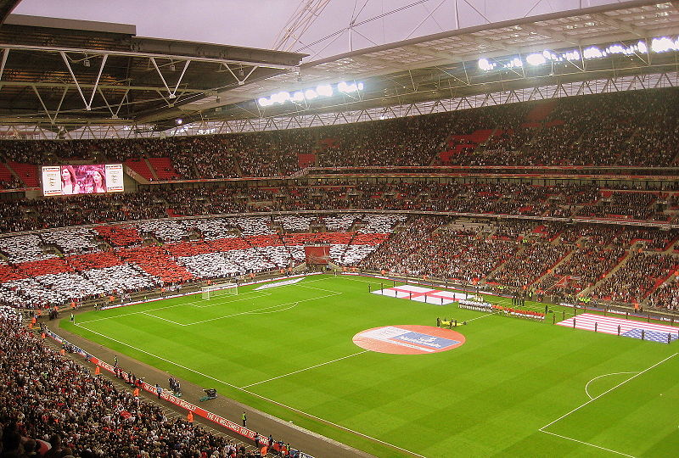
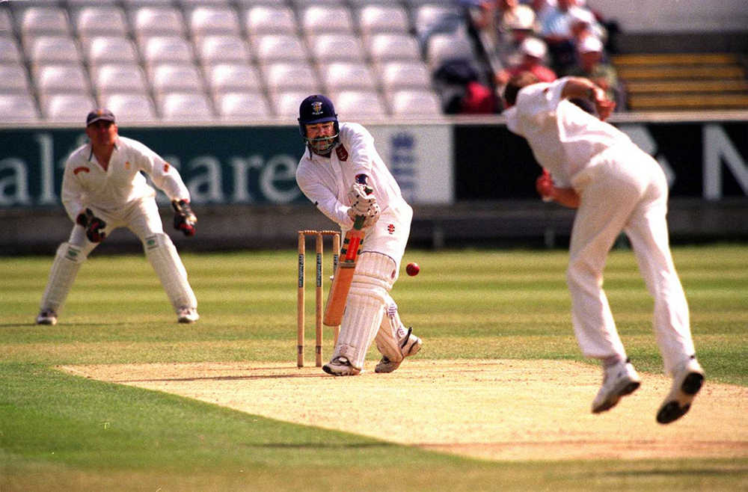
Sports
Sports are very popular in the UK. The most popular sport is football. Other popular sports are cricket and rugby

Slide 7
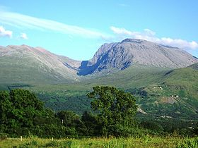
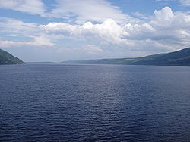
Countryside
The country side of UK is very diverse.
The highest mountain is Ben Nevis and its 1,344 m high.
It is famous for its lakes and fields. The most famous lake is the lock ness.

Slide 8
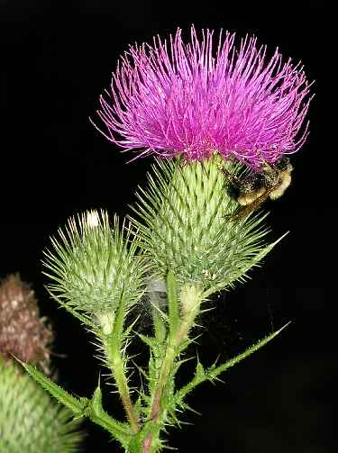
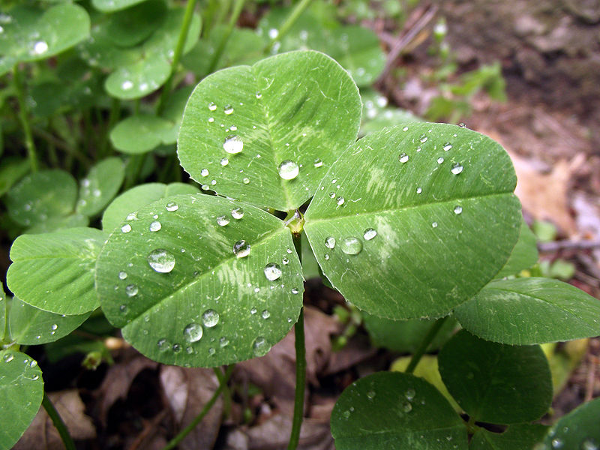
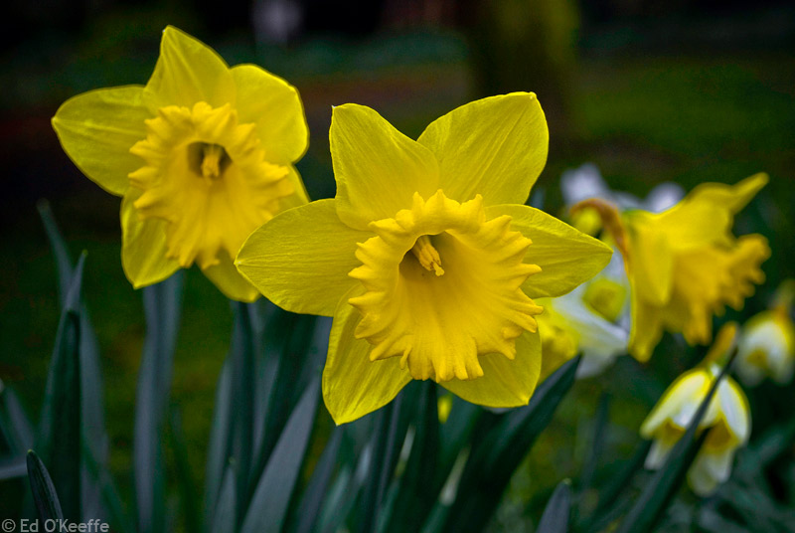
National flowers
The national flowers of UK are: shamrock is in Northern Ireland, daffodil in Wales and thistle in Scotland.

Slide 9
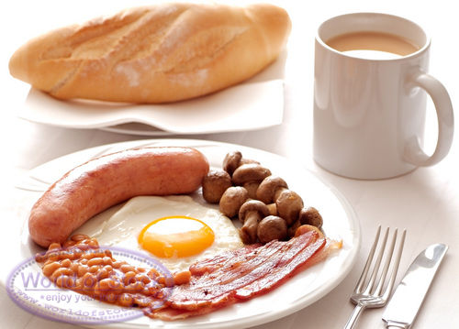
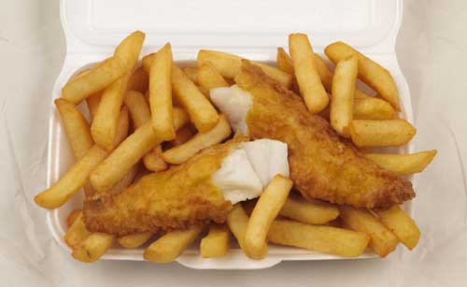
Traditional food
Traditional breakfast is eggs, beacon, sausage and some beans.
The most popular lunch is fish & chips.

Slide 10
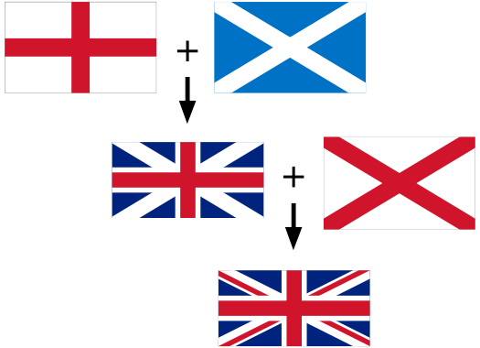
Union Jack
The United Kingdom national flag is called the Union Jack.
It is made up from the flags of: England, Scotland and Northern Ireland

Slide 11
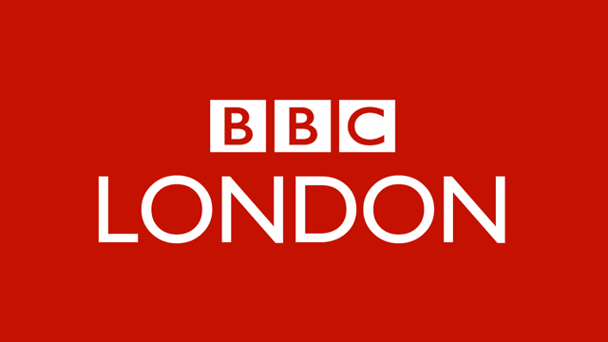
Media
The most popular TV channel is BBC, and the most popular newspaper is The Sun.

Slide 12
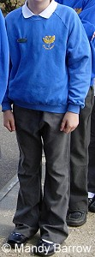
Education
Primary education: (6-11)
Secondary education: (11-18)
Tertiary education: (18+)
some schools in England require children to wear uniforms.

Slide 13
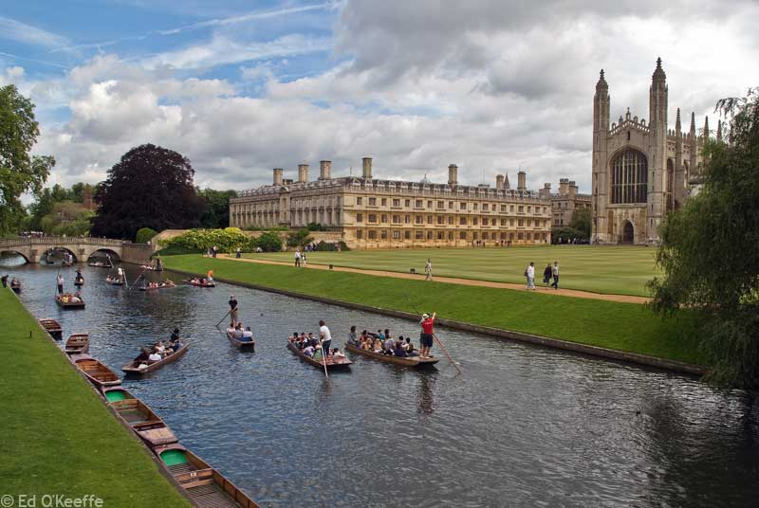
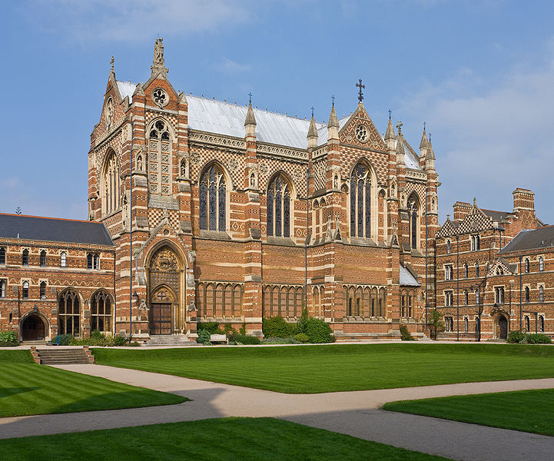
University
Britain’s most well known universities are the University of Cambridge, Oxford and London.

