Slide 1
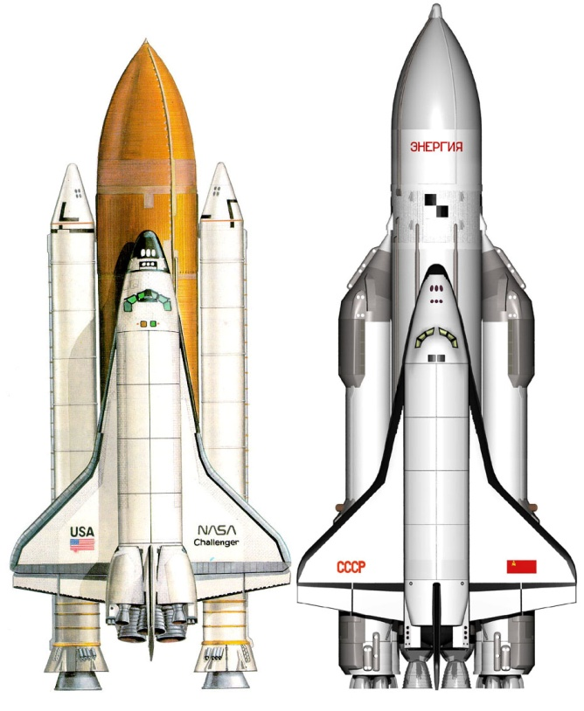
US and Russia in Space
Subject: English
Date: 25.2.2013

Slide 2
Space race:
US (NASA), Soviet Union (USSR)
Getting into space, Moon
4.10.1957 – Sputnik 1
April 169 – Vostok 1 (Yuri Gagarin)
Astronauts, cosmonauts
Moon-Apollo 8, 11
Russians: human in space
Americans: human on the Moon

Slide 3
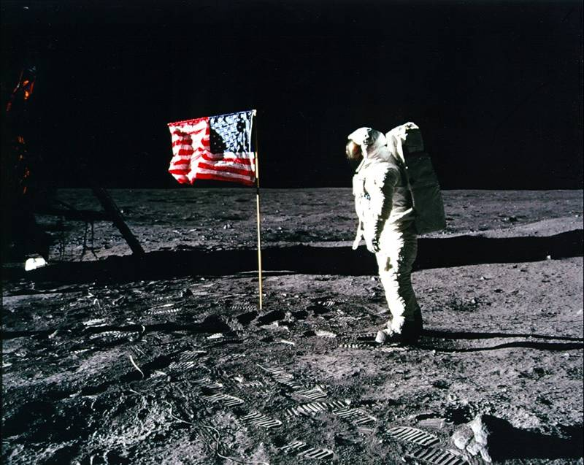
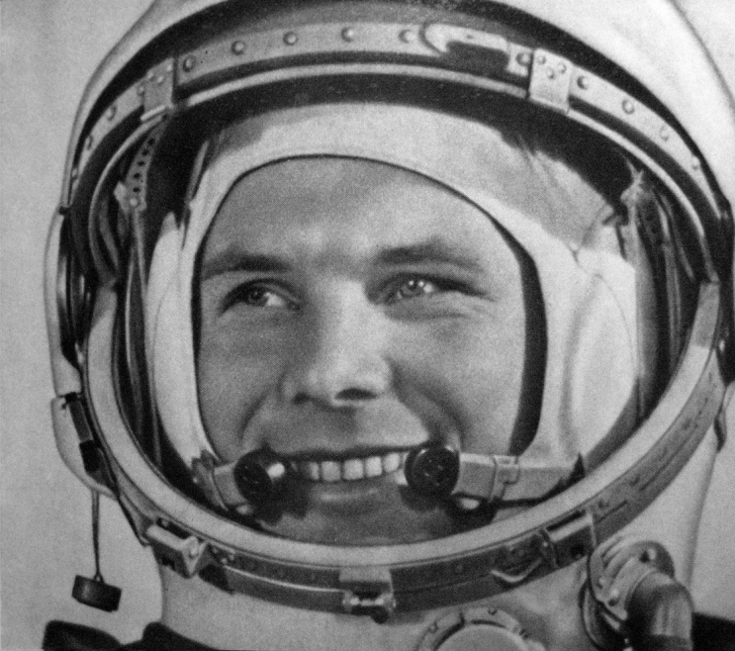
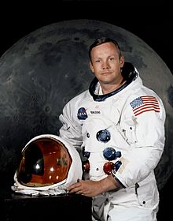
Neil Armstrong:
“That's one small step for man, one giant leap for mankind.”

Slide 4
Nowadays:
End of Union of Soviet Socialist Republics (USSR)
NASA focusing on Mars
Russia continue USSR's program
Both countries trying to implement space tourism.

Slide 5
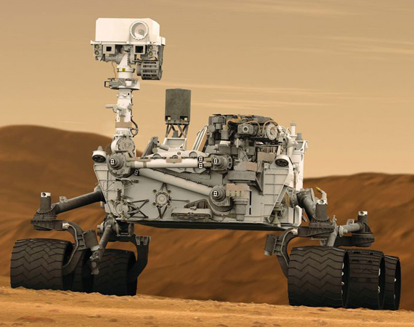
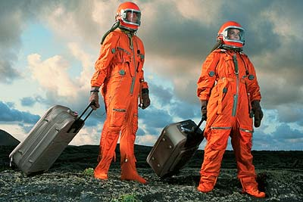

Slide 6
Space Tourism:
Soyuz (2013)
Virgin Galactic:
White Knight
White Knight 2
Russia $20-40milion
US less then $200.000

Slide 7
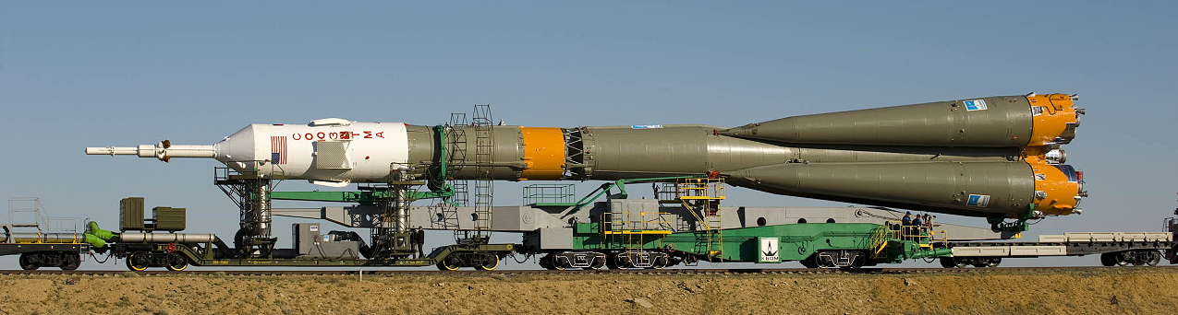
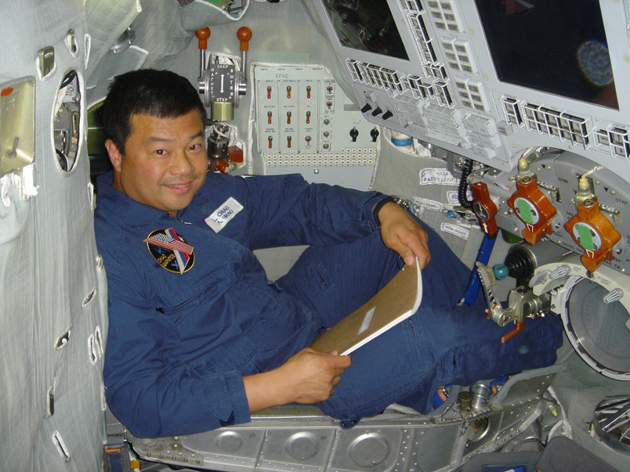

Slide 8
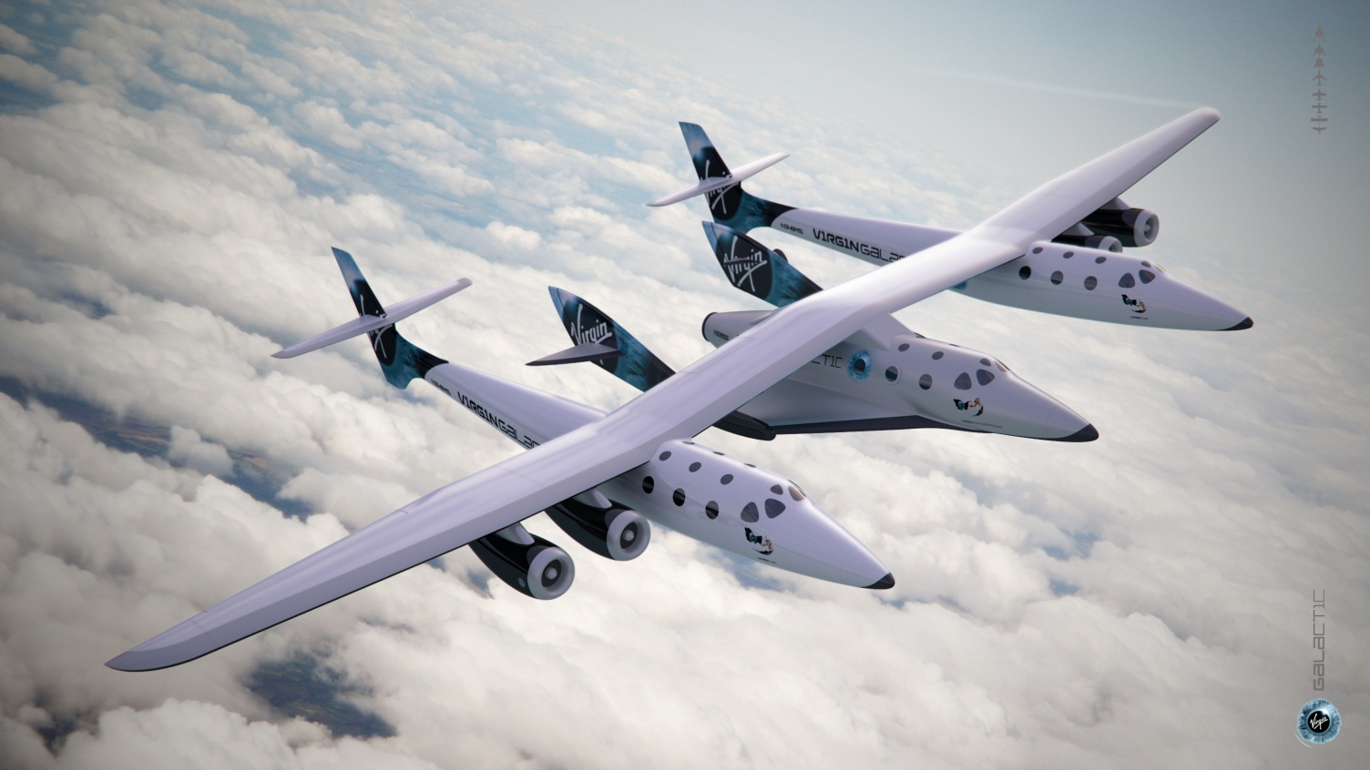
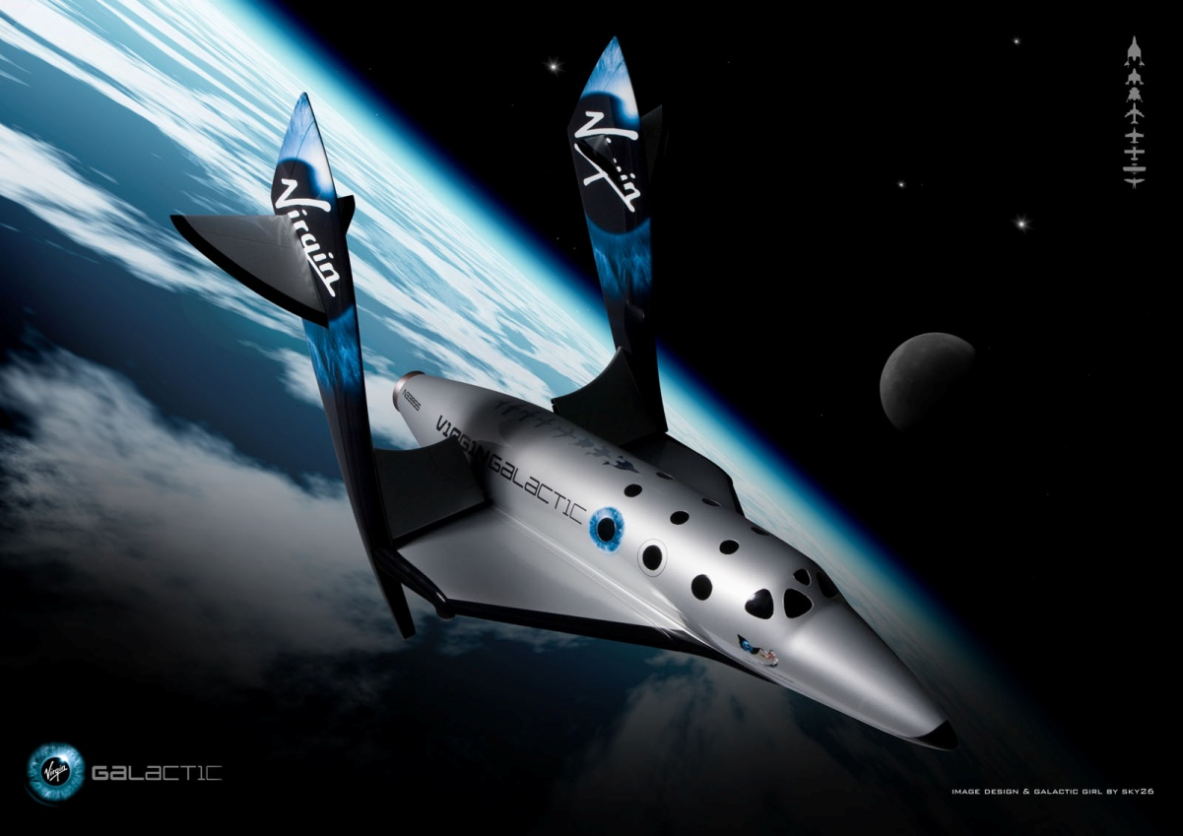
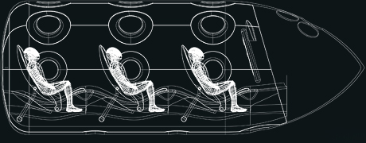

Slide 9
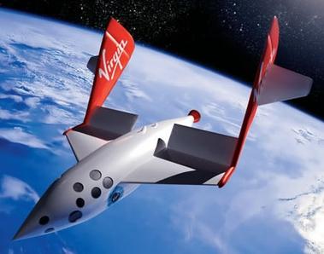
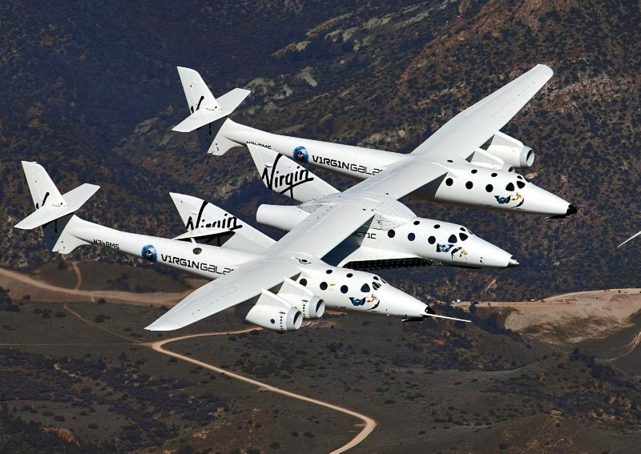
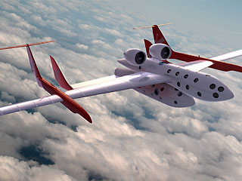
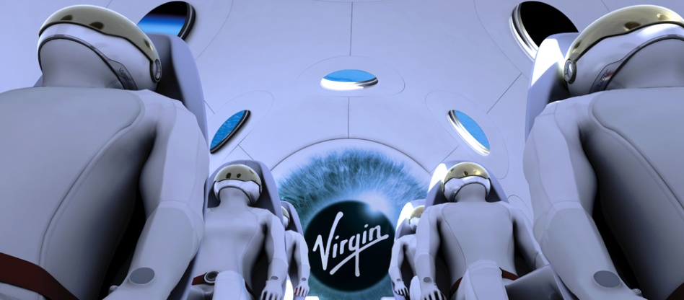

Slide 10
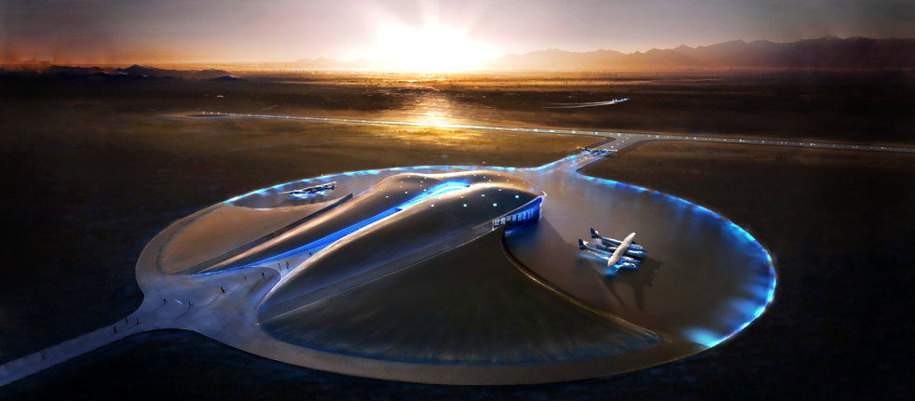
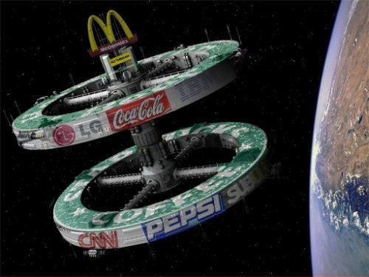
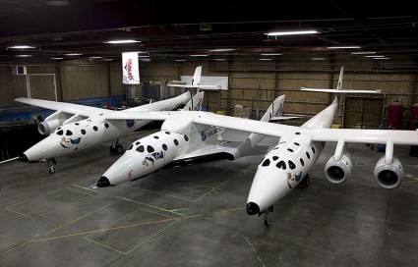

Slide 11
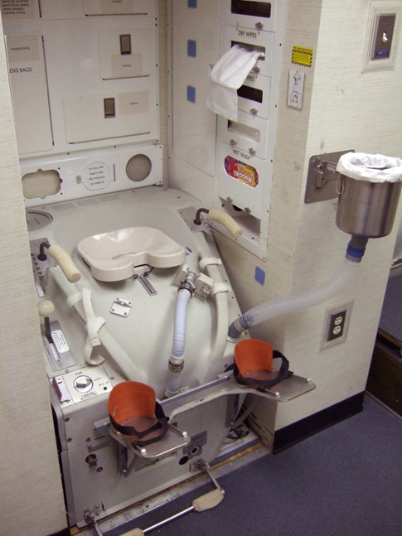
My opinion:
United states of America
NASA

Slide 12
Sources:
Internet:
Space race http://en.wikipedia.org/wiki/Space_Race
Nasa http://mars.jpl.nasa.gov/m2020/
Virgin Galactic http://www.virgingalactic.com/ , http://en.wikipedia.org/wiki/Virgin_Galactic
http://en.wikipedia.org/wiki/Space_tourism

Slide 13
Sources:
Images:
http://www.buran.fr/bourane-buran/img/STS-Buran-grand.jpg
http://historymartinez.files.wordpress.com/2010/10/space-race.jpg
http://www.ast.cam.ac.uk/sites/default/files/assets/images/outreach/gagarin.jpg
http://www.sdtimes.com/blog/image.axd?picture=2012%2F8%2Fnasa-NASA-curiosity-mars-rover-00.jpg
http://twimg0-a.akamaihd.net/profile_images/188302352/nasalogo_twitter.jpg
http://www.dailygalaxy.com/photos/uncategorized/2008/08/11/space_tourism_2.jpg
http://www.operatorchan.org/arch/src/134494227953.jpg
http://limjunying.files.wordpress.com/2008/10/virgin-galactic-in-flight.jpg
http://www.nss.org/tourism/SpaceShipTwo-1600.jpg
http://upload.wikimedia.org/wikipedia/en/1/1d/Virgin_Galactic.png
http://www.virgingalactic.com/assets/img/overview/spaceport/banner.jpg
http://americaspace.com/wp-content/uploads/2012/02/800px-SS2_and_VMS_Eve-425x272.jpg
http://img1.loadtr.com/b-402834-Space_tourism.jpg
http://cdn.inquisitr.com/wp-content/2011/10/Virgin-Galactic.jpg
http://www.sharewonders.com/wp-content/uploads/2012/03/0_61_virgin_galactic.jpg

Slide 14
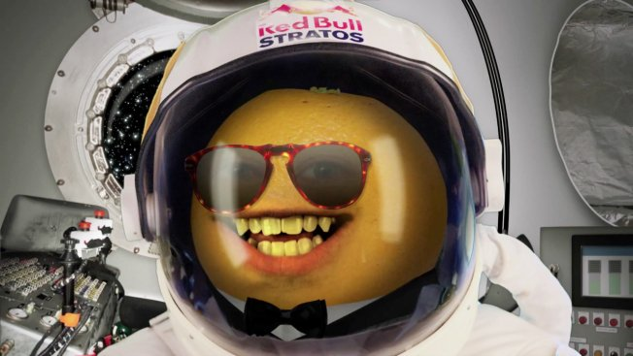
THANK YOU!

