Slide 1
USA
United States of America

Slide 2
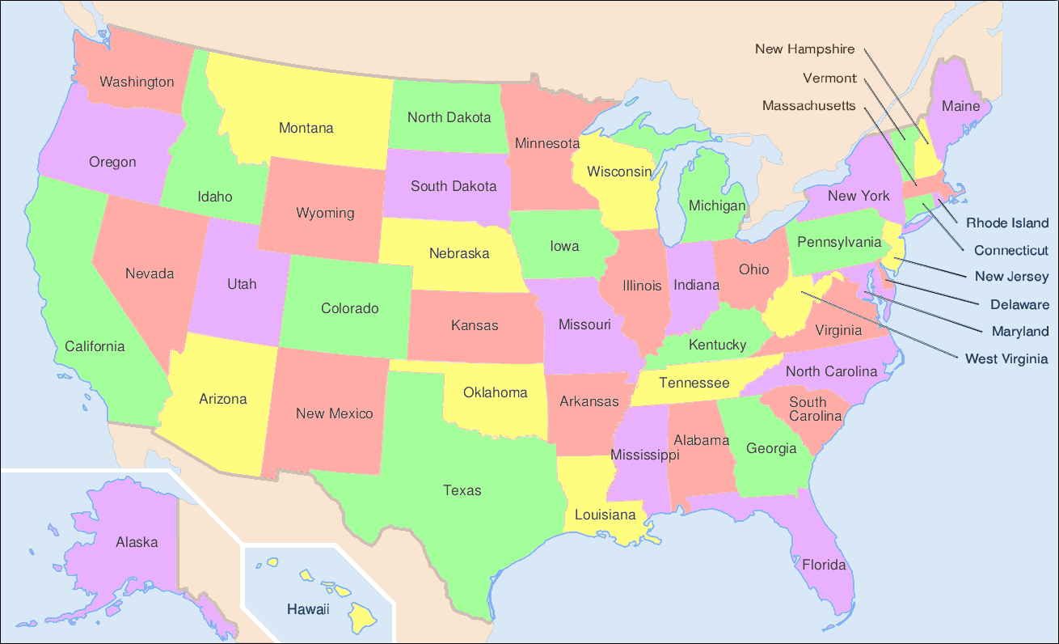
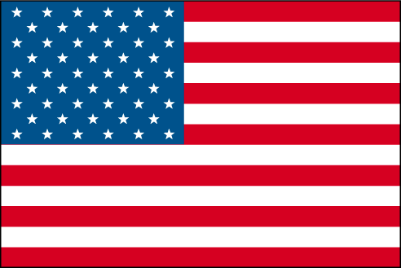
United States of America comprising fifty states and with 310 milion people is United States the third largest country in the world.
States
Flag

Slide 3
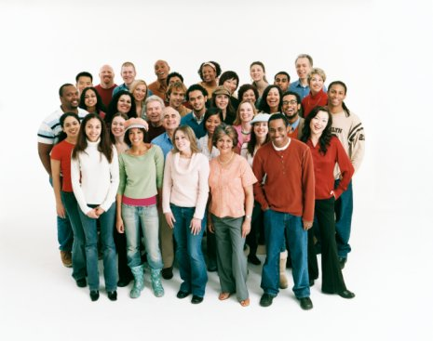
People in America
There lives nine different national group of people like: WHITE AMERICAN, AFRICAN AMERICAN, ASIAN AMERICAN, ALASKA NATIVE and others…
They speak different languages: ENGLISH, SPANISH, CHINISE, KOREAN, FRENCH, TAGALOG…

Slide 4
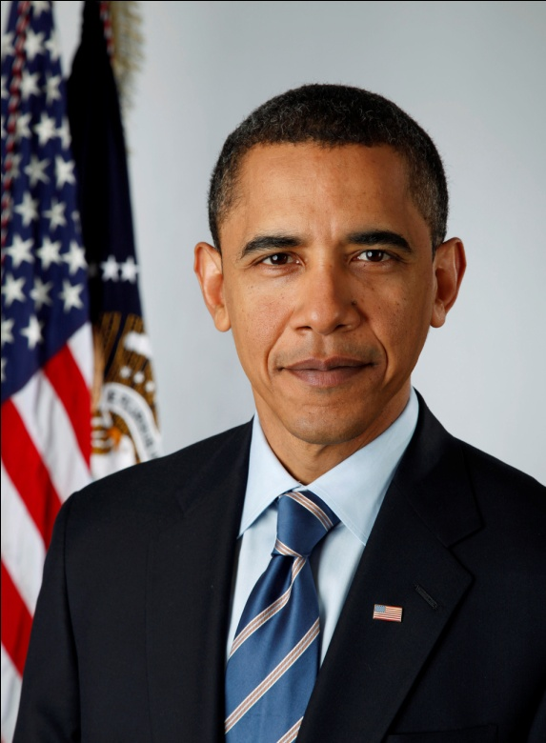
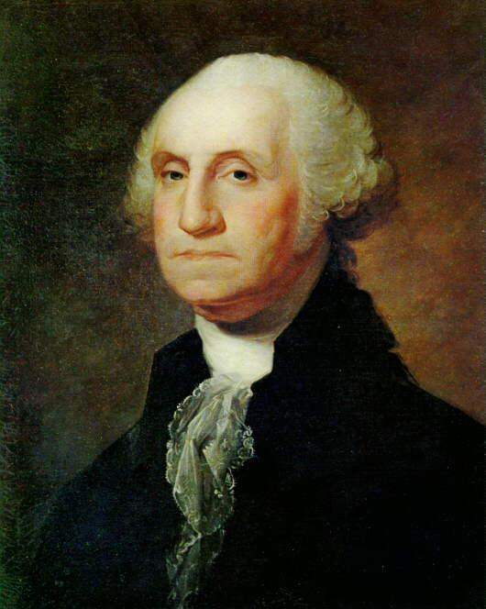
President in U.S.
President is the head of state and the head of government. First president in U.S. was George Washington and today is Brack Obama. President with his family live in White house in Washington D.C.
Brack
Obama
George
Washington

Slide 5
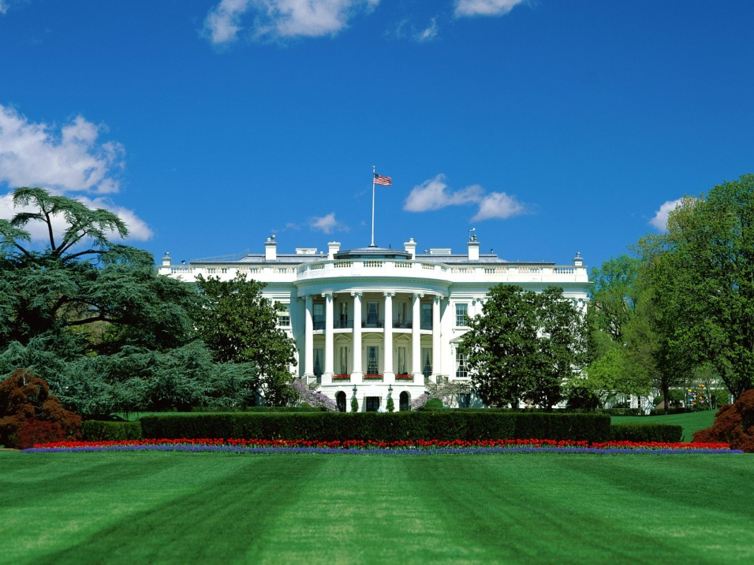
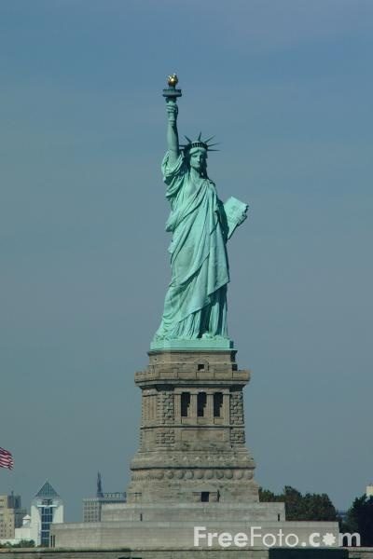
Capital City
The capital city in U.S. is Washington D.C.*, founded on July 16, 1790. In Washington DC you can visit a museum, capitol buildings, zoological park, national mall and more…
White house
* D.C. - district of columbia
Statue of Liberty

Slide 6
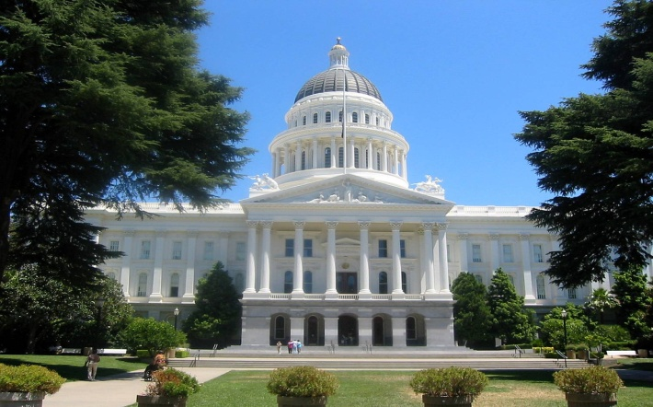
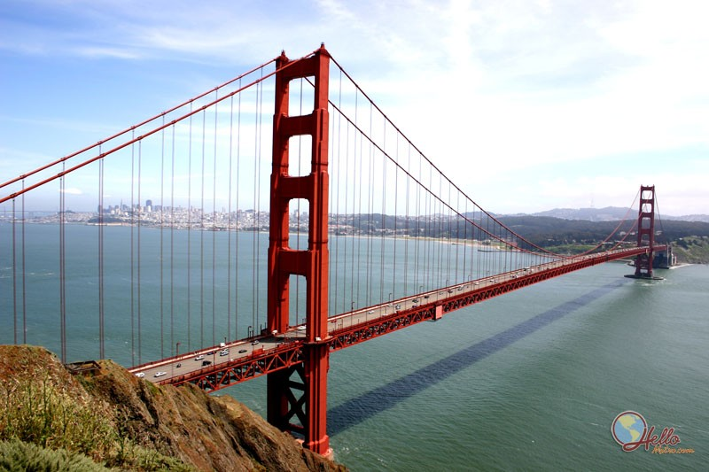
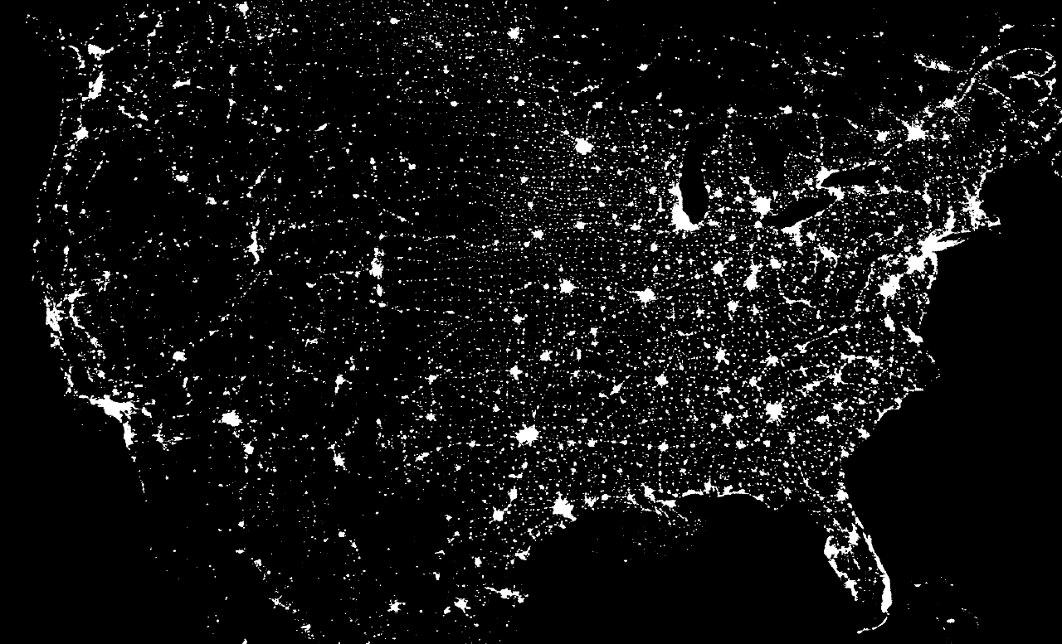
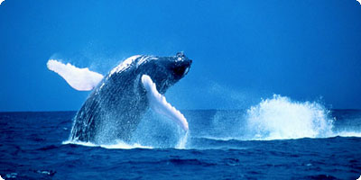
If you will visit USA someday I sugges that you visit California. Theres many things you can see…Like: The Golden Gate bridge in San Francisco, The California State Capitol building in Sacramento, Whale watching in Los Angeles… And much more… Soo if you have a chance visit California.

