Slide 1
VIDEO CARDS

Slide 2
Contens
What is video card?
History
Main Components
Advantages of Video Cards

Slide 3
What is video card?
Is hardware component
Function is to generate and output images to a display
Plugged is into a slot on the computer‘s motherboard

Slide 4
History
First video card was MDA in 1981
In 1995 first card was released

Slide 5
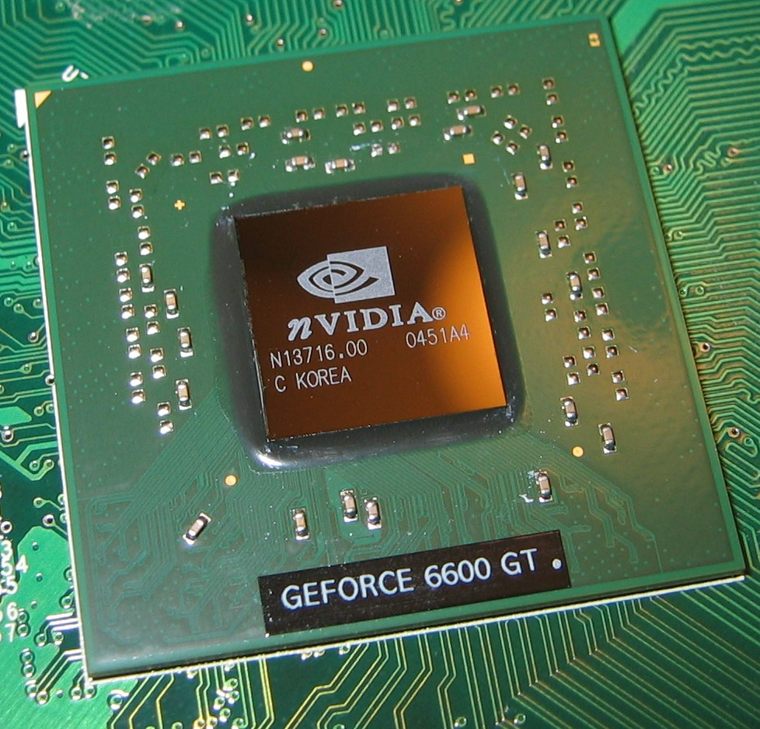
Main components
GPU

Slide 6
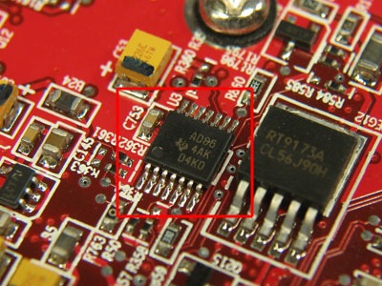
Video BIOS

Slide 7
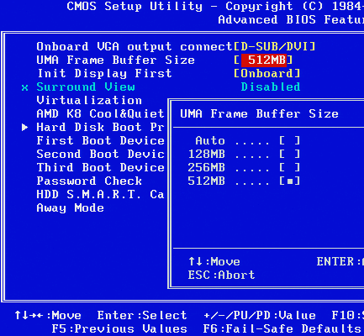
Video memory

Slide 8
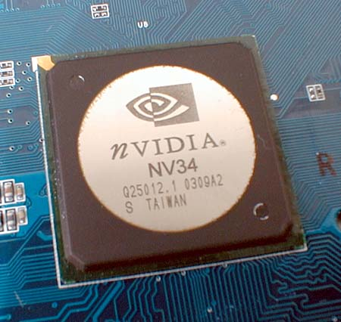
RAMDAC

Slide 9
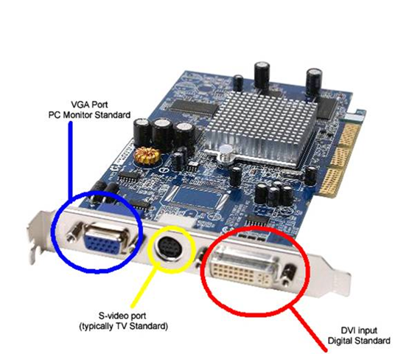
Outputs

Slide 10
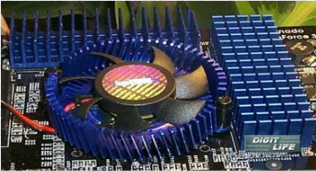
Cooling Devices
Motherboard Interface

Slide 11
Advantages of Video Cards
Anti-Aliasing
Motion Blur
Texture mapping
Depth of field

Slide 12
Summary
What is video card?
History
Main Components
Advantages of Video Cards

Slide 13
Conclusion
Now are ATI and NVIDIA biggest sellers of GPU-s.

Slide 14
QUESTION TIME

Slide 15
Sources
http://www.authorstream.com/Presentation/utpal.mecha-111419-graphics-card-rds-entertainment-ppt-powerpoint/

