Slide 1
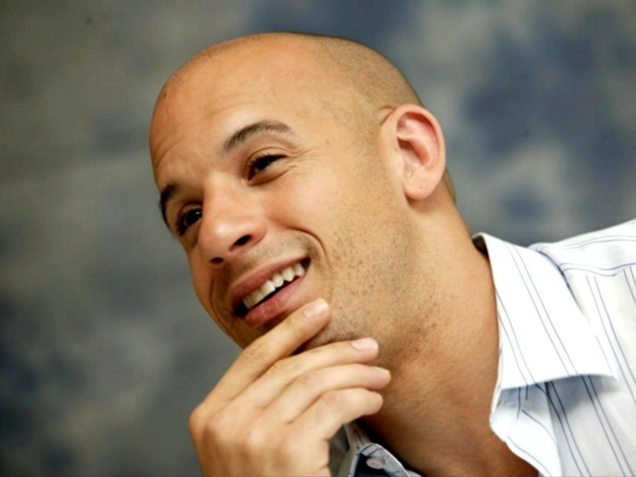
Mark Vincent Diesel

Slide 2
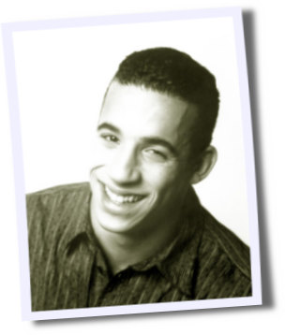
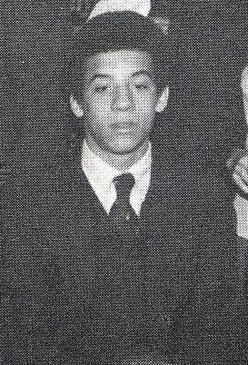
Born on 18. July 1967, New York City
Mother was an astrologer and a psycholagist, called Delora
His father taught theatre

Slide 3
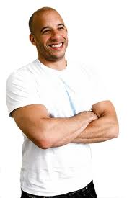
First stage performance at Theater for the New City at age of 7
Regularly acting for the New York Repertory company

Slide 4
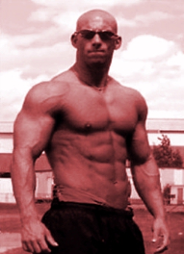
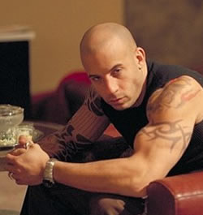
He was heavily into body building and extreme sports

Slide 5
First job as a bouncer at the nightclub
During the day act in various theater productions
Changed name to VIN DIESEL

Slide 6
Went to Holywood
Mom gave him a book "Feature Films at Used Car Prices„
Wrote a short film Multi-Factial ( Vin played the lead role, wrote the script, directed it and pruduced it.), Steven Spilberg was impressed ( the director of Saving private Ryan)

Slide 7
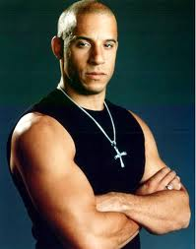
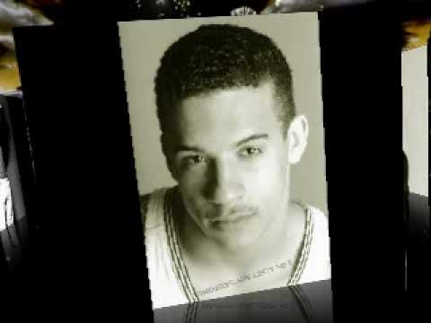
Multi racial looks
Before: disadvantage Now: advantage
He could pull of Asian, Latin American and African characters.

Slide 8
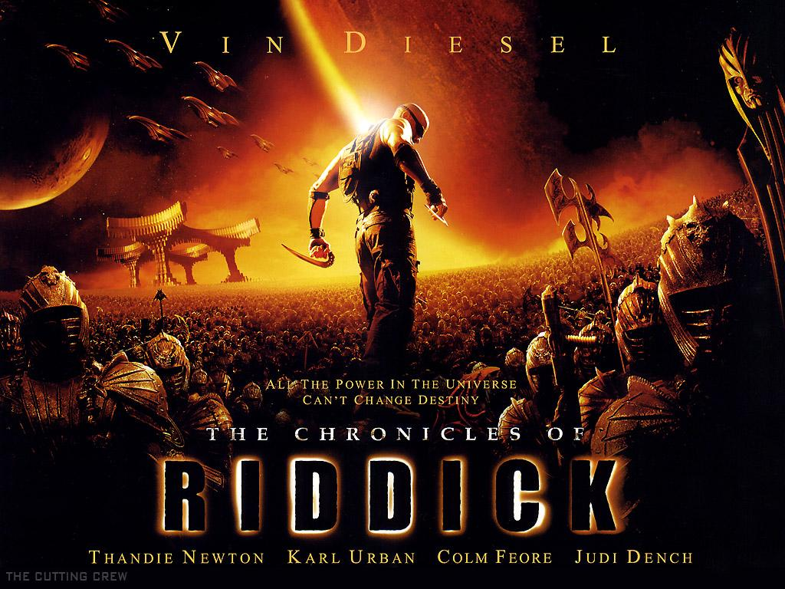
Movies
The Chronicles of Riddick

Slide 9
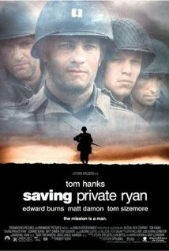
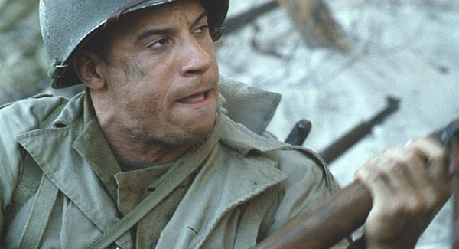
Saving private Ryan ( training on real military base)

Slide 10
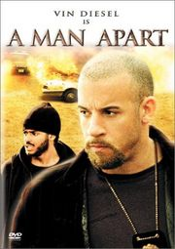
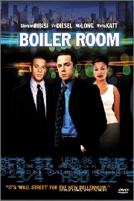
A man apart
Boiler room

Slide 11
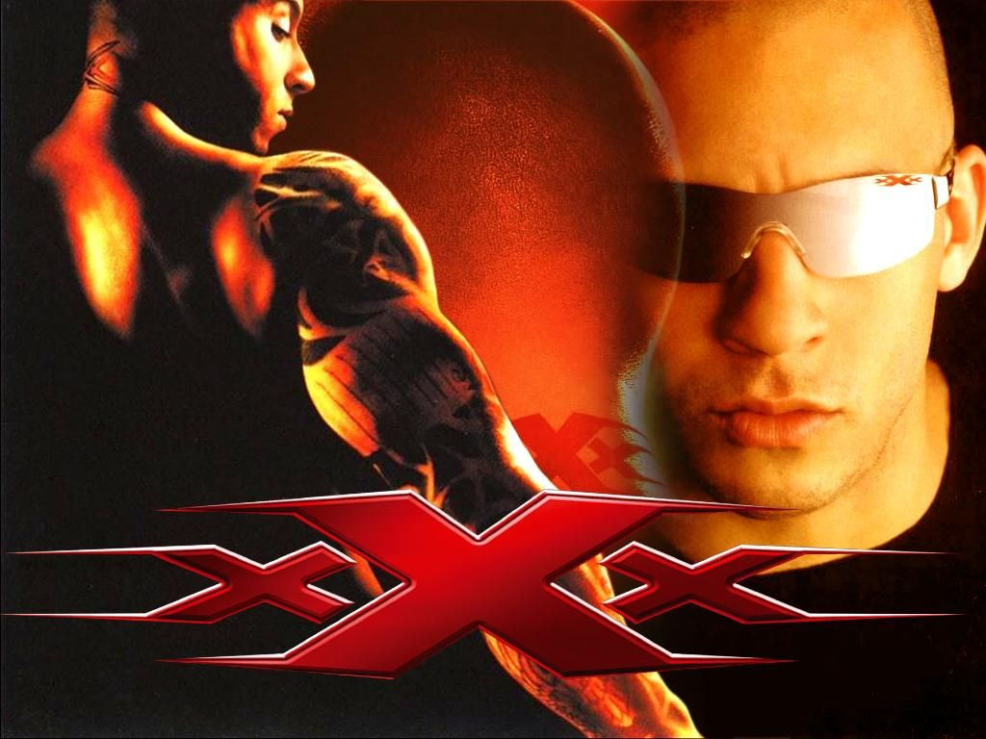
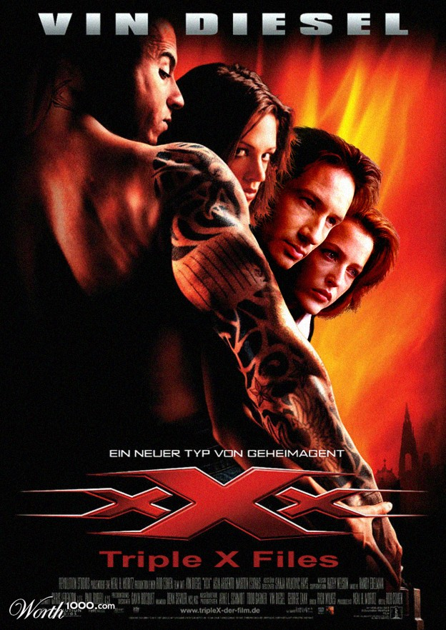
triple x ( xXx )

Slide 12
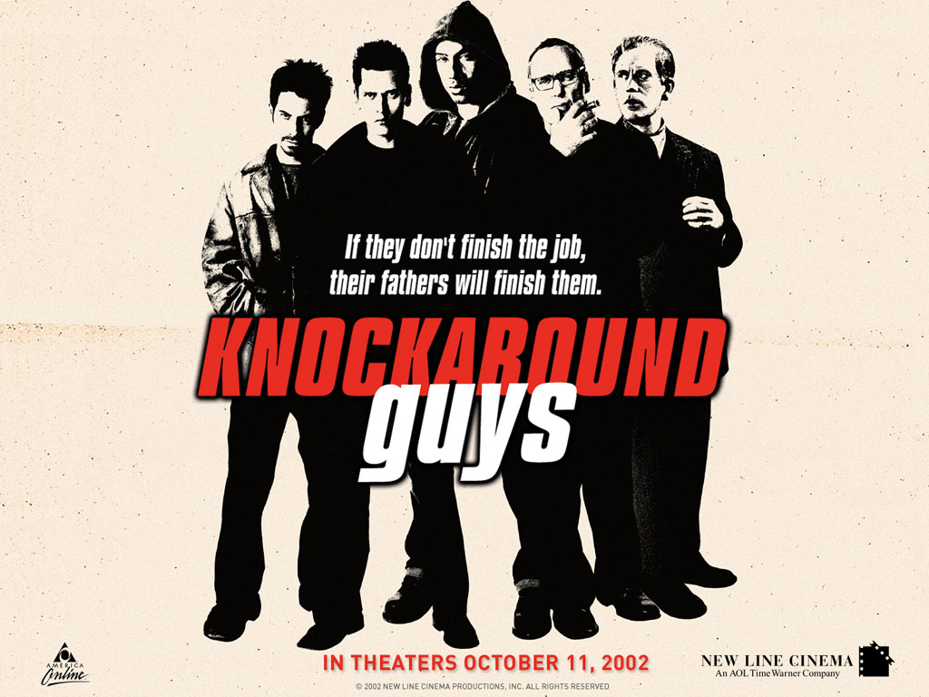
Knockaround Guys

Slide 13
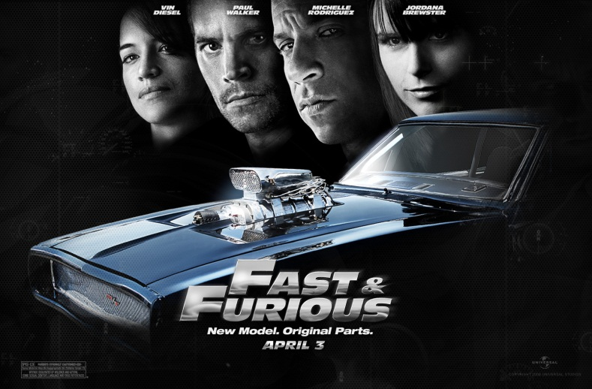
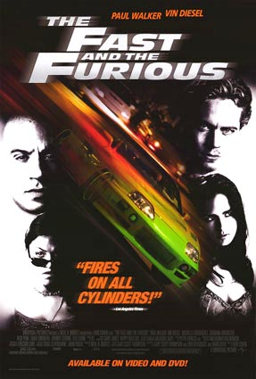
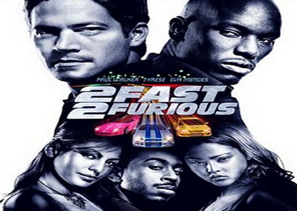
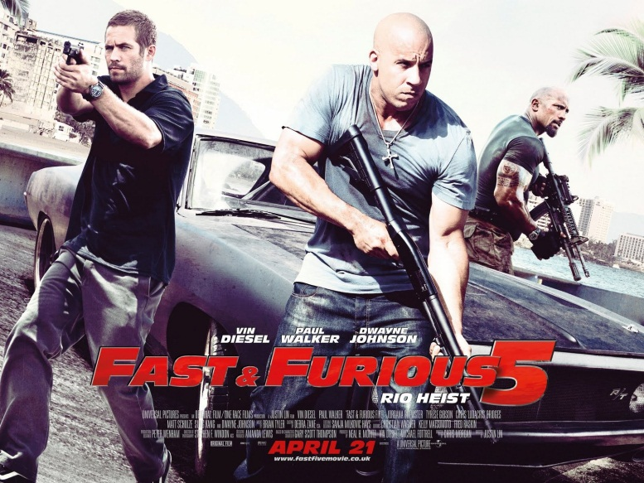
The Fast and the Furious

Slide 14
Owns the production company called
One Race Productions
Formed Tigron Studios, a video game company
Romantically paired with: Fast And The Furious co-star Michelle Rodriguez, Czech model Pavla Hrbkova, and Playboy Playmate Summer Attice, dated reporter Maria Menounos.

Slide 15
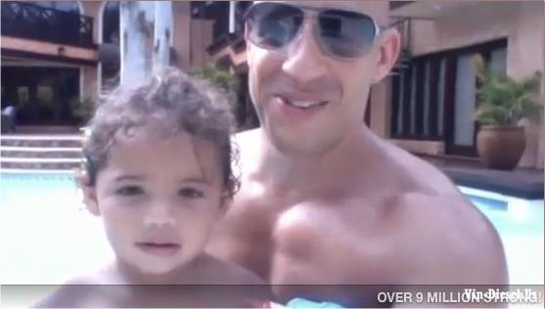
Personal life:
He has a twin brother Paul, a younger brother Tim and a sister Samantha
A daughter named Hania Riley born in 2008, with his girlfriend, model Paloma Jimenez

Slide 16
He prefers to maintain his privacy regarding his personal life: "I'm not gonna put it out there on a magazine cover like some other actors. I come from the Harrison Ford, Marlon Brando, Robert De Niro,
Al Pacino code of silence."

Slide 17
Conclusion:

Slide 18
Thank you for your attention!

