Slide 2
History
1895 in Holyoke, Massachusetts, William G. Morgan created a new game called Mintonette
The game took some of its characteristics from tennis and handball.
The first rules
An international federation, the Fédération Internationale de Volleyball (FIVB), was founded in 1947

Slide 3
Volleyball basics
Is an Olympic sport
Two teams
Three hits to get the ball over the net
- A point is scored if the ball hits the ground

Slide 4
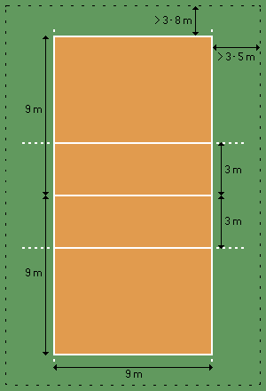
Rules
-The game is played on volleyball courts 18 meters long and 9 meters wide, divided into two 9 x 9 meter "team courts"
Net hight: Men – 243cm
Women – 224cm
-3 metre" line divides the court into "back row" and "front row" areas
-After a team gains the serve, its members must rotate in clockwise direction

Slide 5
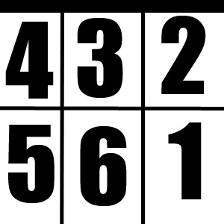
Positions
6 position
Players Clockwise
Positions counterclockwise

Slide 6
Game play
-Each of the two teams consists of six players
-To get play started one team must serve
The opposing team must use a combination of no more than three contacts
Offensive team atacks with hiting the ball over the net
Defensive team defend their self with block

Slide 7
Errors and faults
Ball of court
Ball touched more then three times
One player touched the ball twice in a row
A back-row player hits the ball over the net in a front row
…

Slide 8
Scoring
The game is played until one team scores 25 points.
Teams plays on two points difference when the score is 25
Team wins the game when they have wind 3 sets

Slide 9
Serve
-Underhand and Overhand Serve
-Jump Serve
-Floater
-Spin Serve
-Round-House Serve(a.k.a. Chuck Noris ☺ )

Slide 10
Set
There are Many different sets:
-Max
-Normal
-Alma
-Penal
-End different crosses(Swedish,Russian,…)

Slide 11
Strategy
Every player is specialized , there are many different formations:
- 4-2
6-2
5-1
6-0

Slide 12
Players
-Attacker
-Setter
-Libero
-Blocker
-Corrector

Slide 13
Variations
Beach volleyball
Indoor sand volleyball
Sitting volleyball
Nine-man volleyball
…

