Slide 1
AMY WINEHOUSE A BIOGRAPHY

Slide 2
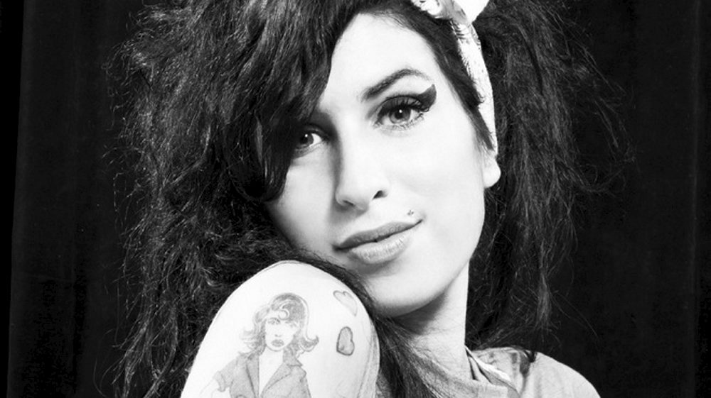
1.BASIC INFORMATION
Amy Jade Winehouse
👶 14. September 1984, England
Songwriter, singer
👵 23. July 2011

Slide 3
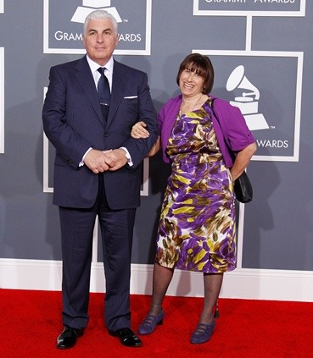
2.PARENTS
Jewish
Grandparents, dad sang jazz to her
Age 9; divorce
Lived with mum; dad weekends

Slide 4
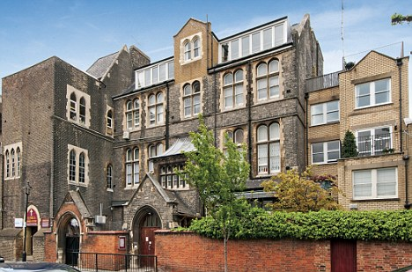
3.EDUCATION
Susi Earnshaw Theatre School; singing lessons, tap dance
Sylvia Young Theatre School; expelled at 14

Slide 5
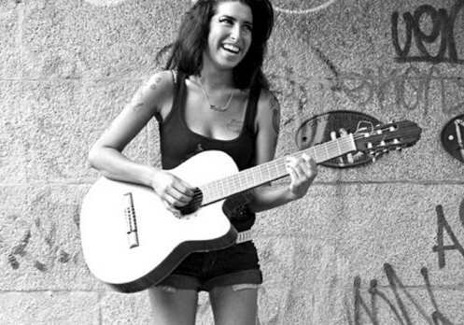
4.CAREER
14 guitar, 15 songs
Debut album; Frank (20th October 2003, 20)
International success; Back to black(2006)
Best-selling album in the UK IN 2007
Rehab, Back to black top songs in the UK

Slide 6
ALBUM COVERS

Slide 7
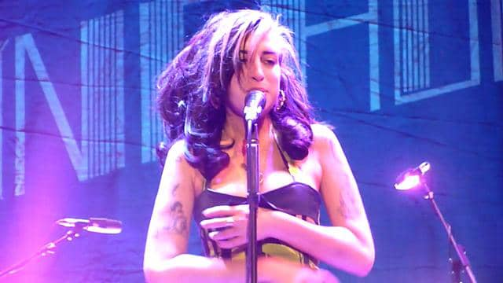
TOURING
5 shows in Brazil
11th February 2011, Dubai
European tour started on 18th June 2011
Belgrade(not remembering city, lyrics, band member names)
Cancelled

Slide 8
LAST APPERANCES
Public appearance; London June 20th 2011(goddaughter)
Recording; Tony Bennett( Duets II)

Slide 9
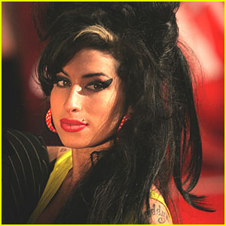
5.IMAGE
Beehive hairdo, red lipstick, heavy eyeliner
Inspiration:1960s girl groups
Richard Blackwell’s list of 10 worst dressed women

Slide 10
6.CONTOVERSY
Age 24; Grammy nominations,
Husband in jail
Paparazzi
Drug, alcohol, cigarette
Label dropping, decided not to(talent)

Slide 11
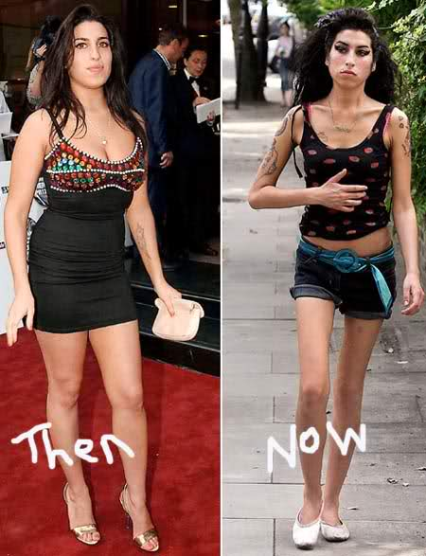
7.PERSONAL LIFE
Weight loss, drugs 2006
Got married to Blake Fielder-Civil in 2007
Suicide
Husband imprisoned 2008-2009
New boyfriend Reg Travis
Marriage based on drugs

Slide 12
HUSBAND AND BOYFRIEND

Slide 13
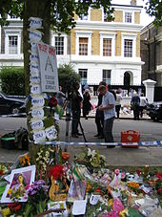
8.DEATH
Bodyguard; at 2 a.m. watching TV, laughing
Later checked on her; no pulse no breathing
Ambulance, pronounced dead at the scene
Alcohol overdose(5x the legal drink-drive limit)

Slide 14
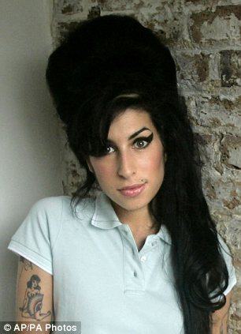
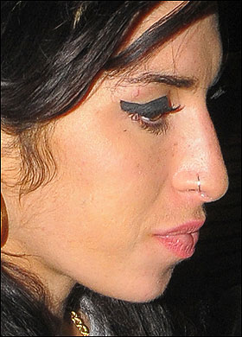
9.INTERESTING FACTS
Beehive 16.5 cm
Pierced nose at 13
She had 1 brother
Had no children

Slide 15
10.SOURCES
Amy Winehouse(b.d.). V Wikipedia. Pridobljeno 1.4.2017, iz https://en.wikipedia.org/wiki/Amy_Winehouse
10 Things You Never Knew About: Amy Winehouse(b.d.). Pridobljeno 1.4.2017, iz http://www.mensxp.com/entertainment/top-10s/12263-10-things-you-never-knew-about-amy-winehouse.html
35 Facts About Amy Winehouse(b.d.). Pridobljeno 1.4.2017, iz http://www.halloffacts.com/facts-about-amy-winehouse.html

Slide 16
11.SONGS
Rehab:
https://www.youtube.com/watch?v=KUmZp8pR1uc
You know I’m no good:
https://www.youtube.com/watch?v=b-I2s5zRbHg

