Slide 1
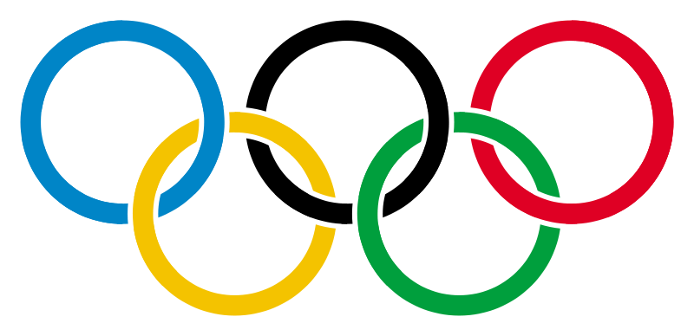
WINTER OLYMPIC GAMES

Slide 2
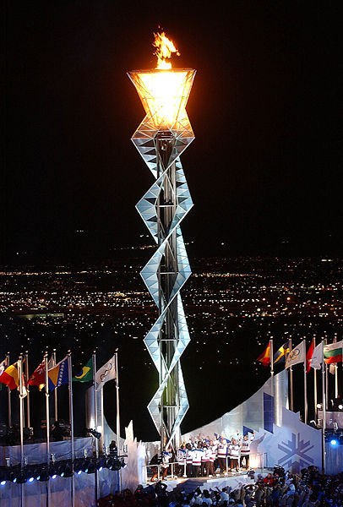
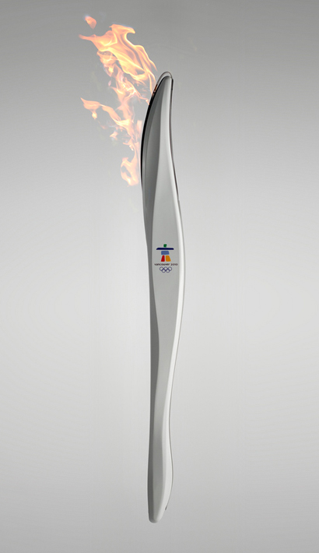
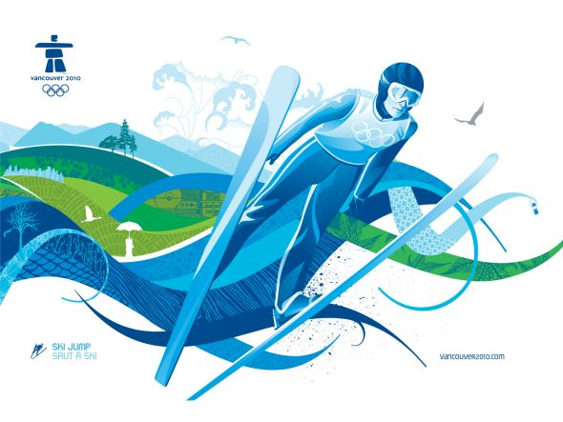
Basic information
The Winter Olympic games are the event, being held every four years.
The competitors from all over the world come to the city, where the games are being held.
The athletes compete in 20 different disciplines (including 5 Paralympics' disciplines).

Slide 3
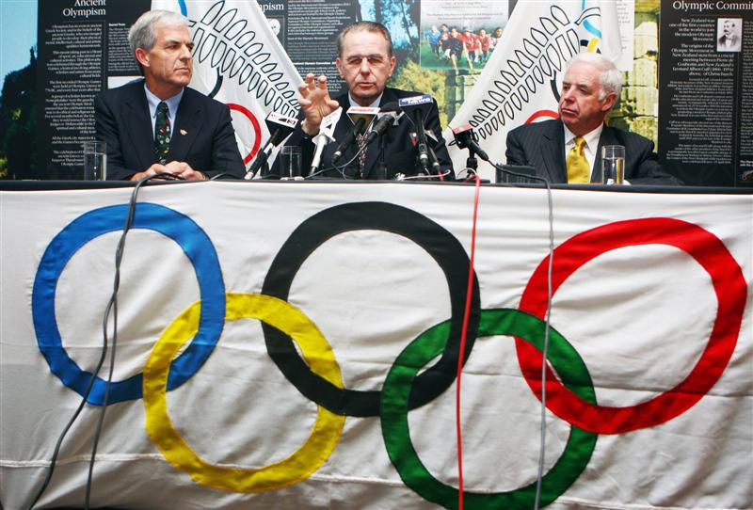
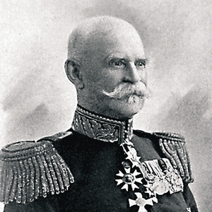
The beginnings
The foundation for the Winter Olympics are Nordic games.
The first man who wanted to add winter sports to Olympic program was Gustav Viktor Balck. He was the organizer of the Nordic games and a member of the International Olympic Committee.

Slide 4
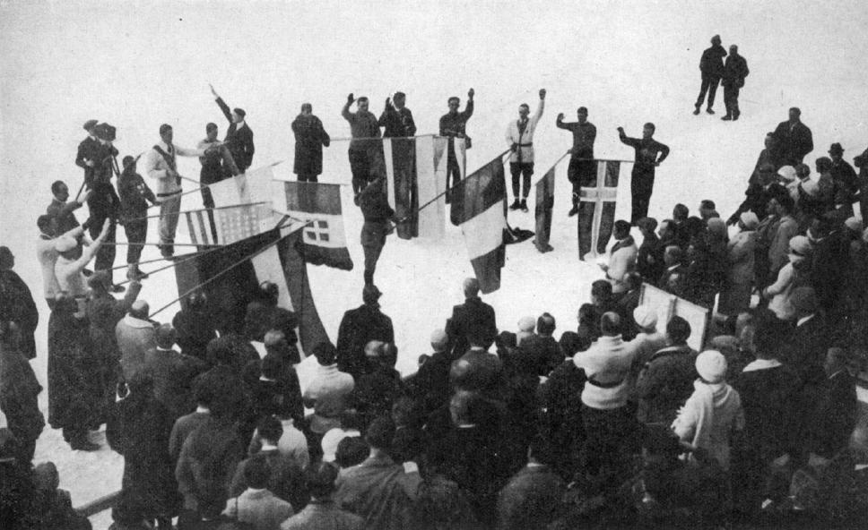
History
The first Summer Olympics with winter sport were in London, in 1908.
The first ‘winter sports week’ was planned in 1916, in Berlin, but the Olympics were cancelled because of the outbreak of the World War I.
The first true Winter Olympics were in 1924, in Chamonix, France.
Then the 1936 marked the last year that the Summer and Winter Olympics were held in the same country.

Slide 5
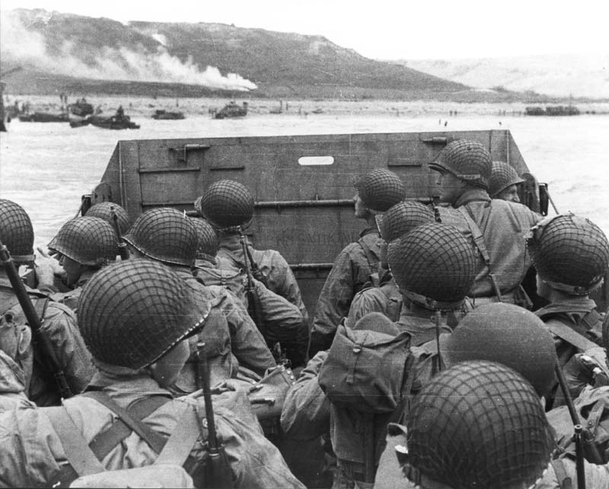
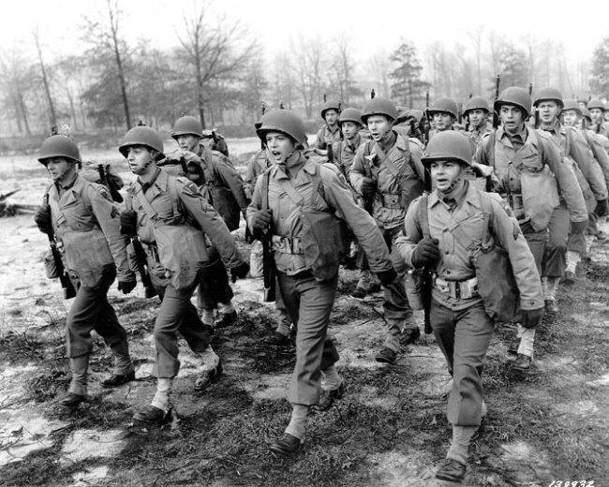
World War II.
The 1940 Winter Olympics had originally been awarded to Sapporo, Japan, but was rescinded because of the Japanese invasion of China. St. Moritz, Switzerland was chosen by the IOC to host the Games, but three months later the IOC cancelled it. Garmisch-Partenkirchen, the hosts of the previous Olympics, stepped in to host the Winter Games again, but both Olympics were cancelled, following Germany's invasion of Poland. The Winter Olympics, in Cortina d'Ampezzo, were cancelled due the continuing World War.

Slide 6
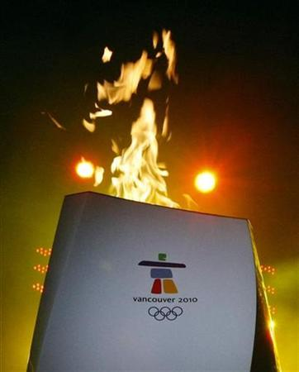
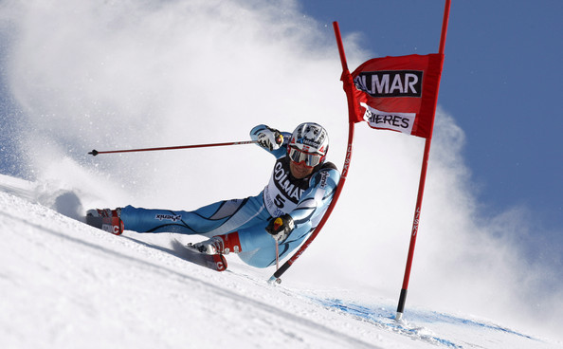
Present
In 1986, the IOC decided to separate the Summer and Winter Games on separate years.
It was decided that 1992 would be the last year to have both, Winter and Summer Olympic Games in the same year.
The Olympics made huge changes since the beginning.
The IOC has had to address several internal scandals, and the use of performance enhancing drugs by Winter Olympians. Only one country (China) has boycotted the Winter Olympics.
The last Olympics were this year in Vancouver, Canada. The competitors were competing in 15 different disciplines.
The next Olympics will be in Sochi, Russia.

