Slide 1
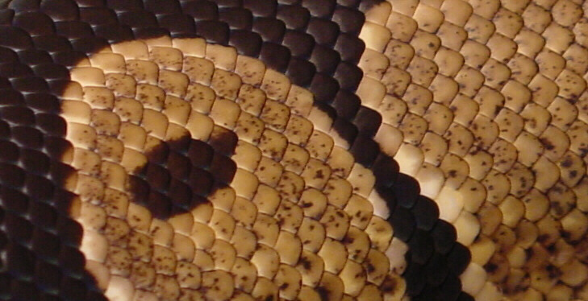
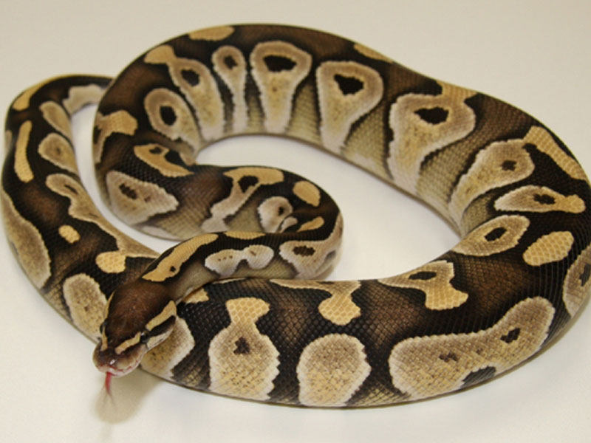
KRαℓjєνι ριтση (Python regius)

Slide 2
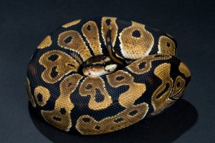
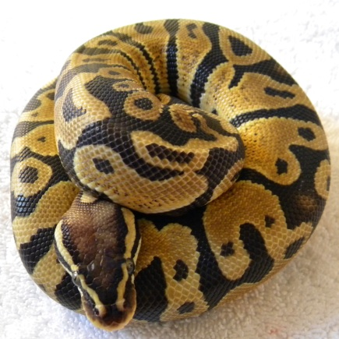
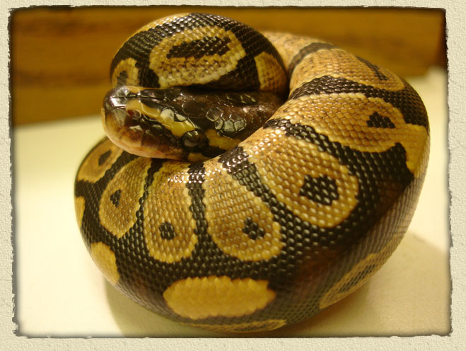

Slide 3
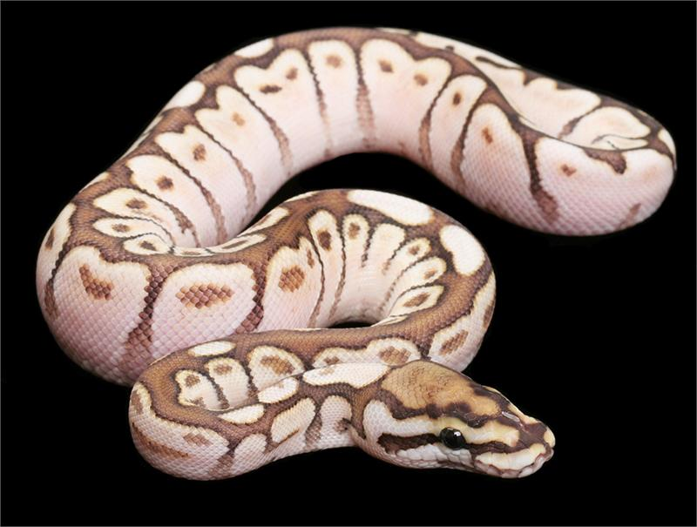
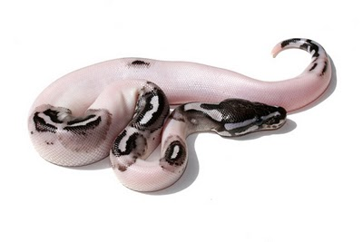
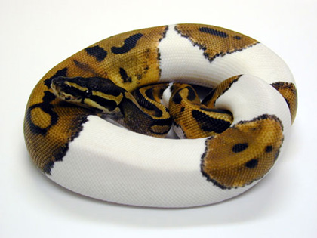
Barve

Slide 4
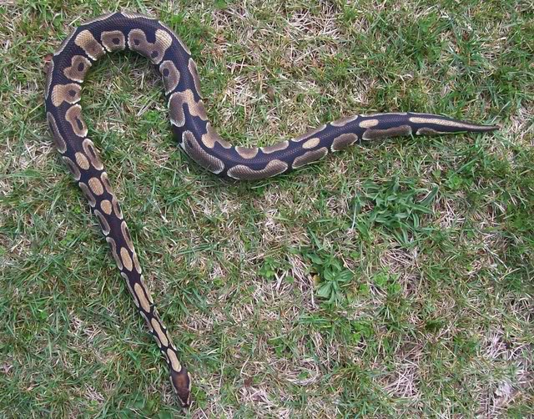
Veikost

Slide 5
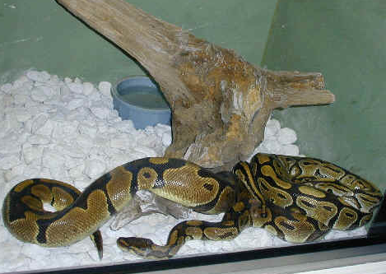
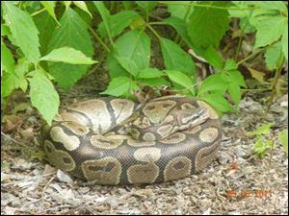
Bivališče

Slide 6
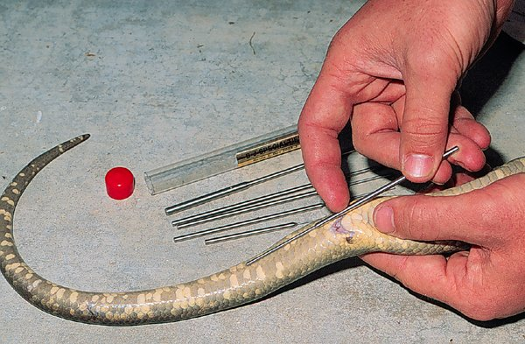
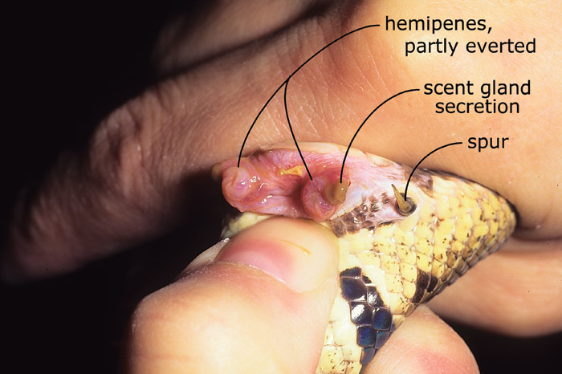
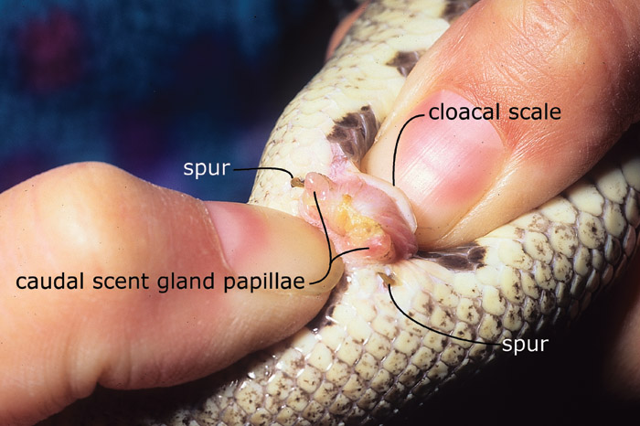
Spol
m
ž

Slide 8
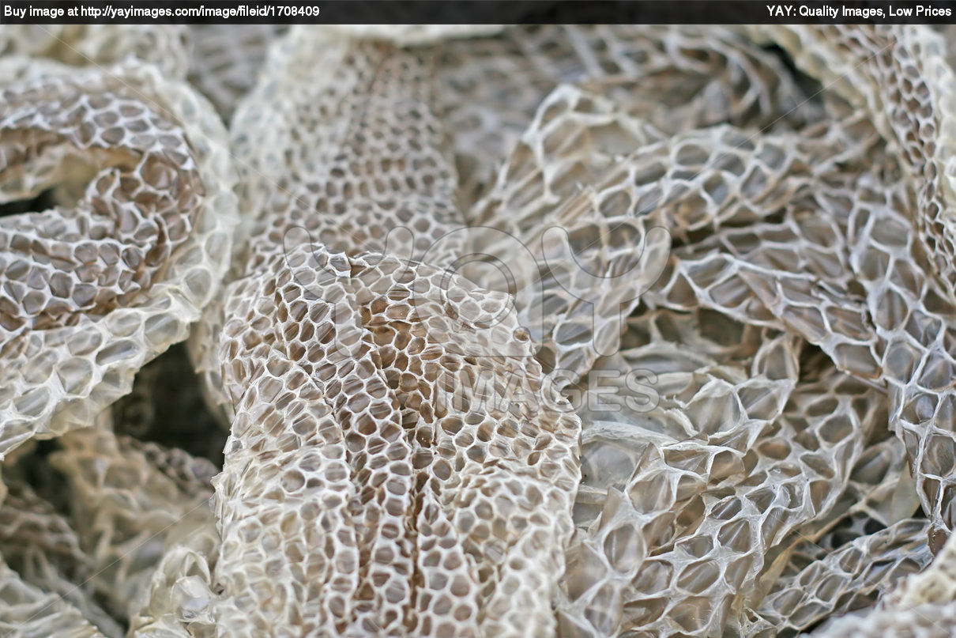
Levitev

Slide 9
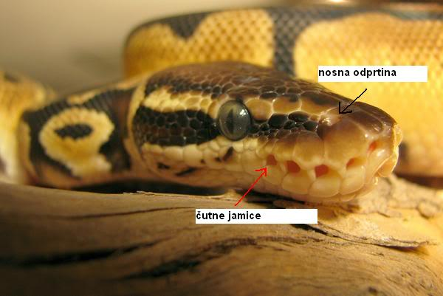
Glava

Slide 10
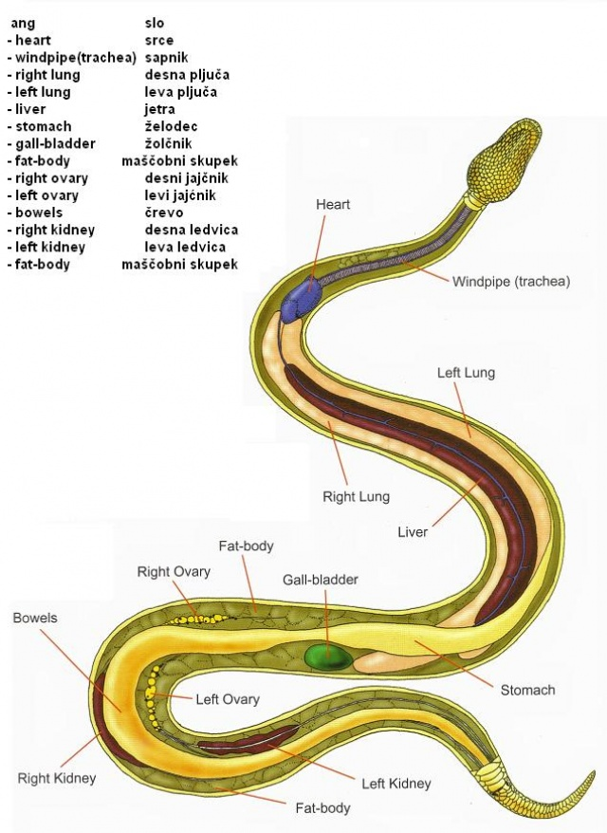
Telo

Slide 11
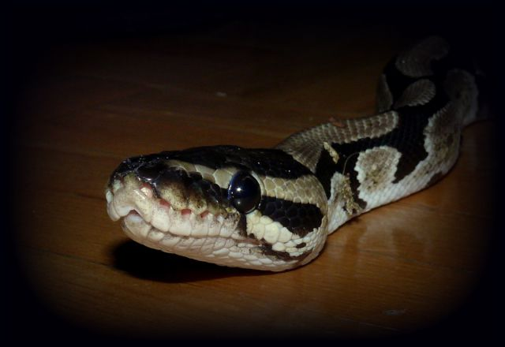
Jezik

Slide 12
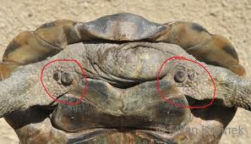
Ostroge

Slide 13
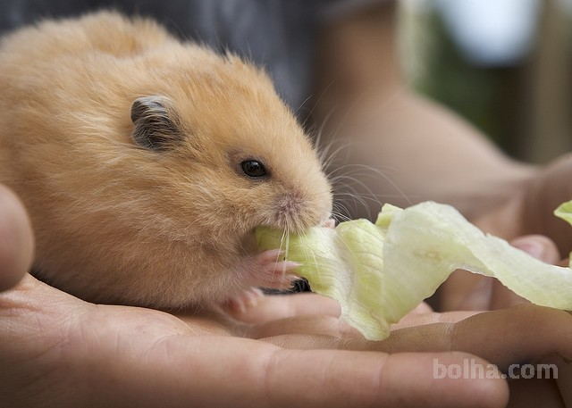
Prehrana

Slide 14
VιRι:
http://www.worldofballpythons.com/morphs/mojave/
http://www.monkeyfrog.com/mega_sized_picspage.html
http://www.zootic.si/index.php?option=com_content&view=article&id=376&Itemid=390
http://go.hrw.com/atlas/norm_htm/world.htm
http://www.squidoo.com/ball-pythons-snakes
http://www.hhpz.org/index.cfm/id/205/
http://www.sandfiredragonranch.com/index.php?main_page=product_info&products_id=25
http://www.sodahead.com/fun/do-u-have-friends-that-will-always-stick-by-your-side/question-2212657/?link=ibaf&q=ball+python+in+ball
http://www.rfadventures.com/babies!.htm
http://pythonregius.com/butterspiderballpythons.aspx
http://www.pedigreedatabase.com/forum.read?mnr=540437-panda-shepherdwhat-do-you-think&pagen=8
http://www.reptilechannel.com/reptile-magazines/reptiles-magazine/december-2008/breeders-choice-desert-ball-python.aspx
http://snakesnmoresnakes.blogspot.com/2009/07/axanthic-piebald-ball-python-photo.html
http://en.wikipedia.org/wiki/File:Ball_python_lucy.JPG
http://world-bird-sanctuary.blogspot.com/2008/09/adopt-snake-spotlight-monty-ball-python.html
http://www.toledoblade.com/local/2011/06/07/Teacher-rescues-snake-from-park-in-Tiffin.html
http://aqualandpetsplus.com/Snake,%20Ball%20Python.htm
http://vpi.com/publications/determining_the_sex_of_snakes
http://www.zootic.si/index.php?option=com_content&view=article&id=576&Itemid=614
http://www.gumtree.com.au/s-ad/heidelberg-west/reptiles-amphibians/reptile-one-terrarium-for-reptiles-amphibians-insects-for-sale/1012799096
http://www.exoreptiles.com/my/index.php?main_page=index&cPath=46_160_85_125_126
http://animal-world.com/encyclo/fresh/plants/plants.htmhttp://www.terarij.si/viewtopic.php?f=41&t=1276
http://cbcreatures.webs.com/snakesskinshedding.htm
http://pariahpack2.webs.com/snakes.htm
http://www.bolha.com/zivali/male-zivali/glodalci/ruski-pritlikovi-hrcki-prodam-mladicke--1285597388.html
http://www.druzina.si/ICD/spletnastran.nsf/all/AA83C5EAB2969D2EC1257A690045BFE1
http://svet-zivali.forumsl.net/t1841-kraljevi-piton-phyton-regius
http://www.dominvrt.si/clanek/predstavitev_ljubljenckov/kraljevi-piton.html
http://www.terarij.si/viewtopic.php?f=24&t=1998
http://www.terarij.si/viewtopic.php?f=77&t=358

