Slide 1
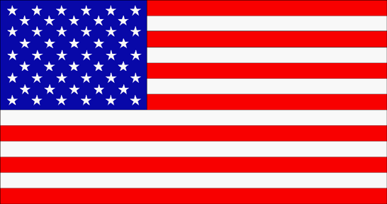
DRŽAVE SEVERNE AMERIKE
PREDSTAVIL BOM VSE DRŽAVE SEVERNE AMERIKE

Slide 2
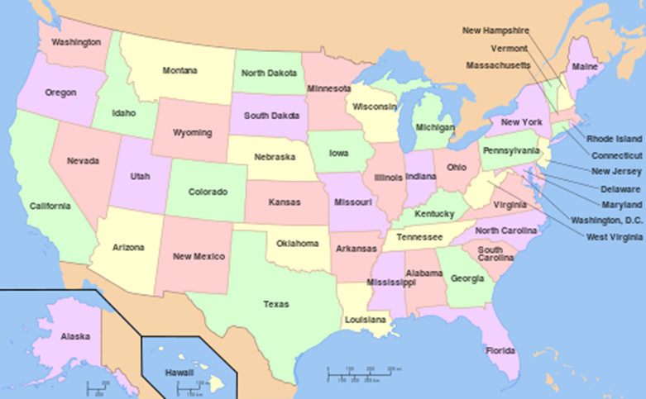
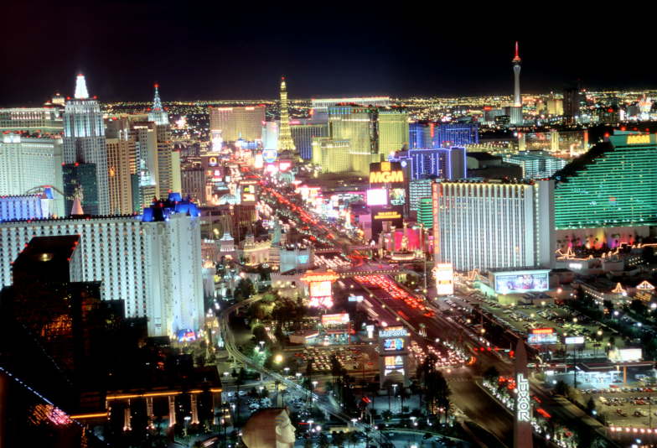
DRŽAVE
State of Washington Washington WA Seattle
West Virginia Zahodna Virginija WV Charleston
State of Wisconsin Wisconsin WI Milwaukee
State of Wyoming Wyoming wy Cheyenne
State of Nevada Nevada NV Las Vegas

Slide 4
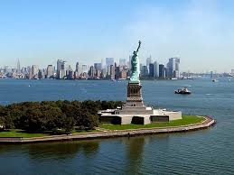
State of Montana Montana MT Billings
State of Nebraska Nebraska NE Omaha
State of New Hampshire New Hampshire NH Manchester
State of New Jersey New Jersey NJ Newark
State of New Mexico Nova Mehika NM Albuquerque
State of New York New York NY New York
State of North Carolina Severna Karolina NC Charlotte
State of North Dakota Severna Dakota ND Fargo
NEW YORK

Slide 5
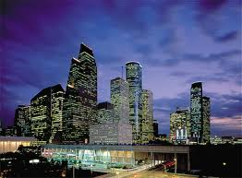
South Dakota Južna Dakota SD Sioux Falls
State of Tennessee Tennessee TN Memphis
State of Texas Teksas TX Houston
State of Utah Utah UT Salt Lake City
State of Minnesota Minnesota MN Minneapolis
State of Mississippi Mississippi MS Jackson
State of Missouri Missouri MO Kansas City
HUSTON TEXAS

Slide 6
State of Ohio Ohio OH Columbus
State of Oklahoma Oklahoma OK OklahomaCitI
State of Oregon Oregon OR Portland
Commonwealth of Pennsylvania Pennsylvania PA Filadelfija
State of Rhode Island and Providence Plantations
Rhode Island RI Providence
State of South Carolina Južna Karolina SC Columbia

Slide 7
State of Iowa Iowa IA Des Moines
State of Kansas Kansas KS Wichita
State of Louisiana Louisiana LA New Orleans
Commonwealth of Kentucky
Kentucky KY Louisville

Slide 8
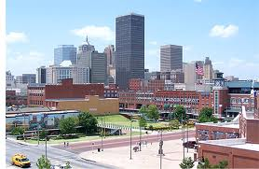
OKLAHOMA CITI
State of Florida Florida FL Jacksonville
State of Georgia Georgia GA Atlanta
State of Hawaii Havaji HI Honolulu
State of Idaho Idaho ID Boise
State of Illinois Illinois IL Chicago
State of Indiana Indiana IN Indianapolis
HAWAII

Slide 9
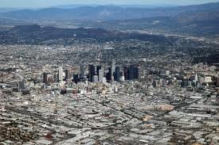
LOS ANGELES
State of Alabama Alabama AL Birmingham
State of Alaska Aljaska AK Anchorage
State of Arizona Arizona AZ Phoenix
State of Arkansas Arkansas AR Little Rock
State of California Kalifornija CA Los Angeles
State of Colorado Kolorado CO Denver
State of Connecticut Connecticut CT Bridgeport
State of Delaware Delaware DE Wilmington

Slide 10
State of Maine Maine ME Portland
State of Maryland Maryland MD Baltimore
Massachusetts Massachusetts MA Boston
State of Michigan Michigan MI Detroit
State of Vermont Vermont VT Burlington
Virginia Virginija VA VirginiaBeach

Slide 11
VIRI IN ZAKLJUČEK
WIKIPEDIJA MEMBER AMERIKA
WIKIPEDIJA DRŽAVE AMERIKE
UNITET STATES
HVALA KER STE PRISLUHNILI IN UPAM DA STE SI KAJ ZAPOMNILI.

