Slide 1
GENERALLY ABOUT VEGAS
Country:United States
State:Nevada
Area:city-352 km²
Elevation(nadmorska višina):610m
City-596,424 people
40 milion people visit Vegas every year
Pacific time zone
Mojave desert-Hot desert climate
http://www.youtube.com/watch?v=
LecMz4IWnms -anthem
The coat of arms
The flag

Slide 2
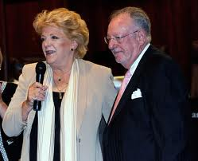
Carolyn Goodman
born March 25, 1939
21st Mayor of Las Vegas
Husband Oscar Goodman (4 children)

Slide 3
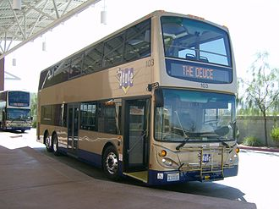
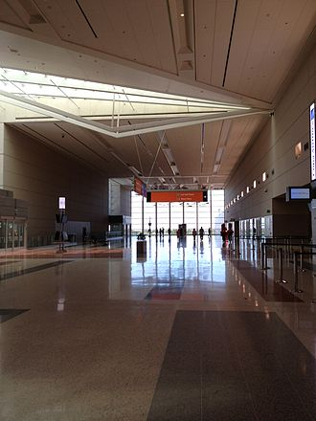
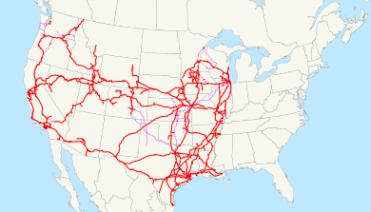
TRANSPORTATION
Bus
Car(highways)
airplane(McCarran International Airport)
Train(the Union Pacific Railroad)
Notes:
3

Slide 4
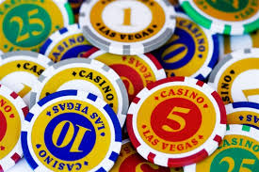
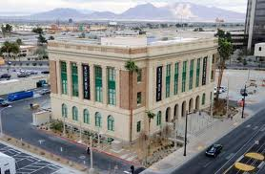
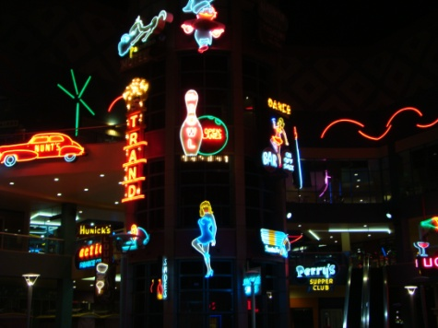
TOURISM
Casinos
Hotels
GAMING INDUSTRY
(poker,roulette,
Blackjack,slots…)
Museum:-The Neon Museum Las Vegas
-The Mob (criminal) Museum
-the Madame Tussaud‘s museum

Slide 5
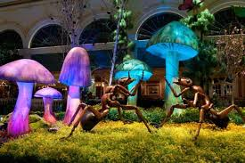
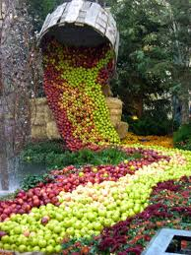
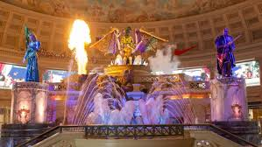
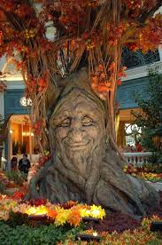
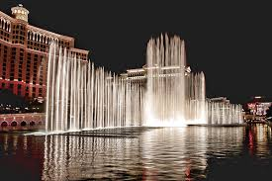
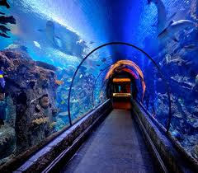
THINGS TO DO
-visit the Aquarium
-Bellagio Gardens
-The Fall of Atlantis Show
-the famous fountain

Slide 6
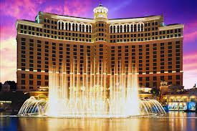
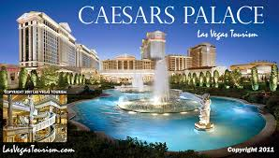
CASINOS AND HOTELS
TOP 5:
1.Bellagio (*****)
2. Caesars Palace Hotel & Casino(****)

Slide 7
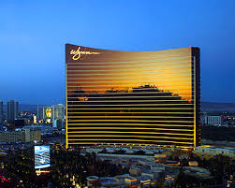
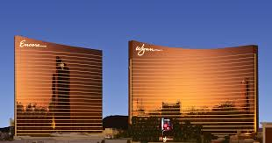
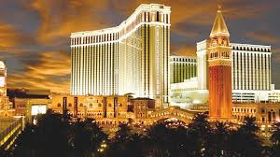
CASINOS AND HOTELS
3. Wynn Las Vegas(*****)
4. Encore at Wynn Las Vegas(*****)
5. Venetian Resort Hotel Casino(*****)
˝sisters˝

Slide 8
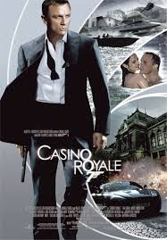
FILMS FROM VEGAS
-LAST VEGAS
-OCEAN‘S ELEVEN
-OCEAN‘S TWELVE
-OCEAN‘S THIRTEEN
-CASINO ROYALE(007)…

Slide 9
http://www.youtube.com/watch?v=f4x5RvqqVdw –las vegas tour
http://www.airpano.com/360Degree-VirtualTour.php?3D=Las-Vegas-USA-at-Night

Slide 10
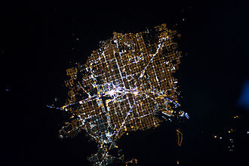
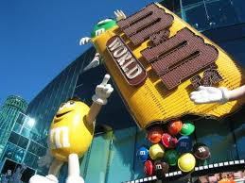
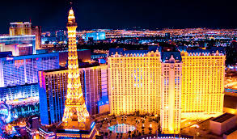
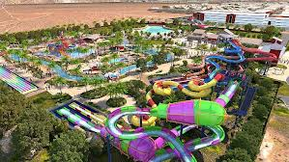
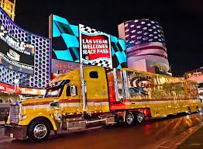
PHOTOS…
Vegas from the space

Slide 11
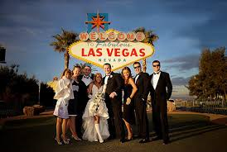
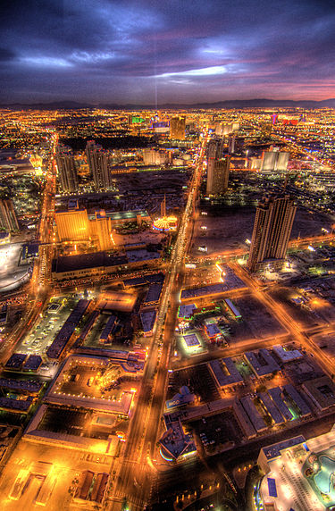
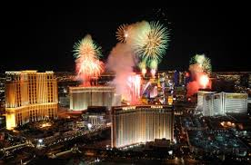
wedding

Slide 12
GLOSSARY
railroad system-ŽELEZNIŠKI SISTEM
Mayor-ŽUPAN
Highways-AVTOCESTE
Desert-PUŠČAVA
Elevation-NADMORSKA VIŠINA
Climate-PODNEBJE
Slots-IGRALNI AVTOMATI

