Slide 1
Madrid

Slide 2
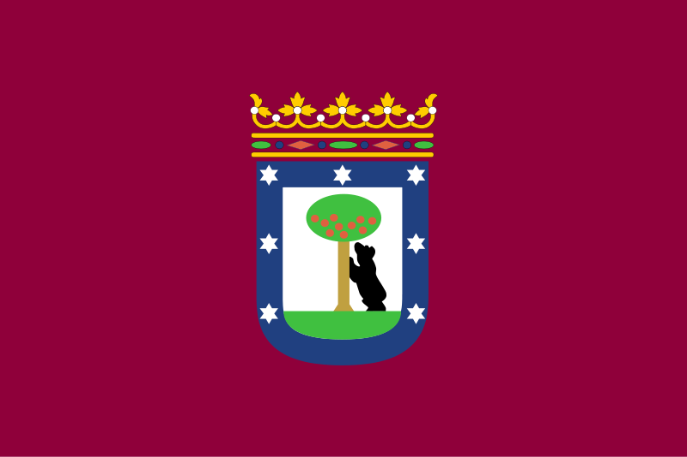
Flag and coat of arms

Slide 3
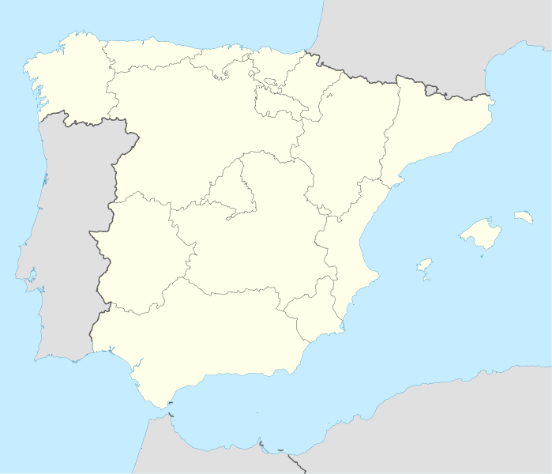
Map
Madrid

Slide 4
Madrid
Madrid is the capital of Spain and also the largest city in country.
In Madrid there are 3,3 million inhabitants and with metropolitan area 6,5 million inhabitants.
It’s the third bigest city in European Union.
The city is in the centre of Spain.
Area is 10.510 km2

Slide 5
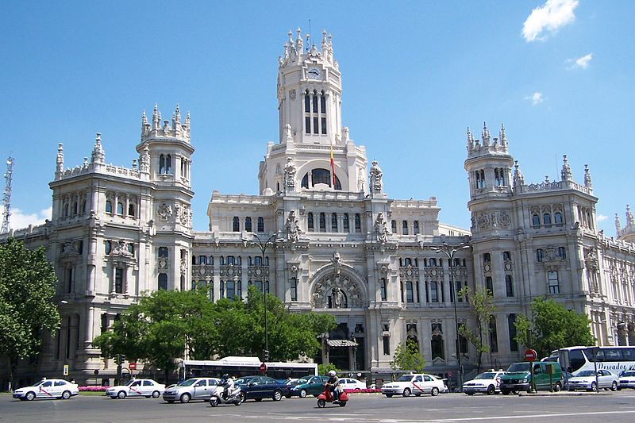
City hall

Slide 6
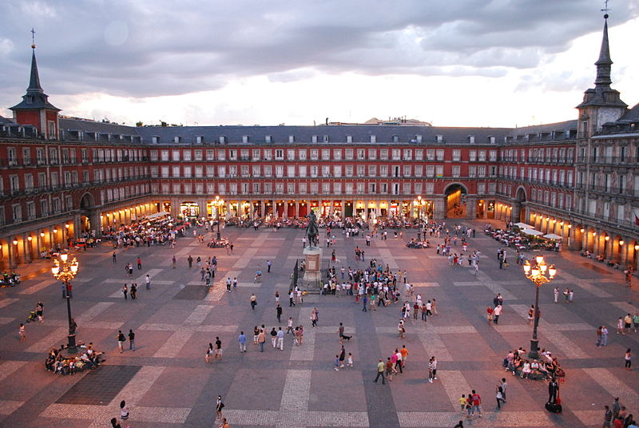
Plaza Mayor
The Plaza
Mayor was
built during
the Habsburg
period and
is a central
Plaza in the
city of Madrid.

Slide 7
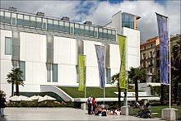
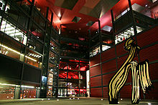
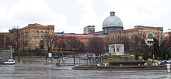
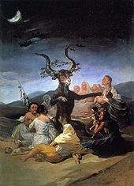
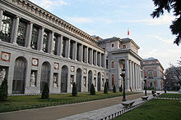
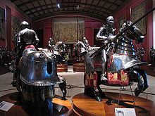
Art galleries and museums
Madrid is one of the top European destinations of art and museums. Best know is Golden Triangel of Art.

Slide 8
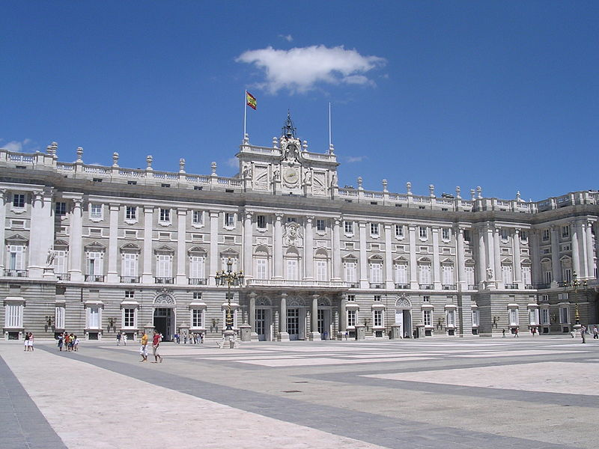
Royal palace

Slide 9
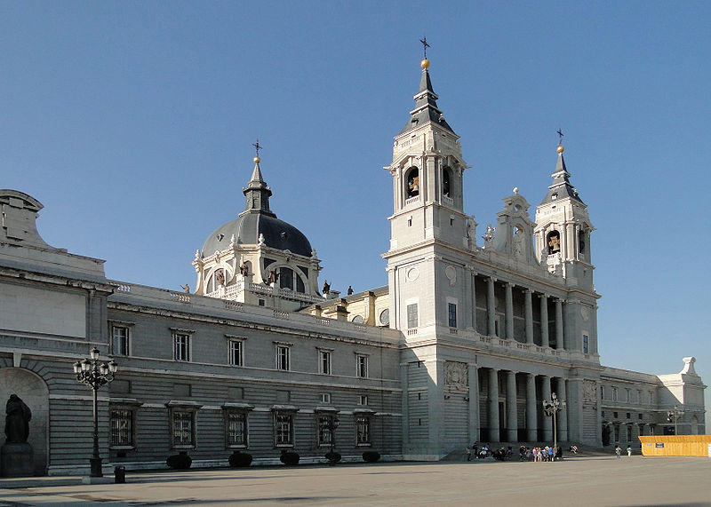
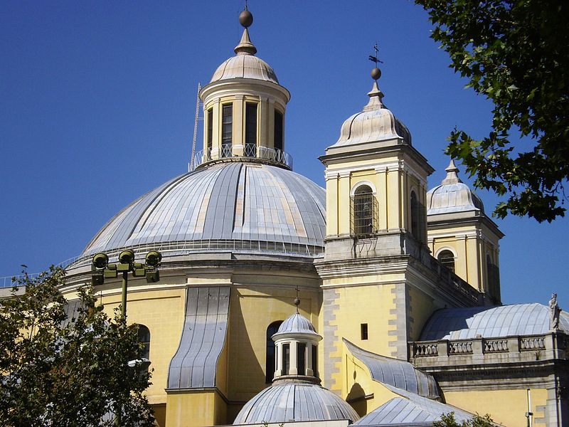
Churches
Madrid has a considerable number of Catholic churches, some of them are between the most important Spanish religious artworks.
The eldest church that survives today is San Nicolas de los Servitas.

Slide 10
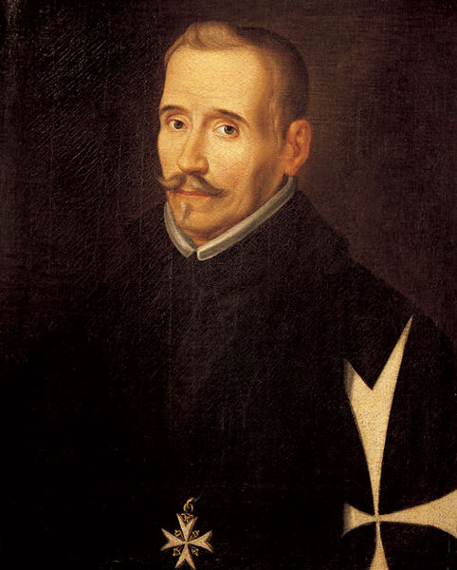
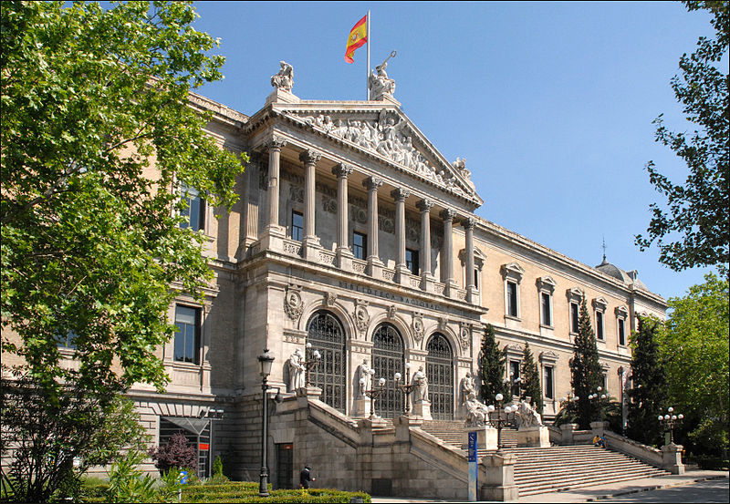
Literature
Madrid has been one of the great centers of Spanish literature. In this city were born some of the best writers of the Spanish Golden Century, including Lope de Vega.

Slide 11
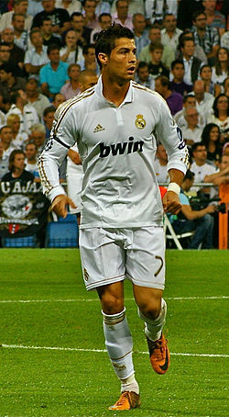
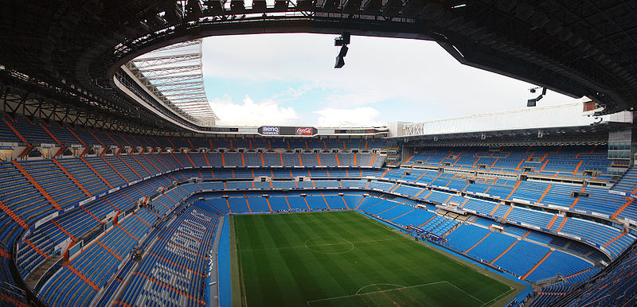
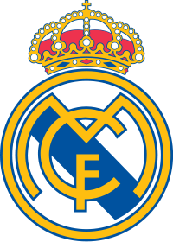
Sport - Real Madrid
Madrid is home to La Liga football club Real Madrid, which plays home games at Santiago Bernabeu. Real Madrid is one of the best football clubs in the world. FIFA selected Real Madrid for the best team of the 20th century.

Slide 12
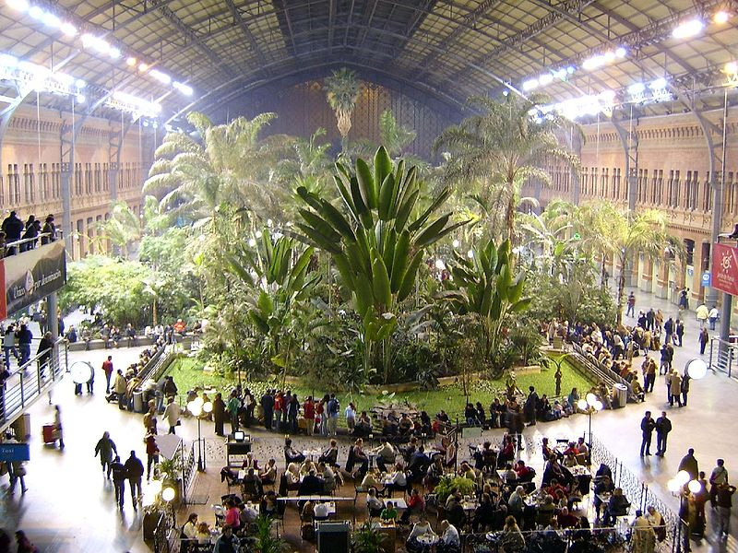
National rail
Atocha railway looks like a tropical forest.

Slide 13
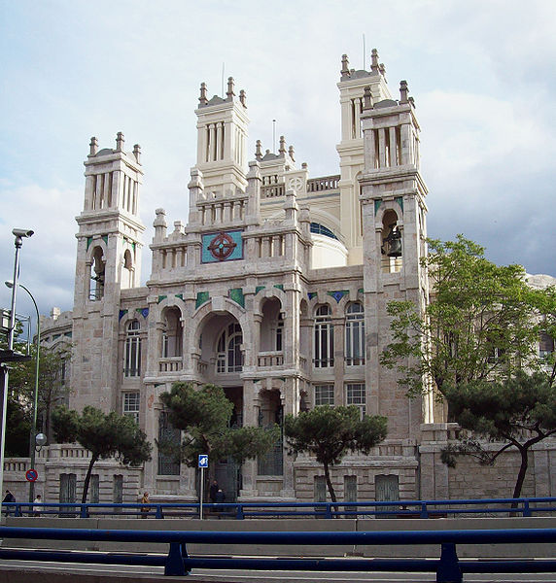
Hospital
This is
Hospital
de Maudes,
the eldest in
Madrid.

