Slide 1
MINERALI

Slide 2
Kaj je mineral?

Slide 3
Kaj je mineral?
je naravna spojina,
nastali s pomočjo geoloških procesov,
Mineralogija
Zapleteni(silikoni), preprosti diamant,
ogromno vrst, predstavil Vam jih bom samo nekaj

Slide 4
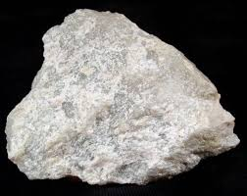
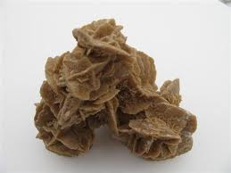
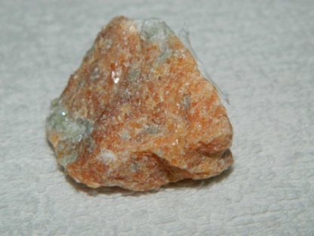
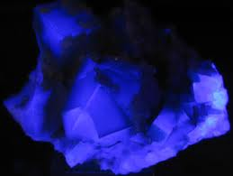
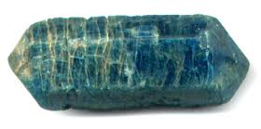
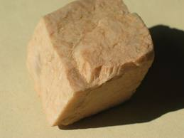
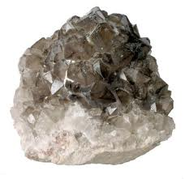
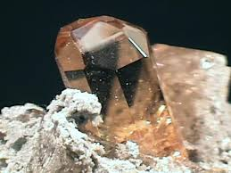
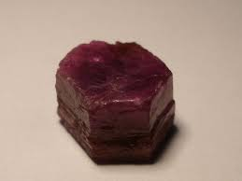
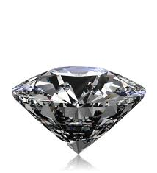
Mohsova trdotna lestvica
Lojevec (1) Sadra (2) Kalcit (3) Fluorit (4)
Apatit (5) Ortoklaz (6) Kremen (7) topaz (8)
Korund (9) Diamant (10)

Slide 5
Nahajališča mineralov
Južna Amerika

Slide 6
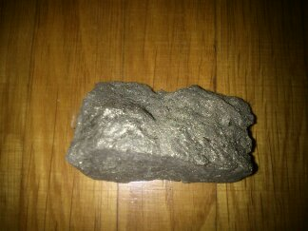
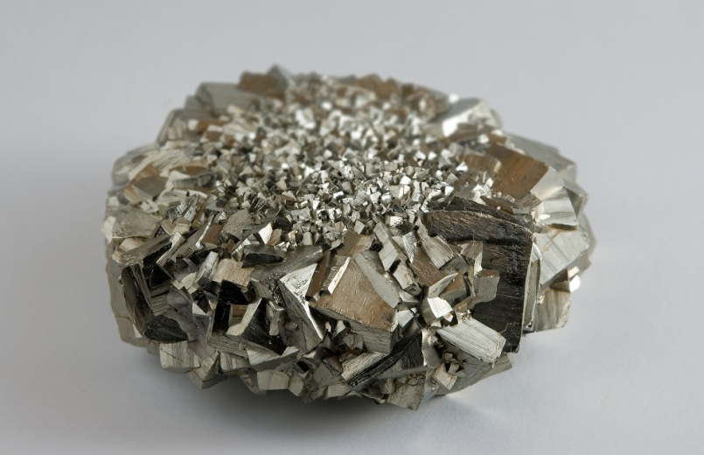
Pirit
Visoka temperatura strupen
Peru
Kategorija: Silikati
NaAlSi3O8
Lom: raven, školjkast
Barva:bela,siva,modra, rdeča,zelena
Sijaj:steklast
Fluorescenca:brez

Slide 7
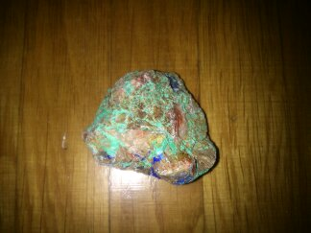
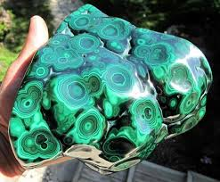
Malahit
Ni strupen
Maroko
Kategorija: minerali
(Ca2CO3(OH3)
Lom:raven
Barva: zelena, rjava, modra
Sijaj: brez
Fluorescenca: brez

Slide 8
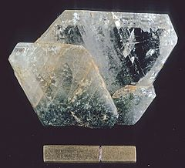
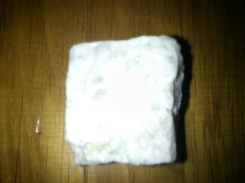
Albit
Kategorija: silikati
NaAlSi3O8
Lom: raven
Barva: Bela, siva, modra, zelena, rdeča
Sijaj: brez sijaja
Flourescenca: brez
Ni strupen
Brazilija

Slide 9
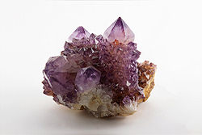
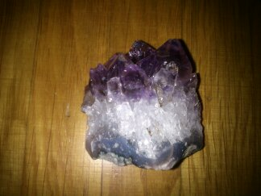
Ametist
Kategorija: oksidi, hidroksidi
Silicijev dioksid (SiO2)
Lom: školjkast
Barva: škrlatna, vijolična
Sijaj: steklast, bleščeč
Zelo razširjen

Slide 10
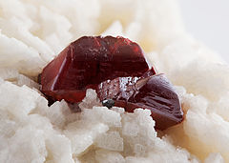
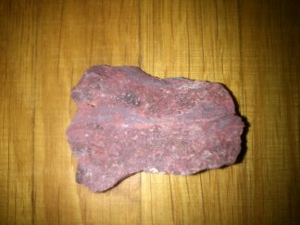
Cinober (ruda živega srebra Hg)
Rudnik tudi v Sloveniji
kategorija: II. sulfati
Živosrebrov sulfid (HgS)
Lom:raven do podškoljkast
Barva:Škrlatno rdeča, rjavo rdeča in svinčeno siva
Sijaj: Diamanten, kovinski
Flourescenca: brez

Slide 11
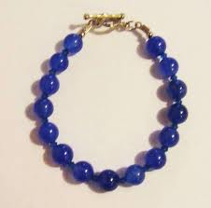
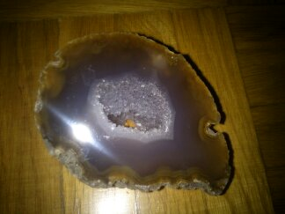
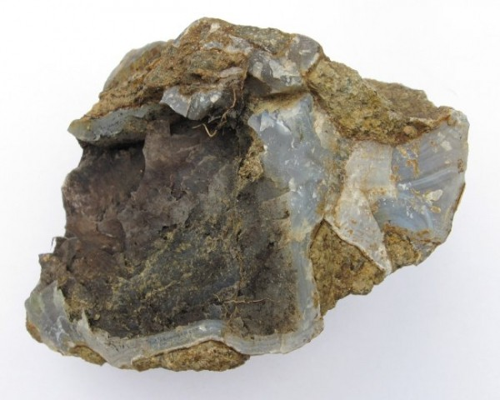
Ahat
Kategorija: Silikati
SiO₂
Lom: školjkast
Barva:Bela, siva, modra, oranžna, rdeča, črna
Sijaj: voščen
Flourescenca: brez
Nakit

Slide 12
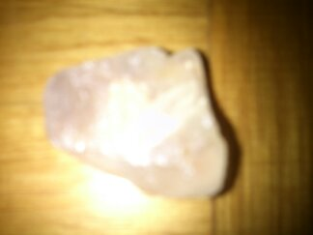
Fluorit
Kitajska
Flourescenca
Kategorija: Haloidi
Kalcijev difluorid (CaF2)
Lom: podškoljkast, neraven
Barva:Brezbarvna, bela, vijolična, modra, zelena, rumena, oranžna, rdeča, rožnata

Slide 13
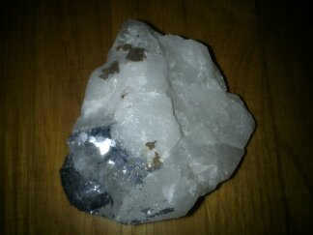
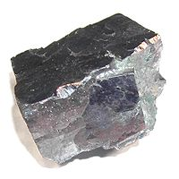
Galenit
Kategorija: Sulfidi
PbS železov sulfid
Lom: podškoljkast
Barva: Svinčeno siv, srebrn
Sijaj: kovinski
Brazilija

Slide 14
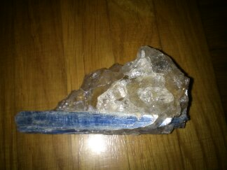
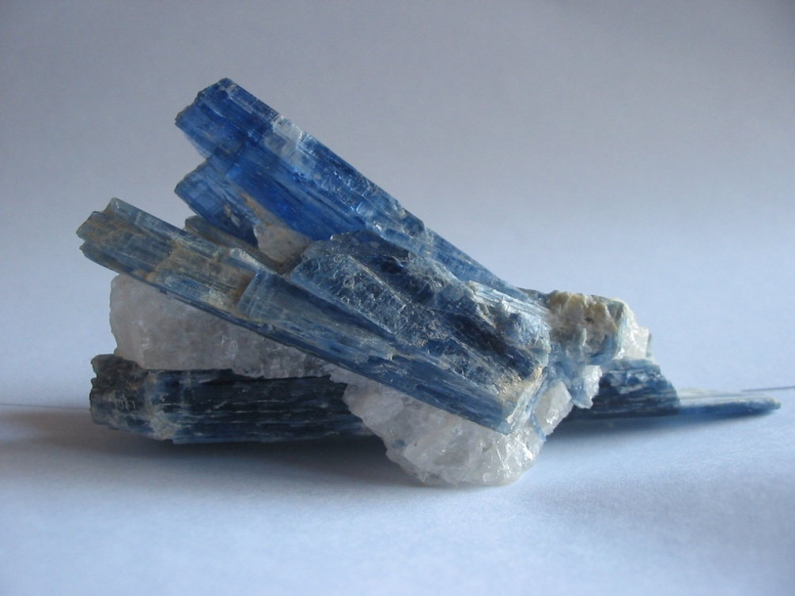
Kianit
Kategorija: silikati
Al₂SiO₅ ali Al₂O₃SiO₂
Lom: razcepljen
Barva: Modra, zelena, bela, siva, črna
Sijaj: steklast, bisern
Flourescenca: brez
Brazilija

Slide 15
Viri in literatura
http://www.welsch.com/index.php5?chap=5_1&gid=475&oldcat=Geologie&dis=0&oldType=Alle
https://www.google.si/search?q=ametist&source=lnms&tbm=isch&sa=X&ei=RBp1UoOqOKWE4AT76IGoDg&ved=0CAcQ_AUoAQ&biw=1745&bih=882#facrc=_&imgdii=_&imgrc=va0kZhgr35dfdM%3A%3BA4d6IJ2kS5mumM%3Bhttp%253A%252F%252Fupload.wikimedia.org%252Fwikipedia%252Fcommons%252Fe%252Fe2%252FAmethyst._Magaliesburg%252C_South_Africa.jpg%3Bhttp%253A%252F%252Fsl.wikipedia.org%252Fwiki%252FAmetist%3B2016%3B1344
https://www.google.si/search?q=ametist&source=lnms&tbm=isch&sa=X&ei=RBp1UoOqOKWE4AT76IGoDg&ved=0CAcQ_AUoAQ&biw=1745&bih=882#q=cinabarit&tbm=isch&facrc=_&imgdii=_&imgrc=Zcgm3qdElVVwBM%3A%3BsMg2apngTxxRXM%3Bhttp%253A%252F%252Fupload.wikimedia.org%252Fwikipedia%252Fcommons%252Fthumb%252F9%252F9e%252FCinnabar_on_Dolomite.jpg%252F240px-Cinnabar_on_Dolomite.jpg%3Bhttp%253A%252F%252Fsl.wikipedia.org%252Fwiki%252FCinabarit%3B240%3B171
https://www.google.si/search?q=ametist&source=lnms&tbm=isch&sa=X&ei=RBp1UoOqOKWE4AT76IGoDg&ved=0CAcQ_AUoAQ&biw=1745&bih=882#q=fluorit&tbm=isch&facrc=_&imgdii=_&imgrc=nCWS-7dUohsakM%3A%3BGCn824oDZcsKOM%3Bhttp%253A%252F%252Fupload.wikimedia.org%252Fwikipedia%252Fcommons%252Fa%252Fae%252FFluorit_mit_hellvioletter_Fluoreszenz.jpg%3Bhttp%253A%252F%252Fcommons.wikimedia.org%252Fwiki%252FFile%253AFluorit_mit_hellvioletter_Fluoreszenz.jpg%3B2500%3B1880
https://www.google.si/search?q=ametist&source=lnms&tbm=isch&sa=X&ei=RBp1UoOqOKWE4AT76IGoDg&ved=0CAcQ_AUoAQ&biw=1745&bih=882#q=galenit&tbm=isch&facrc=_&imgdii=_&imgrc=qqSRyJObxc9sOM%3A%3BCS4RjK78eLvP5M%3Bhttp%253A%252F%252Fupload.wikimedia.org%252Fwikipedia%252Fcommons%252F8%252F86%252FGalenaKansas.jpg%3Bhttp%253A%252F%252Fsl.wikipedia.org%252Fwiki%252FGalenit%3B876%3B876
https://www.google.si/search?q=ametist&source=lnms&tbm=isch&sa=X&ei=RBp1UoOqOKWE4AT76IGoDg&ved=0CAcQ_AUoAQ&biw=1745&bih=882#q=lapis+lazuli&tbm=isch&facrc=_&imgdii=_&imgrc=M5oJVK9lu6cvDM%3A%3Bx7Iqe5hJp4_TDM%3Bhttp%253A%252F%252Fspiraltimes.files.wordpress.com%252F2012%252F11%252Flapis.jpg%3Bhttp%253A%252F%252Fspiraltimes.wordpress.com%252F2012%252F11%252F01%252Flapis-lazuli-mother-of-earth-magick-father-of-luck%252F%3B640%3B480
https://www.google.si/search?q=ametist&source=lnms&tbm=isch&sa=X&ei=RBp1UoOqOKWE4AT76IGoDg&ved=0CAcQ_AUoAQ&biw=1745&bih=882#q=kalcit&tbm=isch&facrc=_&imgdii=_&imgrc=AW5H6kN2mw6f_M%3A%3BCgdHmlUZ5oL_BM%3Bhttp%253A%252F%252Fstatic.kupindoslike.com%252FKalcit
https://www.google.si/search?q=ametist&source=lnms&tbm=isch&sa=X&ei=RBp1UoOqOKWE4AT76IGoDg&ved=0CAcQ_AUoAQ&biw=1745&bih=882#q=pirit+izhlapevanje&tbm=isch&facrc=_&imgdii=_&imgrc=Joadyd5e5IqAmM%3A%3B_1Vr_MhFc9IuPM%3Bhttp%253A%252F%252Fupload.wikimedia.org%252Fwikipedia%252Fcommons%252F1%252F1a%252FPyrite_3.jpg%3Bhttp%253A%252F%252Fen.wikipedia.org%252Fwiki%252FWikipedia%253AFeatured_picture_candidates%252FJuly-2009%3B1969%3B1270
https://www.google.si/search?q=ametist&source=lnms&tbm=isch&sa=X&ei=RBp1UoOqOKWE4AT76IGoDg&ved=0CAcQ_AUoAQ&biw=1745&bih=882#q=kianit&tbm=isch&facrc=_&imgdii=_&imgrc=JFdnmoN3AQTAvM%3A%3BCPuKq3xBrN1TzM%3Bhttp%253A%252F%252Fupload.wikimedia.org%252Fwikipedia%252Fcommons%252F0%252F00%252FKyanite_crystals.jpg%3Bhttp%253A%252F%252Fsl.wikipedia.org%252Fwiki%252FKianit%3B1024%3B768
https://www.google.si/search?q=ahat&source=lnms&tbm=isch&sa=X&ei=1Sh1Ut-_JqXr4wTYrYCYCQ&sqi=2&ved=0CAcQ_AUoAQ&biw=1745&bih=882#facrc=_&imgdii=_&imgrc=_MeAkkpdjeO66M%3A%3BRUbWyxyglP0a0M%3Bhttp%253A%252F%252Fstatic.kupindoslike.com%252FPoludragi-kamen-AHAT-plavi-SW-NARUKVICA_slika_O_2815276.jpg%3Bhttp%253A%252F%252Fwww.kupindo.com%252FRucno-radjen-nakit%252F10319280_Poludragi-kamen-AHAT-plavi-SW-NARUKVICA%3B1374%3B1350
https://www.google.si/search?q=ahat&source=lnms&tbm=isch&sa=X&ei=1Sh1Ut-_JqXr4wTYrYCYCQ&sqi=2&ved=0CAcQ_AUoAQ&biw=1745&bih=882#facrc=_&imgdii=_&imgrc=fYmkc6ek662U8M%3A%3BIqbpwXAuAS27ZM%3Bhttp%253A%252F%252Fs5.mojalbum.com%252F3259445_12744137_13076717%252Flokacije-2008%252Flepoglava-hrvaska-gaveznica-ahat-12-x-8-cm-2-8-2008.jpg%3Bhttp%253A%252F%252Fwww.mojalbum.com%252Fkremen%252Flokacije-2008%252Flepoglava-hrvaska-gaveznica-ahat-12-x-8-cm-2-8-2008%252F13076717%3B600%3B480
http://sl.wikipedia.org/wiki/Kianit

