Slide 1
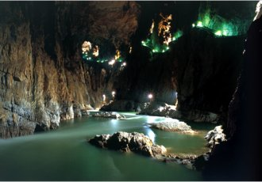
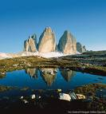
MOKRIŠČA

Slide 2
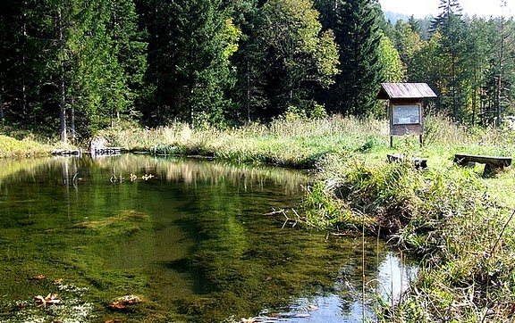
ZNAČILNOSTI EKOSISTEMA
Redno zadostno preplavljeno s površinsko ali podzemsko vodo
Zagotavlja pitno vodo
Različni biotopi
Najhitreje izginjajoči
ekosistemi

Slide 3
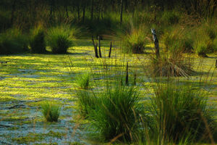
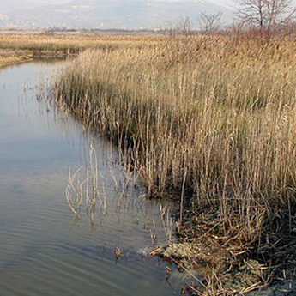
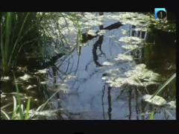
DELITEV
močvirja

Slide 4
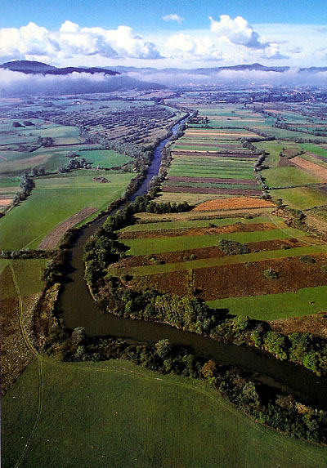
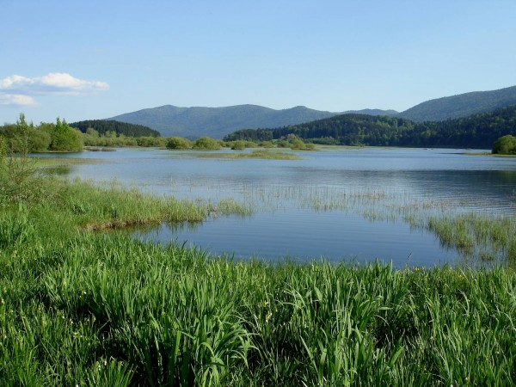
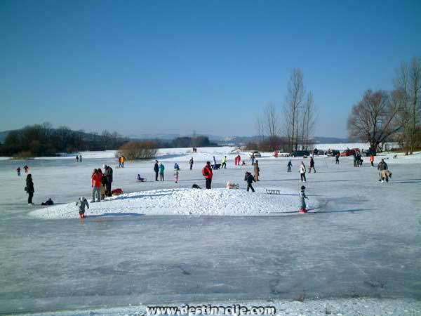
barja
Kraška polja

Slide 5
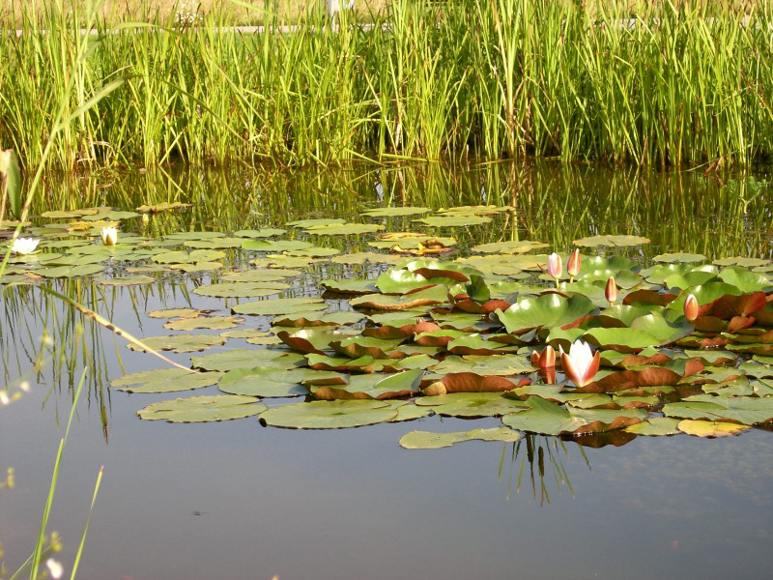
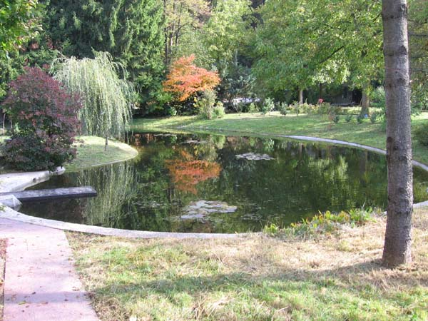
Mokrotni travniki
Mlake
Ribniki
Glinokopi
Območja obalnega
pasu
Poplavna območja
rek
…

Slide 6
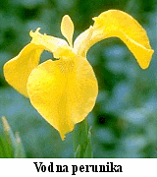
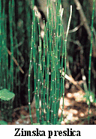
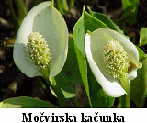
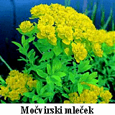
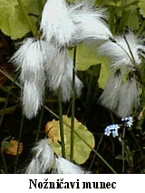
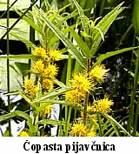
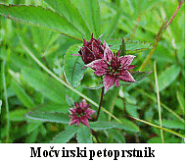
RASTLINE
Pravi kolmež

Slide 7
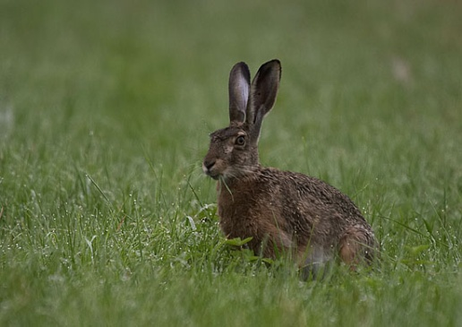
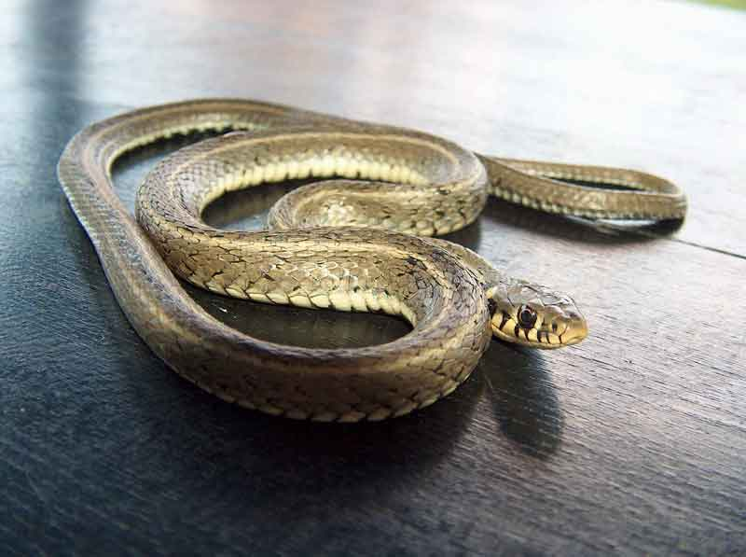
ŽIVALI
Drsalec
Pijavka
Žaba
Raca
Postrv
Komar
Labod
Zajec
Belouška
Jastreb

Slide 8
PREHRANJEVALNI SPLET
Jastreb
Raca
Postrv
Belouška
Komar
Drsalec
Šaši

Slide 9
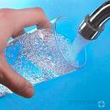
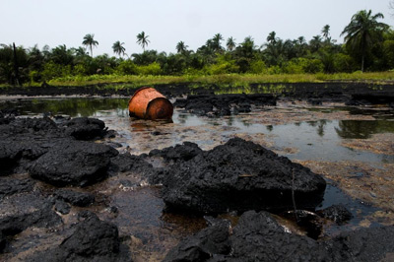
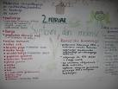
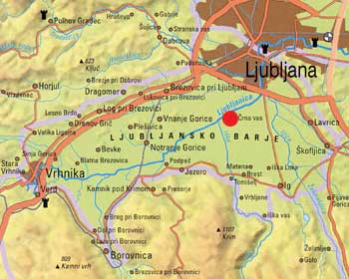
POMEN ZA ČLOVEKA
mokrišč je vedno manj
Pitna voda
2. februarja je
svetovni dan
mokrišč

Slide 10
VIRI
http://sl.wikipedia.org/wiki/Geografija_Slovenije#Zna.C4.8Dilnosti_voda_in_vodnih_obmo.C4.8Dij
http://images.google.si/images?hl=sl&um=1&sa=1&q=slovenske+reke&btnG=Iskanje&aq=f&oq=&start=0
http://sl.wikipedia.org/wiki/Rastlina
http://life.notranjski-park.si/cmsimages/c_221_s.jpg
http://images.google.si/images?hl=sl&gbv=2&tbs=isch%3A1&sa=3&q=kobulasta+vodoljuba&btnG=Iskanje+slik
http://www.dzlb.si/barje-slike/pravi-kolmez.jpg
http://life.notranjski-park.si/cmsimages/c_273_v.jpg
http://www.aquanubis.com/datoteke/clanki/potamogeton_octandrus/thumbnails/thumb_potamogeton_octandrus3.jpg
http://lh5.ggpht.com/_GYnIMBK_-R0/Sn0r4D9jLhI/AAAAAAAABGM/6UAAcidJlD0/s160/DSCN3426-rezika.JPG
http://images.google.com/images?um=1&hl=sl&safe=active&tbs=isch%3A1&sa=1&q=obmorska+nebina&btnG=Iskanje&aq=f&oq=&start=0
http://images.google.com/imgres?imgurl=http://narava.sodja.net/albums/userpics/10005/thumb_pokoncni_petoprstnik.jpg&imgrefurl=http://narava.sodja.net/thumbnails.php
http://lh6.ggpht.com/_rvq7_FpUxPE/SjC09cRo68I/AAAAAAAAKgw/6ATk9-UPEwM/s288/1.jpg
http://images.google.si/images?hl=sl&gbv=2&tbs=isch:1&q=Postrv&sa=N&start=20&ndsp=20
http://images.google.si/imgres?imgurl=http://www.os-volicina.si/ip/rom_sesalci_ribe_jzorko_ebruncic/slike/krap.jpg&imgrefur
http://images.google.si/images?hl=sl&gbv=2&tbs=isch%3A1&sa=3&q=Travni%C5%A1ki+%C5%A1kratec+&btnG=Iskanje+slik
http://images.google.si/images?hl=sl&gbv=2&tbs=isch%3A1&sa=1&q=lipan&btnG=Iskanje&aq=f&oq=&start=0
http://images.google.si/images?hl=sl&gbv=2&tbs=isch%3A1&sa=1&q=fotosinteza&btnG=Iskanje&aq=f&oq=&start=0

Slide 11
http://images.google.si/images?hl=sl&gbv=2&tbs=isch%3A1&sa=1&q=Siva+%C4%8Daplja+&btnG=Iskanje&aq=&oq=&start=0
http://images.google.si/images?hl=sl&gbv=2&tbs=isch%3A1&sa=1&q=%C4%8Copasta+%C4%8Drnica+&btnG=Iskanje&aq=&oq=&start=0 http://images.google.si/images?hl=sl&gbv=2&tbs=isch%3A1&sa=1&q=poto%C4%8Dni+rak&btnG=Iskanje&aq=f&oq=&start=0
http://images.google.com/images?um=1&hl=sl&safe=active&tbs=isch%3A1&sa=1&q=+Mali+ponirek+&btnG=Iskanje&aq=&oq=&start=0
http://images.google.com/images?um=1&hl=sl&safe=active&tbs=isch%3A1&sa=1&q=Poto%C4%8Dna+postranica&btnG=Iskanje&aq=&oq=&start=0
http://images.google.com/images?um=1&hl=sl&safe=active&tbs=isch%3A1&sa=1&q=Velika+%C5%BEagarica+&btnG=Iskanje&aq=&oq=&start=0
http://images.google.com/images?um=1&hl=sl&safe=active&tbs=isch:1&q=Losos&sa=N&start=20&ndsp=20
ttp://www.youth-hostel.si/dinamic/editor/Playing_at_the_Kolpa_river(Author_-_B._Bajzelj)1_AC411.jpg
http://web.vecer.com/portali/2008/packa/slike_packe/2008/11/24/1825448914335101/slika-300.jpg
http://t0.gstatic.com/images?q=tbn:OGFEBzr_ThsJgM:http://www.bohinj-info.com/blog/wp-content/uploads/2009/04/cistilna_akcija_bohinj5.jpg
http://images.google.si/images?hl=sl&gbv=2&tbs=isch:1&q=re%C4%8Dni+transport&sa=N&start=60&ndsp=20 http://images.google.si/images?hl=sl&gbv=2&tbs=isch%3A1&sa=1&q=izsu%C5%A1ena+reka&btnG=Iskanje&aq=f&oq=&start=0
http://images.google.si/images?hl=sl&gbv=2&tbs=isch:1&q=krap&sa=N&start=0&ndsp=20
http://images.google.com/images?um=1&hl=sl&safe=active&tbs=isch%3A1&sa=1&q=TRPOT%C4%8CASTI+PORE%C4%8CNIK&btnG=Iskanje&aq=&oq=&start=0
http://images.google.com/images?um=1&hl=sl&safe=active&tbs=isch%3A1&sa=3&q=slap&btnG=Iskanje+slik
http://images.google.com/images?um=1&hl=sl&safe=active&tbs=isch%3A1&sa=1&q=MEANDRE&btnG=Iskanje&aq=&oq=&start=0
http://lh3.ggpht.com/_2NS6HeIHFXA/SsPRu8mMdMI/AAAAAAAACB0/xyWaNrGAJyA/s160/IMG_1168.JPG

