Slide 1
Nova zelandija
PREDMET: GEOGRAFIJA

Slide 2
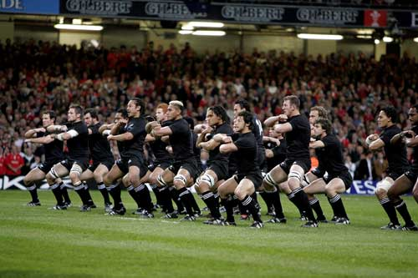
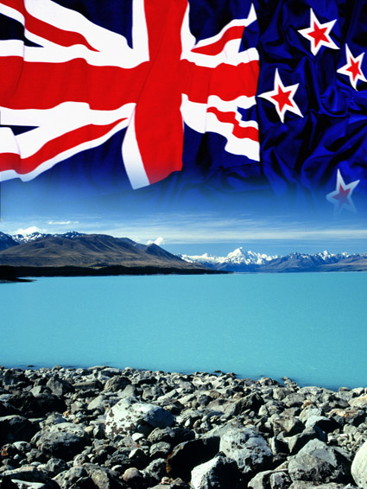
kazalo
Osnovni podatki
Zgodovina
Lega
Površje
Podnebje
Rastlinstvo
Prebivalstvo
Živalstvo
Gospodarstvo
Viri
Njihovo
nogometno društvo
Nova Zelandija

Slide 3
Osnovni podatki
Uradno ime: Aotearoa (maorijsko), New Zeland (angleško)
Glavno mesto: Wellimgton
Uradna jezika: angleščina, maorščina
Prebivalstvo (2003): 120. na svetu 4.000.000
Valuta: novozelandski dolar
Nacionalna žival: kivi
Površina: 73. na svetu 268.680 km²
Časovni pas: UTC+12
Neodvisnost: od Združenega kraljestva 26. september 1907
Religija: 75% kristjanov

Slide 4
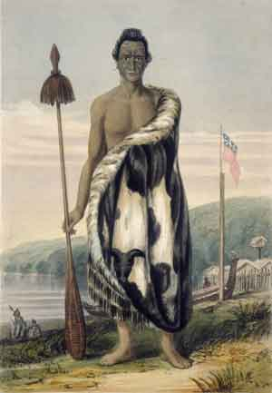
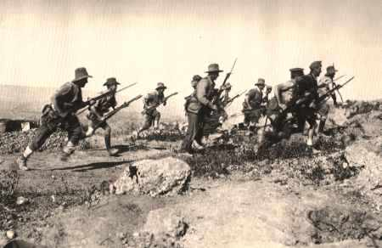
zgodovina
Odkrili zelo pozno
1642 leta je odkril Nizozemec
Pručeval James Cook
Prvotni prebivalci Maori
25.11.1947 je postala suverena država v okviru Britanske skupnosti narodov.
Vojna
Maor

Slide 5
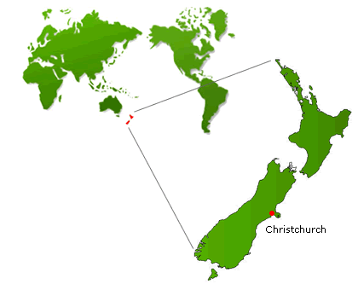
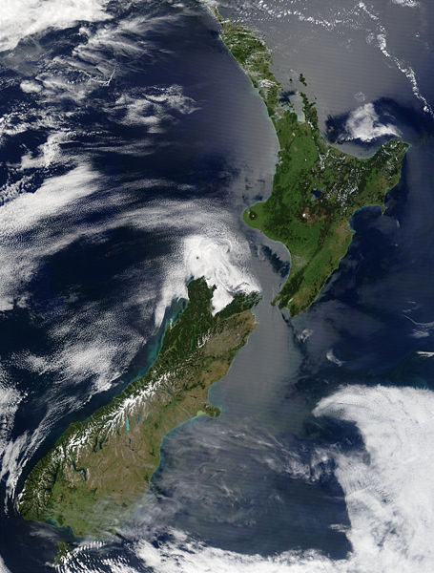
lega
2250 km od Avstralije
Sestavljena iz severnega in južnega otoka
Meji na: Tihi ocean, Tasamsko morje, Antarktiko
Nova Zelandija
Nova Zelandija na zemljevidu

Slide 6
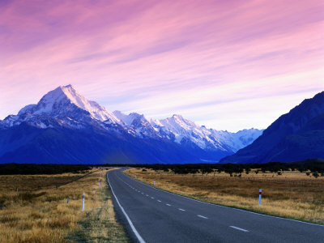
Površje
Dokaj gorato
Na svernem otoku: vulkansko gorovje, gejzirji…
Na južnem otoku: poledenele južne Alpe
Najvišja gora Mont Cook 3754m
Približno 30 %gozdne površine, 50 %travniki in pašniki, 20 % obelovalne povšine
Monte Cook

Slide 7
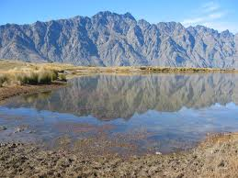
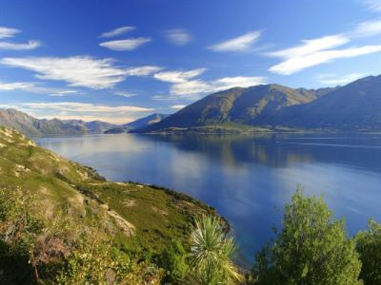
Alpe na južnem otoku
Lepa pokrajina na severnem delu otoka
Vulkan v Novi Zelandiji

Slide 8
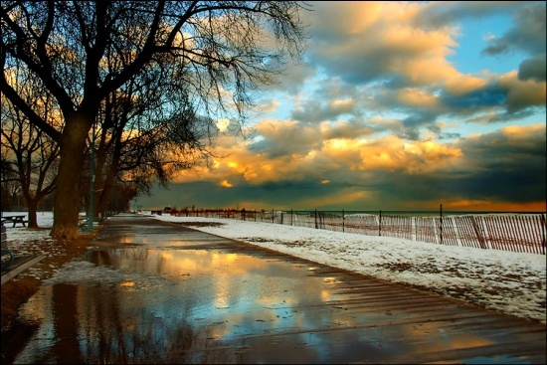
podnebeje
Zmerno toplo oceansko
Skrajni sever subtropsko
“obratni“ letni časi
Povprečna letna temperatura: 18 na S in 13 na J
Spremenljivo podnebje
2000-7500 mm padavin letno
Dnevna svetloba lahko traja do 21. ure
Zime mile in sončne
Pogled na sončni zahod iz predmestja Manukau

Slide 9
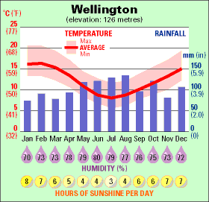
Klimogram mesta Wellington
Sonce- zelo velikokrat je sončno

Slide 10
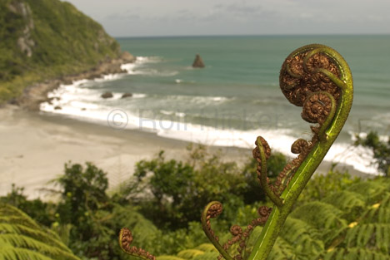
rastlinstvo
Večina zimzelene rastline
Ob obalah in nekaj tudi v notranjosti prevladuje tropski in subtropski vlažen gozd in tudi nekaj savane
Rastlinstvo ob morju

Slide 11
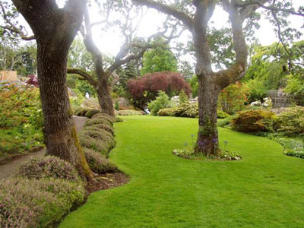
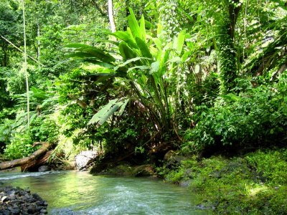
Zimzelene rastline
Tropski vlažni gozd

Slide 12
prebivalstvo
Belci (74%), Maori (15%), Polinezijci (6%) ter Kitajci in Indijci (5%)
Večina prebivalcev živi v mestih, obali
Notranjost zelo redko poseljena
Življenjska raven prebivalcev je že zelo dolgo visoka
Večja mesta so Auckland, Christchurch, Manukau, North Shore,

Slide 13
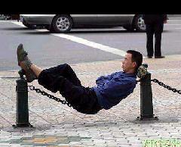
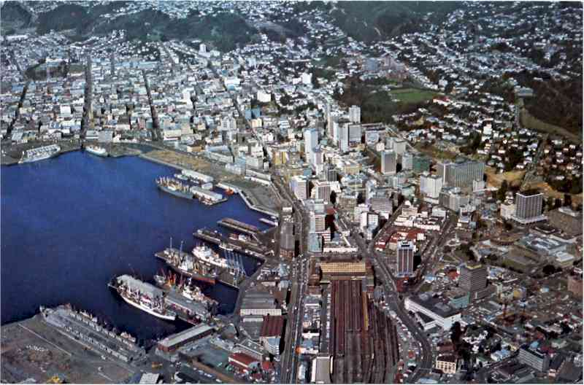
belki
Maor
Kitajec
Wellington

Slide 14
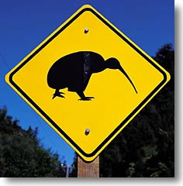
živalstvo
Živalski svet se razlikuje od vseh drugih živalskih svetov na tem planetu.
Ob S obali S otoka živi plazilec , živi fosil iz prazgodovine , tuatara.
Živi cela vrsta velikih in malih ptic
Veliko so tudi uvažali živali
Kivi- nacionalana žival
Znak da se v bljižini nahajao kiviji

Slide 15
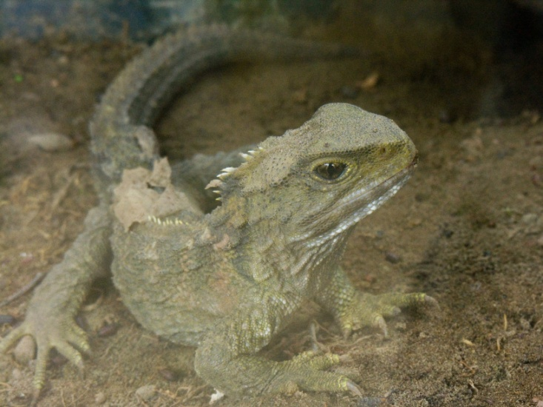
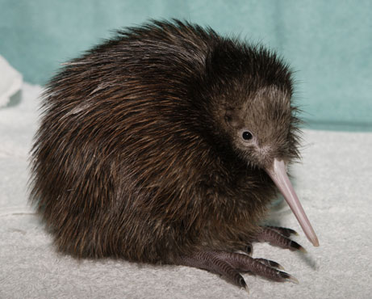
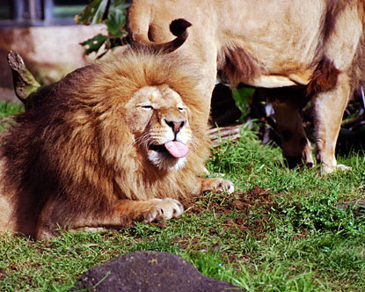
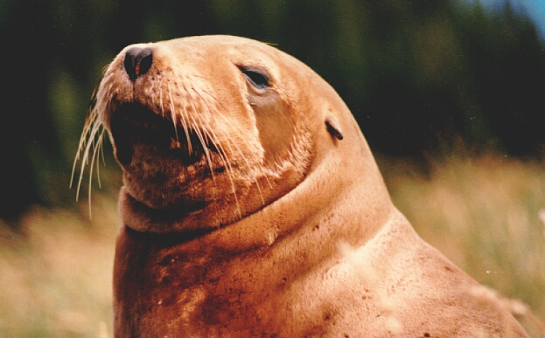
tuatara
kivi
Lev- v živalsem vrtu
morski lev

Slide 16
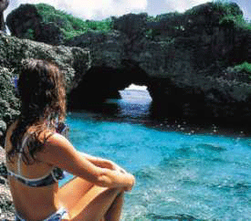
gospodarstvo
Visoko razvita država
Prevladujejo specializirane kmetije.
Najpomembnejša je živinoreja
Je pomembna izvoznica volne, ovčjega in govejega mesa…
Poljedelstvo je bolj usmerjeno na domači trg
Rudno bogastvo je skromno
Turizem je tudi zelo pomemben
Največ turistov prihaja iz Avstralije, ZDA, Japonske, Velike Britanije.
kopalka

Slide 17
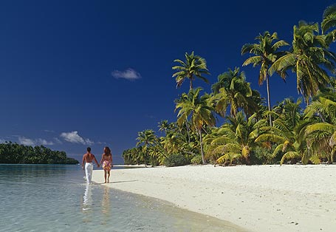
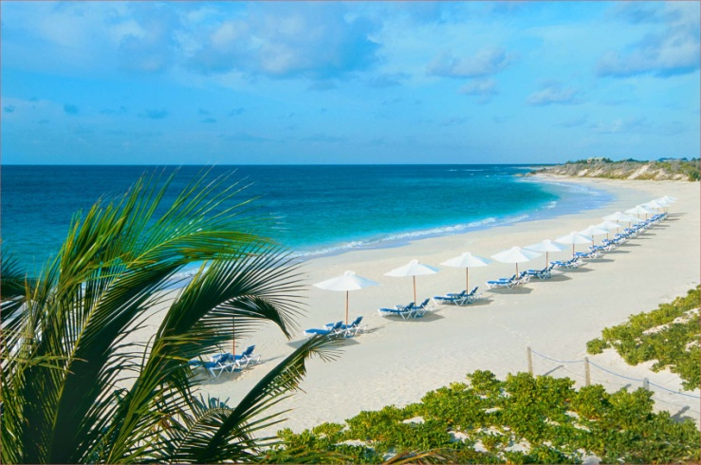
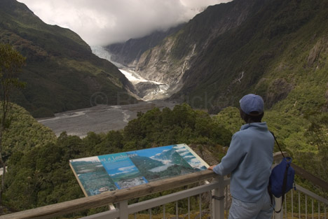
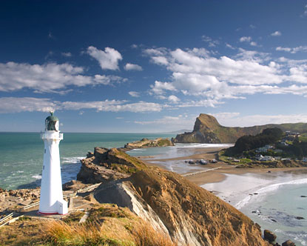
Peščeni plaživ
Novi Zelandiji
Naravni park
na južnem otoku
Plaža s
svetilnikom

Slide 18
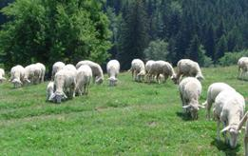
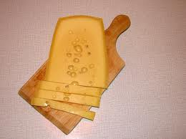
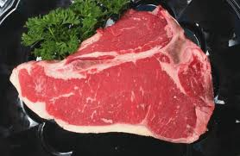
ovčereja
sir
Meso- zrezek

Slide 19
Viri- besedilo
http://www.australasia.si/AUSASIA_SI,,destinacije/nova_zelandija/tab_klima_in_vreme.htm
http://www.smrklja.si/node/16187
http://sites.google.com/site/lucijaako/novazelandija
http://www2.arnes.si/~jdobaj/zgodovina/geografija/8razred/Avst_Ocean/NZelandija_naloge/nz_vsebina.htm

Slide 20
Viri- slike
http://www.google.si/imgres?imgurl=http://www.nathanwinograd.com/wp-content/uploads/2010/04/New-Zealand-flag.jpg&imgrefurl=http://www.nathanwinograd.com/%3Fp%3D3326&usg=__iNrmML1yekoIZKT--a2Epc051A=&h=426&w=640&sz=27&hl=sl&start=0&sig2=PmkwB6vE8MjBkD7ivTQylw&zoom=1&tbnid=6g_wtr6kNACRHM:&tbnh=101&tbnw=151&ei=7q3WTP-rE8GBswbn-rCdCA&prev=/images%3Fq%3Dnew%2Bzeland%2Bflag%26um%3D1%26hl%3Dsl%26biw%3D1916%26bih%3D841%26tbs%3Disch:1&um=1&itbs=1&iact=rc&dur=265&oei=7q3WTP-rE8GBswbn-rCdCA&esq=1&page=1&ndsp=50&ved=1t:429,r:8,s:0&tx=59&ty=65
http://www.google.si/imgres?imgurl=http://www.newzealand-traveler.com/pictures/history.jpg&imgrefurl=http://www.newzealand-traveler.com/history.php&usg=__Ke211M6X7sJrUhFr4xNVH5eu3e4=&h=433&w=300&sz=10&hl=sl&start=0&sig2=wEPeHswvGwlC__HI_AtJhg&zoom=1&tbnid=aTd0pavyQsf1pM:&tbnh=127&tbnw=89&ei=mLDWTNrPNdSCswbd6OiGCA&prev=/images%3Fq%3Dnova%2Bzelandija%2Bzgodovina%26um%3D1%26hl%3Dsl%26sa%3DN%26biw%3D1916%26bih%3D841%26tbs%3Disch:10%2C3&um=1&itbs=1&iact=hc&vpx=300&vpy=178&dur=640&hovh=270&hovw=187&tx=136&ty=144&oei=mLDWTNrPNdSCswbd6OiGCA&esq=1&page=1&ndsp=53&ved=1t:429,r:12,s:0&biw=1916&bih=841
http://www.google.si/imgres?imgurl=http://www.turkishvillas.com/images/ANZACATTACK.jpg&imgrefurl=http://www.turkishvillas.com/anzac-gallipoli.htm&usg=__7gOQ0wgEqNGhMbfn8osXoC3s1BM=&h=292&w=450&sz=19&hl=sl&start=0&sig2=UZpB3L0Rv0rvEpTWHgWBwA&zoom=1&tbnid=xQ1rsI_9zs3ujM:&tbnh=117&tbnw=180&ei=xrHWTJSeAo70sgb39Pj_Bw&prev=/images%3Fq%3Dnova%2Bzelandija%2Bzgodovina%26um%3D1%26hl%3Dsl%26sa%3DN%26biw%3D1916%26bih%3D841%26tbs%3Disch:1&um=1&itbs=1&iact=rc&dur=1029&oei=xrHWTJSeAo70sgb39Pj_Bw&esq=1&page=1&ndsp=53&ved=1t:429,r:1,s:0&tx=138&ty=83

Slide 21
http://www.google.si/imgres?imgurl=http://www.artisanwebdesign.co.nz/images/world-nz-christchurch.gif&imgrefurl=http://www.artisanwebdesign.co.nz/contactus.asp&usg=__WP5vIHv_8n8UJtlaBd9ETbwqQlo=&h=340&w=420&sz=16&hl=sl&start=31&sig2=AOtMWFIiQiZc72c_S9YzwA&zoom=1&tbnid=2aWZScG7ZTLlZM:&tbnh=101&tbnw=125&ei=xLPWTKjNOo6Dswb4u6WJCA&prev=/images%3Fq%3Dnew%2Bzealand%2Bmap%2Bof%2Bthe%2Bworld%26um%3D1%26hl%3Dsl%26sa%3DX%26biw%3D1899%26bih%3D841%26tbs%3Disch:1&um=1&itbs=1
http://www.google.si/imgres?imgurl=http://www.odisej.net/si/imagelib/zoom//default/palma-uvoz/pacifiski-dvojcek-avstralija-in-nova-zelandija/325-lake_wanaka__new_zealand.jpg&imgrefurl=http://www.odisej.net/si/aranzmaji/avstralija/avstralija/pacifiski-dvojcek-avstralija-in-nova-zelandija%3Fcg%3D69%26cn%3D64%26ct%3D524%26ht%3D1886%26tab%3Ddescription&usg=__4cjz36ETKKLKm1csMm987zE2oVA=&h=400&w=533&sz=72&hl=sl&start=0&sig2=-FYEqoNnce9WSxa0r-1GCQ&zoom=1&tbnid=ekTnP8oy50ixAM:&tbnh=129&tbnw=170&ei=vLTWTOzJKsm0tAbnsNnHCA&prev=/images%3Fq%3Dnova%2Bzelandija%2Bpovr%25C5%25A1je%26um%3D1%26hl%3Dsl%26biw%3D1916%26bih%3D841%26tbs%3Disch:1&um=1&itbs=1&iact=hc&vpx=771&vpy=73&dur=359&hovh=194&hovw=259&tx=164&ty=139&oei=vLTWTOzJKsm0tAbnsNnHCA&esq=1&page=1&ndsp=50&ved=1t:429,r:4,s:0
http://www.google.si/imgres?imgurl=http://imagecache6.allposters.com/LRG/21/2188/D5DAD00Z.jpg&imgrefurl=http://abundancesecrets.com/motivational-posters/index.php%3Fitem%3D2694958&usg=__bJkgbnrN6qpVNJpZgVUR5OWQaxQ=&h=300&w=400&sz=30&hl=sl&start=40&sig2=h6wVNRPkGJxcdCmZj64_-w&zoom=1&tbnid=hA7RUTPwyMSvaM:&tbnh=93&tbnw=124&ei=0bjWTKORNoGEswbNmMCbCA&prev=/images%3Fq%3Dnew%2Bzealand%2Bmount%2Bcook%26um%3D1%26hl%3Dsl%26sa%3DX%26biw%3D1899%26bih%3D841%26tbs%3Disch:1&um=1&itbs=1
http://www.google.si/imgres?imgurl=http://www.thecanvasworks.ie/productimages/searchimages/337_Beaulieu.jpg&imgrefurl=http://www.thecanvasworks.ie/cart/viewprod/337.htm&usg=__RRNDBV1N1Hp50_i1fUDBJoM5Ew8=&h=370&w=370&sz=50&hl=sl&start=2&sig2=NxXVgPnSpHxQK3A0gW8PPw&zoom=1&tbnid=3jyf1716MLbNJM:&tbnh=122&tbnw=122&ei=NLrWTKnTCMeFswa5tdyYCA&prev=/images%3Fq%3Dnew%2Bzealand%2Bwoods%26um%3D1%26hl%3Dsl%26biw%3D1899%26bih%3D841%26tbs%3Disch:1&um=1&itbs=1
http://www.qhodnoceni.cz/view_foto.php?fid=525802

Slide 22
http://www.google.si/imgres?imgurl=http://images.forbestraveler.com/media/photos/inspirations/2007/08/volcano-10-g.jpg&imgrefurl=http://membership.forbestraveler.com/adventure/volcano-adventures-slide-10.html&usg=__ss4NPtvGqG4h8rfoPVx9Aikb_gU=&h=280&w=425&sz=61&hl=sl&start=4&sig2=Z8LtmXXH0fWwyOl23MxyNA&zoom=1&tbnid=s_7zb9da29hNEM:&tbnh=83&tbnw=126&ei=X77WTKmBN8qFswadqKWECA&prev=/images%3Fq%3Dnew%2Bzealand%2Bvolcano%26um%3D1%26hl%3Dsl%26sa%3DX%26biw%3D1899%26bih%3D841%26tbs%3Disch:1&um=1&itbs=1
http://www.google.si/imgres?imgurl=http://lloydi.com/travel-witing/round-the-world-trip/_wallpaper/_wallpaper-Images/24.jpg&imgrefurl=http://lloydi.com/travel-writing/round-the-world-trip/_wallpaper/_wallpaper-Pages/Image24.php&usg=__Y8v8yFNZa5fr90E0YZu1uzx3OaQ=&h=768&w=1024&sz=449&hl=sl&start=0&sig2=tB9SODdTkxBuiOTupCgdOQ&zoom=1&tbnid=aGq4_d9qFr0YQM:&tbnh=160&tbnw=213&ei=0MTWTKi3EYKxtAbQ5ImSCA&prev=/images%3Fq%3Dnew%2Bzeland%2Bmountain%26hl%3Dsl%26sa%3DG%26biw%3D1916%26bih%3D841%26gbv%3D2%26tbs%3Disch:1&itbs=1&iact=rc&dur=112&oei=0MTWTKi3EYKxtAbQ5ImSCA&esq=1&page=1&ndsp=32&ved=1t:429,r:8,s:0&tx=116&ty=96
http://www.google.si/imgres?imgurl=http://www.iexplore.com/img2/climate/nzl_01.gif&imgrefurl=http://www.iexplore.com/dmap/New%2BZealand/Weather%2Band%2BClimate&usg=__H8ky9YzLBpYS3Iq6y5F5KyZBrM8=&h=271&w=280&sz=12&hl=sl&start=2&sig2=9ZNCnMZ2BWcY9hABAdSBqg&zoom=1&tbnid=IzvQIVL1uEAYrM:&tbnh=110&tbnw=114&ei=QsfWTOKyG4S1tAbH5OyNCA&prev=/images%3Fq%3Dnew%2Bzealand%2Bweather%26hl%3Dsl%26sa%3DX%26biw%3D1916%26bih%3D841%26gbv%3D2%26tbs%3Disch:1&itbs=1
http://wwwgoogle.si/imgres?imgurl=http://www.wrh.noaa.gov/hnx/newslet/spring03/sun062clipart.jpg&imgrefurl=http://www.wrh.noaa.gov/hnx/newslet/spring03/dryheat.htm&usg=__uZNRjvzmTIdkzGHKruLF7CZIyjQ=&h=300&w=299&sz=48&hl=sl&start=0&sig2=p7gTj2WBDw9xFmQApB-NVg&zoom=1&tbnid=7ilYBNfFP39flM:&tbnh=161&tbnw=160&ei=O8nWTMS9CIaCswaJr7GXCA&prev=/images%3Fq%3Dsun%26hl%3Dsl%26biw%3D1916%26bih%3D841%26gbv%3D2%26tbs%3Disch:1&itbs=1&iact=rc&dur=234&oei=O8nWTMS9CIaCswaJr7GXCA&esq=1&page=1&ndsp=36&ved=1t:429,r:24,s:0&tx=116&ty=72
http://ww.google.si/imgres?imgurl=http://www.photoseek.com/07NZ-3/bin/images/large/07NZ_6230_mossy_trees.jpg&imgrefurl=http://www.photoseek.com/nz3.html&usg=__rFKK3NV08VFGWVF0EI1j1ri8IVI=&h=649&w=487&sz=367&hl=sl&start=0&sig2=C55z0M5Pf0wILXiiaR-BIg&zoom=1&tbnid=EgmmqivzRKHa8M:&tbnh=125&tbnw=94&ei=P8vWTKbaKsuDswaOroiOCA&prev=/images%3Fq%3Dnew%2Bzealand%2Btrees%26hl%3Dsl%26sa%3DX%26gbv%3D2%26biw%3D1899%26bih%3D841%26tbs%3Disch:10%2C2520%2C252&itbs=1&iact=hc&vpx=295&vpy=371&dur=639&hovh=259&hovw=194&tx=118&ty=116&oei=P8vWTKbaKsuDswaOroiOCA&esq=1&page=1&ndsp=52&ved=1t:429,r:43,s:0&biw=1899&bih=841

Slide 23
http://www.google.si/imgres?imgurl=http://www.hickerphoto.com/data/media/152/new-zealand-fern_3532.jpg&imgrefurl=http://www.hickerphoto.com/new-zealand-fern-3532-pictures.htm&usg=__o0MpPVac8gJ49LqdP26ZG6PM3YE=&h=313&w=468&sz=61&hl=sl&start=5&sig2=9NcQV7htq7-xilNVXWpjJQ&zoom=1&tbnid=2oBEuDU_889ZyM:&tbnh=86&tbnw=128&ei=ic7WTLrJG82Cswam-_mVCA&prev=/images%3Fq%3Drastline%2Bnova%2Bzelandija%26hl%3Dsl%26sa%3DX%26gbv%3D2%26biw%3D1899%26bih%3D841%26tbs%3Disch:1&itbs=1
http://www.tropicalholidayshop.com/images/tropical-rain-forest.jpg
http://www.google.si/imgres?imgurl=http://vrt-art.si/media/uploads/_custom/vrt2.jpg&imgrefurl=http://vrt-art.si/sl/Ureditev%2Bvrta&usg=__5l0Ei3rjoWYgTY8kYMleXOKL3R4=&h=300&w=400&sz=68&hl=sl&start=0&sig2=zmKjvUG_fprbuuMPexbi4Q&zoom=1&tbnid=pPe5oo9WP4ysjM:&tbnh=131&tbnw=175&ei=tNPWTOOKMo3xsgbF6uCZCA&prev=/images%3Fq%3Dzimzelene%2Brastline%26um%3D1%26hl%3Dsl%26sa%3DX%26biw%3D1899%26bih%3D841%26tbs%3Disch:1&um=1&itbs=1&iact=hc&vpx=233&vpy=353&dur=1373&hovh=194&hovw=259&tx=198&ty=100&oei=tNPWTOOKMo3xsgbF6uCZCA&esq=1&page=1&ndsp=55&ved=1t:429,r:23,s:0
http://www.google.si/imgres?imgurl=http://img183.imageshack.us/img183/8529/16076864ba9.jpg&imgrefurl=http://www.klemen.fraj.net/%3Fm%3D200610%26paged%3D5&usg=__a_b8k_3j0QqzIcwvWQnwqQWdtJs=&h=301&w=425&sz=24&hl=sl&start=0&sig2=slKE5HQmxr42WOmhTU9Dzw&zoom=1&tbnid=ZIypPn5Rm3spmM:&tbnh=127&tbnw=180&ei=LdXWTK-uDcSytAauv5GUCA&prev=/images%3Fq%3Dbelci%26um%3D1%26hl%3Dsl%26sa%3DN%26biw%3D1899%26bih%3D841%26tbs%3Disch:1&um=1&itbs=1&iact=rc&dur=187&oei=LdXWTK-uDcSytAauv5GUCA&esq=1&page=1&ndsp=53&ved=1t:429,r:12,s:0&tx=90&ty=53
http://kvak.napovednik.com/kitajci
http://www.google.si/imgres?imgurl=http://web7.netdomena1.com/jabadabadu/images/zoom/MNSJAI/indijci_indijke.jpg&imgrefurl=http://web7.netdomena1.com/jabadabadu/index.php%3Foption%3Dcom_zoom%26Itemid%3D35%26page%3Dview%26catid%3D1%26key%3D49&usg=__Z3RhwCa12iwI_82nSF9HlvRpsHc=&h=340&w=452&sz=49&hl=sl&start=0&zoom=1&tbnid=UR7d-dbZyESTeM:&tbnh=131&tbnw=163&prev=/images%3Fq%3Dindijci%26um%3D1%26hl%3Dsl%26sa%3DG%26biw%3D1899%26bih%3D841%26tbs%3Disch:1&um=1&itbs=1&iact=rc&dur=359&ei=sODWTPnUGsGytAbxwtCMCA&oei=sODWTPnUGsGytAbxwtCMCA&esq=1&page=1&ndsp=53&ved=1t:429,r:0,s:0&tx=129&ty=56

Slide 24
http://www.google.si/imgres?imgurl=http://www.flatrock.org.nz/topics/wellington/assets/once_were_wellington.jpg&imgrefurl=http://www.flatrock.org.nz/topics/wellington/switched_on_where_the_wind_blows.htm&usg=__GvR0zKiB8AM-rP75i5qUhMcIWLY=&h=528&w=800&sz=58&hl=sl&start=0&zoom=1&tbnid=-DotPr1mwVioOM:&tbnh=142&tbnw=215&prev=/images%3Fq%3Dwellington%26hl%3Dsl%26sa%3DX%26biw%3D1916%26bih%3D841%26gbv%3D2%26tbs%3Disch:1&itbs=1&iact=rc&dur=250&ei=suLWTIOVKND1sgbuzpSMCA&oei=suLWTIOVKND1sgbuzpSMCA&esq=1&page=1&ndsp=32&ved=1t:429,r:3,s:0&tx=114&ty=86
http://www.google.si/imgres?imgurl=http://upload.wikimedia.org/wikipedia/commons/7/75/Sphenodon_punctatus_in_Waikanae,_New_Zealand.jpg&imgrefurl=http://commons.wikimedia.org/wiki/File:Sphenodon_punctatus_in_Waikanae,_New_Zealand.jpg&usg=__z7C_CnBPtmqdCWaj4JsS49dCPFo=&h=2448&w=3264&sz=1747&hl=sl&start=0&zoom=1&tbnid=5JR1uVhMBmnOCM:&tbnh=129&tbnw=159&prev=/images%3Fq%3Dnova%2Bzelandija%2Btuatara%26um%3D1%26hl%3Dsl%26sa%3DN%26biw%3D1899%26bih%3D841%26tbs%3Disch:1&um=1&itbs=1&iact=rc&dur=328&ei=lOPWTIa4F8eAswbl8oSICA&oei=lOPWTIa4F8eAswbl8oSICA&esq=1&page=1&ndsp=50&ved=1t:29,r:0,s:0&tx=54&ty=49
http://www.google.si/imgres?imgurl=http://4.bp.blogspot.com/_ieqsyxnYlNo/TJMx5XspSkI/AAAAAAAALm8/JCd5qOWzGzM/s1600/kiwi-flag.gif&imgrefurl=http://coronationstreetupdates.blogspot.com/2010/09/coronation-street-fan-club-in-new.html&usg=__2mAeI-L42EEEw98bpgwVDzxfIDE=&h=238&w=350&sz=20&hl=sl&start=0&zoom=1&tbnid=Ww-seCTYUbmDFM:&tbnh=119&tbnw=175&prev=/images%3Fq%3Dkivi%2Bnew%2Bzealand%26um%3D1%26hl%3Dsl%26sa%3DN%26biw%3D1899%26bih%3D841%26tbs%3Disch:1&um=1&itbs=1&iact=hc&vpx=118&vpy=79&dur=967&hovh=185&hovw=272&tx=151&ty=72&ei=C-TWTILzC8OOswb6st2PCA&oei=C-TWTILzC8OOswb6st2PCA&esq=1&page=1&ndsp=55&ved=1t:429,r:0,s:0
http://www.google.si/imgres?imgurl=http://www.disabilitytravel.com/images/kiwi-sign.jpg&imgrefurl=http://www.disabilitytravel.com/independent/new_zealand/answers-new-zealand.htm&usg=__MsIfMZwAQcho8Zg2Iz-FVv3ykYs=&h=240&w=236&sz=17&hl=sl&start=0&zoom=1&tbnid=m3Z6ZzflKvT9AM:&tbnh=134&tbnw=132&prev=/images%3Fq%3Dnew%2Bzealand%2Bkivi%26hl%3Dsl%26sa%3DG%26biw%3D1916%26bih%3D841%26gbv%3D2%26tbs%3Disch:1&itbs=1&iact=hc&vpx=802&vpy=76&dur=405&hovh=192&hovw=188&tx=94&ty=128&ei=9OXWTMqWOY2BswbtsI2MCA&oei=9OXWTMqWOY2BswbtsI2MCA&esq=1&page=1&ndsp=54&ved=1t:429,r:4,s:0

Slide 25
http://www.google.si/imgres?imgurl=http://www.disabilitytravel.com/images/kiwi-sign.jpg&imgrefurl=http://www.disabilitytravel.com/independent/new_zealand/answers-new-zealand.htm&usg=__MsIfMZwAQcho8Zg2Iz-FVv3ykYs=&h=240&w=236&sz=17&hl=sl&start=0&zoom=1&tbnid=m3Z6ZzflKvT9AM:&tbnh=134&tbnw=132&prev=/images%3Fq%3Dnew%2Bzealand%2Bkivi%26hl%3Dsl%26sa%3DG%26biw%3D1916%26bih%3D841%26gbv%3D2%26tbs%3Disch:1&itbs=1&iact=hc&vpx=802&vpy=76&dur=405&hovh=192&hovw=188&tx=94&ty=128&ei=9OXWTMqWOY2BswbtsI2MCA&oei=9OXWTMqWOY2BswbtsI2MCA&esq=1&page=1&ndsp=54&ved=1t:429,r:4,s:0
http://www.google.si/imgres?imgurl=http://www.destination360.com/australia-south-pacific/new-zealand/images/s/auckland-zoo.jpg&imgrefurl=http://www.destination360.com/australia-south-pacific/new-zealand/auckland-zoo&usg=__YDDumNN-9sgiVWjEt4Mr2pe5PXw=&h=332&w=415&sz=64&hl=sl&start=0&zoom=1&tbnid=oEH2NtR9_858xM:&tbnh=133&tbnw=164&prev=/images%3Fq%3Dnew%2Bzealand%2Banimals%26hl%3Dsl%26sa%3DG%26biw%3D1916%26bih%3D841%26gbv%3D2%26tbs%3Disch:1&itbs=1&iact=hc&vpx=691&vpy=508&dur=6723&hovh=201&hovw=251&tx=167&ty=119&ei=NubWTJGTOY6Dswb4u6WJCA&oei=NubWTJGTOY6Dswb4u6WJCA&esq=1&page=1&ndsp=53&ved=1t:429,r:36,s:0
http://www.google.si/imgres?imgurl=http://www.zunal.com/myaccount/uploads/060217_kiwi.jpg&imgrefurl=http://www.zunal.com/index-matrix.php%3FCurriculum%3D101%26Grade%3D102%26page%3D3&usg=__kUXA4w3DOVBeU4dNF66UmudRDBg=&h=370&w=461&sz=41&hl=sl&start=0&zoom=1&tbnid=KvkIfq_AAnKONM:&tbnh=133&tbnw=173&prev=/images%3Fq%3Dnew%2Bzealand%2Banimals%26um%3D1%26hl%3Dsl%26sa%3DX%26biw%3D1899%26bih%3D841%26tbs%3Disch:10%2C252&um=1&itbs=1&iact=hc&vpx=1543&vpy=261&dur=4571&hovh=201&hovw=251&tx=138&ty=94&ei=Z-fWTMmaGMaJhQe_m7SZBQ&oei=T-fWTO_AMND1sgbuzpSMCA&esq=4&page=1&ndsp=51&ved=1t:429,r:39,s:0&biw=1899&bih=841
http://www.google.si/imgres?imgurl=http://www.redorbit.com/modules/reflib/article_images/42_4845b83b872efbedd0e63e73a4fb1df8.jpg&imgrefurl=http://www.redorbit.com/education/reference_library/mammalia/new_zealand_sea_lion/2077/index.html&usg=__doCR1q6jp1joL2HS-fMnPrwHUWo=&h=387&w=623&sz=187&hl=sl&start=0&zoom=1&tbnid=oxJYrGLgi8ETnM:&tbnh=109&tbnw=175&prev=/images%3Fq%3Dnova%2Bzelandija%2Banimals%26hl%3Dsl%26biw%3D1916%26bih%3D841%26gbv%3D2%26tbs%3Disch:10%2C3&itbs=1&iact=hc&vpx=641&vpy=78&dur=5398&hovh=177&hovw=285&tx=93&ty=101&ei=3efWTLWNMcmGsway-aSGCA&oei=3efWTLWNMcmGsway-aSGCA&esq=1&page=1&ndsp=53&ved=1t:429,r:3,s:0&biw=1916&bih=841

Slide 26
http://www.google.si/imgres?imgurl=http://www2.arnes.si/~jdobaj/zgodovina/geografija/8razred/Avst_Ocean/NZelandija_naloge/image046.jpg&imgrefurl=http://www2.arnes.si/~jdobaj/zgodovina/geografija/8razred/Avst_Ocean/NZelandija_naloge/NZnaloge_1.htm&usg=__v6DoTa2J2wiplleOx7d7J24VOtE=&h=164&w=261&sz=12&hl=sl&start=0&zoom=1&tbnid=avLKxrhwBBcdUM:&tbnh=106&tbnw=169&prev=/images%3Fq%3Dnova%2Bzelandija%2B%25C5%25BEivinoreja%26hl%3Dsl%26biw%3D1916%26bih%3D841%26gbv%3D2%26tbs%3Disch:1&itbs=1&iact=hc&vpx=147&vpy=103&dur=452&hovh=131&hovw=208&tx=182&ty=65&ei=mOjWTPXPD4L3sgakx4H9Bw&oei=mOjWTPXPD4L3sgakx4H9Bw&esq=1&page=1&ndsp=54&ved=1t:429,r:0,s:0
http://www.google.si/imgres?imgurl=http://kandela.blog.siol.net/files/2009/09/bohinjski-sir.jpg&imgrefurl=http://kandela.blog.siol.net/2009/09/22/kravji-bal-z-zamudo/&usg=__V8L83m3bRRmXizyWi4SnlQjjvOM=&h=388&w=520&sz=43&hl=sl&start=0&zoom=1&tbnid=2hYUOc9PSnZKFM:&tbnh=134&tbnw=163&prev=/images%3Fq%3Dsir%26hl%3Dsl%26gbv%3D2%26biw%3D1899%26bih%3D841%26tbs%3Disch:1&itbs=1&iact=hc&vpx=120&vpy=356&dur=125&hovh=194&hovw=260&tx=188&ty=79&ei=sunWTNvAL4WDswaZhrSWCA&oei=sunWTNvAL4WDswaZhrSWCA&esq=1&page=1&ndsp=56&ved=1t:429,r:22,s:0
http://www.hickerphoto.com/new-zealand-tourism-information-3542-pictures.htm
http://www.google.si/imgres?imgurl=http://www.spasifikmag.com/images/travel%2520pacific/ARTICLES/niue/18AugNiueTourism.gif&imgrefurl=http://www.spasifikmag.com/travelthepacific_niue18aug08nztourismteamsupwithniue/&usg=__6j-oTm2B0tOOF3Kc8Owk86OgETQ=&h=242&w=275&sz=47&hl=sl&start=0&zoom=1&tbnid=yVmJJZv3Q3qZ8M:&tbnh=134&tbnw=152&prev=/images%3Fq%3Dnova%2Bzelandija%2Bturizem%26um%3D1%26hl%3Dsl%26sa%3DN%26biw%3D1899%26bih%3D841%26tbs%3Disch:1&um=1&itbs=1&iact=rc&dur=374&ei=BerWTLXbHoaytAbN6bGXCA&oei=BerWTLXbHoaytAbN6bGXCA&esq=1&page=1&ndsp=50&ved=1t:429,r:10,s:0&tx=107&ty=87
http://www.google.si/imgres?imgurl=http://www.indonesiaindonesia.com/imagehosting/images/607/1_1LG-cusinart-resort-sandy-beaches.jpg&imgrefurl=http://www.indonesiaindonesia.com/imagehosting/index.php%3Fn%3D32789&usg=__gaoOSXB9VOhDCEL4zOFzysMe6uA=&h=1128&w=1700&sz=237&hl=sl&start=0&zoom=1&tbnid=0ShPEhlgg6oF8M:&tbnh=113&tbnw=170&prev=/images%3Fq%3Dnew%2Bzealand%2Bbeaches%26hl%3Dsl%26gbv%3D2%26biw%3D1899%26bih%3D841%26tbs%3Disch:1&itbs=1&iact=hc&vpx=1353&vpy=80&dur=671&hovh=183&hovw=276&tx=141&ty=116&ei=UOrWTI-dHo2EswaZn-CHCA&oei=UOrWTI-dHo2EswaZn-CHCA&esq=1&page=1&ndsp=48&ved=1t:429,r:7,s:0

Slide 27
http://www.google.si/imgres?imgurl=http://www.rtvslo.si/_up/photos/2009/09/23/u66115-108836_rde-e-meso_blogshow.jpg&imgrefurl=http://www.rtvslo.si/modload.php%3F%26c_mod%3Dblog%26op%3Dfunc%26func%3Dprint%26c_menu%3D31508&usg=__nc5mSgKyaERZCw48F0ebdH5rPec=&h=378&w=580&sz=33&hl=sl&start=8&zoom=1&tbnid=Ky3ZSOafxvnTAM:&tbnh=87&tbnw=134&prev=/images%3Fq%3Dmeso%26hl%3Dsl%26biw%3D1916%26bih%3D841%26gbv%3D2%26tbs%3Disch:1&itbs=1
http://www.google.si/imgres?imgurl=http://www.happytours.eu/images/destinations/cook_islands_beach.jpg&imgrefurl=http://www.happytours.eu/si/porocna-potovanja/nova-zelandija.html&usg=__w74KBtnxdK07I3bEmSvux9oJtE0=&h=314&w=455&sz=31&hl=sl&start=0&zoom=1&tbnid=7NtmYTorxJh1CM:&tbnh=130&tbnw=173&prev=/images%3Fq%3Dnova%2Bzelandija%26um%3D1%26hl%3Dsl%26sa%3DN%26biw%3D1899%26bih%3D841%26tbs%3Disch:1&um=1&itbs=1&iact=hc&vpx=1453&vpy=520&dur=3541&hovh=186&hovw=270&tx=88&ty=84&ei=xevWTNyvGIOGswaJssyFCA&oei=xevWTNyvGIOGswaJssyFCA&esq=1&page=1&ndsp=51&ved=1t:429,r:39,s:0
http://www.google.si/imgres?imgurl=http://www.happytours.eu/images/destinations/new_zealand.jpg&imgrefurl=http://www.happytours.eu/si/porocna-potovanja/nova-zelandija.html&usg=__FRvJUtgV1D9DrRpsZfPZkuGVWFo=&h=332&w=415&sz=43&hl=sl&start=0&zoom=1&tbnid=JOSVFhB50s1yRM:&tbnh=133&tbnw=167&prev=/images%3Fq%3Dnova%2Bzelandija%2Bby%2Bby%26hl%3Dsl%26sa%3DX%26biw%3D1916%26bih%3D841%26gbv%3D2%26tbs%3Disch:1&itbs=1&iact=hc&vpx=804&vpy=72&dur=2683&hovh=201&hovw=251&tx=157&ty=118&ei=QuzWTL_2Foq0tAbkq6ToDg&oei=QuzWTL_2Foq0tAbkq6ToDg&esq=1&page=1&ndsp=49&ved=1t:429,r:4,s:0
http://www.google.si/imgres?imgurl=http://www.nzataglance.com/wp-content/uploads/2008/01/new-zealand-bay-of-islands-large.jpg&imgrefurl=http://www.ringaraja.net/forum/fb.asp%3Fm%3D5090392&usg=__wwIlZwIeq8qxHuKZzEde-GDWu-w=&h=360&w=432&sz=34&hl=sl&start=0&zoom=1&tbnid=Ngp8HFknuXurSM:&tbnh=157&tbnw=187&prev=/images%3Fq%3Dnova%2Bzelandija%2Bbay%2Bbay%26hl%3Dsl%26biw%3D1916%26bih%3D841%26gbv%3D2%26tbs%3Disch:1&itbs=1&iact=rc&dur=94&ei=kezWTJfjMc6Cswb_oryaCA&oei=kezWTJfjMc6Cswb_oryaCA&esq=1&page=1&ndsp=32&ved=1t:429,r:2,s:0&tx=104&ty=124

Slide 28
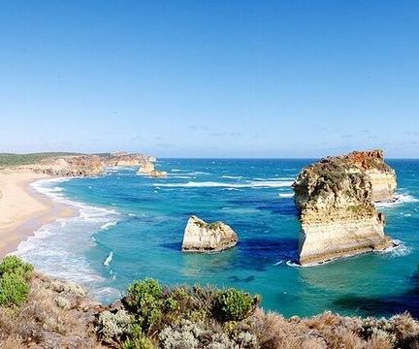
konec

