Slide 1
ROMUNIJA
PREDMET:GEOGRAFIJA

Slide 2
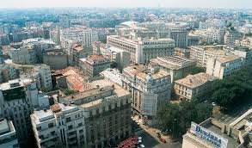
OSNOVNI PODATKI
GLAVNO MESTO: BUKAREŠTA
PREBIVALCI: 20 MILJONOV
POVRŠINA: 238.391 KM2
PREDSEDNIK: KLAUS LOHANNIS
PREDSEDNIK VLADE: VICTOR PONTA
ZASTAVA:

Slide 3
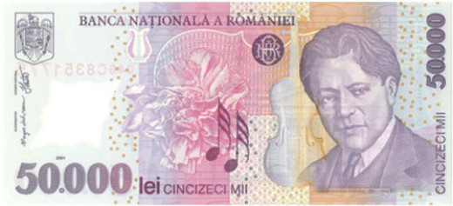
GRB:
DENARNA VALUTA: ROMUNSKI LEV

Slide 4
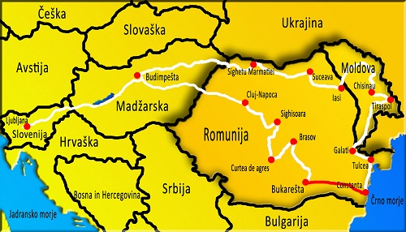
VERA: 80%PRAVOSLAVCEV IN 16%ATEISTOV
SOSEDNJE DRŽAVE:MADŽARSKA,SRBIJA BOLGARIJA IN UKRAJINA
GOSPODARSTVO: INDUSTRIJA,TRGOVINA, NAHAJALIŠČA: NAFTE,PREMOGA,ŽELEZA

Slide 5
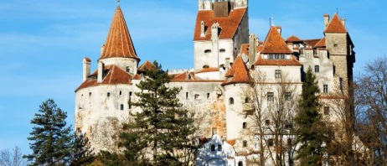
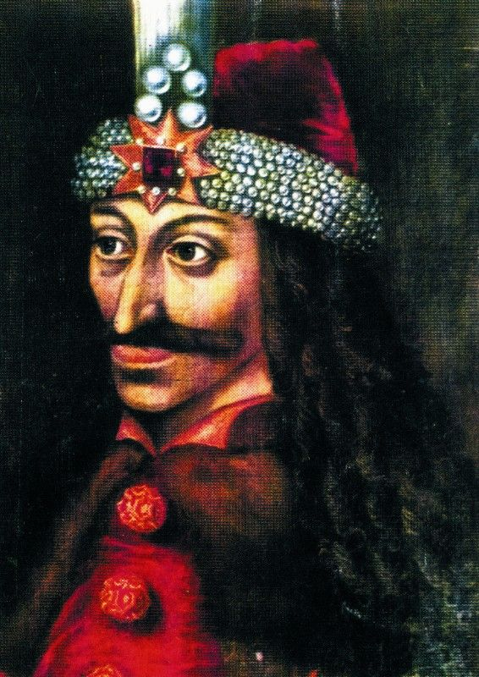
ZANIMIVOSTI
TRANSILVANIJA
GROF DRAKULA

Slide 6
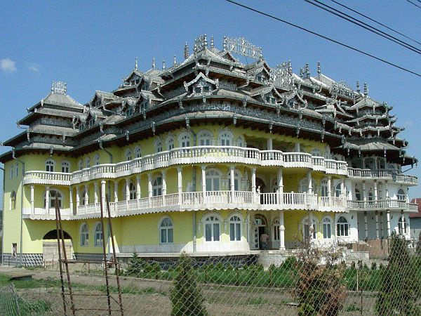
ROMSKI DVOREC

Slide 7
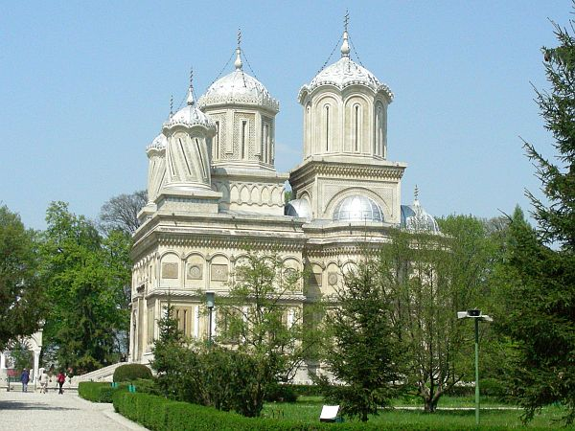
VELIČASTNA CERKEV BISERICA DOBNEASCA

Slide 8
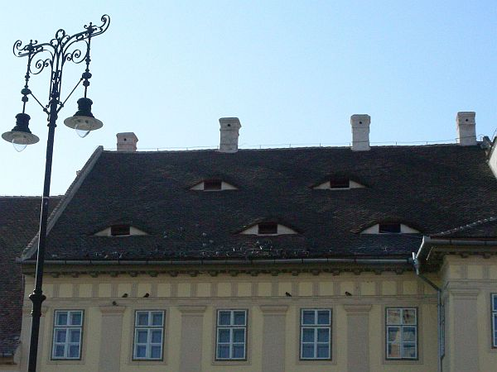
ZNAMENITA OČESA NA STREHAH

Slide 9
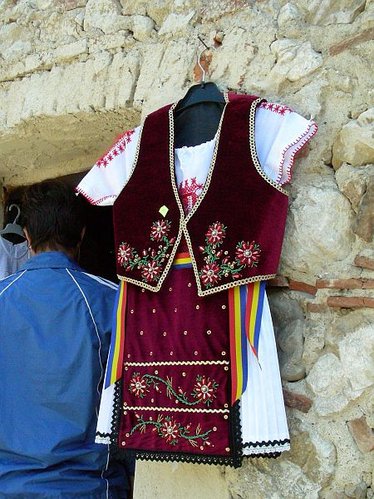
ROMUNSKA
NARODNA
NOŠA

Slide 10
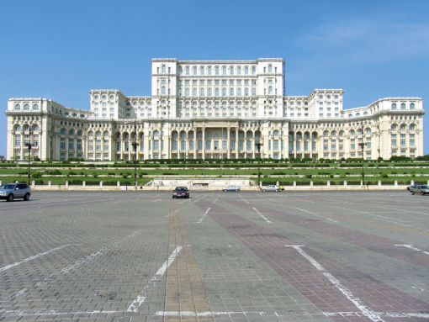
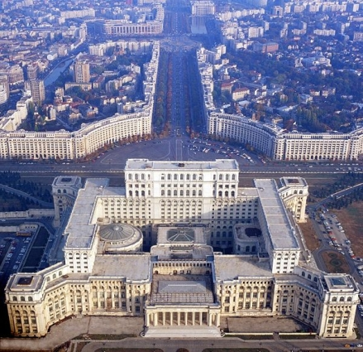
GJHZHU
PALAČA LJUDSTVA

Slide 11
VELIKONOČNA JAJCA

Slide 12
ROMUNSKI GROBOVI

Slide 13
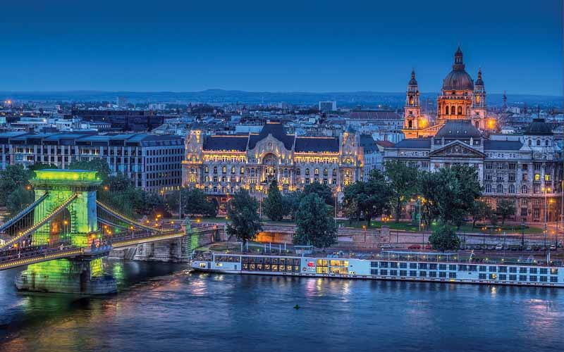
BUKAREŠTA

Slide 14
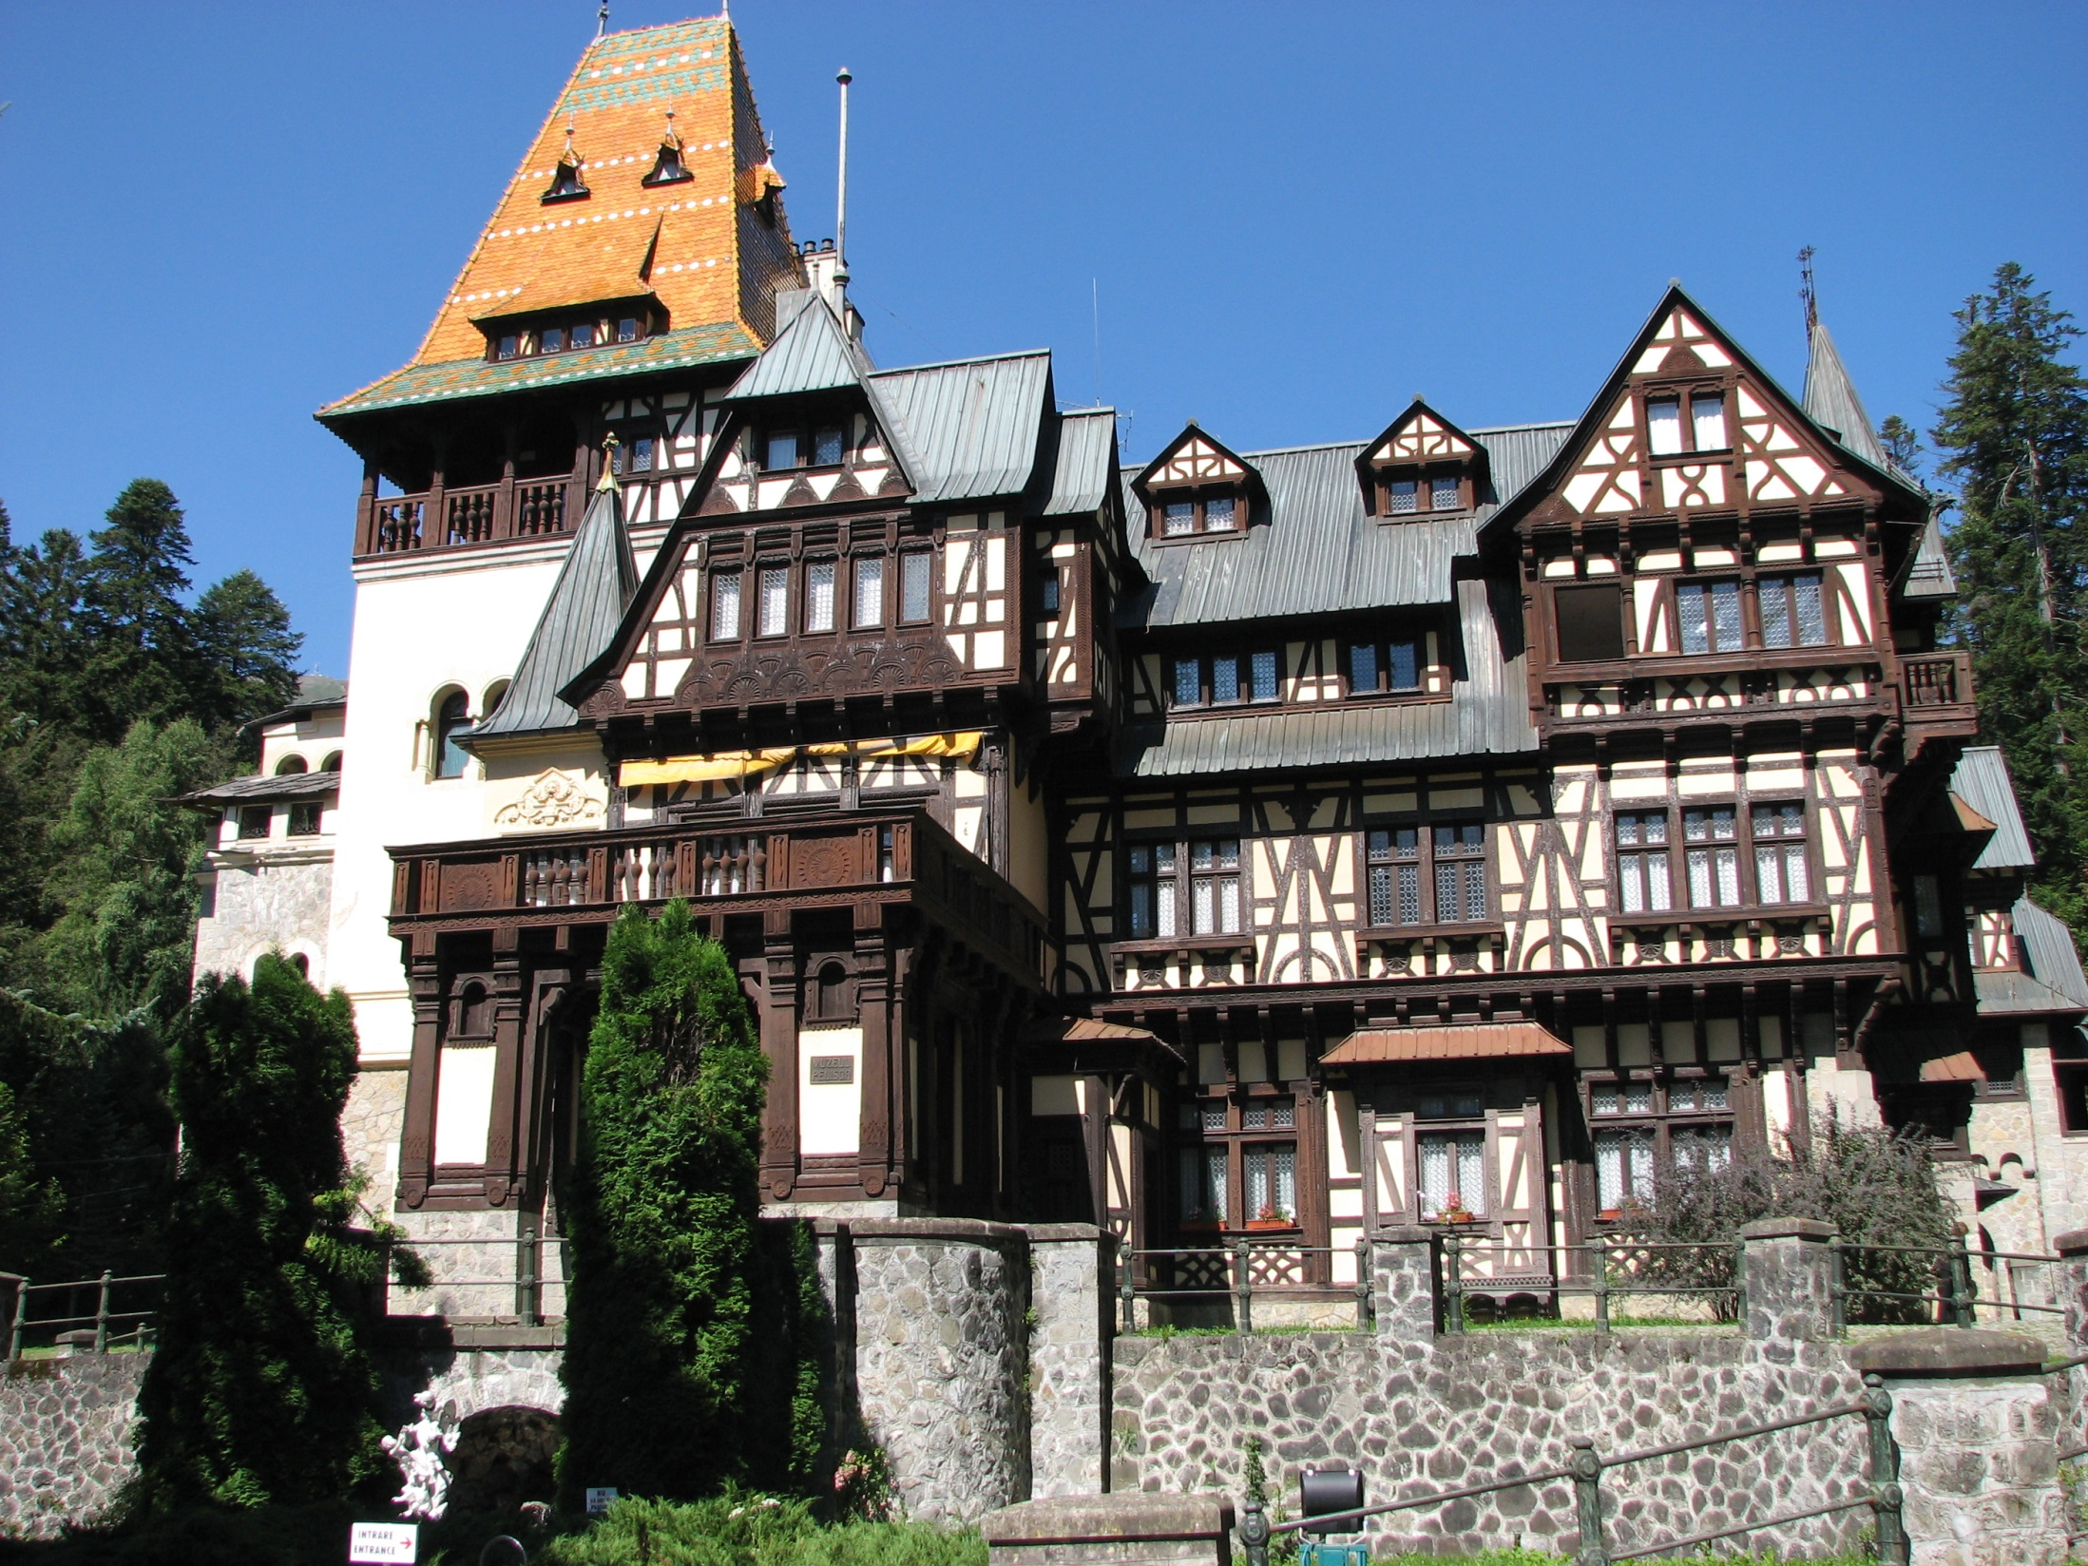
PELISOR

Slide 15
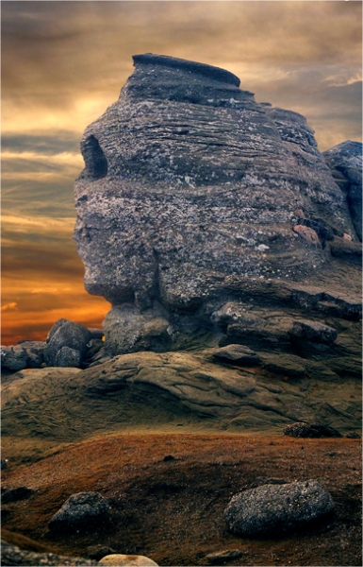
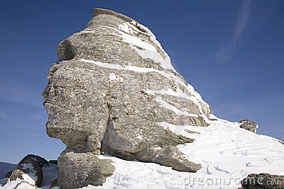
SPHINX

Slide 16
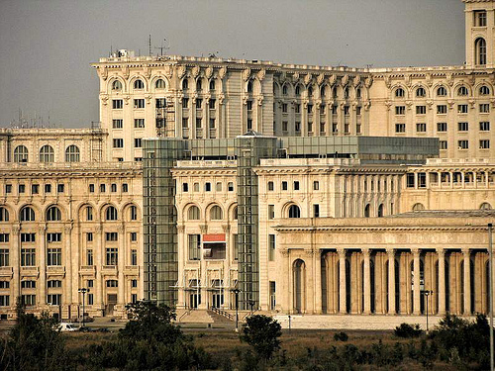
NARODNI MUZEJ NOVEJŠE UMETNOSTI

Slide 17
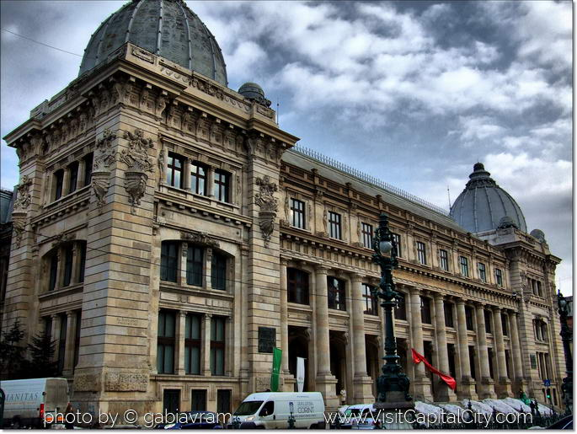
NARODNI MUZEJ ZGODOVINE

Slide 18
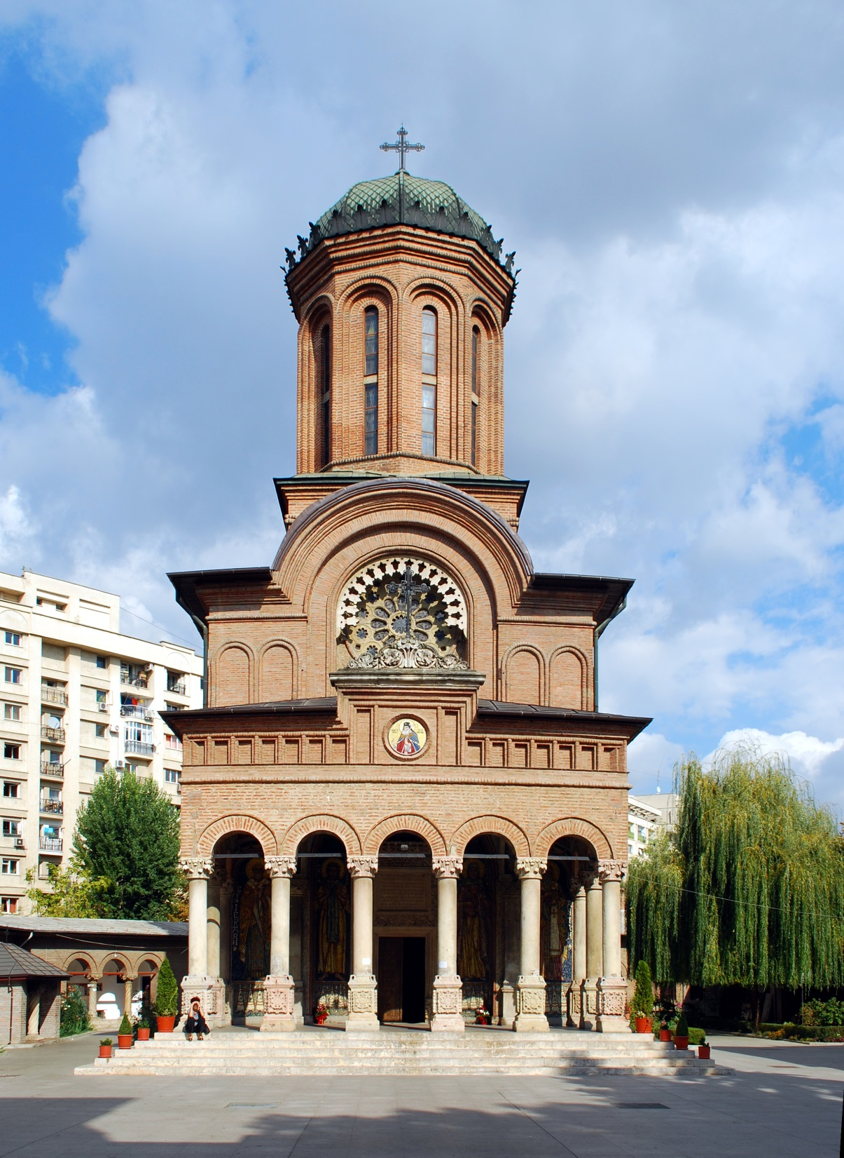
M A ANTIM
HFGH

Slide 19
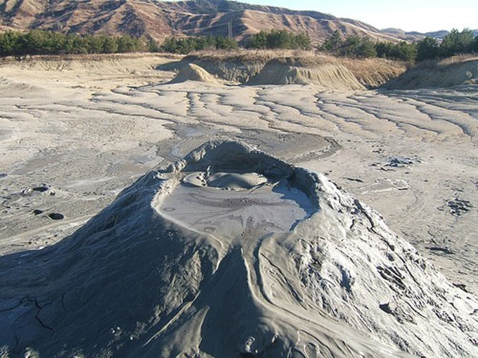
VULKAN NOROIOSI

Slide 20
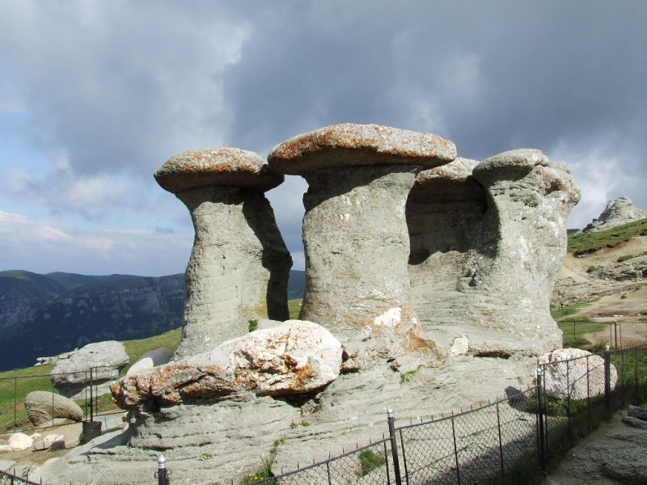
BABLE BUCEGI

Slide 21
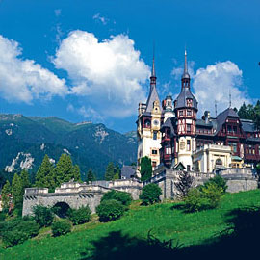
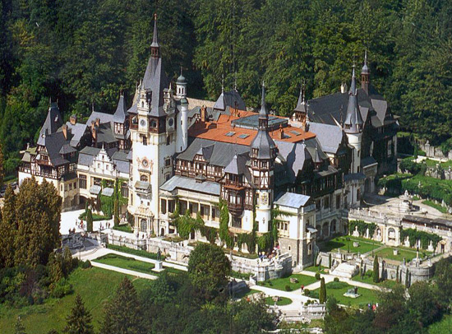
GRAD PELES
HGGKJ

Slide 22
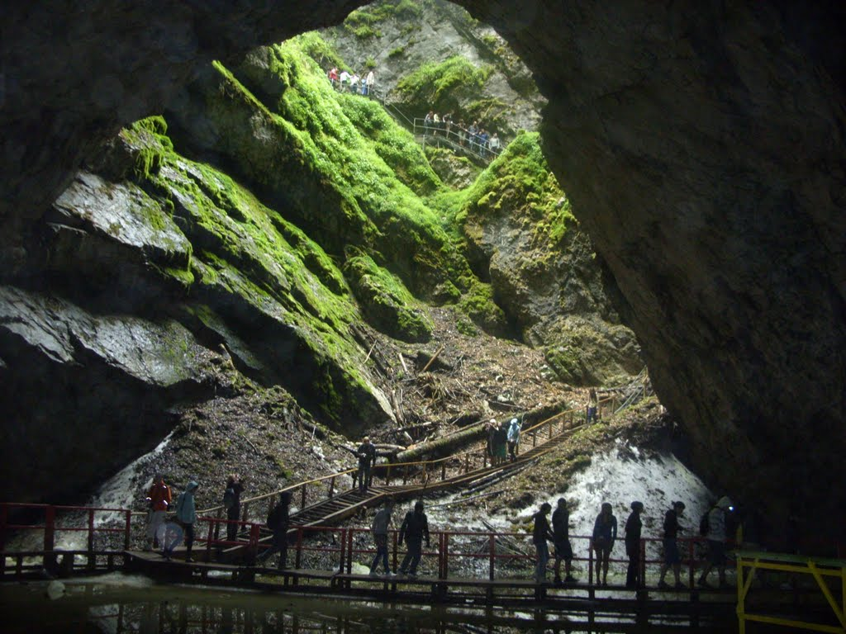
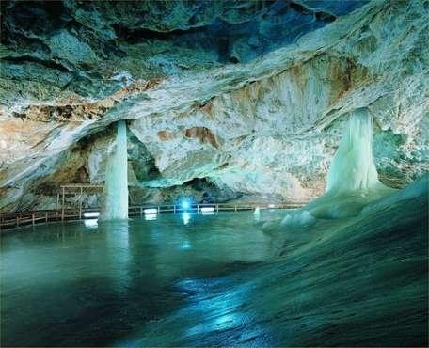
JAMA SCARISOARA

Slide 23
VIRI
https://www.google.si/search?q=peli%C8%99or+castle&biw=1024&bih=623&stick=H4sIAAAAAAAAAGOovnz8BQMDQzsHsxCHfq6-gVmyYaUSJ4iVlGFuGa-lkJ1spZ-Tn5xYkpmfp5-cX5pXUlRplVhSUpSYDBIqfsTozS3w8sc9YSmnSWtOXmO04SKoRUiCi801rySzpFKIj4tHCm6vBgPPl4V6JsH_HjFqBGU7qu04e111enQnAAYK8N-kAAAA&source=lnms&sa=X&ei=T4YhVZjhHsScsgHNBw&sqi=2&pjf=1&ved=0CAoQ_AUoAA&dpr=1#q=scarisoara+cave&stick=H4sIAAAAAAAAAGOovnz8BQMDQzsHsxCHfq6-gVmyYaUSJ4iVXmWalqylkJ1spZ-Tn5xYkpmfp5-cX5pXUlRplVhSUpSYDBIqfsTozS3w8sc9YSmnSWtOXmO04SKoRUiCi801rySzpFKIj4tHCm6vBgPPZdf2qcqFKTLLy5g9StjlOF7Jc58CAC77BhSkAAAA
https://www.google.si/search?q=peli%C8%99or+castle&biw=1024&bih=623&stick=H4sIAAAAAAAAAGOovnz8BQMDQzsHsxCHfq6-gVmyYaUSJ4iVlGFuGa-lkJ1spZ-Tn5xYkpmfp5-cX5pXUlRplVhSUpSYDBIqfsTozS3w8sc9YSmnSWtOXmO04SKoRUiCi801rySzpFKIj4tHCm6vBgPPl4V6JsH_HjFqBGU7qu04e111enQnAAYK8N-kAAAA&source=lnms&sa=X&ei=T4YhVZjhHsScsgHNBw&sqi=2&pjf=1&ved=0CAoQ_AUoAA&dpr=1#q=merry+cemetery+romania&stick=H4sIAAAAAAAAAGOovnz8BQMDQzsHsxCHfq6-gVmyYaUSJ4hlkp1lWaKlkJ1spZ-Tn5xYkpmfp5-cX5pXUlRplVhSUpSYDBIqfsTozS3w8sc9YSmnSWtOXmO04SKoRUiCi801rySzpFKIj4tHCm6vBgNP0QvGv8GTHv6t1N_0i9EnZuWta77PABOvL3mkAAAA
https://www.google.si/search?q=peli%C8%99or+castle&biw=1024&bih=623&stick=H4sIAAAAAAAAAGOovnz8BQMDQzsHsxCHfq6-gVmyYaUSJ4iVlGFuGa-lkJ1spZ-Tn5xYkpmfp5-cX5pXUlRplVhSUpSYDBIqfsTozS3w8sc9YSmnSWtOXmO04SKoRUiCi801rySzpFKIj4tHCm6vBgPPl4V6JsH_HjFqBGU7qu04e111enQnAAYK8N-kAAAA&source=lnms&sa=X&ei=T4YhVZjhHsScsgHNBw&sqi=2&pjf=1&ved=0CAoQ_AUoAA&dpr=1#q=antim&stick=H4sIAAAAAAAAAGOovnz8BQMDQzsHsxCHfq6-gVmyYaUSJ4hlbmhZkaWlkJ1spZ-Tn5xYkpmfp5-cX5pXUlRplVhSUpSYDBIqfsTozS3w8sc9YSmnSWtOXmO04SKoRUiCi801rySzpFKIj4tHCm6vBgPPs8nMoSwRIjsuhLE7_YvamTp1y51CAFD7s5ukAAAA

Slide 24
https://www.google.si/search?q=peli%C8%99or+castle&biw=1024&bih=623&stick=H4sIAAAAAAAAAGOovnz8BQMDQzsHsxCHfq6-gVmyYaUSJ4iVlGFuGa-lkJ1spZ-Tn5xYkpmfp5-cX5pXUlRplVhSUpSYDBIqfsTozS3w8sc9YSmnSWtOXmO04SKoRUiCi801rySzpFKIj4tHCm6vBgPPl4V6JsH_HjFqBGU7qu04e111enQnAAYK8N-kAAAA&source=lnms&sa=X&ei=T4YhVZjhHsScsgHNBw&sqi=2&pjf=1&ved=0CAoQ_AUoAA&dpr=1#q=vulcani+noroiosi+romania&stick=H4sIAAAAAAAAAGOovnz8BQMDQzsHsxCHfq6-gVmyYaUSJ4iVHG9mUKilkJ1spZ-Tn5xYkpmfp5-cX5pXUlRplVhSUpSYDBIqfsTozS3w8sc9YSmnSWtOXmO04SKoRUiCi801rySzpFKIj4tHCm6vBgPPuVQZ9mzhLOl9CrP63m-7qc5UubUBAIaybLakAAAA
https://www.google.si/search?q=peli%C8%99or+castle&biw=1024&bih=623&stick=H4sIAAAAAAAAAGOovnz8BQMDQzsHsxCHfq6-gVmyYaUSJ4iVlGFuGa-lkJ1spZ-Tn5xYkpmfp5-cX5pXUlRplVhSUpSYDBIqfsTozS3w8sc9YSmnSWtOXmO04SKoRUiCi801rySzpFKIj4tHCm6vBgPPl4V6JsH_HjFqBGU7qu04e111enQnAAYK8N-kAAAA&source=lnms&sa=X&ei=T4YhVZjhHsScsgHNBw&sqi=2&pjf=1&ved=0CAoQ_AUoAA&dpr=1#q=babele+bucegi&stick=H4sIAAAAAAAAAGOovnz8BQMDQzsHsxCHfq6-gVmyYaUSJ4hlnpOdm6WlkJ1spZ-Tn5xYkpmfp5-cX5pXUlRplVhSUpSYDBIqfsTozS3w8sc9YSmnSWtOXmO04SKoRUiCi801rySzpFKIj4tHCm6vBgPP2sYoWcsrd7YmPpKPvOpVUd9yLG8DAFb6qBOkAAAA
WIKIPEDIJA
UČBENIK ZA SEDMI RAZRED: GEOGRAFIJA 7 AVTOR:HELENA VRDEV

