Slide 1
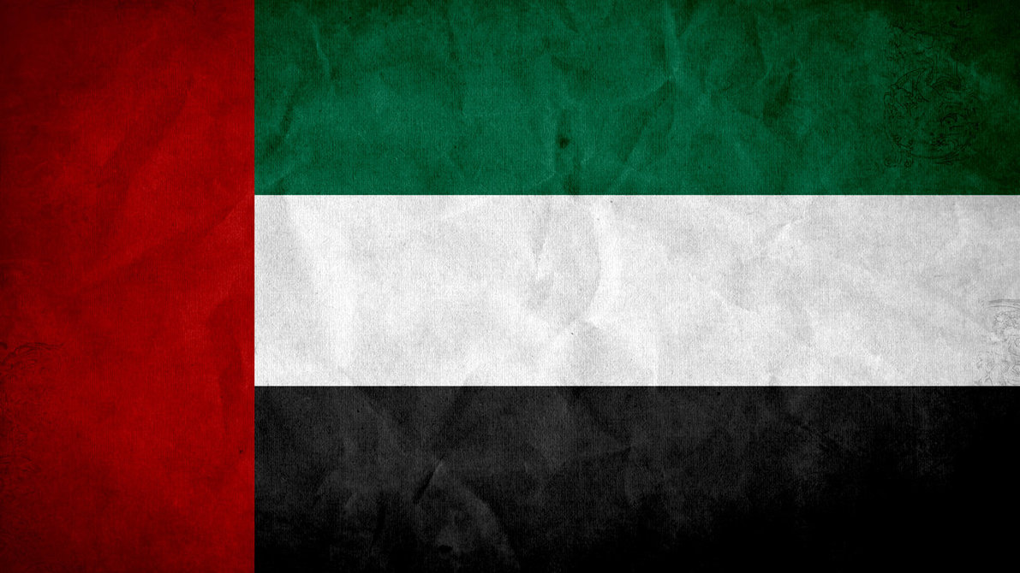
ZDRUŽENI ARABSKI EMIRATI
https://www.google.si/url?sa=i&rct=j&q=&esrc=s&source=images&cd=&cad=rja&uact=8&ved=0ahUKEwiBvcWz8LTQAhXHvxQKHS0-Dc8QjRwIBw&url=http%3A%2F%2Fsyndikata-np.deviantart.com%2Fart%2FUnited-Arab-Emirates-Grunge-Flag-360083891&bvm=bv.139250283,d.d24&psig=AFQjCNHj73KIExr0L8N-kYdfOJb0JDLsPw&ust=1479646869818537

Slide 2
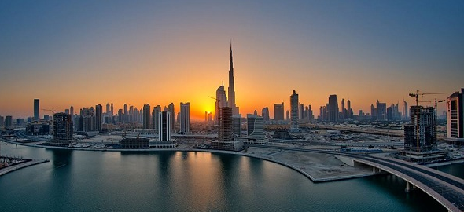
OSNOVNI PODATKI
7 mest ( Emiratov )
Glavno mesto: Abu Dabi
Največje mesto: Dubai
Prebivalstvo: 9,4 M
Površina: 82.880 km
Valuta: dirham
Himna: Ishy Bilady
2
https://www.google.si/url?sa=i&rct=j&q=&esrc=s&source=images&cd=&cad=rja&uact=8&ved=0ahUKEwi11PyVhbXQAhUBoRQKHeipDdAQjRwIBw&url=http%3A%2F%2Fwww.arabiangazette.com%2Fdubai-tops-middle-east-office-space-real-estate-20130623%2F&bvm=bv.139250283,d.d24&psig=AFQjCNHTA9OlwSLtMg1RWcmh2PAE0NarEA&ust=1479652447690151
https://www.google.si/url?sa=i&rct=j&q=&esrc=s&source=images&cd=&cad=rja&uact=8&ved=0ahUKEwiy7_OS9bTQAhWFOhQKHXg7DtAQjRwIBw&url=http%3A%2F%2Fwww.win10themes.com%2Fgrunge-wallpapers.htm&bvm=bv.139250283,d.d24&psig=AFQjCNH3hTICCw9Lq3rvNL9iTXPJwMw5ig&ust=1479648117018517

Slide 3
Uradni jezik: arabščina
Vera: Islam 76% prebivalstva, krščanstvo 8%, drugo 15%
https://www.google.si/url?sa=i&rct=j&q=&esrc=s&source=images&cd=&cad=rja&uact=8&ved=0ahUKEwiy7_OS9bTQAhWFOhQKHXg7DtAQjRwIBw&url=http%3A%2F%2Fwww.win10themes.com%2Fgrunge-wallpapers.htm&bvm=bv.139250283,d.d24&psig=AFQjCNH3hTICCw9Lq3rvNL9iTXPJwMw5ig&ust=1479648117018517
https://youtu.be/Fxa0UDeU7t0

Slide 4
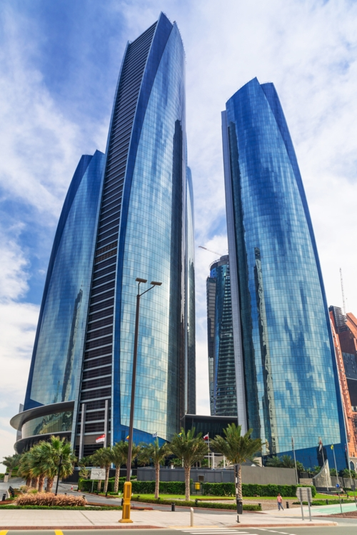
ABU DHABI
prebivalstvo: 896.700 ( 2009 )
Mesto zgrajeno po odkritju nafte l. 1958
Najbogatejši emirat v ZAE v smislu BDP
Večina mesta na otokih
Veliko atrakcij
Veliko nebotičnikov
Peščene plaže
Moderna arhitektura
https://www.google.si/url?sa=i&rct=j&q=&esrc=s&source=images&cd=&cad=rja&uact=8&ved=0ahUKEwiy7_OS9bTQAhWFOhQKHXg7DtAQjRwIBw&url=http%3A%2F%2Fwww.win10themes.com%2Fgrunge-wallpapers.htm&bvm=bv.139250283,d.d24&psig=AFQjCNH3hTICCw9Lq3rvNL9iTXPJwMw5ig&ust=1479648117018517
https://img.thetake.com/product_images/4d6b7503b9d4c6a74cf566bd4cb5e08e2cf169b6636474f955d9355c122a4845.jpeg

Slide 5
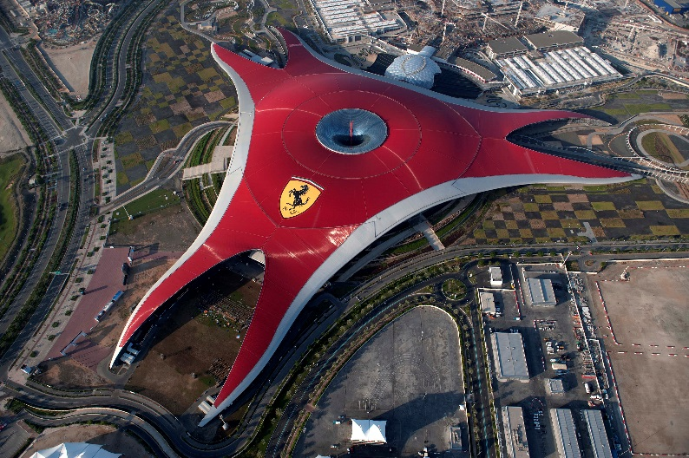
FERRARI WORLD ( ABU DHABI )
Zabaviščni park
Največja pokrita površina na svetu
Odprt: 4. november 2010
Površina: 86,000 m
Najbolj znana atrakcija na Arabskem polotoku
5 vlakcev smrti
Dirkalna steza
Simulatorji vožnje
4D kino
Nahaja se na otoku Yas
2
https://yasisland.ae/wp-content/uploads/2016/09/FWAD-aerial-shot.jpg
https://youtu.be/8sg9QQxbhi8
https://www.google.si/url?sa=i&rct=j&q=&esrc=s&source=images&cd=&cad=rja&uact=8&ved=0ahUKEwiy7_OS9bTQAhWFOhQKHXg7DtAQjRwIBw&url=http%3A%2F%2Fwww.win10themes.com%2Fgrunge-wallpapers.htm&bvm=bv.139250283,d.d24&psig=AFQjCNH3hTICCw9Lq3rvNL9iTXPJwMw5ig&ust=1479648117018517

Slide 6
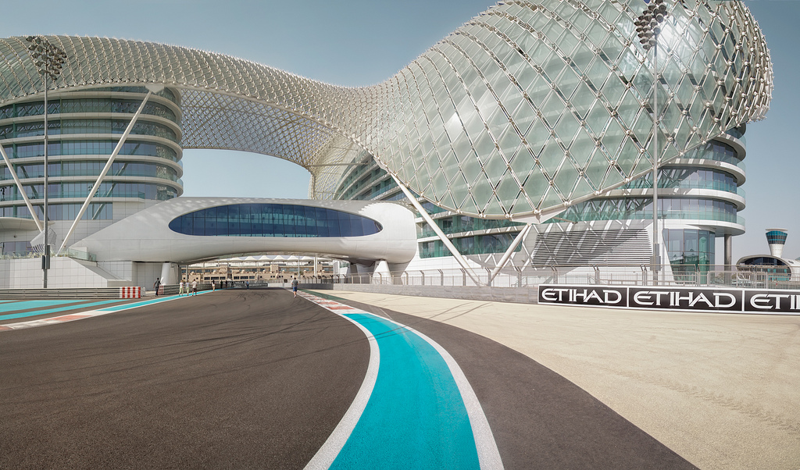
DIRKALIŠČE YAS MARINA ( ABU DHABI )
Leži na otoku Yas
Sprejme 50.000 gledalcev
Odprli so ga maja 2009
Stal je 893 milijonov EUR
Zasnoval ga je Herman Tilke
Dolžina: 5.554 km
Zavoji: 21
Rekord: 1:40.279- Sebastian Vettel
https://www.google.si/url?sa=i&rct=j&q=&esrc=s&source=images&cd=&cad=rja&uact=8&ved=0ahUKEwj-m5S72b_QAhXHECwKHV7dDSwQjRwIBw&url=https%3A%2F%2Fwww.flickr.com%2Fphotos%2Fmartin2012%2F7431097490&psig=AFQjCNGquyRrCJB2iSTu_CtpZo8IbQ1OJw&ust=1480018633605206
https://www.google.si/url?sa=i&rct=j&q=&esrc=s&source=images&cd=&cad=rja&uact=8&ved=0ahUKEwiy7_OS9bTQAhWFOhQKHXg7DtAQjRwIBw&url=http%3A%2F%2Fwww.win10themes.com%2Fgrunge-wallpapers.htm&bvm=bv.139250283,d.d24&psig=AFQjCNH3hTICCw9Lq3rvNL9iTXPJwMw5ig&ust=1479648117018517

Slide 7
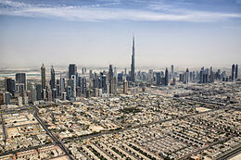
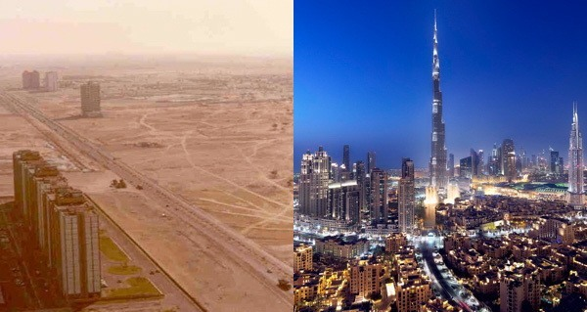
DUBAI
Največji emirat
Prebivalstvo: 2,1 milijona
Slovi po visokih stavbah
Med najbolj obiskanimi turističnimi mesti
Med 10. najdražjimi mesti na svetu
https://www.google.si/url?sa=i&rct=j&q=&esrc=s&source=images&cd=&cad=rja&uact=8&ved=0ahUKEwiy7_OS9bTQAhWFOhQKHXg7DtAQjRwIBw&url=http%3A%2F%2Fwww.win10themes.com%2Fgrunge-wallpapers.htm&bvm=bv.139250283,d.d24&psig=AFQjCNH3hTICCw9Lq3rvNL9iTXPJwMw5ig&ust=1479648117018517
https://upload.wikimedia.org/wikipedia/commons/thumb/1/1b/Dubai_skyline_2015.jpg/260px-Dubai_skyline_2015.jpg
http://all-that-is-interesting.com/wordpress/wp-content/uploads/2016/02/dubai-then-and-now.jpg

Slide 8
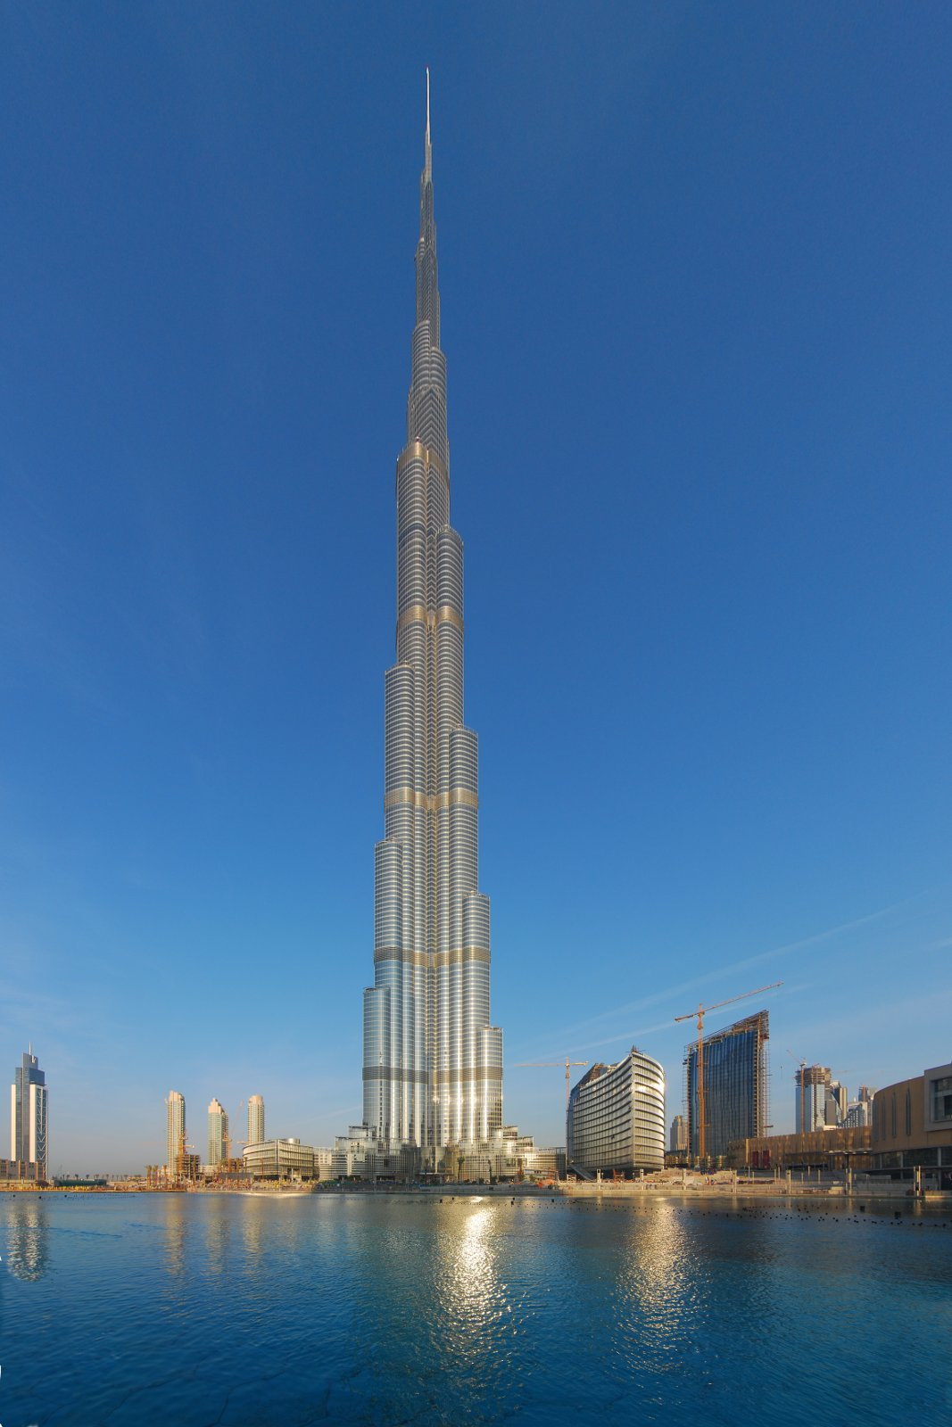
BURJ KHALIFA ( DUBAI )
Zgrajen leta 2010
Začeli so ga graditi l. 2004
Najvišja zgradba je postal že l. 2008
Glavni izvajalec: Samsung
Višina: 828m
211 nadstropij
Načrtovan za mešano rabo
Vrednost: 20 milijard ameriških dolarjev
https://www.google.si/url?sa=i&rct=j&q=&esrc=s&source=images&cd=&cad=rja&uact=8&ved=0ahUKEwiy7_OS9bTQAhWFOhQKHXg7DtAQjRwIBw&url=http%3A%2F%2Fwww.win10themes.com%2Fgrunge-wallpapers.htm&bvm=bv.139250283,d.d24&psig=AFQjCNH3hTICCw9Lq3rvNL9iTXPJwMw5ig&ust=1479648117018517
https://www.google.si/url?sa=i&rct=j&q=&esrc=s&source=images&cd=&cad=rja&uact=8&ved=0ahUKEwiVvfzi6L_QAhVDiywKHZNVBlAQjRwIBw&url=https%3A%2F%2Fen.wikipedia.org%2Fwiki%2FFile%3ABurj_Khalifa_building.jpg&psig=AFQjCNHs6NShKLg9s7CnME1wNrccBOD2Hw&ust=1480022760752165

Slide 9
VIRI
Wikpedia:
https://sl.wikipedia.org/wiki/Zdru%C5%BEeni_arabski_emirati
https://sl.wikipedia.org/wiki/Abu_Dabi
https://sl.wikipedia.org/wiki/Dirkali%C5%A1%C4%8De_Yas_Marina
https://en.wikipedia.org/wiki/Yas_Marina_Circuit
https://en.wikipedia.org/wiki/Ferrari_World
https://en.wikipedia.org/wiki/Yas_Marina_Circuit
https://sl.wikipedia.org/wiki/Dubaj
https://en.wikipedia.org/wiki/Dubai
https://sl.wikipedia.org/wiki/Burd%C5%BE_Kalifa
Google slike
Youtube
https://www.google.si/url?sa=i&rct=j&q=&esrc=s&source=images&cd=&cad=rja&uact=8&ved=0ahUKEwiy7_OS9bTQAhWFOhQKHXg7DtAQjRwIBw&url=http%3A%2F%2Fwww.win10themes.com%2Fgrunge-wallpapers.htm&bvm=bv.139250283,d.d24&psig=AFQjCNH3hTICCw9Lq3rvNL9iTXPJwMw5ig&ust=1479648117018517

Slide 10
https://memecrunch.com/meme/ADKGV/hvala-za-pozornost/image.png?w=500&c=1
https://www.google.si/url?sa=i&rct=j&q=&esrc=s&source=images&cd=&cad=rja&uact=8&ved=0ahUKEwiy7_OS9bTQAhWFOhQKHXg7DtAQjRwIBw&url=http%3A%2F%2Fwww.win10themes.com%2Fgrunge-wallpapers.htm&bvm=bv.139250283,d.d24&psig=AFQjCNH3hTICCw9Lq3rvNL9iTXPJwMw5ig&ust=1479648117018517

