Slide 1
JUSTIN BIEBER

Slide 2
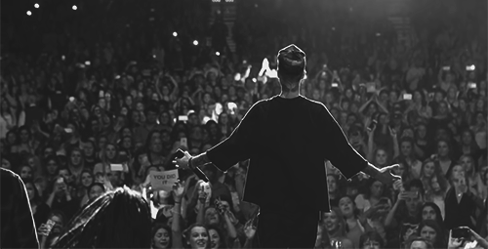
SINGER AND SONGWRITTER

Slide 3
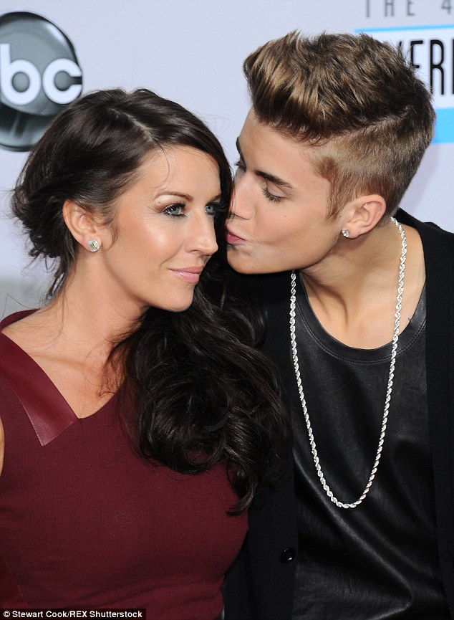
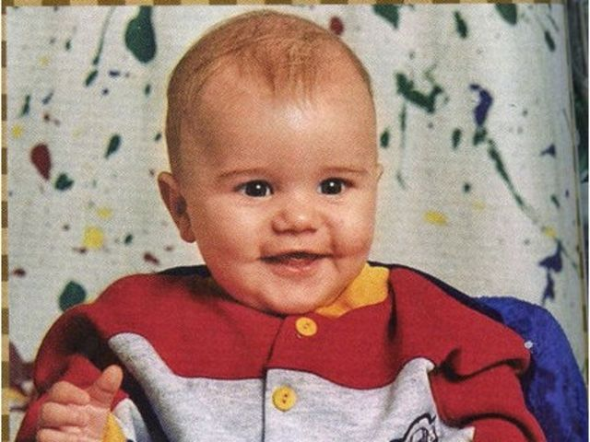
1. MARCH 1994

Slide 4
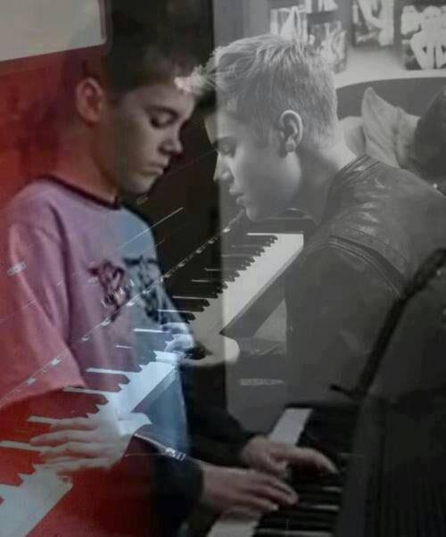
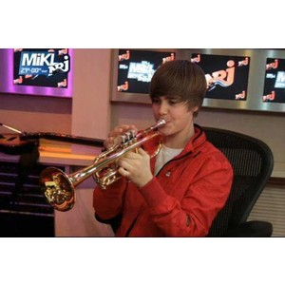
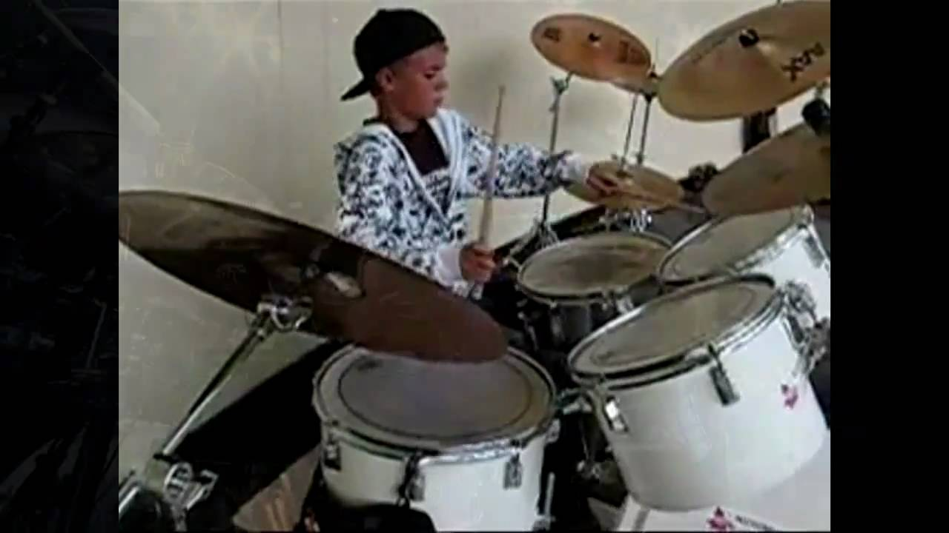
TALENTS

Slide 5
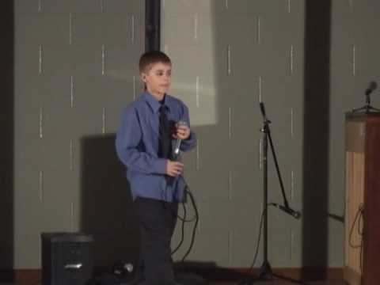
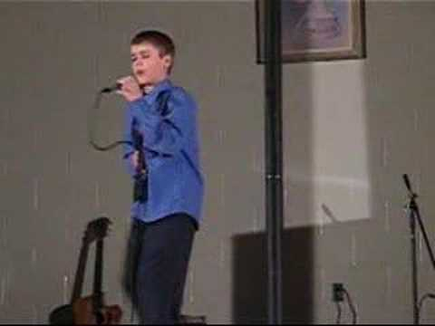
2.PLACE AT THE LOCAL COMPETITION

Slide 6
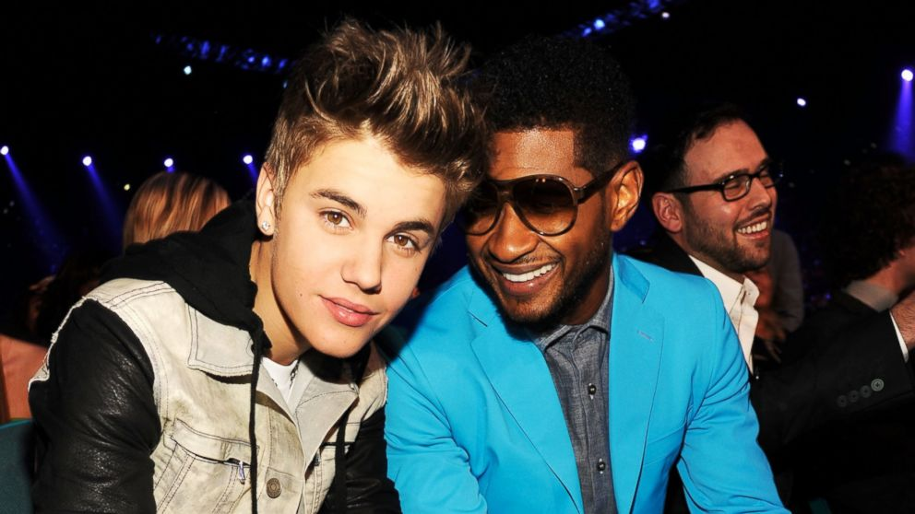
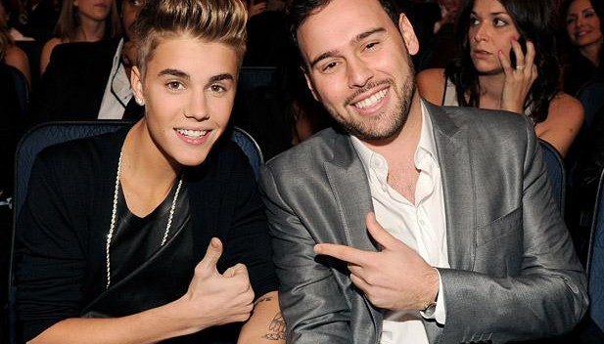
USHER AND SCOOTER BROWN
JUSTIN AND USHER JUSTIN AND SCOOTER BRAUN

Slide 7
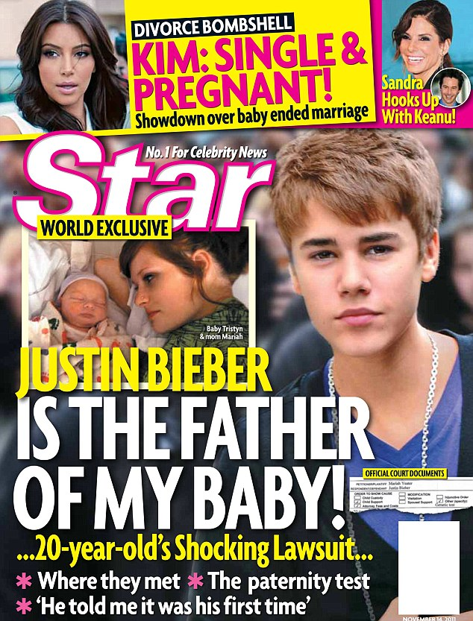
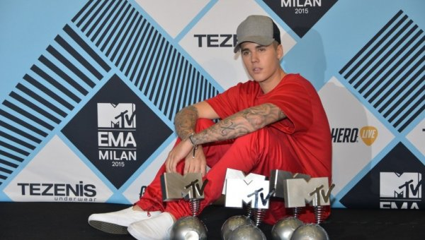
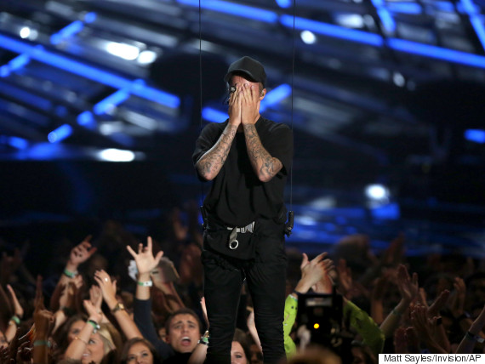
UPS AND DOWNS

Slide 8
FAME AND FORTUNE CAN’T BUY HAPPINES

