Slide 1
Green day

Slide 2
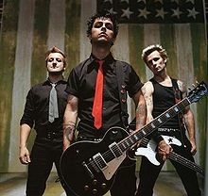
KDO SO?
ameriška rock skupina,
iz Kalifornije,
nastala leta 1989,
člani: Billie Joe Armstrong,
Mike Dirnt,
Tre Cool.
Billie Joe Armstrong – kitara, glavni vokal
Mike Dirnt – bas kitara
Tre Cool - bobni

Slide 3
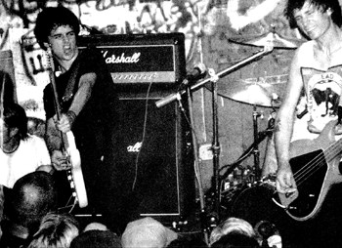
ZGODOVINA
Billie Joe Armstrong, Mike Dirnt, Al Sobrante – Sweet Children,
preimenujejo se v Green Day.
Leta 1990 - skupina izda svoj prvi singl 1,000 Hours,
istega leta Al Sobrante zapusti bend,
Billie in Mike povabita Tre-ja Cool-a.

Slide 4
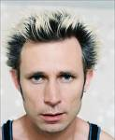
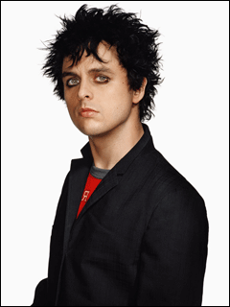
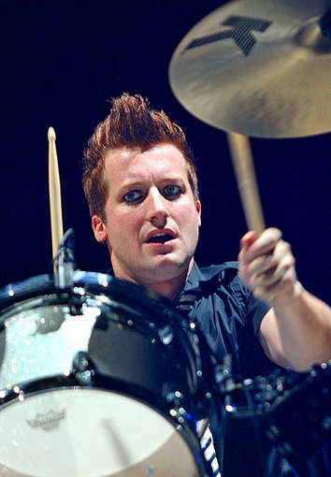
USPEHI
Do danes prodali več kot 70 milijonov zgoščenk,
njihov uspeh deloval na Sum 41 in Good Charlotte,
Imajo štiri Grammy nagrade (najboljši alternativni album - Dookie; najboljši rock album - American Idiot, najboljša pesem leta - Boulevard Of Broken Dreams in najboljši rock album - 21st century breakdown).

Slide 5
GLASBA
Glasbeni slogi: punk rock
pop rock
alternativni rock
vokal, kitara, bas kitara, bobni.
ALBUMI
1039/Smoothed Out Slappy Hours (1990),
Kerplunk (1992),
Dookie (1994),
Insomniac (1995),
Nimrod (1997),
Warning (2000),
American Idiot (2004),
21st Century Breakdown (2009)

Slide 6
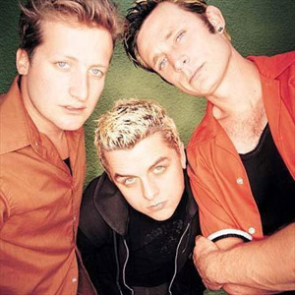
POSLUŠAMO
Green Day: She
http://www.youtube.com/watch?v=XgumG6Oeg1w
Opiši značilnosti glasbe.
O čem govori besedilo?
BESEDILO
She She screams in silence. A sulley roit penetrating through her mind. Waiting for a sign to smash the silence with the brick of self control. Are you locked up in a world that's been planned out for you? Are you feeling like a social tool without a use? Scream at me until my ears bleed. I'm taking heed in just for you. She She's figured out all her doubts were someone else's point of view. Waking up this time to smash the silence with the brick of self control. Are you locked up in a world that's been planned out for you? Are you feeling like a social tool without a use? Scream at me until my ears bleed. I'm taking heed in just for you. Are you locked up in a world that's been planned out for you? Are you feeling like a social tool without a use? Scream at me until my ears bleed. I'm taking heed in just for you.

Slide 7
POSLUŠAMO
Green Day: Wake me up when September ends
Opiši značilnosti glasbe.
O čem govori besedilo?
1. ploskanje | x x |  | x |  | x x |  | x |  | x x |  | x |  | x x |  | x
2. tleskanje s prsti |  | x |  | x |  | x |  | x |  | x |  | x |  | x |  | x
3. udarjanje po kolenih | x | x | x | x |  |  |  |  | x | x | x | x
4. tolkala | x x | x x | x x | x x | x x | x x | x x | x x | x x | x x | x x | x x | x x | x x | x x | x x

Slide 8
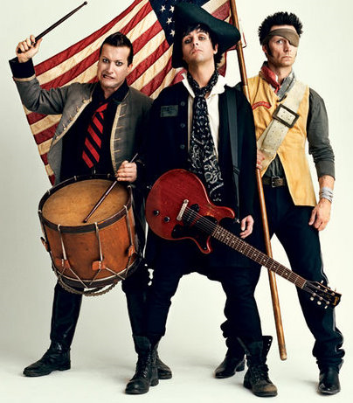
ALI VEŠ?
Billie je pri enajstih letih dobil kitaro, na katero še danes igra.
Njihov najslabše prodan album je bil Warning (2000) – prodali se le milijon izvodov.
Album American Idiot (2004) najbolj izstopa med ostalimi – na njem je veliko več pop rocka, kot na prejšnjih.
Sodelovali so tudi s skupino U2.

Slide 9
GREEN DAY SO ZAKON =)
1. Kdo so člani? Kaj izvajajo?
Billie Joe Armstrong – kitara, glavni vokal,
Mike Dirnt – bas kitara,
Tre Cool – bobni.
2. Naštej tri albume in tri pesmi.
Albumi: American Idiot, 21st Century Breakdown, Dookie.
Pesmi: Know your enemy, She, Wake me up when September ends.
3. Kako se je imenoval bend pred skupino Green Day z Armstrongom in Dirntom?
Bend se je imenoval Sweet Children.

