Slide 1
GUNS N’ ROSES - GN‘R

Slide 2
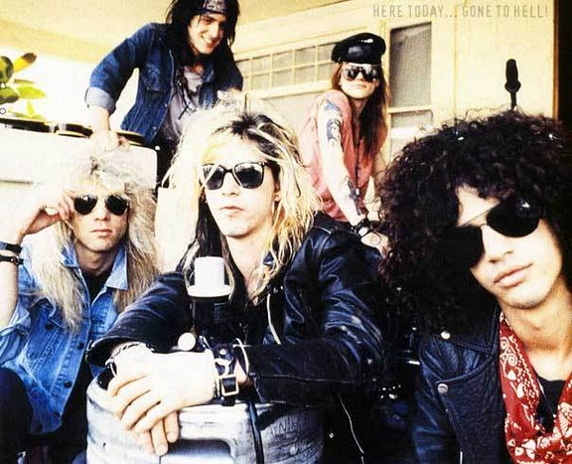
OSNOVNo
Skupina je nastala v Los Angelesu, leta 1985
Prodali so preko 100 milijonov albumov po celem svetu
Skupina je nastala iz dveh prvotnih skupin: Hollywood rose in L.A. Gun’s → Guns n’ roses
Njihova prva turneja: ‘‘Hell tour’’

Slide 3
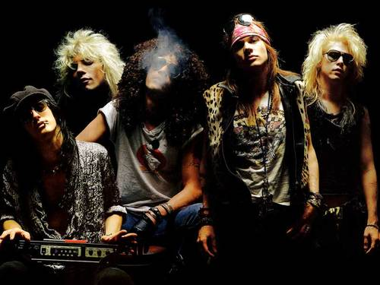
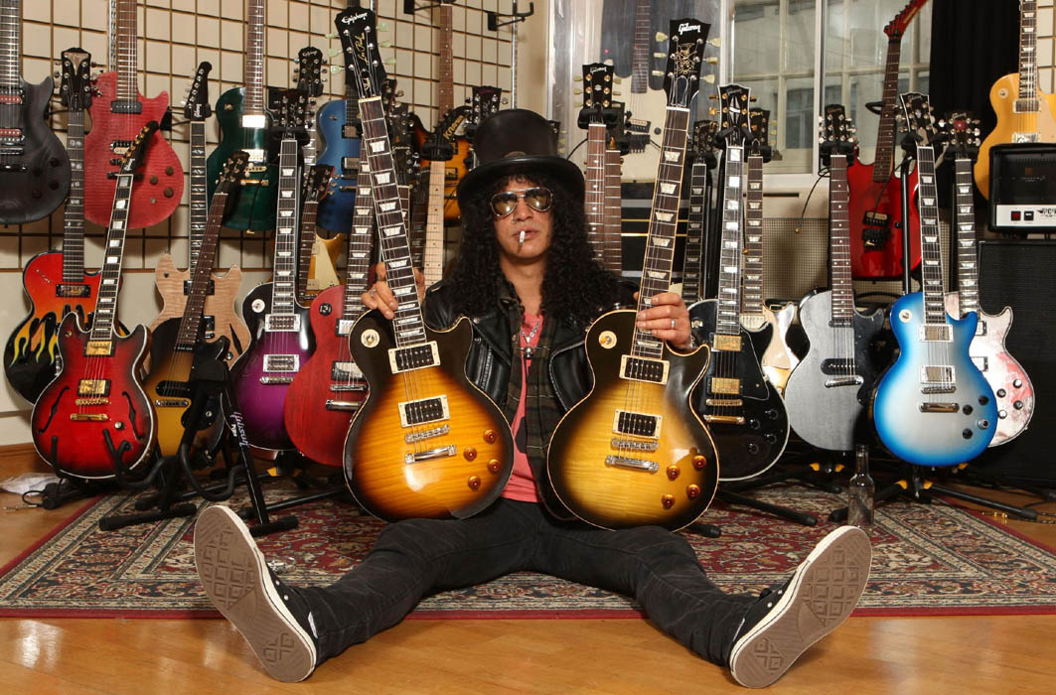
GLASBENI SLOG
punk rock,
blues-rock,
heavy metal in
hard rock

Slide 4
ČLANI
Izvirna zasedba
Axl Rose (vokal)
Slash (kitara)
Duff McKagan (bas)
Izzy Stradlin (ritem kitara)
Steven Adler (bobni)
Trenutna zasedba
Axl Rose(vokal)
Tommy Stinson (bas)
Brian Mantia (bobni)
Frank Ferrer (bobni)
Richard Fortus (kitara)
DJ Ashba (kitara)
Dizzy Reed (klaviature)
Chris Pitman (klaviature)
Ron "Bumblefoot" Thal (kitara)

Slide 5
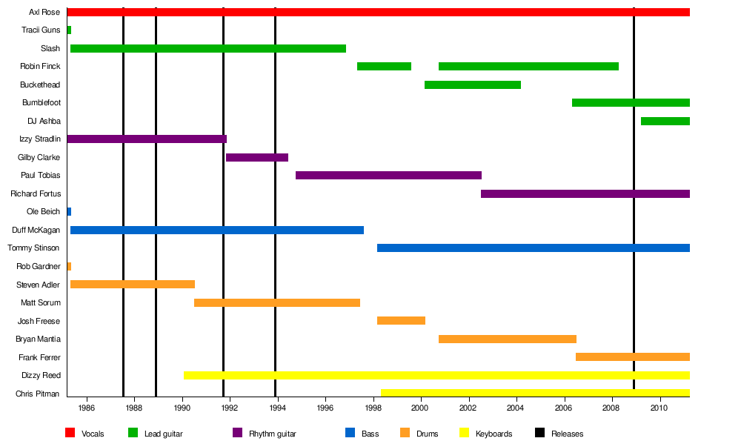

Slide 6
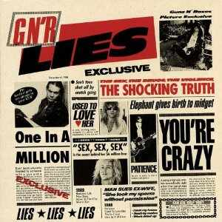
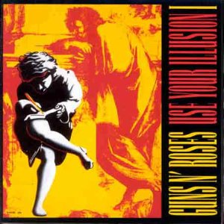
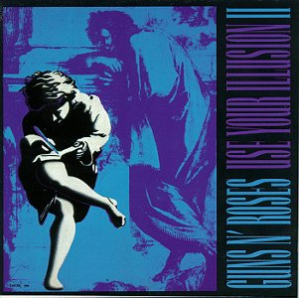
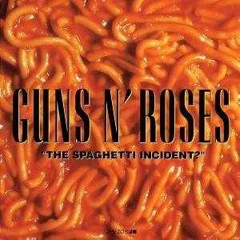
DOSEDANJI ALBUMI
Apetite for Destruction
G N’ R Lies
Use your illusion I.
Use your illusion II.
’’The spagheti incident?’’
Chinese democracy
+ Live era ‘87-’93
+ Greatest hits

Slide 7
NAGRADE, PRIZNANJA IN KRITIKE
NAGRADE | PREJELI | NOMINIRANI
American music awards | 4 | 8
Brit awards | 0 | 4
Grammy awards | 0 | 3
MTV video music awards | 4 | 8
Worlds music awards | 2 | 2
SKUPAJ: | 10 | 25

Slide 8
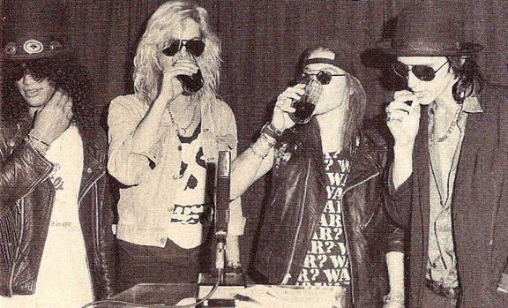
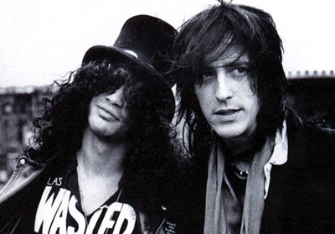
Revija Rolling Stones jih je uvrstila na lestvico "500 najboljših albumov vseh časov "
Q magazine je uvrstila Guns N' Roses na seznam: "50 Bands to See Before You Die "

Slide 9
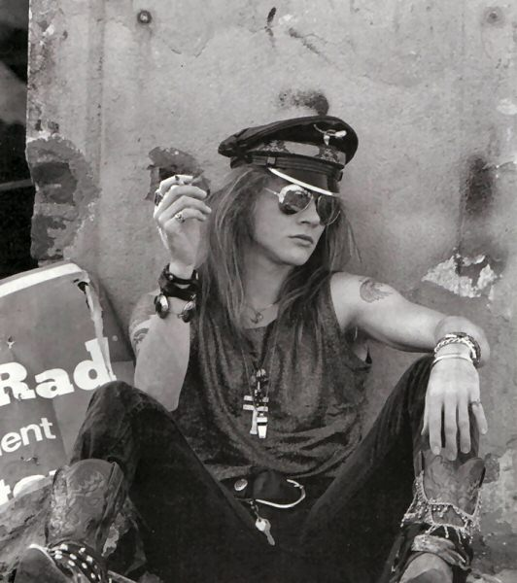
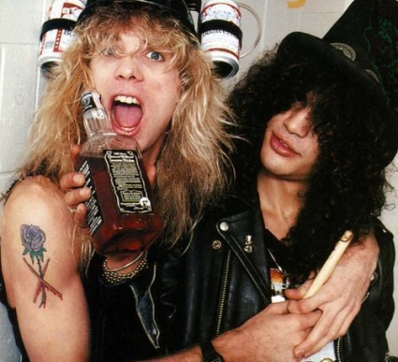
VH1 jih je uvrstila na deveto mesto na seznamu: "100 Greatest Artists of Hard Rock",
in na 11 mesto na seznamu: "Top 50 bands"
Kritiki so nekatere člane obtoževali slabega ravnanja z alkoholom in nekaterimi prepovedanimi substancami
Axl-a pa so kritizirali predvsem zaradi nošenja majic Charlesa Mansona

Slide 10
THE SPAGETTI INCIDENT ?
USE YOUR ILLUSION I.
"Since I Don't Have You"
"New Rose"
"Down on the Farm"
"Human Being"
"Raw Power"
"Ain't It Fun" "Buick Mackane (Big Dumb Sex)"
"Hair of the Dog"
"Attitude"
"You Can't Put Your Arms Around a Memory"
"I Don't Care About You"
"Look at Your Game, Girl"
"Right Next Door to Hell"
"Dust N' Bones"
"Live and Let Die"
"Don't Cry"
"Perfect Crime"
"You Ain't the First"
"Bad Obsession"
"Back Off Bitch"
"Double Talkin' Jive"
"November Rain"
"Garden of Eden"
"Don't Damn Me"
"Bad Apples"
"Dead Horse"
"Coma"

Slide 11
USE YOUR ILLUSION II.
APETITE FOR DESTRUCTION
"Introduction"
"You Could Be Mine"
"Drum Solo & Guitar Solo"
"Theme from "The Godfather""
"Sweet Child O' Mine"
"So Fine"
"Rocket Queen" ("It Tastes Good, Don't It?")
"Move to the City"
"Knockin' on Heaven's Door"
"Estranged"
"Paradise City"
"Welcome to the Jungle"
"It's So Easy"
"Nightrain"
"Out ta Get Me"
"Mr. Brownstone"
"Paradise City"
"My Michelle"
"Think About You"
Sweet Child o' Mine"
"You're Crazy"
"Anything Goes"
"Rocket Queen"

Slide 12
CHINESE DEMOCRACY
G N’ R LIES
"Chinese Democracy"
"Shackler's Revenge"
"Better"
"Street of Dreams"
"If the World"
"There Was a Time"
"Catcher in the Rye"
"Scraped"
"Riad N' the Bedouins"
"Sorry"
"I.R.S."
"Madagascar"
"This I Love"
"Prostitute"
"Reckless Life"
"Nice Boys"
"Digger"
"Move to the City"
"Patience"
"Used to Love Her"
"You're Crazy"
"One in a Million"

Slide 13
ZANIMIVOSTI
GUNS 2 ROSES: skupina, ki imitira originalno zasedbo
Slash, Matt Sorum in Duff McKagan so dandanes v glasbeni skupini ‘Velvet revolver’
Med njihovim nastopom v Donnigtonu sta umrla dva gledalca
Izzy je edini član GN’R ki je maturiral
Slash ima več kot 20 kač
Steven Adler (bobnar) si je med turnejo zlomil roko (udaril je svetilko)

Slide 14
VIRI IN LITERATURA
http://sl.wikipedia.org/wiki/Guns_N'_Roses, prevzeto dne 8.5.2011
http://s.bebo.com/c/photos/albums?MemberId=6489473883, prevzeto dne 8.5.2011
http://www.oyunlab.com/8-Music-resimleri/5133_Guns-N-Roses_resimleri.html#2, prevzeto dne 8.5.2011
http://www.youtube.com/watch?v=Rbm6GXllBiw

