Slide 1
DEMI LOVATO

Slide 2
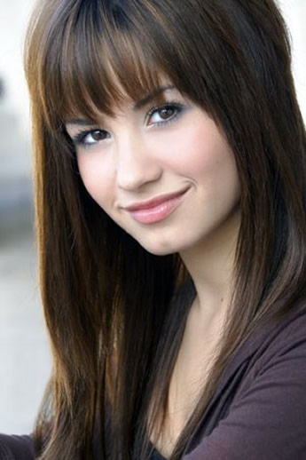
Pravo ime---Demetria Devonne Lovato
20. avgust 1992 v Dallas - Teksas
Pop-rock pevka, plesalka, pianistka, kitaristka, tekstopiska, televizijska, gledališka in filmska igralka ter fotomodel

Slide 3
ZGODNJE ŽIVLJENJE
Mama-Dianna Bonheur Hart De La Garza-; oče-Patric Lovato
Italijanske, mehiške in irske korenine
Ima starejšio sestro Dallas lovato in mlajšo polsestro Madison De La Garza
Šolala se je doma
Diplomo srednje šole si je prislužila julija 2009

Slide 4
IGRANJE
Gledališče---Čarovnik iz Oza, Sleeping beauty, There’s always Tomorrow
Camp Rock---Mitchie Torres
Princess Protection Program
Sonny with the chance---Sonny Munroe
Beg iz zapora, Talenti v belem, As the bells rings, Barney and friends

Slide 5
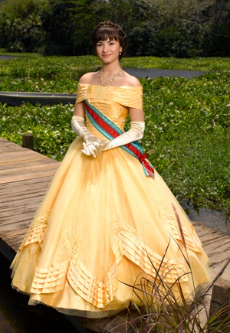
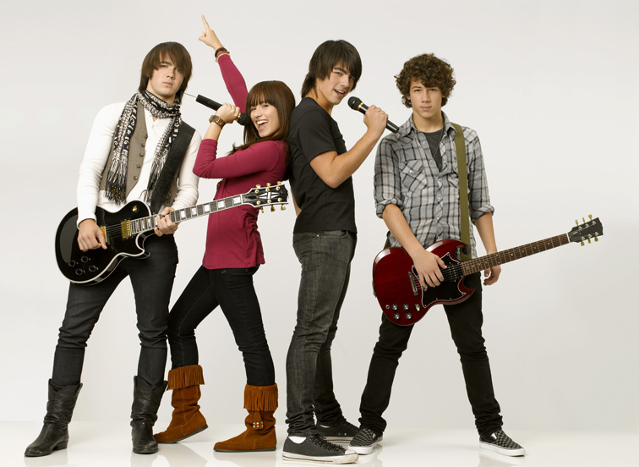
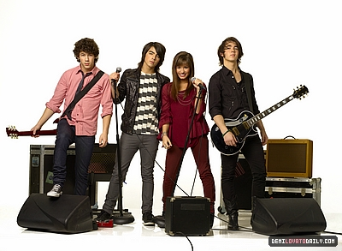

Slide 6
GLASBA
1. album Don’t Forget je izšel 23. septembra 2008
2. album Here We Go Again pa je izšel 21. julija 2009
Napovedala je tudi izid novega albuma za to leto, ki bo bolj R&B usmerjen.
Turneje: ~ Burning Up z Jonas Brothers
~ Summer Tour 2009
~South American Tour
~World Tour 2010 z Jonas Brothers (27.7.-17.10.)

Slide 8
HERE WE GO AGAIN
So how did you get hereunder my skin? I swore that I'd never let you back in Should have known better in trying to let you go Cause here we go go go again Hard as I try I know I can't quit Something about you is so addictive We're falling together you’d think that by now I'd know Cause here we go go go again And again, and again, and again, and again, and again I threw all of your stuff away And I cleared you out of my head And I tore you out of my heart So how did you get here under my skin? I swore that I'd never let you back in Should have known better in trying to let you go Cause here we go go go again Hard as I try I know I can't quit Something about you is so addictive We're falling together you'd think that by now I'd know Cause here we go go here we go again Here we go again Should have known better in trying to let you go 'Cause here we go go go again
I throw all of your stuff away I’m gonna clear you out of my head I tear you out of my heart And ignore all your messages I tell everyone we are through 'Cause I'm so much better without you But it’s just another pretty lie 'Cause I break down Every time you come around O Oh O Oh So how did you get here under my skin? I swore that I'd never let you back in Should have known better in trying to let you go 'Cause here we go go go again Hard as I try I know I can't quit Something about you is so addictive We're falling together you'd think that by now I'd know cause here we go go go again You never know what you want And you never say what you mean But I start to go insane Every time that you look at me You only hear half of what I say And you're always showing up too late And I know that I should say goodbye But it's no use Can't be with or without you O Oh O Oh

Slide 9
THIS IS ME (JOE JONAS)
I've always been the kind of girl That hid my face So afraid to tell the world What I've got to say But I have this dream Right inside of me I'm gonna let it show, it's time To let you know To let you know This is real, this is me I'm exactly where I'm supposed to be, now Gonna let the light, shine on me Now I've found, who I am There's no way to hold it in No more hiding who I want to be This is me Do you know what it's like To feel so in the dark To dream about a life Where you're the shining star Even though it seems Like it's too far away I have to believe in myself It's the only way This is real, This is me I'm exactly where I'm supposed to be, now Gonna let the light, shine on me Now I've found, who I am There's no way to hold it in No more hiding who I want to be This is me
You're the voice I hear inside my head The reason that I'm singin' I need to find you I gotta find you You're the missin' piece I need The song inside of me I need to find you I gotta find you This is real, This is me I'm exactly where I'm supposed to be, now Gonna let the light, shine on me Now I've found, who I am There's no way to hold it in No more hiding who I want to be You're the missing piece I need The song inside of me You're the voice I hear Inside my head The reason that I'm singin' Now I've found, who I am There's no way to hold it in No more hiding who I want to be This is me

Slide 10
Druge znane skladbe:
Go Back
La La Land
Don’t Forget
Remember December
Catch Me
Gift Of A Friend

Slide 11
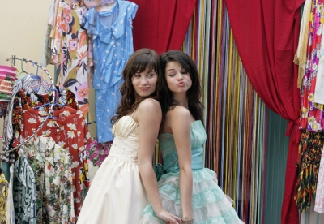
ZASEBNO ŽIVLJENJE
Zaradi nasilja v šoli se je šolala doma.
Vzornica---Kelly Clackson
Najboljša prijateljica---Selena Gomez
Razmerja:
~Trace Cyrus
~Joe Jonas
Je vegetarijanka

Slide 12
Je zagovornica organizacije PACER proti nasilju.
Je članica organizacije Disney’s Friends For Change, ki podpira okolju prijazno ravnanje.
Pesem Send It On je posnela za to organizacijo.

Slide 13
NAGRADE IN DOSEŽKI
Teen Choice Award-»Televizijska izbira – preboj ženske zvezdnice« za delo Sonny With a Chace
»Izbira glasbe – turneja« za Summer Tour 2009
Honorary Ambassador of Education Award

