Slide 1
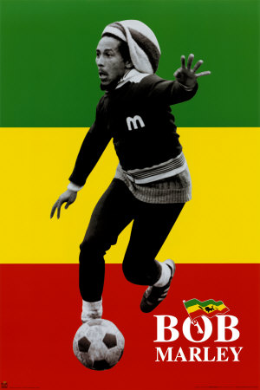
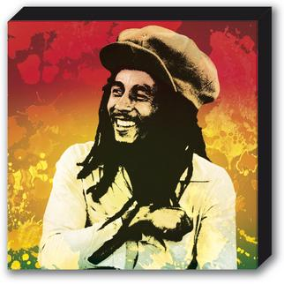
Bob Marley

Slide 2
Background informations: Birth name: Robert Nesta Marley Also known as: Tuff Gong Born: February 6, 1945 Nine Miles, Saint Ann, Jamaica Died: May 11, 1981 Genre: Reggae, ska, rocksteady Occupation: Singer, songwriter, guitarist Instrument: Guitar, vocals Years active: 1962 – 1981 Label: Studio One, Beverley’s Upseeter/ Trojan Island/Tuff Gong Associated acts: The wailers Band, The Wailers

Slide 3
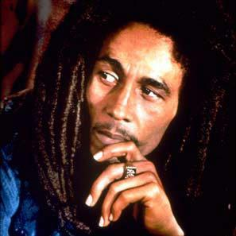
HITS:
I shot the sheriff,
No woman, No cry,
Three little birds,
Exodus,
Could you be loved,
Jamming,
Redemption song
One love[one of his most famous love songs]

Slide 4
Bob Marley once reflected:
I don’t have prejudice against myself. My father was white and my mother was black. Them call me half-caste or whatewer. Me don’t dip on nobady’s side. Me don’t dip on the black man’s side or the white man’s side. Me dip on God’s side, the one who create me and cause me to come from black and white.

Slide 5
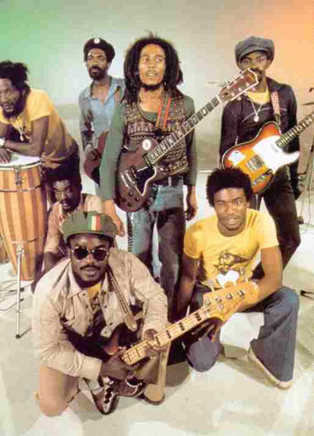
Musical career:
Bob Marley, Bunny Livingston,
Peter McIntosh, Junior Braitheaite,
Beverley Kelso and Cherry Smith –
rocksteady group first named
“The Teenagers”. Later “The Wailing
Rudeboys”, then to “The Wailing
Wailers”, and finally to “The Wailers”.

Slide 6
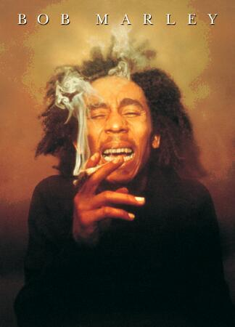
Albums:
* The Wailing Wailers 1966
* The Best of the Wailers 1970
* Soul Rebels 1970
* Soul Revolution 1971
* Soul Revolution Part II 1971
* African Herbsman 1973
* Catch a Fire 1973 [Wailers first album]
* Burnin' 1973
* Rasta Revolution 1974
* Natty Dread 1974
* Rastaman Vibration 1976
* Exodus 1977
* Kaya 1978
* Survival 1979
* Uprising 1980
* Confrontation (izdano po Marleyjevi smrti) 1983

Slide 7
Bob Marley’s 13 childrens:
Imani Carole, born May 22, 1963, to Cheryl Murray;
Sharon, born November 23, 1964, to Rita in previous relationship;
Cedella born August 23, 1967, to Rita;
David "Ziggy", born October 17, 1968, to Rita;
Stephen, born April 20, 1972, to Rita;
Robert "Robbie", born May 16, 1972, to Pat Williams;
Rohan, born May 19, 1972, to Janet Hunt;
Karen, born 1973 to Janet Bowen;
Stephanie, born August 17, 1974; according to Cedella Booker she was the daughter of Rita and a man called Ital with whom Rita had an affair; nonetheless she was acknowledged as Bob's daughter;
Julian, born June 4, 1975, to Lucy Pounder;
Ky-Mani, born February 26, 1976, to Anita Belnavis;
Damian, born July 21, 1978, to Cindy Breakspeare;
Makeda, born May 30, 1981, to Yvette Crichton.

Slide 8
Awards and honors:
1976: Band of the Year (Rolling Stone)
June 1978: Awarded the Peace Medal of the Third World from the United Nations
February 1981: Awarded Jamaica's third highest honor, the Jamaican Order of Merit
March 1994: Inducted into the Rock and Roll Hall of Fame
1999: Album of the Century for Exodus (Time Magazine)
February 2001: A star on the Hollywood Walk of Fame
February 2001: Awarded Grammy Lifetime Achievement Award
2004: Rolling Stone Magazine ranked him #11 on their list of the 100 Greatest Artists of All Time.[11]
"One Love" named song of the millennium by The BBC
Voted as one of the greatest lyricists of all time by a BBC poll.[12]
2007 A plaque dedicated to him by Nubian Jak community trust and supported by Her Majesties Foreign Office.

Slide 9
Tours:
Apr–Jul 1973: Catch a Fire Tour (England, USA)
Oct–Nov 1973: Burnin' Tour (USA, England)
Jun–Jul 1975: Natty Dread Tour (USA, Canada, England)
Apr–Jul 1976: Rastaman Vibration Tour (USA, Canada, Germany, Sweden, Netherlands, France, England, Wales)
May–Jun 1977: Exodus Tour (France, Belgium, Netherlands, Germany, Sweden, Denmark, England)
May–Aug 1978: Kaya Tour (USA, Canada, England, France, Spain, Sweden, Denmark, Norway, Netherlands, Belgium)
Apr–May 1979: Babylon by Bus Tour (Japan, New Zealand, Australia, Hawaii)
Oct–Dec 1979: Survival Tour (USA, Canada, Trinidad/Tobago, Bahamas)
May–Sep 1980: Uprising Tour (Switzerland, Germany, France, Norway, Sweden, Denmark, Belgium, Netherlands, Italy, Spain, Ireland, England, Scotland, Wales, USA)

Slide 11
