Slide 1
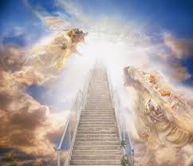
Kdo pozna Alecio Beth Moore?
8.9.1979
P!nk
-James Moore-navdih
- L.A. Reid-kariera

Slide 2
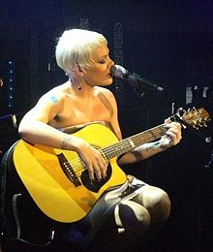
Samostojna kariera
__________
Choise
1.) “Can’t take me home”
2.) “Missundaztood”
3.) “Try this”
4.) “i’m not dead”
5.) “Funhouse”

Slide 3
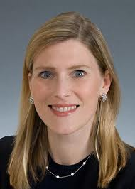
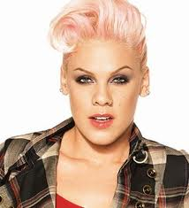
Choise
R&B skupina
1995-1998
“Key to my heart”
1995-1998
Chrissy Conway
Sharon Flanagan

Slide 4
Can’t take me home
4.4.2000
Prvi album
There you go
Most girls
You make me sick

Slide 5
Missundaztood
20.11.2001
“Lady Marmalade”-Moulin Rouge
“Get the party started”
“Don’t let me get me”
“Just like a pill”
“Family portret”

Slide 6
Try this
10.11. 2003
God is a DJ
Trouble
Last to know
Prva nagrada Grammy

Slide 7
I’m not dead
4.4.2006
Stupid Girls
Who Knew
U+Ur hand

Slide 8
Funhouse
24.10.2008
Funhouse
Sober
Please don't leave me
So what
Greatest Hits... So Far!!!
“Raise Your Glass”

Slide 9
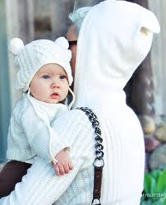
Zasebno življenje
Mož Carey Hart
Costa rica
Februar 2010-napoved
2.2.2011
Willow Sage Hart

Slide 10
Hvala za pozornost

