Slide 1
PUNK

Slide 2
PUNK HISTORY
Punk developed between 1974 and 1976.
Fast, short songs, often political, anti-establishment lyrics.
Ramones, Sex Pistols, The Clash in late 1976 recognized as new musical movement.
In 1980’s Hardcore and Oi punk, Pop punk(Green Day, Offspring).

Slide 3
PUNK GENRE

Slide 4
PUNK CLOTHES

Slide 5
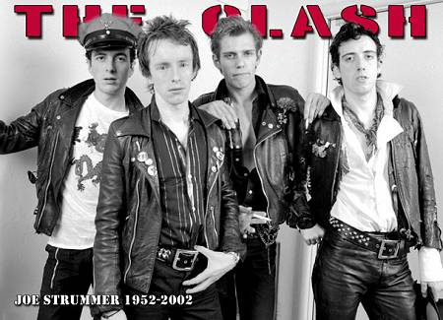
PUNK IN U.K.
First bands started playing in 1976

Slide 6
PUNK IN SLOVENIA
First band started playing in 1977

Slide 7
LITERATURE
Wikipedia

