Slide 1
HAMLET
William Shakespeare

Slide 2
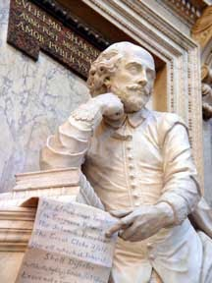
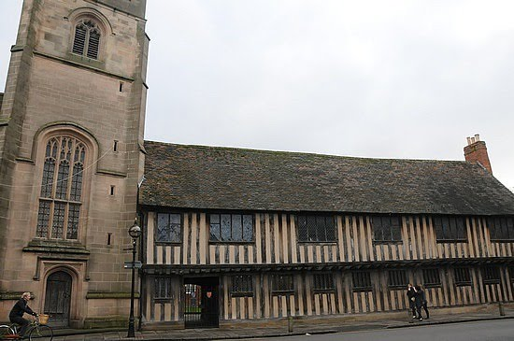
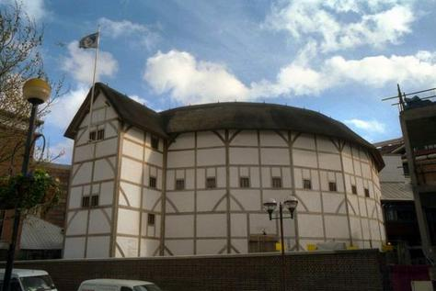
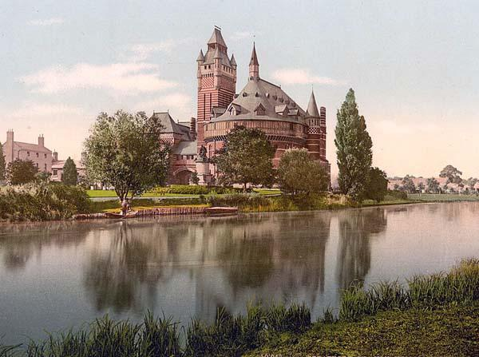
William Shakespeare
ŽIVLJENJE:
1564 – 1616
Največji angleški dramatik
Šolanje v klasični gimnaziji, nato pa univerzi
Imel je 3 otroke, umrl mu je 11 let star sin Hamnet.
DELO:
Deloval je v Londonu
Postal je solastnik gledališča GLOBUS
Usode dramskih junakov se navezujejo na njegovo življenje
Njegovo delovanje delimo na tri obdobja.

Slide 3
Obdobja Shakespeara
Zgodnje obdobje: 1590 - 1601. Tit Andronik, Romeo in Julia, Julij Cezar
Osrednje obdobje: 1601 – 1608. Hamlet, Kralj Lear, Macbeth in Othello, Kakor vam drago, Troilus in Kresida.
Pozno obdobje: od 1608 naprej. Zimska pravljica,Vihar.

Slide 4
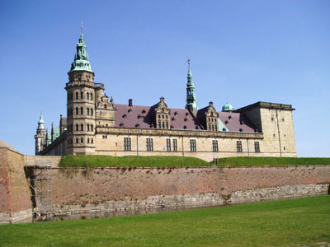
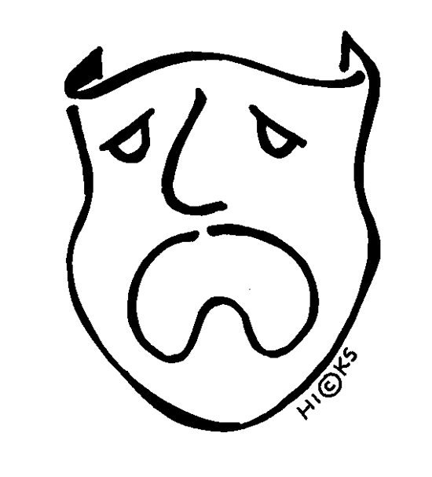
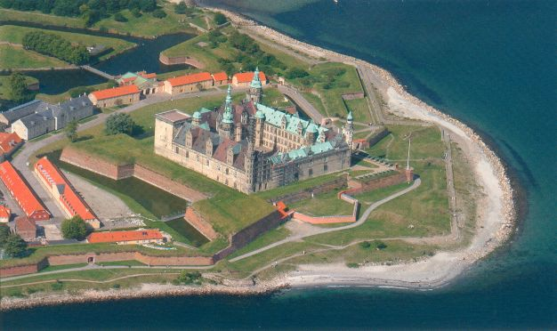
HAMLET
Tragedija nastane v osrednjem obdobju Shakespearovega delovanja.
ČAS: Nekaj mesecev
KRAJ: Danski dvor - ELSINOR

Slide 5
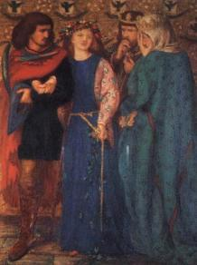
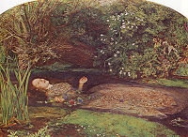
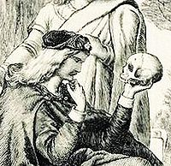
Oznaka osebe
Hamlet: Maščevalen, občutljiv, pogumen, iznajdljiv, zelo zmeden, depresiven, razočaran…
Ofelija: Zvesta in ubogljiva hči, krhka, žalostna.
Klavdij: Egoističen, važen, ukazovalen, hudoben, prepričljiv,…
Polonij: Nezaupljiv, nerazumevajoč, ustrežljiv kralju, potuhnjen.
Laert: Maščevalen, jezen.
Gertruda, mati : Krhka, zaskrbljena, podrejena kralju, neprepričana.

Slide 6
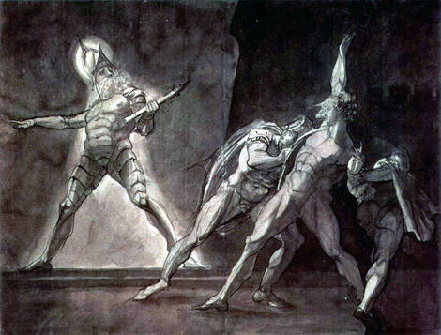
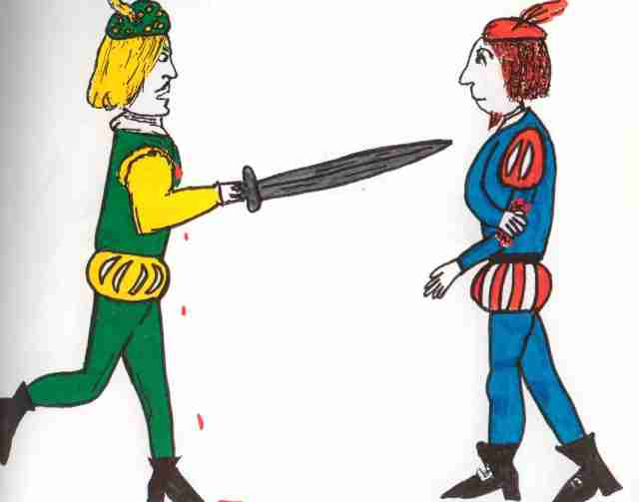
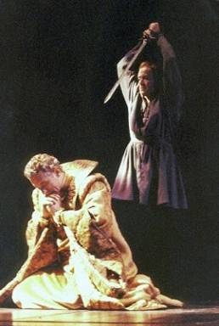
Dramski trikotnik
Kraljevo vedenje potrdi Hamletove sume. Hamlet zabode Polonija, saj je razkril da mu je prisluškoval.
Vrh
Hamletovo blaznost raziskujeta njegova bivša sošolca Rozenkranc in Gildenstern pod vodstvom Polonija. Hamlet da uprizoriti igro, na las podobno očetovi smrti in se odloči opazovati kralja.
Prestrašen kralj pošlje Hamleta v Anglijo in mu nastavi past. Hamlet se reši in vrne na Dansko, kjer ga čaka dvoboj z Laertom. Laert in kralj sta Hamletu nastavila past, saj je konjica Laertovega meča zastrupljena.
Zaplet
Razplet
Hamlet in Laert sta zastrupljena zaradi konjice meča. Pred smrtjo Laert izda kralja in Hamlet ga pokonča. Mati popije zastrupljeno vino in umre skupaj z ostalimi.
Prikaže se duh Hamletovega očeta. Hamlet utrdi sum v morilca in se odloči maščevati.
Zasnova
Razsnova

Slide 7
CITAT
To be, or not to be, that is the question: Whether 'tis nobler in the mind to suffer The slings and arrows of outrageous fortune, Or to take arms against a sea of troubles, And by opposing end them? To die, to sleep, No more; and by a sleep to say we end The heart-ache, and the thousand natural shocks That flesh is heir to: 'tis a consummation Devoutly to be wished. To die, to sleep; To sleep, perchance to dream – ay, there's the rub: For in that sleep of death what dreams may come, When we have shuffled off this mortal coil, Must give us pause – there's the respect That makes calamity of so long life. For who would bear the whips and scorns of time, The oppressor's wrong, the proud man's contumely, The pangs of despised love, the law’s delay, The insolence of office, and the spurns That patient merit of the unworthy takes, When he himself might his quietus make With a bare bodkin? Who would fardels bear, To grunt and sweat under a weary life, But that the dread of something after death, The undiscovered country from whose bourn No traveller returns, puzzles the will, And makes us rather bear those ills we have Than fly to others that we know not of? Thus conscience does make cowards of us all, And thus the native hue of resolution Is sicklied o'er with the pale cast of thought, And enterprises of great pitch and moment, With this regard their currents turn awry, And lose the name of action. Soft you now, The fair Ophelia! Nymph, in thy orisons Be all my sins remembered.

Slide 8
Hvala za pozornost !

