Slide 1
Animal Farm and The Russian Revolution: A Comparison

Slide 2
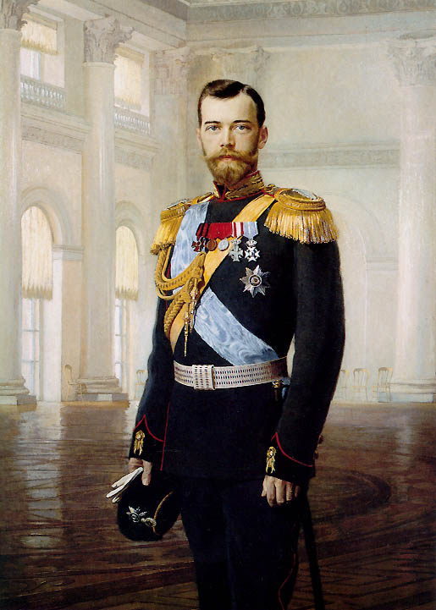
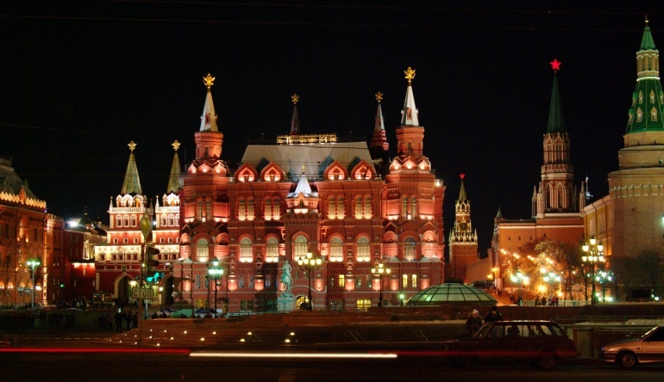
Tsar Nicholas II
was part of the Romanov dynasty that ruled Russia for over 300 years
an autocrat – a self-appointed ruler who holds all the political power
March 1917 - food riots and army mutinies in Petrograd - Czar Nicholas couldn’t cope with the difficult situation, so he abdicated the throne
In Animal Farm …
Czar Nicholas II = ??

Slide 3
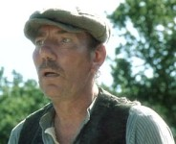
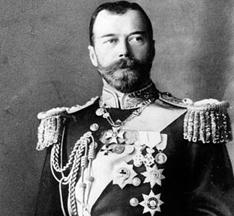
Farmer Jones = Czar Nicholas II
Farmer Jones
The irresponsible owner of the farm
Lets his animals starve and beats them with a whip
Sometimes shows random kindness
Czar Nicholas II
Weak Russian Leader during the 1900’s
Often cruel and brutal to his subjects
Showed isolated kindness

Slide 4
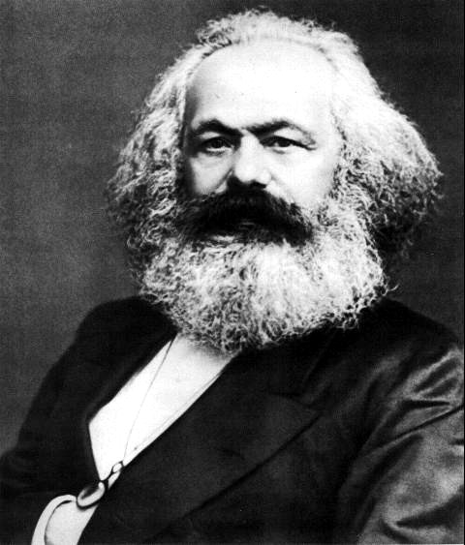
Karl Marx
believed the workers were the true producers of wealth
but the capitalists (bourgeoisie) owned the means of production – land and industry - and made huge profits while the workers earned just enough to survive
called for “workers of the world” to unite against their capitalist oppressors
believed that eventually the proletariat would rise up against the capitalist system throughout the world
In Animal Farm …
Karl Marx = ??

Slide 5
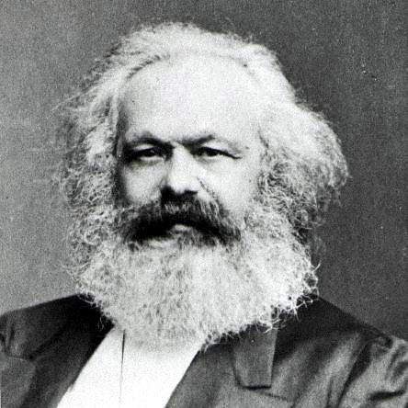
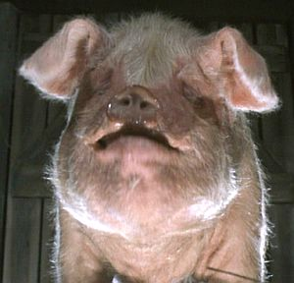
Old Major = Karl Marx
Old Major
an old boar whose speech about the evils perpetrated by humans rouses the animals into rebelling
his philosophy concerning the tyranny of Man is named Animalism
dies before the revolution
Karl Marx
wants to unite the working class to overthrow the government
the inventor of Communism
dies before the Russian Revolution

Slide 6
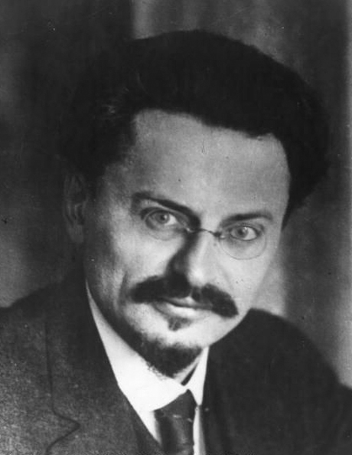
Leon Trotsky
a brilliant intellectual and speaker who organized the Red Army and led it to victory in the Civil War
Trotsky and Stalin disagreed on Russia’s future - Trotsky wanted the Communist revolution to be worldwide
Stalin defeated Trotsky at the Communist Party Congress in 1927 and gained control of the secret police
Trotsky was chased away by the KGB (secret police) and fled to Mexico City, where a Soviet agent killed him with an axe in 1940
In Animal Farm …
Leon Trotsky = ??

Slide 7
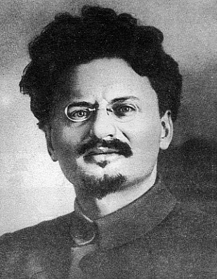
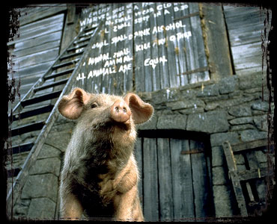
Snowball = Leon Trotsky
Snowball
becomes one of the most valuable leaders of the rebellion
after drawing complicated plans for the construction of a windmill, he is chased off the farm by Napoleon’s dogs and is thereafter blamed for the animals’ troubles
(scapegoat)
Leon Trotsky
a pure communist leader who was influenced by the teachings of Karl Marx
wanted to improve life for people in Russia, but was driven away by Lenin’s KGB

Slide 8
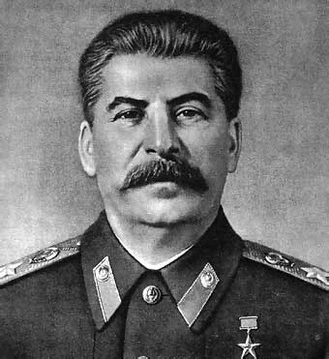
Joseph Stalin
not well-educated
named General Secretary of the Communist Party in 1922
although this position seemed unimportant, Stalin used his position as secretary to gain supporters for his future rise to power
he eventually defeated Trotsky in the struggle for power
In Animal Farm …
Joseph Stalin = ??

Slide 9
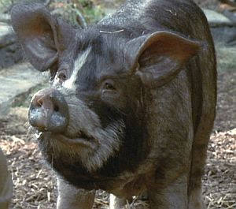
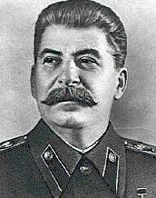
Napoleon = Joseph Stalin
Napoleon
leads the rebellion against Farmer Jones
after the rebellion’s success, he systematically begins to control all aspects of the farm until he is an undisputed tyrant
Joseph Stalin
the communist dictator of the Soviet Union from 1922-1953 who killed all who opposed him
loved power and used the KGB (secret police) to enforce his ruthless, corrupt politics

Slide 10
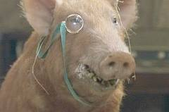
Other Important Characters
Squealer
a big mouth pig who becomes Napoleon’s mouthpiece
has the ability to manipulate the animals’ thoughts through the use of hollow, yet convincing rhetoric
Propaganda department
the members of the department would use lies to convince the people to follow Stalin

Slide 11
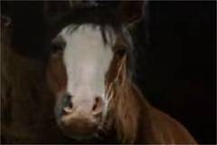
Boxer
dedicated horse who helps in the building of the windmill but is sold to a glue-boiler after collapsing from exhaustion
Communist supporters of Stalin
many stayed loyal even after it was obvious Stalin was a tyrant.
eventually they were betrayed, ignored, and even killed by him

Slide 12
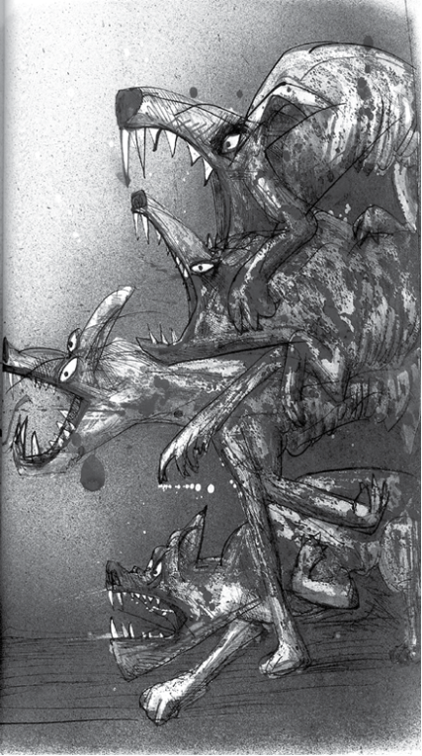
The dogs
from the start , they are loyal animals
rewarded for dealing ruthlessly with any objectors and murdering Napoleon‘s opposition
represent the KGB (secret police)

Slide 13
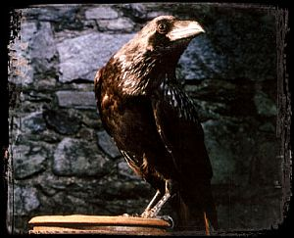
Moses
a tame raven
pet of Jones who tells the animals stories about a paradise called Sugarcandy Mountain
Religion
Stalin used religious principles to influence people to work and to avoid revolt

Slide 14
Mollie
resists the animal rebellion because she doesn't want to give up the petting and treats she receives from humans
represents vain, selfish people in Russia and throughout the world who ignored the revolution and sought residence in more inviting countries

Slide 15
Animalism = Communism
Animalism
taught by Old Major
better life for animals
all animals are equal
everyone owns the farm
Communism
invented by K. Marx
all people are equal
government owns everything
people own the government

Slide 16
Napoleon‘s Show Trials = Moscow Purge Trials
By 1936, Stalin began to use what would become known as the Moscow Purge Trials to control workers.
In 1936, sixteen prominent and loyal Communists publicly confessed to unbelievable crimes – spying, terrorism, and plotting with Leon Trotsky.
There was no evidence of their guilt other than the confessions.
All sixteen were immediately executed.
About 70% of the Party leadership became victims of the Great Purge.
These trials served as an example of what would happen to people if they opposed Stalin.

