Slide 1
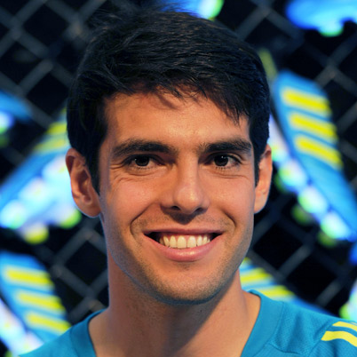
Kaká

Slide 2
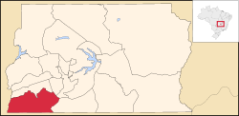
Personal information
Full name: Ricardo Izecson dos Santos Leite Kaka
Date of birth: 22 April 1982
Place of birth: Gama, Brazil

Slide 3
Carrer
Youth career
1994-2000 (12-18) Sao Paulo
Senior career
2001-2003 (19-21) Sao Paulo (59 assists, 23 goals)
2003-2009 (21-28) Milan (193 assists, 70 goals)
2009+ (28+) REAL MADRID <3 (80 assist, 23 goals)

Slide 4
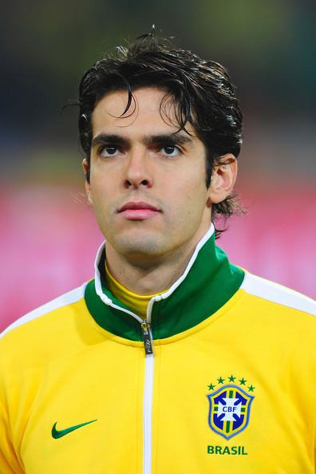
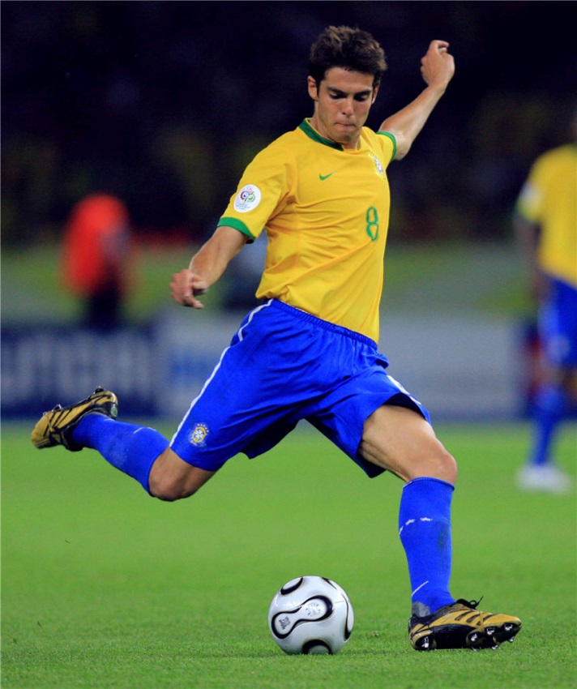
National Team
2001 (19) Brazil U20 (5 assists, 1 goals)
2002+ (20+) (87 assists, 29 goals)

Slide 5
Family
Father Bosco Izecson Pereira Leite (a civil engineer)
Mother Simone dos Santos (an elementary school teacher)
Younger Brother Rodrigo (best known as Diago). Also Professional football player.

Slide 6
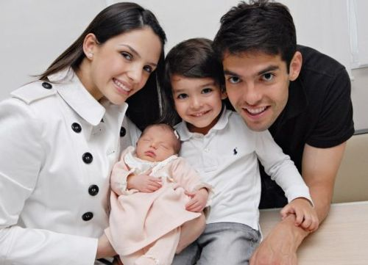
Personal life
His wife Caroline Celico
They get married on 23 December 2005
Son Luca Celico Leite (born 10 June 2008
Daughter Isabella (born 23 April 2011)

Slide 7
Viri
Internet predvsem wikipedia ☺

